Slide 1
Operating System Principles:
File Systems
CS 111
Operating Systems
Peter Reiher

Slide 2
Outline
File systems:
  Why do we need them?
  Why are they challenging?
Basic elements of file system design
Designing file systems for disks
  Basic issues
  Free space, allocation, and deallocation

Slide 3
Introduction
Most systems need to store data persistently
  So it’s still there after reboot, or even power down
Typically a core piece of functionality for the system
  Which is going to be used all the time
Even the operating system itself needs to be stored this way
So we must store some data persistently

Slide 4
Our Persistent Data Options
Use raw storage blocks to store the data
  On a hard disk, flash drive, whatever
  Those make no sense to users
  Not even easy for OS developers to work with
Use a database to store the data
  Probably more structure (and possibly overhead) than we need or can afford
Use a file system
  Some organized way of structuring persistent data
  Which makes sense to users and programmers

Slide 5
File Systems
Originally the computer equivalent of a physical filing cabinet
Put related sets of data into individual containers
Put them all into an overall storage unit
Organized by some simple principle
  E.g., alphabetically by title
  Or chronologically by date
Goal is to provide:
  Persistence
  Ease of access
  Good performance

Slide 6
The Basic File System Concept
Organize data into natural coherent units
  Like a paper, a spreadsheet, a message, a program
Store each unit as its own self-contained entity
  A file
  Store each file in a way allowing efficient access
Provide some simple, powerful organizing principle for the collection of files
  Making it easy to find them
  And easy to organize them

Slide 7
File Systems and Hardware
File systems are typically stored on hardware providing persistent memory
  Disks, tapes, flash memory, etc.
With the expectation that a file put in one “place” will be there when we look again
Performance considerations will require us to match the implementation to the hardware
But ideally, the same user-visible file system should work on any reasonable hardware

Slide 8
What Hardware Do We Use?
Until recently, file systems were designed for disks
Which required many optimizations based on particular disk characteristics
  To minimize seek overhead
  To minimize rotational latency delays
Generally, the disk provided cheap persistent storage at the cost of high latency
  File system design had to hide as much of the latency as possible

Slide 9
Disk vs SSD Performance
 | Cheeta (archival) | Barracuda (high perf) | Extreme/Pro (SSD)
RPM | 7,000 | 15,000 | n/a
average latency | 4.3ms | 2ms | n/a
average seek | 9ms | 4ms | n/a
transfer speed | 105MB/s | 125MB/s | 540MB/s
sequential 4KB read | 39us | 33us | 10us
sequential 4KB write | 39us | 33us | 11us
random 4KB read | 13.2ms | 6ms | 10us
random 4KB write | 13.2ms | 6ms | 11us

Slide 10
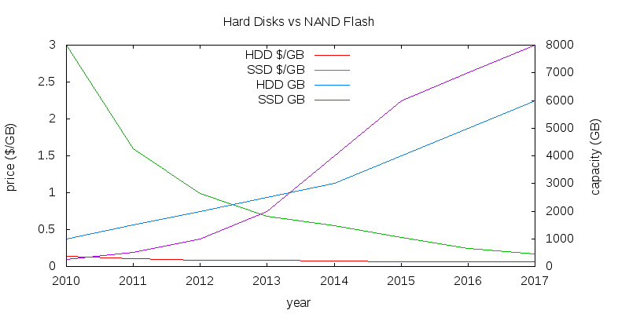
Random Access: Game Over
Hard disks will still be cheaper and offer more capacity
But not by that much
And SSDs have all the other advantages

Slide 11
Data and Metadata
File systems deal with two kinds of information
Data – the information that the file is actually supposed to store
  E.g., the instructions of the program or the words in the letter
Metadata – Information about the information the file stores
  E.g., how many bytes are there and when was it created
  Sometimes called attributes
Ultimately, both data and metadata must be stored persistently
  And usually on the same piece of hardware

Slide 12
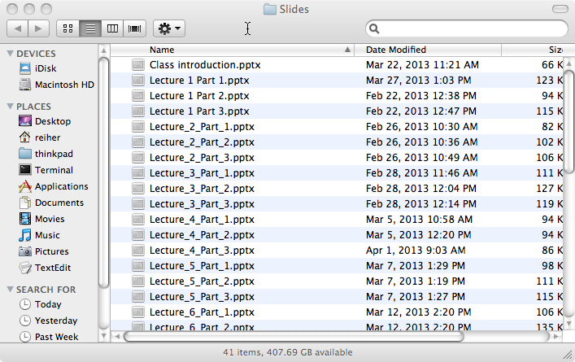


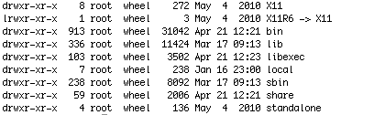
Bridging the Gap
We want something like . . .
But we’ve got something like . . .
How do we get from the hardware to the useful abstraction?
Which is even worse when we look inside:
Or . . .
Or at least

Slide 13
A Further Wrinkle
We want our file system to be agnostic to the storage medium
Same program should access the file system the same way, regardless of medium
  Otherwise it’s hard to write portable programs
Should work the same for disks of different types
Or if we use a RAID instead of one disk
Or if we use flash instead of disks
Or if even we don’t use persistent memory at all
  E.g., RAM file systems

Slide 14
Desirable File System Properties
What are we looking for from our file system?
  Persistence
  Easy use model
    For accessing one file
    For organizing collections of files
  Flexibility
    No limit on number of files
    No limit on file size, type, contents
  Portability across hardware device types
  Performance
  Reliability
  Suitable security

Slide 15
The Performance Issue
How fast does our file system need to be?
Ideally, as fast as everything else
  Like CPU, memory, and the bus
  So it doesn’t provide a bottleneck
But these other devices operate today at nanosecond speeds
Disk drives operate at millisecond speeds
  Flash drives are faster, but not processor or RAM speeds
Suggesting we’ll need to do some serious work to hide the mismatch

Slide 16
The Reliability Issue
Persistence implies reliability
We want our files to be there when we check, no matter what
Not just on a good day
So our file systems must be free of errors
  Hardware or software
Remember our discussion of concurrency, race conditions, etc.?
  Might we have some challenges here?

Slide 17
“Suitable” Security
What does that mean?
Whoever owns the data should be able to control who accesses it
  Using some well-defined access control model and mechanism
With strong guarantees that the system will enforce his desired controls
  Implying we’ll apply complete mediation
  To the extent performance allows

Slide 18
Basics of File System Design
Where do file systems fit in the OS?
File control data structures

Slide 19
File Systems and the OS
App 1
App 2
App 3
App 4
system calls
The file system API
file container
operations
directory
operations
file
I/O
A common internal interface for file systems
virtual file system integration layer
device
I/O
socket
I/O
CD FS
DOS FS
UNIX FS
EXT3 FS
…
…
Some example file systems
Non-file system services that use the same API
Device independent block I/O
device driver interfaces (disk-ddi)
CD
drivers
disk
drivers
diskette
drivers
flash
drivers

Slide 20
File Systems and Layered Abstractions
At the top, apps think they are accessing files
At the bottom, various block devices are reading and writing blocks
There are multiple layers of abstraction in between
Why?
Why not translate directly from application file operations to devices’ block operations?

Slide 21
The File System API
App 1
App 2
App 3
App 4
system calls
file container
operations
directory
operations
file
I/O
virtual file system integration layer
device
I/O
socket
I/O
CD FS
DOS FS
UNIX FS
EXT3 FS
…
…
Device independent block I/O
device driver interfaces (disk-ddi)
CD
drivers
disk
drivers
diskette
drivers
flash
drivers

Slide 22
The File System API
Highly desirable to provide a single API to programmers and users for all files
Regardless of how the file system underneath is actually implemented
A requirement if one wants program portability
  Very bad if a program won’t work because there’s a different file system underneath
Three categories of system calls here
  File container operations
  Directory operations
  File I/O operations

Slide 23
File Container Operations
Standard file management system calls
  Manipulate files as objects
  These operations ignore the contents of the file
Implemented with standard file system methods
  Get/set attributes, ownership, protection ...
  Create/destroy files and directories
  Create/destroy links
Real work happens in file system implementation

Slide 24
Directory Operations
Directories provide the organization of a file system
  Typically hierarchical
  Sometimes with some extra wrinkles
At the core, directories translate a name to a lower-level file pointer
Operations tend to be related to that
  Find a file by name
  Create new name/file mapping
  List a set of known names

Slide 25
File I/O Operations
Open – use name to set up an open instance
Read data from file and write data to file
  Implemented using logical block fetches
  Copy data between user space and file buffer
  Request file system to write back block when done
Seek
  Change logical offset associated with open instance
Map file into address space
  File block buffers are just pages of physical memory
  Map into address space, page it to and from file system

Slide 26
The Virtual File System Layer
App 1
App 2
App 3
App 4
system calls
file container
operations
directory
operations
file
I/O
virtual file system integration layer
device
I/O
socket
I/O
CD FS
DOS FS
UNIX FS
EXT3 FS
…
…
Device independent block I/O
device driver interfaces (disk-ddi)
CD
drivers
disk
drivers
diskette
drivers
flash
drivers

Slide 27
The Virtual File System
(VFS) Layer
Federation layer to generalize file systems
  Permits rest of OS to treat all file systems as the same
  Support dynamic addition of new file systems
Plug-in interface or file system implementations
  DOS FAT, Unix, EXT3, ISO 9660, network, etc.
  Each file system implemented by a plug-in module
  All implement same basic methods
    Create, delete, open, close, link, unlink,
    Get/put block, get/set attributes, read directory, etc.
Implementation is hidden from higher level clients
  All clients see are the standard methods and properties

Slide 28
The File System Layer
App 1
App 2
App 3
App 4
system calls
file container
operations
directory
operations
file
I/O
virtual file system integration layer
device
I/O
socket
I/O
CD FS
DOS FS
UNIX FS
EXT3 FS
…
…
Device independent block I/O
device driver interfaces (disk-ddi)
CD
drivers
disk
drivers
diskette
drivers
flash
drivers

Slide 29
The File Systems Layer
Desirable to support multiple different file systems
All implemented on top of block I/O
  Should be independent of underlying devices
All file systems perform same basic functions
  Map names to files
  Map <file, offset> into <device, block>
  Manage free space and allocate it to files
  Create and destroy files
  Get and set file attributes
  Manipulate the file name space

Slide 30
Why Multiple File Systems?
Why not instead choose one “good” one?
There may be multiple storage devices
  E.g., hard disk and flash drive
  They might benefit from very different file systems
Different file systems provide different services, despite the same interface
  Differing reliability guarantees
  Differing performance
  Read-only vs. read/write
Different file systems used for different purposes
  E.g., a temporary file system

Slide 31
Device Independent Block I/O Layer
App 1
App 2
App 3
App 4
system calls
file container
operations
directory
operations
file
I/O
virtual file system integration layer
device
I/O
socket
I/O
CD FS
DOS FS
UNIX FS
EXT3 FS
…
…
Device independent block I/O
device driver interfaces (disk-ddi)
CD
drivers
disk
drivers
diskette
drivers
flash
drivers

Slide 32
File Systems and Block I/O Devices
File systems typically sit on a general block I/O layer
A generalizing abstraction – make all disks look same
Implements standard operations on each block device
  Asynchronous read (physical block #, buffer, bytecount)
  Asynchronous write (physical block #, buffer, bytecount)
Map logical block numbers to device addresses
  E.g., logical block number to <cylinder, head, sector>
Encapsulate all the particulars of device support
  I/O scheduling, initiation, completion, error handlings
  Size and alignment limitations

Slide 33
Why Device Independent
Block I/O?
A better abstraction than generic disks
Allows unified LRU buffer cache for disk data
  Hold frequently used data until it is needed again
  Hold pre-fetched read-ahead data until it is requested
Provides buffers for data re-blocking
  Adapting file system block size to device block size
  Adapting file system block size to user request sizes
Handles automatic buffer management
  Allocation, deallocation
  Automatic write-back of changed buffers

Slide 34
Why Do We Need That Cache?
File access exhibits a high degree of reference locality at multiple levels:
  Users often read and write a single block in small operations, reusing that block
  Users read and write the same files over and over
  Users often open files from the same directory
  OS regularly consults the same meta-data blocks
Having common cache eliminates many disk accesses, which are slow

Slide 35
File Systems Control Structures
A file is a named collection of information
Primary roles of file system:
  To store and retrieve data
  To manage the media/space where data is stored
Typical operations:
  Where is the first block of this file?
  Where is the next block of this file?
  Where is block 35 of this file?
  Allocate a new block to the end of this file
  Free all blocks associated with this file

Slide 36
Finding Data On Disks
Essentially a question of how you managed the space on your disk
Space management on disk is complex
  There are millions of blocks and thousands of files
  Files are continuously created and destroyed
  Files can be extended after they have been written
  Data placement on disk has performance effects
  Poor management leads to poor performance
Must track the space assigned to each file
  On-disk, master data structure for each file

Slide 37
On-Disk File Control Structures
On-disk description of important attributes of a file
  Particularly where its data is located
Virtually all file systems have such data structures
  Different implementations, performance & abilities
  Implementation can have profound effects on what the file system can do (well or at all)
A core design element of a file system
Paired with some kind of in-memory representation of the same information

Slide 38
The Basic File Control
Structure Problem
A file typically consists of multiple data blocks
The control structure must be able to find them
Preferably able to find any of them quickly
  I.e., shouldn’t need to read the entire file to find a block near the end
Blocks can be changed
New data can be added to the file
  Or old data deleted
Files can be sparsely populated

Slide 39
The In-Memory Representation
There is an on-disk structure pointing to disk blocks (and holding other information)
When file is opened, an in-memory structure is created
Not an exact copy of the disk version
  The disk version points to disk blocks
  The in-memory version points to RAM pages
    Or indicates that the block isn’t in memory
  Also keeps track of which blocks are dirty and which aren’t

Slide 40
In-Memory Structures and Processes
What if multiple processes have a given file open?
Should they share one control structure or have one each?
In-memory structures typically contain a cursor pointer
  Indicating how far into the file data has been read/written
Sounds like that should be per-process . . .

Slide 41
Per-Process or Not?
What if cooperating processes are working with the same file?
  They might want to share a cursor
And how can we know when all processes are finished with an open file?
  So we can reclaim space used for its in-memory descriptor
Implies a two-level solution
  A structure shared by all
  A structure shared by cooperating processes

Slide 42
The Unix Approach
Two processes can share one descriptor
Two descriptors can share one inode
Open-file references
(UNIX user file descriptor)
in process descriptor
stdin
stdin
stdin
stdout
stdout
stdout
stderr
stderr
stderr
offset
options
I-node ptr
offset
options
I-node ptr
offset
options
I-node ptr
offset
options
I-node ptr
offset
options
I-node ptr
Open file instance
descriptors
I-node
I-node
I-node
I-node
In-memory file descriptors
(UNIX struct inode)
On-disk file descriptors
(UNIX struct dinode)
I-node
I-node
I-node
I-node
I-node

Slide 43
File System Structure
How do I organize a disk into a file system?
  Linked extents
    The DOS FAT file system
  File index blocks
    Unix System V file system

Slide 44
Basics of File System Structure
Most file systems live on disks
Disk volumes are divided into fixed-sized blocks
  Many sizes are used: 512, 1024, 2048, 4096, 8192 ...
Most blocks will be used to store user data
Some will be used to store organizing “meta-data”
  Description of the file system (e.g., layout and state)
  File control blocks to describe individual files
  Lists of free blocks (not yet allocated to any file)
All operating systems have such data structures
  Different OSes and file systems have very different goals
  These result in very different implementations

Slide 45
The Boot Block
The 0th block of a disk is usually reserved for the boot block
  Code allowing the machine to boot an OS
Not usually under the control of a file system
  It typically ignores the boot block entirely
Not all disks are bootable
  But the 0th block is usually reserved, “just in case”
So file systems start work at block 1

Slide 46
Managing Allocated Space
A core activity for a file system, with various choices
What if we give each file same amount of space?
  Internal fragmentation ... just like memory
What if we allocate just as much as file needs?
  External fragmentation, compaction ... just like memory
Perhaps we should allocate space in “pages”
  How many chunks can a file contain?
The file control data structure determines this
  It only has room for so many pointers, then file is “full”
So how do we want to organize the space in a file?

Slide 47
Linked Extents
A simple answer
File control block contains exactly one pointer
  To the first chunk of the file
  Each chunk contains a pointer to the next chunk
  Allows us to add arbitrarily many chunks to each file
Pointers can be in the chunks themselves
  This takes away a little of every chunk
  To find chunk N, you have to read the first N-1 chunks
Pointers can be in auxiliary “chunk linkage” table
  Faster searches, especially if table kept in memory

Slide 48
The DOS File System
boot block
block 0₅₁₂
Cluster size and FAT length are specified in the BPB
block 1₅₁₂
BIOS parameter
block (BPB)
block 2₅₁₂
File
Allocation
Table
(FAT)
Data clusters begin immediately after the end of the FAT
cluster #1
(root directory)
Root directory begins in the first data cluster
cluster #2
…

Slide 49
DOS File System Overview
DOS file systems divide space into “clusters”
  Cluster size (multiple of 512) fixed for each file system
  Clusters are numbered 1 though N
File control structure points to first cluster of a file
File Allocation Table (FAT), one entry per cluster
  Contains the number of the next cluster in file
  A 0 entry means that the cluster is not allocated
  A -1 entry means “end of file”
File system is sometimes called “FAT,” after the name of this key data structure

Slide 50
DOS FAT Clusters
directory entry
File Allocation Table
name: myfile.txt
1
2
3
4
5
6
x
Each FAT entry corresponds to a cluster, and contains the number of the next cluster.
-1 = End of File
0 = free cluster
length: 1500 bytes
x
1st cluster: 3
4
5
cluster #3
first 512 bytes of file
-1
0
cluster #4
second 512 bytes of file
cluster #5
last 476 bytes of file

Slide 51
DOS File System Characteristics
To find a particular block of a file
  Get number of first cluster from directory entry
  Follow chain of pointers through File Allocation Table
Entire File Allocation Table is kept in memory
  No disk I/O is required to find a cluster
  For very large files the search can still be long
No support for “sparse” files
  Of a file has a block n, it must have all blocks < n
Width of FAT determines max file system size
  How many bits describe a cluster address?
  Originally 8 bits, eventually expanded to 32

Slide 52
File Index Blocks
A different way to keep track of where a file’s data blocks are on the disk
A file control block points to all blocks in file
  Very fast access to any desired block
  But how many pointers can the file control block hold?
File control block could point at extent descriptors
  But this still gives us a fixed number of extents

Slide 53
Hierarchically Structured File
Index Blocks
To solve the problem of file size being limited by entries in file index block
The basic file index block points to blocks
Some of those contain pointers which in turn point to blocks
Can point to many extents, but still a limit to how many
  But that limit might be a very large number
  Has potential to adapt to wide range of file sizes

Slide 54
Unix System V File System
Boot block
Block 0
Super
block
Block size and number of I-nodes are specified in super block
Block 1
Block 2
I-nodes
I-node #1 (traditionally) describes the root directory
Available
blocks
Data blocks begin immediately after the end of the I-nodes.

Slide 55
Unix Inodes and Block Pointers
Block pointers
(in I-node)
Triple-indirect
Double-indirect
Indirect blocks
Data blocks
1st
1st
2nd
...
3rd
2nd
4th
5th
10th
6th
...
...
7th
11th
8th
9th
10th
...
1034th
11th
...
...
1035th
12th
13th
2058th
...
...
2059th

Slide 56
Why Is This a Good Idea?
The UNIX pointer structure seems ad hoc and complicated
Why not something simpler?
  E.g., all block pointers are triple indirect
File sizes are not random
  The majority of files are only a few thousand bytes long
Unix approach allows us to access up to 40Kbytes (assuming 4K blocks) without extra I/Os
  Remember, the double and triple indirect blocks must themselves be fetched off disk

Slide 57
How Big a File Can Unix Handle?
The on-disk inode contains 13 block pointers
  First 10 point to first 10 blocks of file
  11th points to an indirect block (which contains pointers to 1024 blocks)
  12th points to a double indirect block (pointing to 1024 indirect blocks)
  13th points to a triple indirect block (pointing to 1024 double indirect blocks)
Assuming 4k bytes per block and 4 bytes per pointer
  10 direct blocks = 10 * 4K bytes = 40K bytes
  Indirect block = 1K * 4K = 4M bytes
  Double indirect = 1K * 4M = 4G bytes
  Triple indirect = 1K * 4G = 4T bytes
  At the time system was designed, that seemed impossibly large
  But . . .

Slide 58
Unix Inode Performance Issues
The inode is in memory whenever file is open
So the first ten blocks can be found with no extra I/O
After that, we must read indirect blocks
  The real pointers are in the indirect blocks
  Sequential file processing will keep referencing it
  Block I/O will keep it in the buffer cache
1-3 extra I/O operations per thousand pages
  Any block can be found with 3 or fewer reads
Index blocks can support “sparse” files
  Not unlike page tables for sparse address spaces

