Slide 1
Introduction
CS 111
Operating System Principles
Peter Reiher

Slide 2
Outline
Administrative materials
Introduction to the course
  Why study operating systems?
  Basics of operating systems

Slide 3
Administrative Issues
Instructor and TAs
Load and prerequisites
Web site, syllabus, reading, and lectures
Exams, homework, projects
Grading
Academic honesty

Slide 4
Instructor: Peter Reiher
UCLA Computer Science department faculty member
Long history of research in operating systems
Email: reiher@cs.ucla.edu
Office: 3532F Boelter Hall
  Office hours: TTh 1-2
  Often available at other times

Slide 5
My OS Background
My Ph.D. dissertation was on the Locus operating system
Much research on file systems
  Ficus, Rumor, Truffles, Conquest
Research on OS security issues
  Data Tethers

Slide 6
TA
Diyu Zhou
  zhoudiyu@cs.ucla.edu
Lab sessions:
  Lab 1A, Fridays 10-12 AM, Geology 4660
Office hours to be announced

Slide 7
Instructor/TA Division of Responsibilities
Instructor handles all lectures, readings, and tests
  Ask me about issues related to these
TAs handle projects
  Ask them about issues related to these
Generally, instructor won’t be involved with project issues
  So direct those questions to the TAs

Slide 8
Web Site
Some materials found on CCLE web site
  Project materials, for example
Most materials here:
  http://www.lasr.cs.ucla.edu/classes/111_summer17
What’s there:
  Schedules for reading, lectures, exams, projects
  Copies of lecture slides (Powerpoint and PDF)
  Announcements
  Sample midterm and final problems

Slide 9
Prerequisite Subject Knowledge
CS 32 programming
  Objects, data structures, queues, stacks, tables, trees
CS 33 systems programming
  Assembly language, registers, memory
  Linkage conventions, stack frames, register saving
CS 35L Software Construction Laboratory
  Useful software tools for systems programming
If you haven’t taken these classes, expect to have a hard time in 111

Slide 10
Course Format
Two weekly reading assignments
  Mostly from the primary text
  Some supplementary materials available on web
Two weekly lectures
Four (10-25 hour) individual projects
  Exploring and exploiting OS features
  Plus one warm-up project
A midterm and a final exam

Slide 11
Course Load
Reputation: THE hardest undergrad CS class
  Fast pace through much non-trivial material
Expectations you should have
  lectures 4-6 hours/week
  reading 3-6 hours/week
  projects 3-20 hours/week
  exam study 5-15 hours (twice)
Keeping up (week by week) is critical
  Catching up is extremely difficult

Slide 12
Primary Text for Course
Remzi and Andrea Arpaci-Dusseau: Operating Systems: Three Easy Pieces
  Freely available on line at http://pages.cs.wisc.edu/~remzi/OSTEP/
Supplemented with web-based materials

Slide 13
Course Grading
Basis for grading:
  Class evaluation 1%
  1 midterm exam 24%
  Final exam 30%
  Lab 0 5%
  Other labs 10% each
I do look at distribution for final grades
  But don’t use a formal curve
All scores available on MyUCLA
  Please check them for accuracy

Slide 14
Midterm Examination
When: First lecture of the 6th week (in class section, Tuesday, July 25)
Scope: All lectures up to the exam date
  Approximately 60% lecture, 40% text
Format:
  Closed book
  10-15 essay questions, most with short answers
Goals:
  Test understanding of key concepts
  Test ability to apply principles to practical problems

Slide 15
Final Exam
When: Thursday, August 24, in class
Scope: Entire course
Format:
  4-6 hard multi-part essay questions
  You get to pick a subset of them to answer
Goals:
  Test mastery of key concepts
  Test ability to apply key concepts to real problems
  Use key concepts to gain insight into new problems

Slide 16
Lab Projects
Format:
  1 warm-up project
  4 regular projects
  Done individually
Goals:
  Develop ability to exploit OS features
  Develop programming/problem solving ability
  Practice software project skills
Lab and lecture are fairly distinct
  Ask instructor about tests and lectures
  Ask TAs about labs

Slide 17
Late Assignments & Make-ups
Labs
  Due dates set by TA
  TA also sets policy on late assignments
  The TA will handle all issues related to labs
    Ask him, not me
    Don’t expect me to overrule his decisions
Exams
  Alternate times or make-ups only possible with prior consent of the instructor
  If you miss a test, too bad

Slide 18
Academic Honesty
It is OK to study with friends
  Discussing problems helps you to understand them
It is OK to do independent research on a subject
  There are many excellent treatments out there
But all work you submit must be your own
  Do not write your lab answers with a friend
  Do not copy another student's work
  Do not turn in solutions from off the web
  If you do research on a problem, cite your sources
I decide when two assignments are too similar
  And I forward them immediately to the Dean
If you need help, ask the instructor

Slide 19
Academic Honesty – Projects
Do your own projects
  If you need additional help, ask the TA
You must design and write all your own code
  Do not ask others how they solved the problem
  Do not copy solutions from the web, files or listings
  Cite any research sources you use
  Exception: one project allows two person teams
Protect yourself
  Do not show other people your solutions
  Be careful with old listings

Slide 20
Academic Honesty and the Internet
You might be able to find existing answers to some of the assignments on line
Remember, if you can find it, so can we
  And we have, before
It IS NOT OK to copy the answers from other people’s old assignments
  People who tried that have been caught and referred to the Office of the Dean of Students
ANYTHING you get off the Internet must be treated as reference material
  If you use it, quote it and reference it

Slide 21
Introduction to the Course
Purpose of course and relationships to other courses
Why study operating systems?
What is an operating system?

Slide 22
What Will CS 111 Do?
Build on concepts from other courses
  Data structures, programming languages, assembly language programming, computer architectures, ...
Prepare you for advanced courses
  Data bases, data mining, and distributed computing
  Security, fault-tolerance, high availability
  Network protocols, computer system modeling
Provide you with foundation concepts
  Processes, threads, virtual address space, files
  Capabilities, synchronization, leases, deadlock

Slide 23
Why Study Operating Systems?
Why do we have them, in the first place?
Why are they important?
What do they do for us?

Slide 24
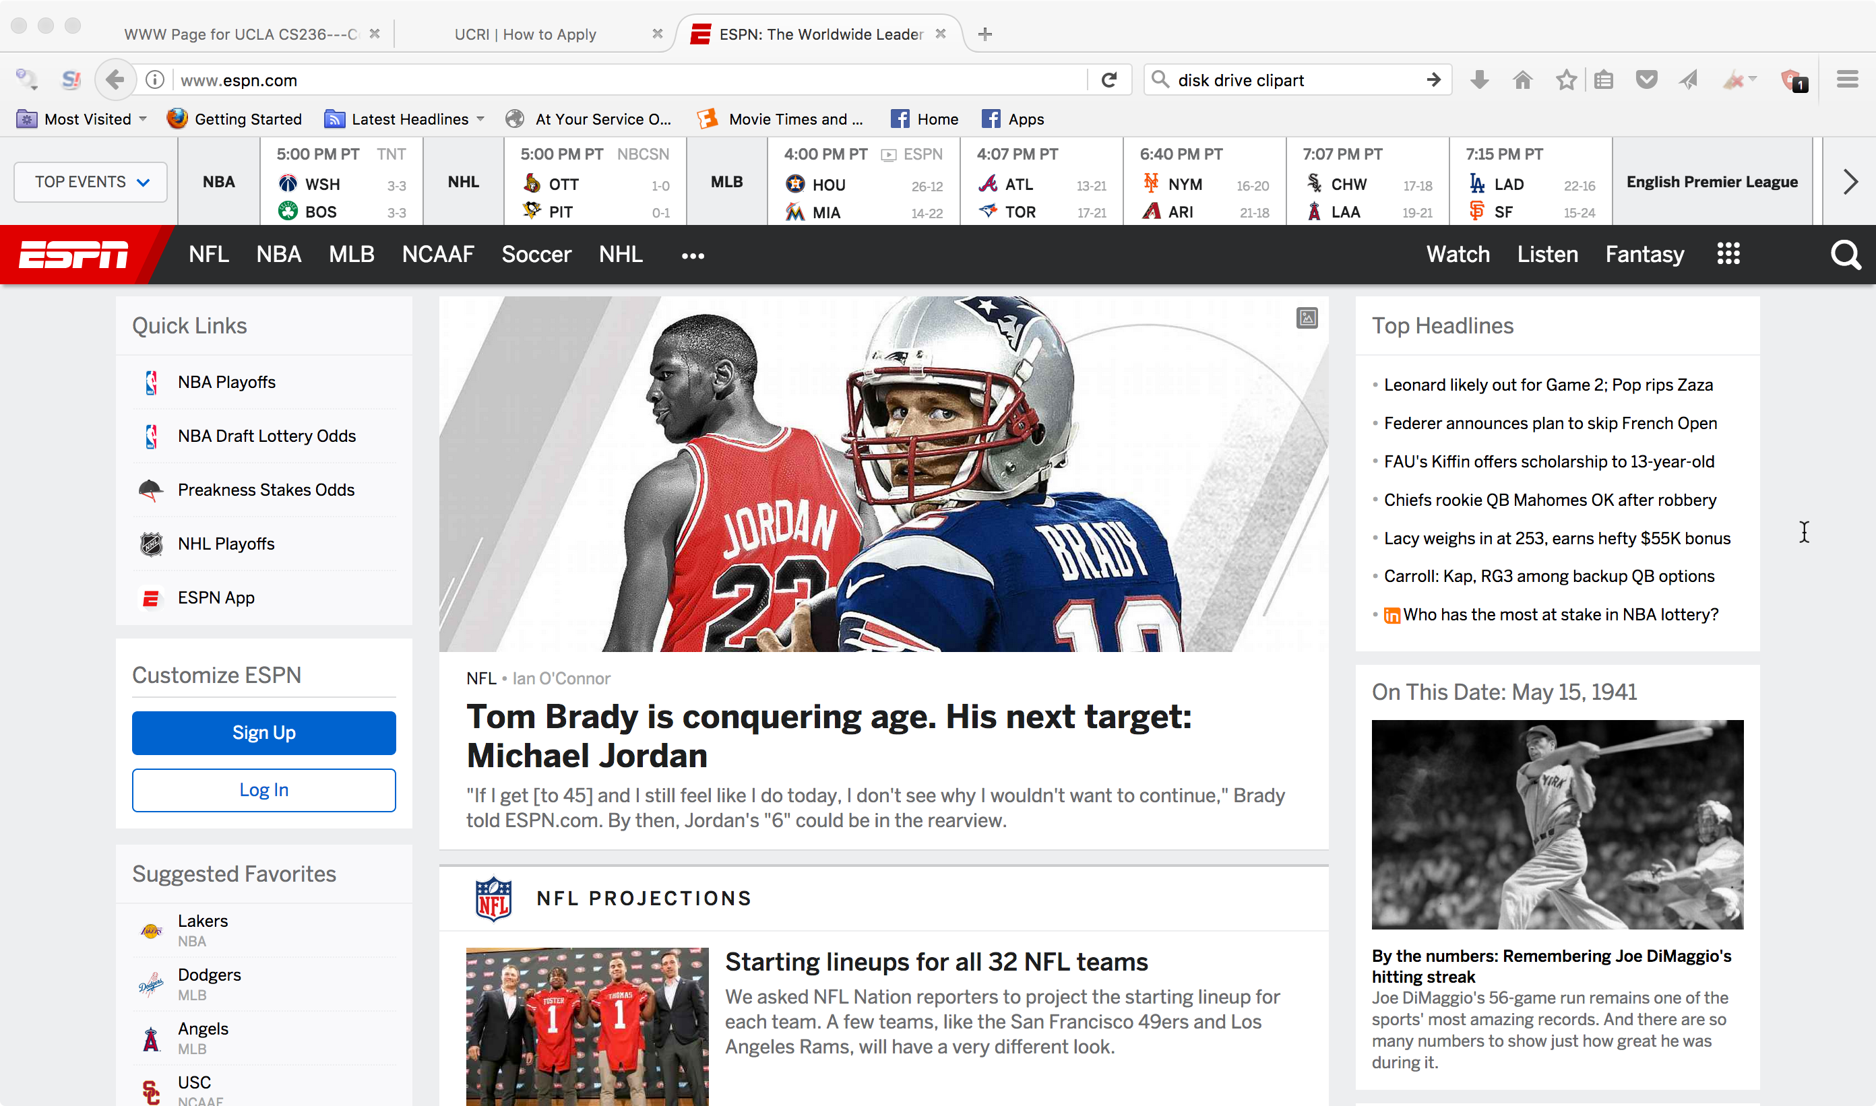
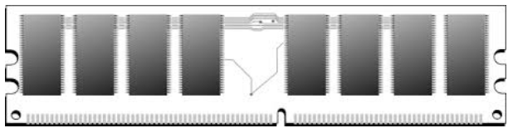
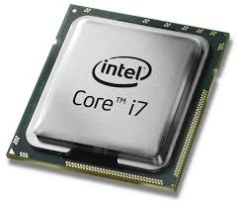
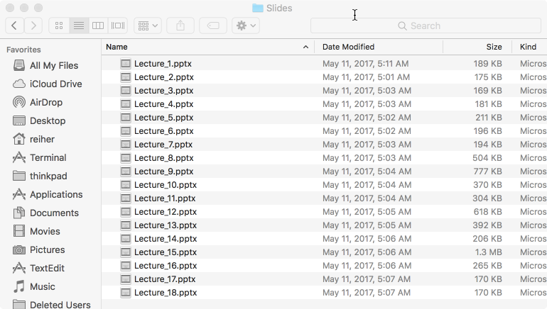
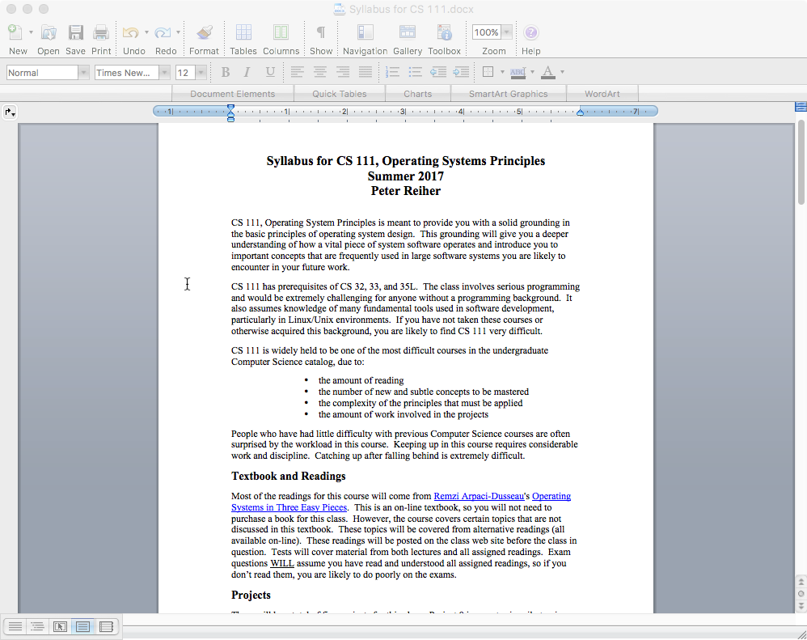
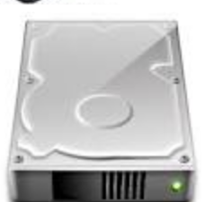
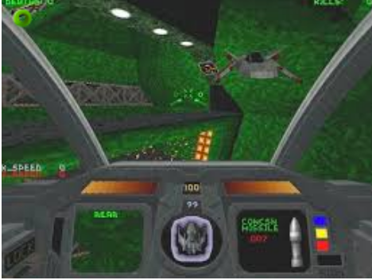
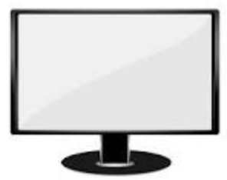

Starting From the Bottom
Here’s what you’ve got
Here’s what you want

Slide 25
What Can You Do With What You’ve Got?
Read or write some binary words
Report X and Y movements
MOV
ADD
JMP
SQRTPD
Write to groups of pixels
READ
REQUEST SENSE
Read or write a block of data

Slide 26

And You Want This?

Slide 27
You’re Going to Need Some Help
And that’s what the operating system is about
Helping you perform complex operations
  Using various hardware
  And probably various bits of software
While hiding the complexity
And making sure nothing gets in the way of anything else

Slide 28
What Is An Operating System, Anyway?
System software intended to provide support for higher level applications
  Some higher level system software
  But primarily for user processes
The software that sits between the hardware and everything else
The software that hides nasty details
  Of hardware, software, and common tasks
On a good day, the OS is your best computing friend

Slide 29
But Why Are You Studying Them?
High probability none of you will ever write an operating system
  Or even fix an operating system bug
Not very many different operating systems are in use
  So the number of developers for them is small
So why should you care about them?

Slide 30
Everybody Has One
Practically all computing devices you will ever use has an operating system
  Servers, laptops, desktop machines, tablets, smart phones, game consoles, set-top boxes
Many things you don’t think of as computers have CPUs in side
  Usually with an operating system
  Internet of Things devices
So you will work with operating systems

Slide 31
How Do You Work With OSes?
You configure them
You use their features when you write programs
You rely on services that they offer
  Memory management
  Persistent storage
  Scheduling and synchronization
  Interprocess communications
  Security

Slide 32
Another Good Reason
Many hard problems have been tackled in the context of operating systems
  How to coordinate separate computations
  How to manage shared resources
  How to virtualize hardware and software
  How to organize communications
  How to protect your computing resources
The operating system solutions are often applicable to programs and systems you write

Slide 33
The Philosophy of Operating Systems
Over the years we’ve developed some wisdom in building operating systems
Lessons learned, things that worked well, things that worked poorly
This wisdom informs modern operating system design
And much of it carries over into development of any complex software system

Slide 34
Some OS Wisdom
View services as objects and operations
  Behind every object there is a data structure
Interface vs. implementation
  An implementation is not a specification
  Many compliant implementations are possible
  Inappropriate dependencies cause problems
An interface specification is a contract
  Specifies responsibilities of producers & consumers
  Basis for product/release interoperability

Slide 35
More OS Wisdom
Modularity and functional encapsulation
  Complexity hiding and appropriate abstraction
Separate policy from mechanism
  Policy determines what can/should be done
  Mechanism implements basic operations to do it
  Mechanisms shouldn’t dictate or limit policies
  Policies must be changeable without changing mechanisms
Parallelism and asynchrony are powerful and vital
  But dangerous when used carelessly
Performance and correctness are often at odds
  Correctness doesn’t always win . . .

Slide 36
What Is An Operating System?
Many possible definitions
One is:
  It is low level software . . .
  That provides better, more usable abstractions of the hardware below it
  To allow easy, safe, fair use and sharing of those resources

Slide 37
What Does an OS Do?
It manages hardware for programs
  Allocates hardware and manages its use
  Enforces controlled sharing (and privacy)
  Oversees execution and handles problems
It abstracts the hardware
  Makes it easier to use and improves SW portability
  Optimizes performance
It provides new abstractions for applications
  Powerful features beyond the bare hardware

Slide 38
What Does An OS Look Like?
A set of management & abstraction services
  Invisible, they happen behind the scenes
Applications see objects and their services
  CPU supports data-types and operations
    bytes, shorts, longs, floats, pointers, ...
    add, subtract, copy, compare, indirection, ...
  So does an operating system, but at a higher level
    files, processes, threads, devices, ports, ...
    create, destroy, read, write, signal, ...
An OS extends a computer
  Creating a much richer virtual computing platform
    Supporting richer objects, more powerful operations

Slide 39
Where Does the OS Fit In?
Applications Software
(e.g. word processor, compiler, VOIP program, ...)
Application Binary Interface
System Services/Libraries
(e.g. string, random #s, encryption, graphics ...)
System Call Interface
Operating System
Privileged instruction set
Standard instruction set
Hardware
(arithmetic, logical, copy, test, flow-control operations, ...)

Slide 40
What’s Special About the OS?
It is always in control of the hardware
  Automatically loaded when the machine boots
  First software to have access to hardware
  Continues running while apps come & go
It alone has complete access to hardware
  Privileged instruction set, all of memory & I/O
It mediates applications’ access to hardware
  Block, permit, or modify application requests
It is trusted
  To store and manage critical data
  To always act in good faith
If the OS crashes, it takes everything else with it
  So it better not crash . . .

Slide 41
Instruction Set Architectures (ISAs)
The set of instructions supported by a computer
  What bit patterns correspond to what operations
There are many different ISAs (all incompatible)
  Different word/bus widths (8, 16, 32, 64 bit)
  Different features (low power, DSPs, floating point)
  Different design philosophies (RISC vs. CISC)
  Competitive reasons (68000, x86, PowerPC)
They usually come in families
  Newer models add features (e.g., Pentium vs. 386)
  But remain upwards-compatible with older models
    A program written for an ISA will run on any compliant CPU

Slide 42
Privileged vs. General Instructions
Most modern ISAs divide instruction set into privileged vs. general
Any code running on the machine can execute general instructions
Processor must be put into a special mode to execute privileged instructions
  Usually only in that mode when the OS is running
  Privileged instructions do things that are “dangerous”

Slide 43
Platforms
ISA doesn’t completely define a computer
  Functionality beyond user mode instructions
    Interrupt controllers, DMA controllers
    Memory management unit, I/O busses
    BIOS, configuration, diagnostic features
    Multi-processor & interconnect support
  I/O devices
    Display, disk, network, serial device controllers
These variations are called “platforms”
  The platform on which the OS must run

Slide 44
Portability to Multiple ISAs
A successful OS will run on many ISAs
  Some customers cannot choose their ISA
  If you don’t support it, you can’t sell to them
Which implies we’ll abstract the ISA
Minimal assumptions about specific HW
  General frameworks are HW independent
    File systems, protocols, processes, etc.
  HW assumptions isolated to specific modules
    Context switching, I/O, memory management
  Careful use of types
    Word length, sign extension, byte order, alignment

Slide 45
Distributing an OS
Developers want their OS to run on as many machines as possible
There are many different ISAs
  And other platform differences
Even more types of peripherals
And vast numbers of different applications and configurations
How to get wide, effective distribution?

Slide 46
Binary Distribution Model
Binary is the opposite of source
  A source distribution must be compiled
  A binary distribution is ready to run
OSes usually distributed in binary
One binary distribution per ISA
  No need for special per-OEM OS versions
Binary model for platform support
  Device drivers can be added, after-market
    Can be written and distributed by 3rd parties
    Same driver works with many versions of OS

Slide 47
Why Not a Source Distribution?
What is wrong with distributing an OS in source form?
  On what are you going to compile it?
  Are your customers competent to build the OS? Do they want to build the OS?
  Do you really want to give all of your customers the sources to your main product?
Open source OSes are available
  But most users still download the binary versions

Slide 48
Binary Configuration Model
Good to eliminate manual/static configuration
  Enable one distribution to serve all users
  Improve both ease of use and performance
Automatic hardware discovery
  Self-identifying busses
    PCI, USB, PCMCIA, EISA, etc.
  Automatically find and load required drivers
Automatic resource allocation
  Eliminate fixed sized resource pools
  Dynamically (re)allocate resources on demand

Slide 49
Flexibility
Different customers have different needs
We cannot anticipate all possible needs
We must design for flexibility/extension
  Mechanism/policy separation
    Allow customers to override default policies
    Changing policies without having to change the OS
  Dynamically loadable features
    Allow new features to be added, after market
    File systems, protocols, load module formats, etc.
  Feature independence and orthogonality

Slide 50
Interface Stability
People want new releases of an OS
  New features, bug fixes, enhancements
People also fear new releases of an OS
  OS changes can break old applications
How can we prevent such problems?
  Define well specified Application Interfaces
    Application programming interfaces (APIs)
    Application binary interfaces (ABIs)
  Applications only use committed interfaces
  OS vendors preserve upwards-compatibility

Slide 51
What Functionality Is In the OS?
As much as necessary, as little as possible
  OS code is very expensive to develop and maintain
Functionality must be in the OS if it ...
  Requires the use of privileged instructions
  Requires the manipulation of OS data structures
  Must maintain security, trust, or resource integrity
Functions should be in libraries if they ...
  Are a service commonly needed by applications
  Do not actually have to be implemented inside OS
But there is also the performance excuse
  Some things may be faster if done in the OS

Slide 52
The OS and Abstraction
One major function of an OS is to offer abstract versions of resources
  As opposed to actual physical resources
Essentially, the OS implements the abstract resources using the physical resources
  E.g., processes (an abstraction) are implemented using the CPU and RAM (physical resources)
  And files (an abstraction) are implemented using disks (a physical resource)

Slide 53
Why Abstract Resources?
The abstractions are typically simpler and better suited for programmers and users
  Easier to use than the original resources
    E.g., don’t need to worry about keeping track of disk interrupts
  Compartmentalize/encapsulate complexity
    E.g., need not be concerned about what other executing code is doing and how to stay out of its way
  Eliminate behavior that is irrelevant to user
    E.g., hide the slow erase cycle of flash memory
  Create more convenient behavior
    E.g., make it look like you have the network interface entirely for your own use

Slide 54
Generalizing Abstractions
Lots of variations in machines’ HW and SW
So make many different types appear to be same
  So applications can deal with single common class
Usually involves a common unifying model
  E.g., portable document format (pdf) for printers
  Or SCSI standard for disks, CDs and tapes
Usually involves a federation framework
  Per sub-type implementations of standard functions
For example:
  Printer drivers make different printers look the same
  Browser plug-ins to handle multi-media data

Slide 55
Why Do We Want This Generality?
For example, why do we want all printers to look the same?
  So we could write applications against a single model, and have it “just work” with all printers
What’s the alternative?
  Program our application to know about all possible printers
  Including those that were invented after we had written our application!

Slide 56
Does a General Model Limit Us?
Does it stick us with the “least common denominator” of a hardware type?
  Like limiting us to the least-featureful of all printers?
Not necessarily
  The model can include “optional features”
    If present, implemented in a standard way
    If not present, test for them and do “something” if they’re not there
Many devices will have features not in the common model
  There are arguments for and against the value of such features

Slide 57
Common Types of OS Resources
Serially reusable resources
Partitionable resources
Sharable resources

Slide 58
Serially Reusable Resources
Used by multiple clients, but only one at a time
  Time multiplexing
Require access control to ensure exclusive use
Require graceful transitions from one user to the next
Examples: printers, bathroom stalls

Slide 59
What Is A Graceful Transition?
A switch that totally hides the fact that the resource used to belong to someone else
  Don’t allow the second user to access the resource until the first user is finished with it
    No incomplete operations that finish after the transition
  Ensure that each subsequent user finds the resource in “like new” condition
    No traces of data or state left over from the first user

Slide 60
Partitionable Resources
Divided into disjoint pieces for multiple clients
  Spatial multiplexing
Needs access control to ensure:
  Containment: you cannot access resources outside of your partition
  Privacy: nobody else can access resources in your partition
Examples: RAM, hotel rooms

Slide 61
Do We Still Need Graceful Transitions?
Yes
Most partitionable resources aren’t permanently allocated
  The page frame of RAM you’re using now will belong to another process later
As long as it’s “yours,” no transition required
But sooner or later it’s likely to become someone else’s

Slide 62
Shareable Resources
Usable by multiple concurrent clients
  Clients do not have to “wait” for access to resource
  Clients don’t “own” a particular subset of resource
May involve (effectively) limitless resources
  Air in a room, shared by occupants
  Copy of the operating system, shared by processes
May involve under-the-covers multiplexing
  Cell-phone channel (time and frequency multiplexed)
  Shared network interface (time multiplexed)

Slide 63
Do We Still Need Graceful Transitions?
Typically not
The shareable resource usually doesn’t change state
Or isn’t “reused”
We never have to clean up what doesn’t get dirty
  Like an execute-only copy of the OS
Or things that disappear after use
  Like the previous second’s bandwidth on a cellular telephone channel
Shareable resources are great!
  When you can have them . . .

Slide 64
General OS Trends
They have grown larger and more sophisticated
Their role has fundamentally changed
  From shepherding the use of the hardware
  To shielding the applications from the hardware
  To providing powerful application computing platform
  To becoming a sophisticated “traffic cop”
They still sit between applications and hardware
Best understood through services they provide
  Capabilities they add
  Applications they enable
  Problems they eliminate

Slide 65
Why?
Ultimately because it’s what users want
The OS must provide core services to applications
Applications have become more complex
  More complex internal behavior
  More complex interfaces
  More interactions with other software
The OS needs to help with all that complexity

Slide 66
OS Convergence
There are a handful of widely used OSes
  And a few special purpose ones (e.g., real time and embedded system OSes)
New ones come along very rarely
OSes in the same family (e.g., Windows or Linux) are used for vastly different purposes
  Making things challenging for the OS designer
Most OSes are based on pretty old models
  Linux comes from Unix (1970s vintage)
  Windows from the early 1980s

Slide 67
Why Have OSes Converged?
They’re expensive to build and maintain
  So it’s a hard business to get into and stay in
They only succeed if users choose them over other OS options
  Which can’t happen unless you support all the apps the users want (and preferably better)
  Which requires other parties to do a lot of work
You need to have some clear advantage over present acceptable alternatives

Slide 68
Conclusion
Understanding operating systems is critical to understanding how computers work
Operating systems interact directly with the hardware
Operating systems provide services via abstractions
Operating systems are constrained by many non-technical factors

