Slide 1
File Systems: Introduction CS 111 On-Line MS Program Operating Systems Peter Reiher

Slide 2
Outline
File systems:
Why do we need them?
Why are they challenging?
Basic elements of file system design
Designing file systems for disks
Basic issues
Free space, allocation, and deallocation

Slide 3
Introduction
Most systems need to store data persistently
So it’s still there after reboot, or even power down
Typically a core piece of functionality for the system
Which is going to be used all the time
Even the operating system itself needs to be stored this way
So we must store some data persistently

Slide 4
Our Persistent Data Options
Use raw disk blocks to store the data
Those make no sense to users
Not even easy for OS developers to work with
Use a database to store the data
Probably more structure (and possibly overhead) than we need or can afford
Use a file system
Some organized way of structuring persistent data
Which makes sense to users and programmers

Slide 5
File Systems
Originally the computer equivalent of a physical filing cabinet
Put related sets of data into individual containers
Put them all into an overall storage unit
Organized by some simple principle
E.g., alphabetically by title
Or chronologically by date
Goal is to provide:
Persistence
Ease of access
Good performance

Slide 6
The Basic File System Concept
Organize data into natural coherent units
Like a paper, a spreadsheet, a message, a program
Store each unit as its own self-contained entity
A file
Store each file in a way allowing efficient access
Provide some simple, powerful organizing principle for the collection of files
Making it easy to find them
And easy to organize them

Slide 7
File Systems and Hardware
File systems are typically stored on hardware providing persistent memory
Disks, tapes, flash memory, etc.
With the expectation that a file put in one “place” will be there when we look again
Performance considerations will require us to match the implementation to the hardware
Remember seek time and rotational latency?
But ideally, the same user-visible file system should work on any reasonable hardware

Slide 8
File Systems and OS Abstractions
Obviously a version of the basic memory abstraction
So we’d expect read() and write() operations for it
We could have a file system abstraction very close to the hardware reality
E.g., exposing disk cylinders or flash erase cycles
But it’s better to hide the messy details
Treat files as magically persistent memory

Slide 9
Data and Metadata
File systems deal with two kinds of information
Data – the information that the file is actually supposed to store
E.g., the instructions of the program or the words in the letter
Metadata – Information about the information the file stores
E.g., how many bytes are there and when was it created
Sometimes called attributes
Ultimately, both data and metadata must be stored persistently
And usually on the same piece of hardware

Slide 10
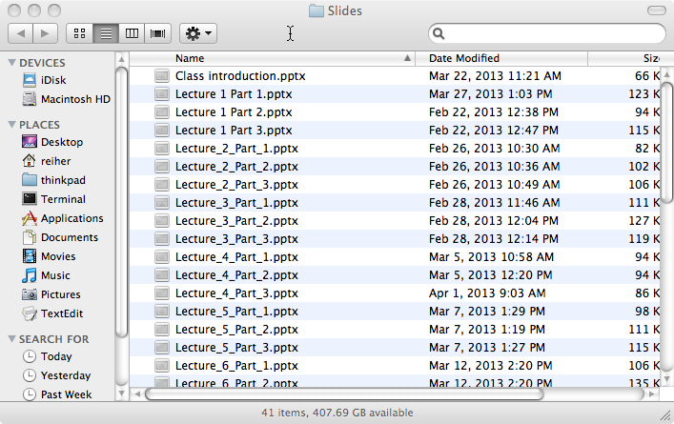


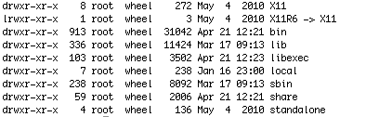
Bridging the Gap
We want something like . . .
But we’ve got something like . . .
How do we get from the hardware to the useful abstraction?
Which is even worse when we look inside:
Or . . .
Or at least

Slide 11
A Further Wrinkle
We want our file system to be agnostic to the storage medium
Same program should access the file system the same way, regardless of medium
Otherwise hard to write portable programs
Should work the same for disks of different types
Or if we use a RAID instead of one disk
Or if we use flash instead of disks
Or if even we don’t use persistent memory at all
E.g., RAM file systems

Slide 12
Desirable File System Properties
What are we looking for from our file system?
Persistence
Easy use model
For accessing one file
For organizing collections of files
Flexibility
No limit on number of files
No limit on file size, type, contents
Portability across hardware device types
Performance
Reliability
Suitable security

Slide 13
The Performance Issue
How fast does our file system need to be?
Ideally, as fast as everything else
Like CPU, memory, and the bus
So it doesn’t provide a bottleneck
But these other devices operate today at nanosecond speeds
Disk drives operate at millisecond speeds
Suggesting we’ll need to do some serious work to hide the mismatch

Slide 14
The Reliability Issue
Persistence implies reliability
We want our files to be there when we check, no matter what
Not just on a good day
So our file systems must be free of errors
Hardware or software
Remember our discussion of concurrency, race conditions, etc.?
Might we have some challenges here?

Slide 15
“Suitable” Security
What does that mean?
We’ll discuss security more in a future lecture, but . . .
Whoever owns the data should be able to control who accesses it
With strong guarantees that the system will enforce his desired controls

