Slide 1
Devices and Device Drivers CS 111 On-Line MS Program Operating Systems Peter Reiher

Slide 2
Outline
The role of devices
Device drivers
Classes of device driver

Slide 3
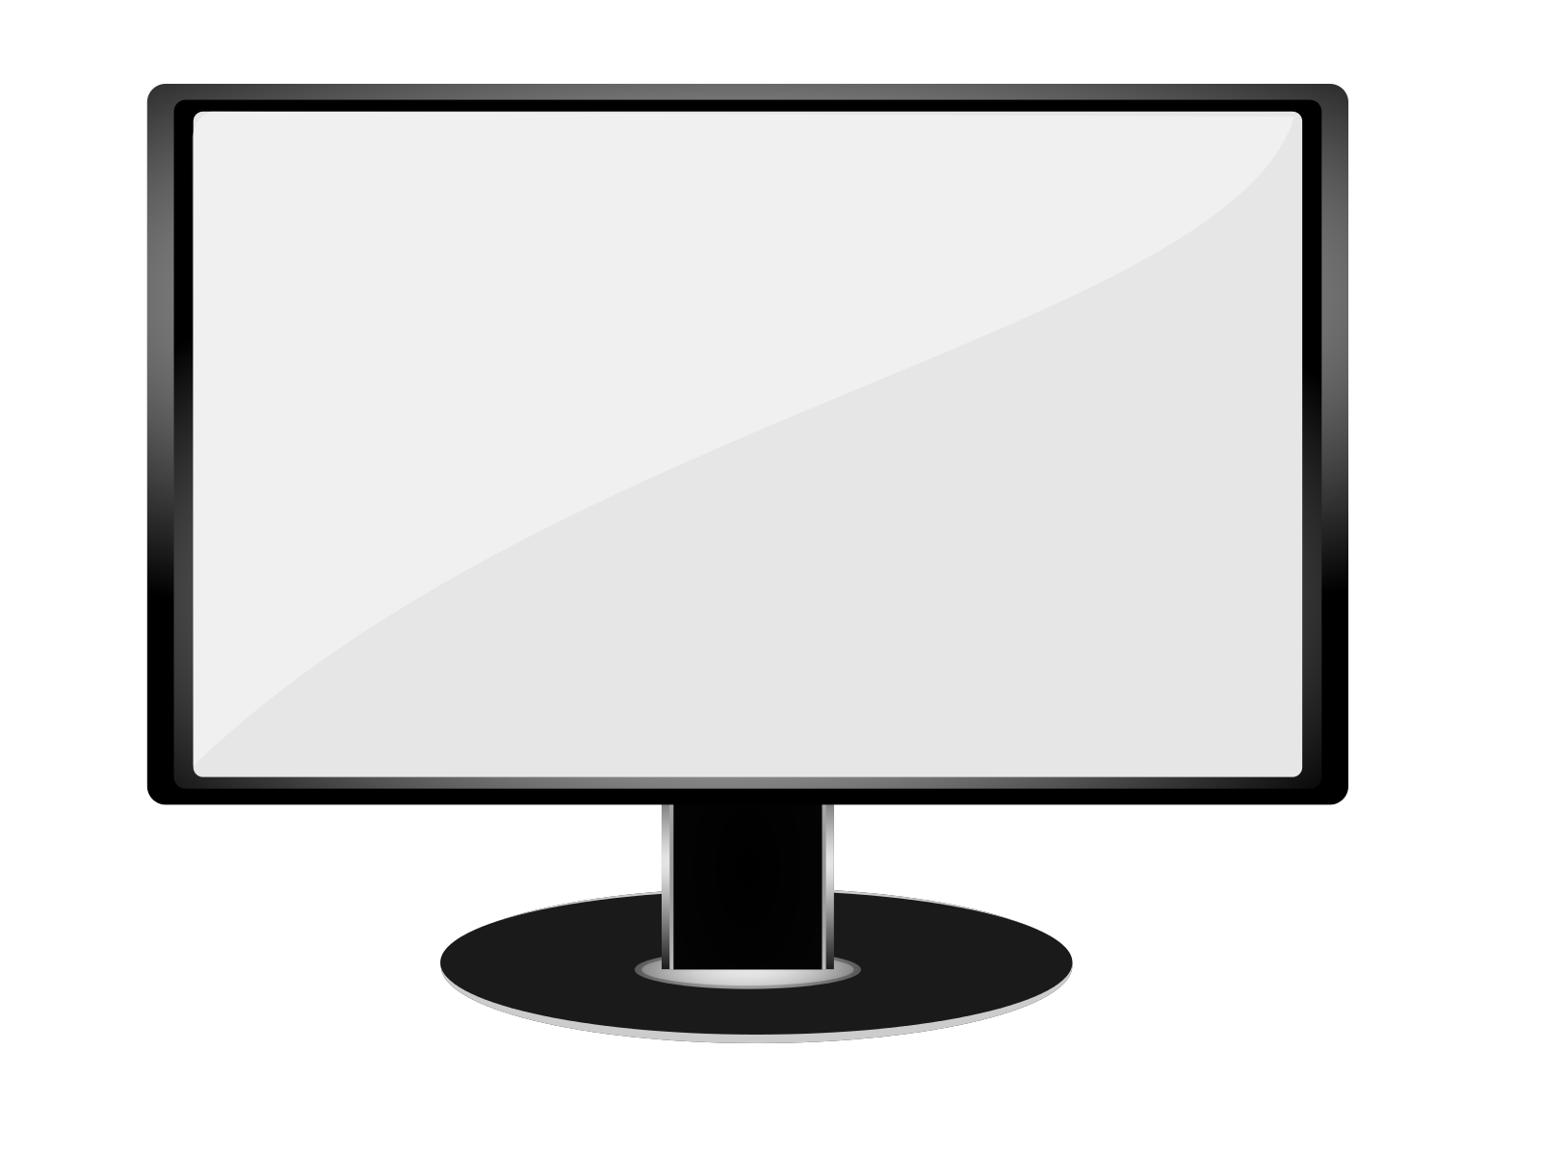
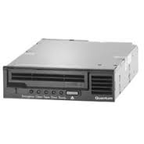


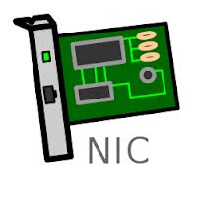
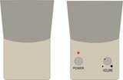

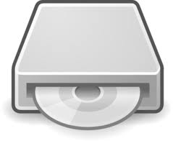
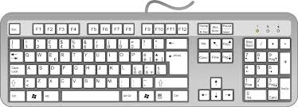
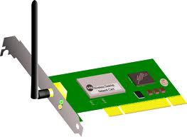
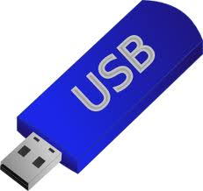


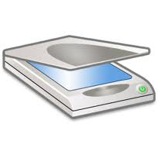
So You’ve Got Your Computer . . .
It’s got memory, a bus, a CPU or two
But there’s usually a lot more to it than that
And who knows what else?

Slide 4
Welcome to the Wonderful World of Peripheral Devices!
Our computers typically have lots of devices attached to them
Each device needs to have some code associated with it
To perform whatever operations it does
To integrate it with the rest of the system
In modern commodity OSes, the code that handles these devices dwarfs the rest

Slide 5
Peripheral Device Code and the OS
Why are peripheral devices the OS’ problem, anyway?
Why can’t they be handled in user-level code?
Maybe they sometimes can, but . . .
Some of them are critical for system correctness
E.g., the disk drive holding swap space
Some of them must be shared among multiple processes
Which is often rather complex
Some of them are security-sensitive
Perhaps more appropriate to put the code in the OS

Slide 6
Where the Device Driver Fits in
At one end you have an application
Like a web browser
At the other end you have a very specific piece of hardware
Like an Intel Gigabit CT PCI-E Network Adapter
In between is the OS
When the application sends a packet, the OS needs to invoke the proper driver
Which feeds detailed instructions to the hardware

Slide 7
Connecting Peripherals
Most peripheral devices don’t connect directly to the processor
Or to the main bus
They connect to a specialized peripheral bus
Which, in turn, connects to the main bus
Various types are common
PCI
USB
Several others

Slide 8
Device Drivers
Generally, the code for these devices is pretty specific to them
It’s basically code that drives the device
Makes the device perform the operations it’s designed for
So typically each system device is represented by its own piece of code
The device driver
A Linux 2.6 kernel had over 3200 of them . . .

Slide 9
Typical Properties of Device Drivers
Highly specific to the particular device
Inherently modular
Usually interacts with the rest of the system in limited, well defined ways
Their correctness is critical
At least device behavior correctness
Sometimes overall correctness
Generally written by programmers who understand the device well
But are not necessarily experts on systems issues

Slide 10
What About Abstractions?
Sounds like device drivers don’t offer a lot of opportunity to use abstractions
Since each is specific to one piece of hardware
But there are some useful similarities at higher levels
We typically customize each device driver on top of a few powerful abstractions

Slide 11
Using Abstractions for Devices
OS defines idealized device classes
Disk, display, printer, tape, network, serial ports
Classes define expected interfaces/behavior
All drivers in class support standard methods
Device drivers implement standard behavior
Make diverse devices fit into a common mold
Protect applications from device eccentricities
Abstractions regularize and simplify the chaos of the world of devices

Slide 12
What Can Driver Abstractions Help With?
Encapsulate knowledge of how to use the device
Map standard operations into operations on device
Map device states into standard object behavior
Hide irrelevant behavior from users
Correctly coordinate device and application behavior
Encapsulate knowledge of optimization
Efficiently perform standard operations on a device
Encapsulate fault handling
Understanding how to handle recoverable faults
Prevent device faults from becoming OS faults

Slide 13
Abstractions on the Other End
Devices typically connect to some standard type of bus
Which requires the hardware to conform to that bus standard
So driver interactions with the physical device are mediated through a standard
Effectively providing an abstraction on the other side of the OS’ role

Slide 14
How Do Device Drivers Fit Into a Modern OS?
There may be a lot of them
They are each pretty independent
You may need to add new ones later
So a pluggable model is typical
OS provides capabilities to plug in particular drivers in well defined ways
Then plug in the ones a given machine needs
Making it easy to change or augment later

Slide 15
Layering Device Drivers
The interactions with the bus, down at the bottom, are pretty standard
How you address devices on the bus, coordination of signaling and data transfers, etc.
Not too dependent on the device itself
The interactions with the applications, up at the top, are also pretty standard
Typically using some file-oriented approach
In between are some very device specific things

Slide 16
A Pictorial View
User space
System
Call
App 1
App 2
App 3
Kernel
space
Device
Drivers
Device
Call
USB bus controller
PCI bus controller
Hardware
USB
bus
PCI
bus

Slide 17
Device Drivers Vs. Core OS Code
What if we’re building an embedded device? Does the analysis change then?
Device driver code is in the OS, but . . .
What belongs in core OS vs. a device driver?
Common functionality belongs in the OS
Caching
File systems code not tied to a specific device
Network protocols above physical/link layers
Specialized functionality belongs in the drivers
Things that differ in different pieces of hardware
Things that only pertain to the particular piece of hardware

