Slide 1
Authentication for
Operating Systems
What is authentication?
How does the problem apply to operating systems?
Techniques for authentication in operating systems

Slide 2
What Is Authentication?
Determining the identity of some entity
  Process
  Machine
  Human user
Requires notion of identity
  One implication is we need some defined name space
And some degree of proof of identity

Slide 3
Where Do We Use
Authentication in the OS?
Typically users authenticate themselves to the system
Their identity tends to be tied to the processes they create
  OS can keep track of this easily
Once authenticated, users (and their processes) typically need not authenticate again
  One authentication per session, usually
Distributed systems greatly complicate things

Slide 4
Authentication Mechanisms
Something you know
  E.g., passwords
Something you have
  E.g., smart cards or tokens
Something you are
  Biometrics
Somewhere you are
  Usually identifying a role

Slide 5
Passwords
Authentication by what you know
One of the oldest and most commonly used security mechanisms
Authenticate the user by requiring him to produce a secret
  Usually known only to him and to the authenticator

Slide 6
Problems With Passwords
They have to be unguessable
  Yet easy for people to remember
If sent over the network, susceptible to password sniffers
Unless fairly long, brute force attacks often work on them

Slide 7
Handling Passwords
The OS must be able to check passwords when users log in
So must the OS store passwords?
Not really
  It can store an encrypted version
Encrypt the offered password
  Using a one-way function
  E.g., a secure hash algorithm like SHA1
And compare it to the stored version
Why use a one-way function, instead of, say, AES or some other symmetric algorithm?

Slide 8
Is Encrypting the Password
File Enough?
What if an attacker gets a copy of your password file?
No problem, the passwords are encrypted
  Right?
Yes, but . . .

Slide 9


Dictionary Attacks
Harpo 2st6’sG0
Zeppo G>I5{as3
Chico w*-;sddw
Karl sY(34,ee
Groucho We6/d02,
Gummo 3(;wbnP]
Dictionary
sY(34,ee
aardvark
Now you can hack the Communist Manifesto!
340jafg;
aardwolf
sY(34,ee
K]ds+3a,
abaca
abaca is Karl Marx’s password!
Rats!!!!

Slide 10
Salted Passwords
A technique to combat dictionary attacks
Combine the plaintext password with a random number
  Then run it through the one-way function
The random number need not be secret
It just has to be different for different users
You store the salt integer with the password
  Generally in plaintext
If the attacker steals the password file, won’t he get the salt values in plaintext, too? Why is this OK? (Or at least OK-ish?) Why don’t we need to encrypt the stored salts?

Slide 11

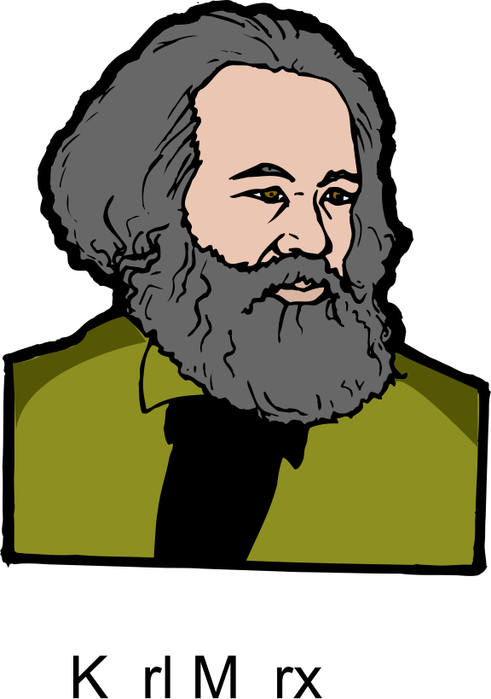
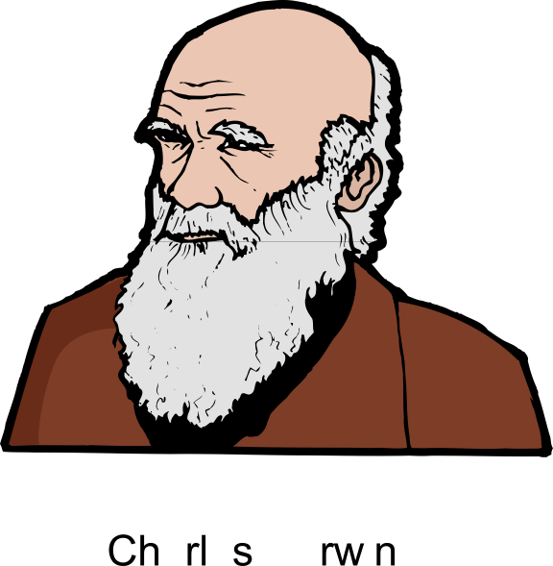

Did It Fix Our Problem?
Karl Marx
Charles Darwin
Karl Marx
Charles Darwin
beard
beard
D0Cls6&
aardvark 340jafg;
aardwolf K[ds+3a,
abaca sY(34,ee
. . .
beard ^*eP61a-
)#4,doa8

Slide 12
Are My Passwords Safe Now?
If I salt and encrypt them, am I OK?
Depends on the quality of the passwords chosen
Attacker can still perform dictionary attacks on an individual password, with its salt
If the password isn’t in the dictionary, no problem
If it is, the attack succeeds
Which is why password choice is important

Slide 13
Password Selection
Generally, long passwords chosen from large character sets are good
Short passwords chosen from small character sets are bad
How long?
  A matter of time
  Moore’s law forces us to make them ever longer
What’s a large character set?
  Upper and lower case letters, plus numbers, plus symbols (like ^ and @)

Slide 14
Authentication Devices
Authentication by what you have
A smart card or other hardware device that is readable by the computer
  Safest if device has some computing capability
  Rather than just data storage
Authenticate by providing the device to the computer
More challenging when done remotely, of course

Slide 15
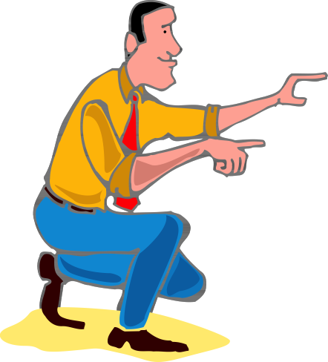
Authentication With Smart Cards
Authentication verified!
challenge
challenge
E(challenge)
E(challenge)
How can the server be sure of the remote user’s identity?
By proper use of cryptography

Slide 16
Problems With Authentication Devices
If lost or stolen, you can’t authenticate yourself
  And maybe someone else can
  Often combined with passwords to avoid this problem
Unless cleverly done, susceptible to sniffing attacks
Requires special hardware
There have been successful attacks on some smart cards

Slide 17
Biometric Authentication
Authentication based on who you are
Things like fingerprints, voice patterns, retinal patterns, etc.
To authenticate, allow the system to measure the appropriate physical characteristics
Biometric measurement converted to binary and compared to stored values
  With some level of match required

Slide 18
Problems With Biometrics
Requires very special hardware
May not be as foolproof as you think
Many physical characteristics vary too much for practical use
  Day to day or over long periods of time
Generally not helpful for authenticating programs or roles
What happens when it’s cracked?
  You only have two retinas, after all

Slide 19
Characterizing Biometric Accuracy
How many false positives?
Match made when it shouldn’t have been
Versus how many false negatives?
Match not made when it should have been
False Positive Rate
False Negative Rate
The Crossover Error Rate (CER)
Generally, the higher the CER is, the better the system
Errors
Sensitivity

Slide 20
Some Typical Crossover Error Rates
Technology Rate
Retinal Scan 1:10,000,000+
Iris Scan 1:131,000
Fingerprints 1:500
Facial Recognition 1:500
Hand Geometry 1:500
Signature Dynamics 1:50
Voice Dynamics 1:50
Data as of 2002
Things can improve a lot in this area over time
Also depends on how you use them
And on what’s important to your use

Slide 21
A Biometric Cautionary Tale
A researcher in Japan went out and bought some supplies from a hobby store (in 2002)
He used them to create gummy fingers
  With gummy fingerprints
With very modest tinkering, his gummy fingers fooled all commercial fingerprint readers
Maybe today’s readers are better
  Maybe not . . .

