Slide 1
Networking for Operating Systems CS 111 On-Line MS Program Operating Systems Peter Reiher

Slide 2
Outline
Introduction to networking
Networking implications for operating systems
Networking and distributed systems

Slide 3
Networking: A Brief History
In the early 1960s, operating systems rarely had any concern with networks at all
Today, networking is a core concern of almost all operating systems
How did we get from there to here?

Slide 4
The Analog Age of Networking
Point-to-Point connection technology
Lay or lease (analog) dedicated lines
Limited connectivity, very expensive, special purpose hardware
Use the (analog) telephone network
Limited bandwidth, intermittent connectivity, primitive modems
Services
Remote device connection
Remote terminal (dial-in access)
Remote card readers and printers (for job submission)
Remote instrumentation (attached to phones)
Computer-to-computer communication

Slide 5
The ARPANET
Based on a dedicated sub-network
Special purpose Interface Message Processors
Interconnected by 56KB leased lines
Packet switched (vs. circuit switched) communication
Automatic routing (negotiated among the IMPs)
Host computers saw a digital network
Host-to-IMP interconnection was digital
Packet routing and delivery was automatic
Continuous connectivity between all network hosts
First message sent in 1969
Modest, but increasing deployment by early 1970s

Slide 6
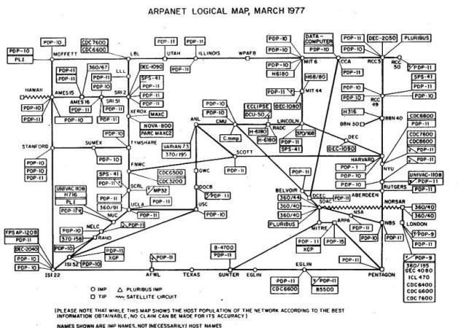

Slide 7
Early Data Protocols
Goals
Enable exploitation of networked computer resources
Remote access protocols
BBN report 1822 (interconnection of a host & IMP)
telnet (1969, RFC #15)
Remote Job Submission (1971, RFC #88)
File Transfer Protocol (1971, RFC #114)
Impact:
Got researchers working on digital networking
Led to development of collaborative protocols
mail (1972, RFC #385)
voice (1977, RFC #741)

Slide 8
Work Group Computing
Goals:
Enhanced collaboration (e-mail, calendars, files)
Sharing expensive resources (printers, large disks)
Peer-to-peer resource sharing
Machines export resources for use by the group
Users send requests to owners of desired resources
Little/no centralization of resources or services
Impact:
Challenged notion of the self-contained system
Introduced global resource/authentication domains
Primarily supporting single enterprise

Slide 9
Client/Server Computing
Goals:
Cost-effective resource & service concentration
Centralized system management
Larger scale shared resource domains
Extended peer-to-peer resource sharing
Discovery, configuration, authentication, etc.
Impact:
Fat servers and thin clients
Ubiquitous standards, high interoperability
Assumed availability of network infrastructure
Major changes to OS structure and philosophy

Slide 10
The World Wide Web
The technological innovations were simple
HTTP – anonymous file transfer with caching
HTML – a “mark-up” language with external links
www – a “Universal Resource Locator” namespace
The implications changed the technological world
All systems are now fully inter-connected
People buy services, software is just an implementation
Services are provided over networks, via protocols
Heterogeneity (of hardware, OS, software) is a given

Slide 11
Distributed Computing
A model where some or almost all of the computation occurs on multiple machines
Becoming increasingly important
Why?
Most of the interesting resources are elsewhere
A single system has very limited capacity & bandwidth
A single system is a single point of failure
Rejects the old model
Software runs on the local CPU, under the local OS
Some resources may be fetched over a network
Instead, the network is the computer
The local CPU and OS are merely a point of access
What features of computing and technology trends, if any, work against the move to distributed computing? What computing won’t be distributed in ten years?

Slide 12
Implications of These Changes For the Operating System
Increasing amounts of activity will require networking
Handling networking well will become ever more critical
The operating system must be better at handling the special characteristics of networks
Not just another peripheral device
Instead, the key demand on future systems

Slide 13
Networking Implications for the Operating System
Supporting various networking models has required serious operating system support
Changes in the clients
Changes in protocol implementations
Changes to IPC and inter-module plumbing
Changes to object implementations and semantics
Challenges of distributed computing

Slide 14
Changing Paradigms
Network connectivity becomes “a given”
New applications assume/exploit connectivity
New distributed programming paradigms emerge
New functionality depends on network services
Thus, applications demand new services from the OS:
Location independent operations
Rendezvous between cooperating processes
WAN scale communication, synchronization
Support for splitting and migrating computations
Better virtualization services to safely share resources
Network performance becomes critical

Slide 15
The Old Networking Clients
Most clients were basic networking applications
Implementations of higher level remote access protocols
telnet, FTP, SMTP, POP/IMAP, network printing
Occasionally run, to explicitly access remote systems
Applications specifically written to network services
OS provided transport level services
TCP or UDP, IP, NIC drivers
Little impact on OS APIs
OS objects were not expected to have network semantics
Network apps provided services, did not implement objects

Slide 16
The New Networking Clients
The OS itself is a client for network services
OS may depend on network services
netboot, DHCP, LDAP, Kerberos, etc.
OS-supported objects may be remote
Files may reside on remote file servers
Console device may be a remote X11 client
A cooperating process might be on another machine
Implementations must become part of the OS
For both performance and security reasons
Local resources may acquire new semantics
Remote objects may behave differently than local

Slide 17
The Old Implementations
Network protocol implemented in user-mode daemon
Daemon talks to network through device driver
Client requests
Sent to daemon through IPC port
Daemon formats messages, sends them to driver
Incoming packets
Daemon reads from driver and interprets them
Unpacks data, forward to client through IPC port
Advantages – user mode code is easily changed
Disadvantages – lack of generality, poor performance, weak security

Slide 18
User-Mode Protocol Implementations
TCP/IP daemon
SMTP – mail delivery application
user mode
kernel mode
socket API
sockets (IPC)
device read/write
ethernet NIC driver
And off to the packet’s destination!

Slide 19
The New Implementations
Basic protocols implemented as OS modules
Each protocol implemented in its own module
Protocol layering implemented with module plumbing
Layering and interconnections are configurable
User-mode clients attach via IPC-ports
Which may map directly to internal networking plumbing
Advantages
Modularity (enables more general layering)
Performance (less overhead from entering/leaving kernel)
Security (most networking functionality inside the kernel)
A disadvantage – larger, more complex OS

Slide 20
In-Kernel Protocol Implementations
Instant messaging application
SMTP – mail delivery application
user mode
kernel mode
Socket API
Sockets
Streams
Streams
UDP datagrams
TCP session management
Streams
IP transport & routing
Streams
802.12 Wireless LAN
And off to the packet’s destination!
Data Link Provider Interface
Linksys WaveLAN m-port driver

Slide 21
A Basic Ethernet Stack
connections
UDP
IETF 768
stream packetizing
TCP
IETF 793
flow
control
error
control
datagrams
Border Gateway Protocol
IETF 1267
route
table
datagram frag/assy
Address Resolution Protocol
IETF 826
IP/ICMP
IETF 791-2
ICMP
routing & addressing
Interface configuration
interfaces
MAC driver
ethernet
IEEE 802.3
NIC driver

Slide 22
IPC Implications
IPC used to be occasionally used for pipes
Now it is used for all types of services
Demanding richer semantics, and better performance
Used to interconnect local processes
Now it interconnects agents all over the world
Need naming service to register & find partners
Must interoperate with other OSes IPC mechanisms
Used to be simple and fast inside the OS
We can no longer depend on shared memory
We must be prepared for new modes of failure

Slide 23
Improving Our OS Plumbing
Protocol stack performance becomes critical
To support file access, network servers
High performance plumbing: UNIX Streams
General bi-directional in-kernel communications
Can interconnect any two modules in kernel
Can be created automatically or manually
Message based communication
Put (to stream head) and service (queued messages)
Accessible via read/write/putmsg/getmsg system calls

Slide 24
Network Protocol Performance
Layered implementation is flexible and modular
But all those layers add overhead
Calls, context switches and queuing between layers
Potential data recopy at boundary of each layer
Protocol stack plumbing must also be high performance
High bandwidth, low overhead
Copies can be avoided by clever data structures
Messages can be assembled from multiple buffers
Pass buffer pointers rather than copying messages
Network adaptor drivers support scatter/gather
Increasingly more of the protocol stack is in the NIC

