Slide 1
Network Security
Computer Security
Peter Reiher
February 7, 2017

Slide 2
Outline
Network security threats
Denial of service attacks
Traffic control mechanisms
Firewalls
Encryption for network security & VPNs
Wireless security
Honeypots and honeynets

Slide 3
Some Important Network Characteristics for Security
Degree of locality
Media used
Protocols used

Slide 4
Degree of Locality
Some networks are very local
  E.g., an Ethernet
  Benefits from:
    Physical locality
    Small number of users and machines
    Common goals and interests
Other networks are very non-local
  E.g., the Internet backbone
  Many users/sites share bandwidth

Slide 5
Network Media
Some networks are wires, cables, or over telephone lines
  Can be physically protected
Other networks are satellite links or other radio links
  Physical protection possibilities more limited

Slide 6
Protocol Types
TCP/IP is the most used
  But it only specifies some common intermediate levels
  Other protocols exist above and below it
In places, other protocols replace TCP/IP
And there are lots of supporting protocols
  Routing protocols, naming and directory protocols, network management protocols
  And security protocols (IPSec, ssh, ssl)

Slide 7
Implications of Protocol Type
The protocol defines a set of rules that will always be followed
  But usually not quite complete
  And they assume everyone is at least trying to play by the rules
  What if they don’t?
Specific attacks exist against specific protocols

Slide 8
Threats To Networks
Wiretapping
  Passive or active
Impersonation
Attacks on message
  Confidentiality
  Integrity
Denial of service attacks

Slide 9
Impersonation
A packet comes in over the network
  With some source indicated in its header
Often, the action to be taken with the packet depends on the source
But attackers may be able to create packets with false sources

Slide 10
How Do We Determine Packet “Identity”?
Source address
  Just bits, therefore spoofable
Cryptographic techniques
  Possible, but expensive and key issues must be solved
Just knowing
  Maybe it’s hard to “get into” the medium
  Relies on some assumptions

Slide 11
Violations of Message Confidentiality
Other problems can cause messages to be inappropriately divulged
Misdelivery can send a message to the wrong place
  Clever attackers can make it happen
Message can be read at an intermediate gateway or a router
Sometimes an intruder can get useful information just by traffic analysis

Slide 12
Message Integrity
Even if the attacker can’t create the packets he wants, sometimes he can alter proper packets
To change the effect of what they will do
Typically requires access to part of the path message takes

Slide 13
Denial of Service
Attacks that prevent legitimate users from doing their work
By flooding the network
Or corrupting routing tables
Or flooding routers
Or destroying key packets

Slide 14
How Do Denial of Service Attacks Occur?
Basically, the attacker injects some form of traffic
Most current networks aren’t built to throttle uncooperative parties very well
All-inclusive nature of the Internet makes basic access trivial
Universality of IP makes reaching most of the network easy

Slide 15
An Example: SYN Flood
Based on vulnerability in TCP
Attacker uses initial request/response to start TCP session to fill a table at the server
Preventing new real TCP sessions
SYN cookies and firewalls with massive tables are possible defenses

Slide 16
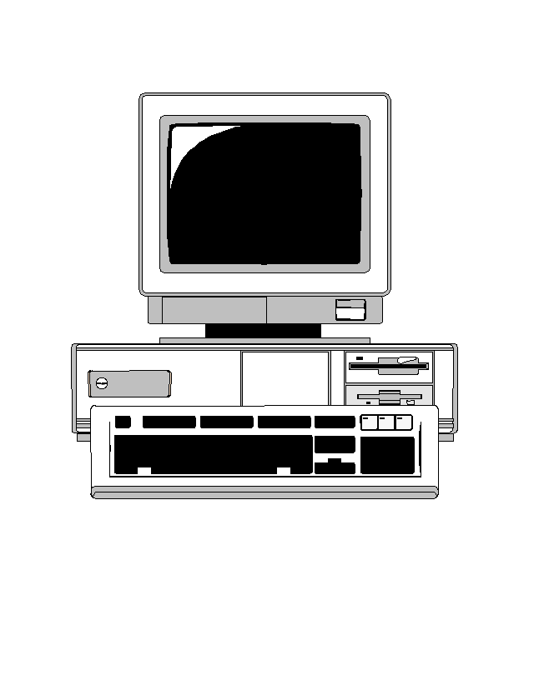

Normal SYN Behavior
SYN
SYN/ACK
ACK
Table of open TCP connections

Slide 17
A SYN Flood
SYN
SYN
SYN
SYN
SYN/ACK
SYN/ACK
SYN/ACK
SYN/ACK
SYN
Server can’t fill request!
Table of open TCP connections

Slide 18
SYN Cookies
And no changes to TCP protocol itself
KEY POINT: Server doesn’t need to save cookie value!
SYN/ACK number is secret function of various information
Client IP address & port, server’s IP address and port, and a timer
SYN
+ 1
SYN/ACK
No room in the table, so send back a SYN cookie, instead
ACK
Server recalculates cookie to determine if proper response

Slide 19
General Network Denial of Service Attacks
Need not tickle any particular vulnerability
Can achieve success by mere volume of packets
If more packets sent than can be handled by target, service is denied
A hard problem to solve

Slide 20
Distributed Denial of Service Attacks
Goal: Prevent a network site from doing its normal business
Method: overwhelm the site with attack traffic
Response: ?

Slide 21



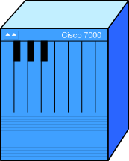
The Problem

Slide 22
Why Are These Attacks Made?
Generally to annoy
Sometimes for extortion
Sometimes to prevent adversary from doing something important
  E.g., distraction from another attack
If directed at infrastructure, might cripple parts of Internet

Slide 23
Attack Methods
Pure flooding
  Of network connection
  Or of upstream network
Overwhelm some other resource
  SYN flood
  CPU resources
  Memory resources
  Application level resource
Direct or reflection

Slide 24
Why “Distributed”?
Targets are often highly provisioned servers
A single machine usually cannot overwhelm such a server
So harness multiple machines to do so
Also makes defenses harder

Slide 25
How to Defend?
A vital characteristic:
  Don’t just stop a flood
  ENSURE SERVICE TO LEGITIMATE CLIENTS!!!
If you deliver a manageable amount of garbage, you haven’t solved the problem
Nor have you if you prevent a flood by dropping all packets

Slide 26
Complicating Factors
High availability of compromised machines
  Millions of zombie machines out there
Internet is designed to deliver traffic
  Regardless of its value
IP spoofing allows easy hiding
Distributed nature makes legal approaches hard
Attacker can choose all aspects of his attack packets
  Can be a lot like good ones

Slide 27
Basic Defense Approaches
Overprovisioning
Dynamic increases in provisioning
Hiding
Tracking attackers
Legal approaches
Reducing volume of attack
None of these are totally effective

Slide 28
Reflection Attacks
Attacker doesn’t send packets to the target
He sends packets to a third party node
  With the target’s IP address spoofed
Third party sends response to target
If response is much bigger than request, amplifies the attack
Possible reflectors – DNS servers, nntp servers, other non-TCP protocol services

Slide 29
Traffic Control Mechanisms
Filtering
  Source address filtering
  Other forms of filtering
Rate limits
Protection against traffic analysis
  Padding
  Routing control

Slide 30
Source Address Filtering
Filtering out some packets because of their source address value
  Usually because you believe their source address is spoofed
Often called ingress filtering
  Or egress filtering . . .

Slide 31
Source Address Filtering for Address Assurance
Router “knows” what network it sits in front of
  In particular, knows IP addresses of machines there
Filter outgoing packets with source addresses not in that range
Prevents your users from spoofing other nodes’ addresses
  But not from spoofing each other’s

Slide 32
Source Address Filtering Example
95.113.27.12
56.29.138.2
My network shouldn’t be creating packets with this source address
128.171.192.*
So drop the packet

Slide 33
Source Address Filtering in the Other Direction
Often called egress filtering
  Or ingress filtering . . .
Occurs as packets leave the Internet and enter a border router
  On way to that router’s network
What addresses shouldn’t be coming into your local network?

Slide 34
Filtering Incoming Packets
128.171.192.5
128.171.192.7
Packets with this source address should be going out, not coming in
128.171.192.*
So drop the packet

Slide 35
Other Forms of Filtering
One can filter on things other than source address
  Such as worm signatures, unknown protocol identifiers, etc.
Also, there are unallocated IP addresses in IPv4 space
  Can filter for packets going to or coming from those addresses
Some source addresses for local use only
  Internet routers can drop packets to/from them

Slide 36
Realistic Limits on Filtering
Little filtering possible in Internet core
  Packets being handled too fast
  Backbone providers don’t want to filter
  Damage great if you screw it up
Filtering near edges has its own limits
  In what’s possible
  In what’s affordable
  In what the router owners will do

Slide 37
Rate Limits
Many routers can place limits on the traffic they send to a destination
Ensuring that the destination isn’t overloaded
  Popular for denial of service defenses
Limits can be defined somewhat flexibly
But often not enough flexibility to let the good traffic through and stop the bad

Slide 38
Padding
Sometimes you don’t want intruders to know what your traffic characteristics are
Padding adds extra traffic to hide the real stuff
Fake traffic must look like real traffic
  Usually means encrypt it all
Must be done carefully, or clever attackers can tell the good stuff from the noise

Slide 39
Routing Control
Use ability to control message routing to conceal the traffic in the network
Used in onion routing to hide who is sending traffic to whom
  For anonymization purposes
Routing control also used in some network defense
  To hide real location of a machine
  E.g., SOS DDoS defense system

Slide 40
Firewalls
What is a firewall?
A machine to protect a network from malicious external attacks
Typically a machine that sits between a LAN/WAN and the Internet
Running special software to regulate network traffic

Slide 41
Typical Use of a Firewall
???
The
Internet
???
Firewall
Local Network

Slide 42
Firewalls and Perimeter Defense
Firewalls implement a form of security called perimeter defense
Protect the inside of something by defending the outside strongly
  The firewall machine is often called a bastion host
Control the entry and exit points
If nothing bad can get in, I’m safe, right?

Slide 43
Weaknesses of Perimeter Defense Models
Breaching the perimeter compromises all security
Windows passwords are a form of perimeter defense
  If you get past the password, you can do anything
Perimeter defense is part of the solution, not the entire solution

Slide 44
Weaknesses of Perimeter Defense

Slide 45
Defense in Depth
An old principle in warfare
Don’t rely on a single defensive mechanism or defense at a single point
Combine different defenses
Defeating one defense doesn’t defeat your entire plan

Slide 46
So What Should Happen?

Slide 47
Or, Better

Slide 48
Or, Even Better

Slide 49
So Are Firewalls Any Use?
Definitely!
They aren’t the full solution, but they are absolutely part of it
Anyone who cares about security needs to run a decent firewall
They just have to do other stuff, too

Slide 50
The Brass Tacks of Firewalls
What do they really do?
Examine each incoming packet
Decide to let the packet through or drop it
  Criteria could be simple or complex
Perhaps log the decision
Maybe send rejected packets elsewhere
Pretty much all there is to it

Slide 51
Types of Firewalls
Filtering gateways
  AKA screening routers
Application level gateways
  AKA proxy gateways
Reverse firewalls

Slide 52
Filtering Gateways
Based on packet header information
  Primarily, IP addresses, port numbers, and protocol numbers
Based on that information, either let the packet through or reject it
Stateless firewalls

Slide 53
Example Use of
Filtering Gateways
Allow particular external machines to telnet into specific internal machines
  Denying telnet to other machines
Or allow full access to some external machines
And none to others

Slide 54
A Fundamental Problem
IP addresses can be spoofed
If your filtering firewall trusts packet headers, it offers little protection
Situation may be improved by IPsec
  But hasn’t been yet
Firewalls can perform the ingress/egress filtering discussed earlier

Slide 55
Filtering Based on Ports
Most incoming traffic is destined for a particular machine and port
  Which can be derived from the IP and TCP headers
Only let through packets to select machines at specific ports
Makes it impossible to externally exploit flaws in little-used ports
  If you configure the firewall right . . .

Slide 56
Pros and Cons of
Filtering Gateways
Fast
Cheap
Flexible
Transparent
Limited capabilities
Dependent on header authentication
Generally poor logging
May rely on router security

Slide 57
Application Level Gateways
Also known as proxy gateways
Firewalls that understand the application-level details of network traffic
  To some degree
Traffic is accepted or rejected based on the probable results of accepting it
Stateful firewalls

Slide 58
How Application Level Gateways Work
Firewall treats packets as part of flows
Either configured to handle common types of traffic
  Like TCP, HTTP, etc.
  Or proxies are plugged into a framework
Incoming packets handled by type of flow
  Typically determined by protocol type and port
Firewall typically accepts or rejects them

Slide 59
Deep Packet Inspection
What the proxies do, when used
Looking into packets beyond their headers
  Especially the IP header
“Deep” sometimes also means deeper understanding of what’s going on
  Though not always

Slide 60
Firewall Proxies
Programs capable of understanding particular kinds of traffic
  E.g., FTP, HTTP, videoconferencing
Proxies are specialized
A good proxy has deep understanding of the network application
Typically limited by complexity and performance issues

Slide 61
Pros and Cons of Application Level Gateways
Highly flexible
Good logging
Content-based filtering possible
Potentially transparent
Slower
More complex and expensive
Highly dependent on sophistication

Slide 62
Reverse Firewalls
Normal firewalls keep stuff from the outside from getting inside
Reverse firewalls keep stuff from the insider from getting outside
Often colocated with regular firewalls
Why do we need them?

Slide 63
Possible Uses of Reverse Firewalls
Concealing details of your network from attackers
Preventing compromised machines from sending things out
  E.g., intercepting bot communications or stopping DDoS
  Preventing data exfiltration

Slide 64
Firewall Characteristics
Statefulness
Transparency
Handling authentication
Handling encryption

Slide 65
Stateful Firewalls
Much network traffic is connection-oriented
  E.g., telnet and videoconferencing
Proper handling of that traffic requires the firewall to maintain state
But handling information about connections is more complex

Slide 66
Firewalls and Transparency
Ideally, the firewall should be invisible
  Except when it vetoes access
Users inside should be able to communicate outside without knowing about the firewall
External users should be able to invoke internal services transparently

Slide 67
Firewalls and Authentication
Many systems want to give special privileges to specific sites or users
Firewalls can only support that to the extent that strong authentication is available
  At the granularity required
For general use, may not be possible
  In current systems

Slide 68
Firewalls and Encryption
Firewalls provide no confidentiality
Unless the data is encrypted
But if the data is encrypted, the firewall can’t examine it
So typically the firewall must be able to decrypt
  Or only work on unencrypted parts of packets
Can decrypt, analyze, and re-encrypt

