Slide 1
Network Security: Firewalls, Network Cryptography, and Honeypots
Computer Security
Peter Reiher
February 9, 2017

Slide 2
Firewall Configuration and Administration
Again, the firewall is the point of attack for intruders
Thus, it must be extraordinarily secure
How do you achieve that level of security?

Slide 3
Firewall Location
Clearly, between you and the bad guys
But you may have some different types of machines/functionalities
Sometimes makes sense to divide your network into segments
  Typically, less secure public network and more secure internal network
  Using separate firewalls

Slide 4
Firewalls and DMZs
A standard way to configure multiple firewalls for a single organization
Used when organization runs machines with different openness needs
  And security requirements
Basically, use firewalls to divide your network into segments

Slide 5
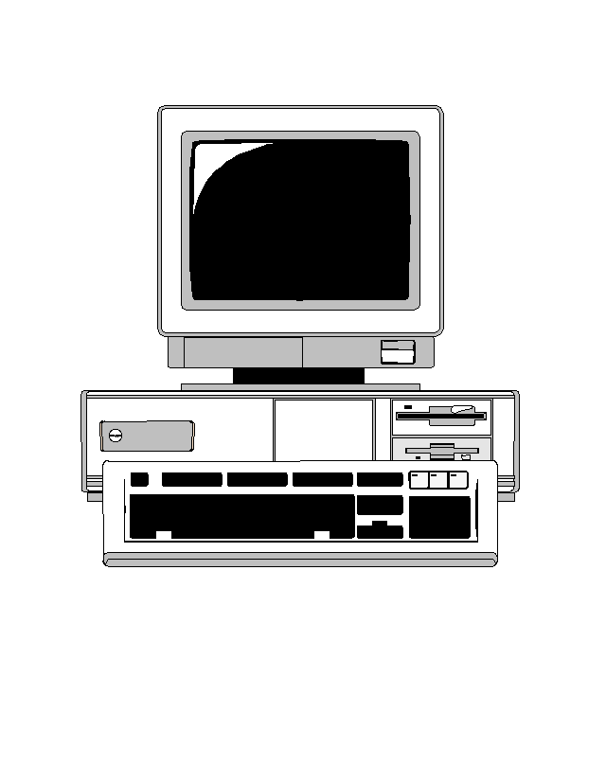

A Typical DMZ Organization
Your web server
The Internet
DMZ
Firewall set up to protect your web server
Firewall set up to protect your LAN
Your production LAN

Slide 6
Advantages of DMZ Approach
Can customize firewalls for different purposes
Can customize traffic analysis in different areas of network
Keeps inherently less safe traffic away from critical resources

Slide 7
Dangers of a DMZ
Things in the DMZ aren’t well protected
  If they’re compromised, provide a foothold into your network
One problem in DMZ might compromise all machines there
Vital that main network doesn’t treat machines in DMZ as trusted
Must avoid back doors from DMZ to network

Slide 8
Firewall Hardening
Devote a special machine only to firewall duties
Alter OS operations on that machine
  To allow only firewall activities
  And to close known vulnerabilities
Strictly limit access to the machine
  Both login and remote execution

Slide 9
Keep Your Firewall Current
New vulnerabilities are discovered all the time
Must update your firewall to fix them
Even more important, sometimes you have to open doors temporarily
  Make sure you shut them again later
Can automate some updates to firewalls
How about getting rid of old stuff?

Slide 10
Closing the Back Doors
Firewall security is based on assumption that all traffic goes through the firewall
So be careful with:
  Wireless connections
  Portable computers
  Sneakernet mechanisms and other entry points
Put a firewall at every entry point to your network
And make sure all your firewalls are up to date

Slide 11


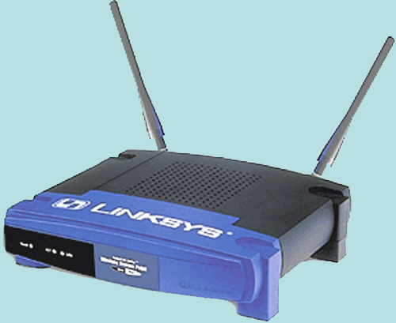

What About Portable Computers?
Bob
Alice
Carol
Xavier
Local Café

Slide 12
Now Bob Goes To Work . . .
Worker
Bob
Worker
Worker
Worker
Bob’s Office

Slide 13
How To Handle This Problem?
Essentially quarantine the portable computer until it’s safe
Don’t permit connection to wireless access point until you’re satisfied that the portable is safe
  Or put them in constrained network
Common in Cisco, Microsoft, and other companies’ products
  Network access control

Slide 14
Single Machine Firewalls
Instead of separate machine protecting network,
A machine puts software between the outside world and the rest of machine
Under its own control
To protect itself
Available on most modern systems

Slide 15
Pros of Individual Firewalls
Customized to particular machine
  Specific to local software and usage
Under machine owner’s control
Can use in-machine knowledge for its decisions
May be able to do deeper inspection
Provides defense in depth

Slide 16
Cons of Personal Firewalls
Only protects that machine
Less likely to be properly configured
  Since most users don’t understand security well
  And/or don’t view it as their job
  Probably set to the default
On the whole, generally viewed as valuable

Slide 17
Encryption and Network Security
Relies on the kinds of encryption algorithms and protocols discussed previously
Can be applied at different places in the network stack
With different effects and costs

Slide 18
Link Level Encryption
Source
Destination
plaintext
ciphertext
ciphertext
plaintext
ciphertext
ciphertext
ciphertext
plaintext
ciphertext
ciphertext
plaintext
ciphertext
plaintext
Let’s say we want to send a message using encryption
Different keys (maybe even different ciphers) used at each hop

Slide 19
End-to-End Encryption
Source
Destination
plaintext
plaintext
ciphertext
ciphertext
ciphertext
ciphertext
ciphertext
When would link encryption be better?
Cryptography only at the end points
Only the end points see the plaintext
Normal way network cryptography done

Slide 20
Where Are the Endpoints, Anyway?
If you do end-to-end encryption, where are the endpoints?
The network layer end points?
The transport layer end points?
The application layer end points?
Maybe not even end machine to end machine (e.g., VPNs)?
Has serious implications for where you do cryptography
  And keying and trust issues

Slide 21
IPsec
Standard for applying cryptography at the network layer of IP stack
Provides various options for encrypting and authenticating packets
  On end-to-end basis
  Without concern for transport layer (or higher)

Slide 22
What IPsec Covers
Message integrity
Message authentication
Message confidentiality

Slide 23
What Isn’t Covered
Non-repudiation
Digital signatures
Key distribution
Traffic analysis
Handling of security associations
Some of these covered in related standards

Slide 24
Some Important Terms for IPsec
Security Association - “A Security Association (SA) is a simplex ‘connection’ that affords security services to the traffic carried by it.”
  Basically, a secure one-way channel
SPI (Security Parameters Index) – Combined with destination IP address and IPsec protocol type, uniquely identifies an SA

Slide 25
General Structure of IPsec
Really designed for end-to-end encryption
  Though could do link level
Designed to operate with either IPv4 or IPv6
Meant to operate with a variety of different ciphers
And to be neutral to key distribution methods
Has sub-protocols
  E.g., Encapsulating Security Payload

Slide 26
Encapsulating Security
Payload (ESP) Protocol
Encrypt the data and place it within the ESP
The ESP has normal IP headers
Can be used to encrypt just the payload of the packet
Or the entire IP packet

Slide 27
ESP Modes
Transport mode
  Encrypt just the transport-level data in the original packet
  No IP headers encrypted
Tunnel mode
  Original IP datagram is encrypted and placed in ESP
  Unencrypted headers wrapped around ESP

Slide 28
ESP in Transport Mode
Extract the transport-layer frame
  E.g., TCP, UDP, etc.
Encapsulate it in an ESP
Encrypt it
The encrypted data is now the last payload of a cleartext IP datagram

Slide 29
ESP Transport Mode
Original
IP header
ESP
Hdr
Normal Packet
Payload
ESP
Trlr
ESP
Auth
Encrypted
Authenticated

Slide 30
Using ESP in Tunnel Mode
Encrypt the IP datagram
  The entire datagram
Encapsulate it in a cleartext IP datagram
Routers not understanding IPsec can still handle it
Receiver reverses the process

Slide 31
ESP Tunnel Mode
Original
Packet
Payload
New
IP hdr
ESP
Hdr
Orig.
IP hdr
ESP
Trlr
ESP
Auth
Encrypted
Authenticated

Slide 32
Uses and Implications of Tunnel Mode
Typically used when there are security gateways between sender and receiver
  And/or sender and receiver don’t speak IPsec
Outer header shows security gateway identities
  Not identities of real parties
Can thus be used to hide some traffic patterns

Slide 33
What IPsec Requires
Protocol standards
  To allow messages to move securely between nodes
Supporting mechanisms at hosts running IPsec
  E.g., a Security Association Database
Lots of plug-in stuff to do the cryptographic heavy lifting

Slide 34
The Protocol Components
Pretty simple
Necessary to interoperate with non-IPsec equipment
So everything important is inside an individual IP packet’s payload
No inter-message components to protocol
  Though some security modes enforce inter-message invariants

Slide 35
The Supporting Mechanisms
Methods of defining security associations
Databases for keeping track of what’s going on with other IPsec nodes
  To know what processing to apply to outgoing packets
  To know what processing to apply to incoming packets

Slide 36
Plug-In Mechanisms
Designed for high degree of generality
So easy to plug in:
  Different crypto algorithms
  Different hashing/signature schemes
  Different key management mechanisms

Slide 37
Status of IPsec
Accepted Internet standard
Widely implemented and used
  Supported in Windows 2000 and later
  In Linux 2.6 (and later) kernel
  Mac OS 10.6 and later
The architecture doesn’t require everyone to use it
RFC 3602 on using AES in IPsec still listed as “proposed”
AES will become default for ESP in IPsec

Slide 38
SSL and TLS
SSL – Secure Socket Layer
TLS – Transport Layer Security
The common standards for securing network applications in Internet
  E.g., web browsing
Essentially, standards to negotiate, set up, and apply crypto

Slide 39
The Basics of SSL
Usually a client/server operation
Client contacts server
A negotiation over authentication, key exchange, and cipher takes place
Authentication is performed and key agreed upon
Then all packets are encrypted with that key and cipher at application level

Slide 40
Common Use
Server authenticates to client using an X.509 certificate
  Typically, client not authenticated
    Though option allows it
Client provides material to server to derive session key
Client and server derive same session key, start sending encrypted packets

Slide 41
Crypto in TLS/SSL
Several options supported
RSA or elliptic curve for PK part
AES, DES, 3DES, or others for session cryptography
Not all are regarded as still secure
Chosen by negotiation between client and server

Slide 42
Use of SSL/TLS
The core crypto for web traffic
Commonly used for many other encrypted communications
Used in all major browsers
Usually not part of OS per se
  But all major OSes include libraries or packages that implement it

Slide 43
Security Status of SSL/TLS
Kind of complex
SSL is not very secure
Early versions of TLS not so secure
Later versions of TLS fairly secure
  Depending on cipher choice
Recent chosen-plaintext attacks shown to work on all versions
  In special circumstances

Slide 44
Virtual Private Networks
VPNs
What if your company has more than one office?
And they’re far apart?
  Like on opposite coasts of the US
How can you have secure cooperation between them?
Could use leased lines, but . . .

Slide 45
Encryption and Virtual
Private Networks
Use encryption to convert a shared line to a private line
Set up a firewall at each installation’s network
Set up shared encryption keys between the firewalls
Encrypt all traffic using those keys

Slide 46
Actual Use of Encryption in VPNs
VPNs run over the Internet
Internet routers can’t handle fully encrypted packets
Obviously, VPN packets aren’t entirely encrypted
They are encrypted in a tunnel mode
  Often using IPSec
Gives owners flexibility and control

Slide 47
Key Management and VPNs
All security of the VPN relies on key secrecy
How do you communicate the key?
  In early implementations, manually
  Modern VPNs use IKE or proprietary key servers
How often do you change the key?
  IKE allows frequent changes

Slide 48
VPNs and Firewalls
VPN encryption is typically done between firewall machines
  VPN often integrated into firewall product
Do I need the firewall for anything else?
Probably, since I still need to allow non-VPN traffic in and out
Need firewall “inside” VPN
  Since VPN traffic encrypted
  Including stuff like IP addresses and ports
  “Inside” means “later in same box” usually

Slide 49
VPNs and Portable Computing
Increasingly, workers connect to offices remotely
  While on travel
  Or when working from home
VPNs offer a secure solution
  Typically as software in the portable computer
Usually needs to be pre-configured

Slide 50
VPN Deployment Issues
Desirable not to have to pre-deploy VPN software
  Clients get access from any machine
Possible by using downloaded code
  Connect to server, download VPN applet, away you go
  Often done via web browser
  Leveraging existing SSL code
  Authentication via user ID/password
  Implies you trust the applet . . .
Issue of compromised user machine

Slide 51
Wireless Network Security
Wireless networks are “just like” other networks
Except . . .
  Almost always broadcast
  Generally short range
  Usually supporting mobility
  Often very open

Slide 52
Types of Wireless Networks
802.11 networks
  Variants on local area network technologies
Bluetooth networks
  Very short range
Cellular telephone networks
Line-of-sight networks
  Dedicated, for relatively long hauls
Satellite networks

Slide 53
The General Solution For Wireless Security
Wireless networks inherently less secure than wired ones
So we need to add extra security
How to do it?
Link encryption
  Encrypt traffic just as it crosses the wireless network
  Decrypt it before sending it along

Slide 54
Why Not End-to-End Encryption?
Some non-wireless destinations might not be prepared to perform crypto
  What if wireless user wants protection anyway?
Doesn’t help wireless access point provide exclusive access
  Any eavesdropper can use network

Slide 55
802.11 Security
Originally, 802.11 protocols didn’t include security
Once the need became clear, it was sort of too late
  Huge number of units in the field
  Couldn’t change the protocols
So, what to do?

Slide 56
WEP
First solution to the 802.11 security problem
Wired Equivalency Protocol
Intended to provide encryption in 802.11 networks
  Without changing the protocol
  So all existing hardware just worked
The backward compatibility worked
The security didn’t

Slide 57
What Did WEP Do?
Used stream cipher (RC4) for confidentiality
  With 104 bit keys
  Usually stored on the computer using the wireless network
  24 bit IV also used
Used checksum for integrity

Slide 58
What Was the Problem With WEP?
Access point generates session key from its own permanent key plus IV
  Making replays and key deduction attacks a problem
IV was intended to prevent that
But it was too short and used improperly
In 2001, WEP cracking method shown
  Took less than 1 minute to get key

Slide 59
WPA and WPA2
Generates new key for each session
Can use either TKIP or AES mode
Various vulnerabilities in TKIP mode
AES mode hasn’t been cracked yet
  May be available for some WPA
  Definitely in WPA2

Slide 60
Honeypots and Honeynets
A honeypot is a machine set up to attract attackers
Classic use is to learn more about attackers
Ongoing research on using honeypots as part of a system’s defenses

Slide 61
Setting Up A Honeypot
Usually a machine dedicated to this purpose
Probably easier to find and compromise than your real machines
But has lots of software watching what’s happening on it
Providing early warning of attacks

Slide 62
What Have Honeypots Been Used For?
To study attackers’ common practices
There are lengthy traces of what attackers do when they compromise a honeypot machine
Not clear these traces actually provided much we didn’t already know

Slide 63
Honeynets
A collection of honeypots on a single network
  Maybe on a single machine with multiple addresses
  More often using virtualization
Typically, no other machines are on the network
Since whole network is phony, all incoming traffic is probably attack traffic

Slide 64
What Can You Do With Honeynets?
Similar things to honeypots
  But at the network level
Also good for tracking the spread of worms
  Worm code typically visits them repeatedly
Main tool for detecting and analyzing botnets
Gives evidence of DDoS attacks
  Through backscatter
  Based on attacker using IP spoofing

Slide 65
Honeynets and Botnets
Honeynets widely used by security researchers to “capture” bots
Honeynet is reachable from Internet
Intentionally weakly defended
Bots tend to compromise them
Researcher gets a copy of the bot

Slide 66
Issues With Honeynet Research
Don’t want captured bot infecting others
  Or performing other attack activities
So you need to prevent it from attacking out
But you also need to see its control traffic

Slide 67
What To Do With a Bot?
When the bot is captured, what do you do with it?
Typically, analyze it
  Especially for new types of bots
  To find weaknesses
  And to track rest of botnet
Analysis helpful for tracing “ancestry”

Slide 68
Do You Need A Honeypot?
Not in the same way you need a firewall
Only useful if your security administrator spending a lot of time watching things
  E.g., very large enterprises
Or if your job is observing hacker activity
Something that someone needs to be doing
  Particularly, security experts watching the overall state of the network world
  But not necessarily you

