Slide 1
Network Layering, Naming, and Name Resolution
CS 118
Computer Network Fundamentals
Peter Reiher

Slide 2
Outline
Naming within layers
Name space issues
Resolving names

Slide 3
What do names mean?
Names are just labels
  Until told otherwise, they mean nothing
  Unique within a layer: the only thing you know
They can they mean more
  Layer
  Physical location
  Network location

Slide 4
Impact of multiple layers
Multiple name spaces
Multiple names for the same party
Names for parties, names for relays
The need for translation

Slide 5


Multiple name spaces
Names are unique to a layer
  May or may not be unique for all layers
Name in one layer != name in other
  One party might have multiple names
    For each layer in which it participates
    For each party it emulates
  Or no name at all
    Without a name, what happens?
    Can it participate? How?

Slide 6
Translation
Mapping between names (labels)
  DNS: lever.cs.ucla.edu -> 131.179.128.30
  Reverse DNS: 131.179.128.30 -> lever.cs.ucla.edu
  Google: Peter Reiher-> http://fmg-www.cs.ucla.edu/reiher/

Slide 7
Layering requires translation
Change of layer = change of name
Each layer has its own namespace
Need to find translation:
  Equivalent of a local name in new namespace

Slide 8



Example: my PC to your MAC

Slide 9




Example: my PC to your MAC
Labels in the common layer
  My PC = banana
  Your MAC = apple
Labels when we’re on the same lower layer:
  My PC = silver
  Your MAC = copper

Slide 10
Getting there…
I send a message to you:
  I send a message from banana to apple
Translate to lower layer
  Source: banana to silver
  Destination: apple to copper
Relay at lower layer
  Message goes from silver to copper
Translate back
  Message at copper (you) is re-addressed from banana to apple

Slide 11
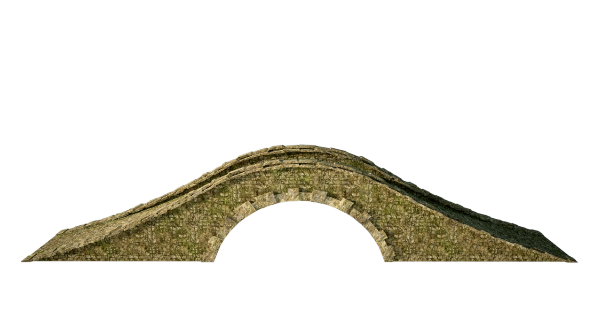
Layering
Nodes have names at multiple layers
  Endpoint names in the common, higher layer
  Local names in individual lower layers
A
T
K
P
B
7
Σ
1
9
r
s
Δ

Slide 12
Result
Layering requires resolution
  Can’t get between different layers otherwise
  Can’t get across different layers otherwise
Resolution is more than just another name
  Enables aliasing, proxying

Slide 13
Name Space Issues
Semantics
Human factors (ease of use)
Management

Slide 14
Name semantics
Location
  Physical
  Logical
Route
  Sequence of waypoints (intermediate nodes)
Ownership
  Who delegated it
  Who owns it now

Slide 15
Naming human factors
Express
Remember
Guess

Slide 16
Expressing names
Character set
  IPv4 – Decimal
  IPv6, Ethernet – Hexadecimal
  Old DNS – a-z, 0-9, “-” but can’t start/end with “-”
  New DNS – encodes other characters as “old DNS” strings
Grouping
  128.9.160.161 (4 groups of 8b)
  2001:0:9d38:6ab8:0:0:0:6b35 (8 groups of 16b)
Shorthand
  2001:0:9d38:6ab8:0:0:0:6b35 =
  2001:0:9d38:6ab8::6b35

Slide 17
Remembering names
DNS’s original purpose
  Text shorthand is easier than writing numbers
lever.cs.ucla.edu vs. 131.179.128.30

Slide 18
Guessing names
DNS’s evolved purpose
Apple.com
  Apple records (Paul McCartney)
  Apple computers (Steve Jobs)
  US copyright has multiple categories
    Literary works, dramatic works, musical works, pantomime and choreography, motion picture works, etc.
  .com is one category
Should we be able to “guess” a DNS name?

Slide 19
Naming management
Assignment
Dynamics
Indirection
Implementation

Slide 20
Name assignment
Authoritative
  Externally assigned
Local
  Self-assigned
  Might collide (how do we fix this?)

Slide 21
Name dynamics
Add names
Remove names
Change names

Slide 22

Adding names
Not just “collision avoidance”
  US street numbers
    Odd/even per side
    In order along a street
    Can’t just choose any unused house number
  Between 33 and 35?
  33 ½ !

Slide 23


Removing names
Easy to stop using, but:
  Who to inform?
  When to inform?
  What to do with “in transit”?

Slide 24

Changing names
Combines add and remove, with a twist
  Avoid collision
  Inform of change?
  Forward in-transit?

Slide 25
Benefits of indirection
Self-management
  I can assign lever.cs.ucla.edu’s IP address automatically, or it can discover one for itself.
Mobility
  I can move lever.cs.ucla.edu to another IP address without needing to tell you at all.
Overloading
  Aliases and proxies

Slide 26
Name overloading
Aliases
  Multiple names for one party
Proxies
  One name for multiple parties

Slide 27
Uses of aliases
Support internetworking
  The bridge has at least three names:
    Name in the upper, common layer
    Name in the egress layer (the one you’re leaving)
    Name in the ingress layer (the one you’re entering)
Emulation
  When a node acts as if it were more than one node

Slide 28
Uses of proxies
Load distribution
  www.google.com ➔ many IP addresses
Localization
  www.netflix.com ➔ “nearby” IP address
Fault tolerance
  Backup time servers

Slide 29
Implementation issues
Name management (support naming itself)
  Cost to add
  Cost to delete
  Cost to index (lookup)
  Locking (for consistency, if distributed)
Same as any a large, distributed database
  Caching, hierarchies, etc.
  Structure in the names can help us

Slide 30

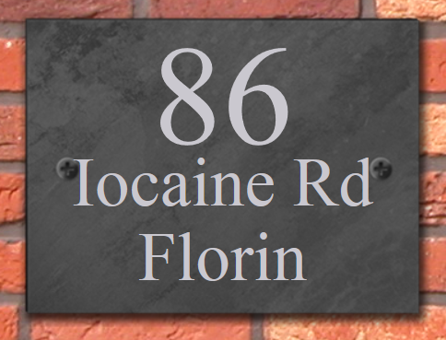
Terminology
Resolution
  Translating a name in one context
  into a name in a different context

Slide 31
Resolution mapping
Name(type1) ➔ name(type2)
Aliases
  Types can be same: Joe ➔ Joseph
Address resolution
  Name translated to an address
  An address is just a name used for relaying
Either direction
  Upper layer to lower layer for relaying
  Lower layer to upper layer for upper-layer name ops

Slide 32
Resolution mechanisms
Fixed
Local
Central
Distributed

Slide 33
Fixed
Link broadcast
  255.255.255.255 (IPv4)
  FF:FF:FF:FF:FF:FF (Ethernet)
Specific groups
  All nodes, all routers, all DHCP servers (IPv6)
Me [loopback]
  127.0.0.1 – 127.0.0.255 (IPv4)
  ::1 (IPv6)

Slide 34
Fixed pros and cons
Pros
  Always works
Cons
  Useful only for a very small set of names
  No support for operations (add/delete/change)

Slide 35
Local
Filename internal to the machine
  Hosts.txt
    DNS names to IP addresses
    myname.here ➔ 10.0.0.2
  Services.txt
    Service names to registered port numbers
    HTTP ➔80
    SMTP ➔25

Slide 36
Local pros and cons
Pros
  Easy to implement
  Cheap to resolve
Cons
  Hard to manage
  Doesn’t scale
  Difficult to keep consistent across endpoints
  Inefficient operations (add/delete/rename)

Slide 37

Central
A single server at a known address
  Server can be implemented various ways
  ATM LAN emulation (LANE)
  Napster (originally)
  NOTE: emulates broadcast queries

Slide 38
Central pros and cons
Pros
  Easy to coordinate
  Easy to deploy
  Can be fairly efficient (e.g., use a real DB engine)
  Scales bigger than you think (Napster)
Cons
  Doesn’t scale, eventually
  Not fault tolerant
  (but you mitigate this with a “hot spare”)

Slide 39
Distributed
In-band
Out-of-band

Slide 40
In-band
RPC, TCPMUX use
  Open a connection
    To the TCPMUX service (port 1)
    To the RPC portmap/rpcbind (port 111)
  Indicate the service you want by name
    Get transferred to that service (TCPMUX)
    Get told what port to use instead
Registration
  RPC programs register with portmap
  TCPMUX uses services.txt

Slide 41
In-band pros and cons
Pros
  Easy to deploy independently
  Can be very lightweight
Cons
  Replication of effort (no shared effort)
  Difficult to scale

Slide 42
Out-of-band
Hierarchical
  Using structure in the name space
  Matching that to distributed system structure
  Structure limits where you need to look
Search
  Look around in “plausible” places
Broadcast
  Flood (look everywhere)

Slide 43
Hierarchical
Ordered
  Specific name structure
Follow through the hierarchy to resolve the name

Slide 44
DNS
Hierarchical names
  Right to left
  Starts with “.ROOT” (implicit)
Two mechanisms:
  Iterative
  Recursive

Slide 45
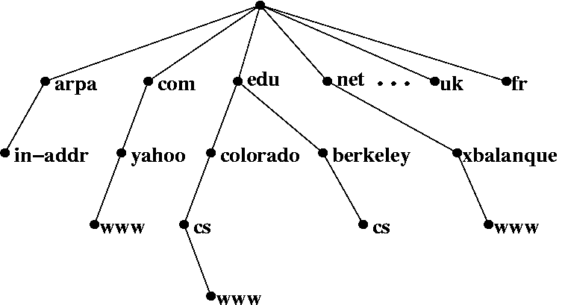
DNS Hierarchy
Tree of strings

Slide 46
Roots
Need to start somewhere
  As with any naming, need to KNOW something first
  13 DNS root servers
Most clients don’t start at the root
  They ask a server (pre-configured)
  The servers then start at the root (if needed)

Slide 47
Iterative vs. recursive
Start at the root (in either case)
In iterative, querier asks DNS servers in turn for help
In recursive, querier asks root server
  Which recursively asks the other servers
If querier knows intermediate point, start there
  Rather than from the root

Slide 48
Iterative DNS
. (ROOT)
.edu = X
.com = Y
.de = Z
.edu
usc.edu = P
ucla.edu = Q
ucla.edu
ee.ucla.edu = J
cs.ucla.edu = K
cs.ucla.edu
lever.cs.ucla.edu = R
www.cs.ucla.edu = S
www.cs.ucla.edu
Web Server

Slide 49
Iterative DNS
. (ROOT)
.edu = X
.com = Y
.de = Z
.edu
usc.edu = P
ucla.edu = Q
ucla.edu
ee.ucla.edu = J
cs.ucla.edu = K
I know where .edu is!
cs.ucla.edu
lever.cs.ucla.edu = R
www.cs.ucla.edu = S
www.cs.ucla.edu
Web Server

Slide 50
Iterative DNS
. (ROOT)
.edu = X
.com = Y
.de = Z
.edu
usc.edu = P
ucla.edu = Q
ucla.edu
ee.ucla.edu = J
cs.ucla.edu = K
AND I know where ucla.edu is!
cs.ucla.edu
lever.cs.ucla.edu = R
www.cs.ucla.edu = S
www.cs.ucla.edu
Web Server

Slide 51
Iterative DNS
. (ROOT)
.edu = X
.com = Y
.de = Z
.edu
usc.edu = P
ucla.edu = Q
ucla.edu
ee.ucla.edu = J
cs.ucla.edu = K
I even know where cs.ucla.edu is!
cs.ucla.edu
lever.cs.ucla.edu = R
www.cs.ucla.edu = S
www.cs.ucla.edu
Web Server

Slide 52
Iterative DNS
. (ROOT)
.edu = X
.com = Y
.de = Z
.edu
usc.edu = P
ucla.edu = Q
ucla.edu
ee.ucla.edu = J
cs.ucla.edu = K
Actually, I know where www.cs.ucla.edu is!
cs.ucla.edu
lever.cs.ucla.edu = R
www.cs.ucla.edu = S
www.cs.ucla.edu
Web Server

Slide 53
Iterative DNS
. (ROOT)
.edu = X
.com = Y
.de = Z
.edu
usc.edu = P
ucla.edu = Q
ucla.edu
ee.ucla.edu = J
cs.ucla.edu = K
cs.ucla.edu
lever.cs.ucla.edu = R
www.cs.ucla.edu = S
www.cs.ucla.edu
Web Server

Slide 54
Recursive DNS
. (ROOT)
.edu = X
.com = Y
.de = Z
.edu
usc.edu = P
ucla.edu = Q
ucla.edu
ee.ucla.edu = J
cs.ucla.edu = K
cs.ucla.edu
lever.cs.ucla.edu = R
www.cs.ucla.edu = S
www.cs.ucla.edu
Web Server

Slide 55
Iterative vs. recursive
Iterative
  Pros
    Client retains control
    Responses can be client-customized
    Local caching
  Cons
    Many packets
    Long delays
Recursive
  Pros
    More efficient
    Faster
    Aggregate caching
  Cons
    Client hands over control
    Responses can’t be customized

Slide 56
Other DNS uses
Load distribution
  One name ➔ many addresses
  Respond with entire list, rotated “round robin”
  NB: not load BALANCING; no feedback used
Localization
  Infer topological/geographic location
  Use location to prioritize or mask responses
Fault tolerance
  List of backups/alternates

Slide 57
DNS pros and cons
Pros
  Local control over subsets of the name space
  Similar names end up in one place
Cons
  Need to start at root creates a vulnerability
  Depends on servers in many places
  (no fate sharing)
  Caching and replication consistency issues
  Similar names end up in one place

Slide 58
Search Approaches
Unstructured
  Ask neighbors or anyone else who might know
  Some peer file sharing services used this
Structured
  Use information about query to start search in a good spot
  Someone who has the translation
  Or knows who will
  Distributed hash tables, e.g.

Slide 59

Broadcast
Undirected message
Flooded to all
  Or a preconfigured set,
  e.g., “all routers”
The ultimate in unstructured search

Slide 60
ARP
128.9.160.161 ➔128.9.160.7
  .161 shouts “WHO HAS 128.9.160.7?”
  .7 responds “.7 is 0F:EE:…”
128.9.160.161 ➔201.35.6.2
  .161 shouts “WHO HAS 201.35.6.2?”
  .7 responds “.7 is 0F:EE:…”
  .7 lies

Slide 61
Broadcast pros and cons
Pros
  Easy to configure
  Fault tolerant (reaches everyone)
Cons
  Doesn’t scale
  Can cause high load (“chatter”)

Slide 62
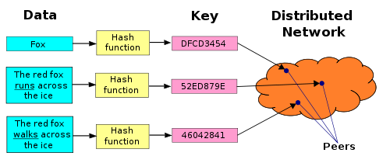
Distributed Hash Table (DHT)
Structured search
Using a hierarchy (like the DNS)
  Scrambled using a hash

Slide 63
DHT variants
Many variants
  Different structure to name space and thus server interconnections
  Some are “regular” (ring, hypercube), others are varieties of trees
  Most include replication and fault-tolerance
Widely used
  Bittorrent file sharing
  Freenet anonymous networking

Slide 64
DHT pros and cons
Pros
  Fault tolerant
  Scalable
  Load distributing
  Hash avoids locality of similar names
Cons
  Complexity
  Hash avoids locality of similar names
There are locality-preserving hashes, but that somewhat defeats the point of a DHT)

Slide 65
Caching
Many name translation operations are expensive
So avoid duplication of them
Exploit “locality of reference”
  Endpoint repeating its own requests
  Endpoints repeating each others’ requests
Keep a copy
  At the original endpoint
  At any relay

Slide 66
Where is caching used?
In the endpoint
  ARP, i.e., IP->ethernet
  Web responses
At a server, to aggregate requests
  DNS server (home router, on a LAN)
  Web proxy cache (home router sometimes)
At the edge of an enterprise (organization)
  DNS

Slide 67
Cache timeouts and performance
Timeout issues
  How long to keep a copy
  What to do when the copy expires?
    Ask for another one (proactive)?
    Just delete the stale entry (reactive)?
Performance
  Longer can reduce load, improve response
  Too long will ignore changes (delete/rename)

Slide 68
Cache invalidation
Various events cause an entry to expire
  Timeout
    Time since info was first retrieved (DNS)
    Time since last request (ARP)
  Conflicting information
    If requests are broadcast, responses can too
    Check to see if responses match (ARP)

Slide 69
Summary
Different names may exist for the same thing at different layers
Names often need to be resolved from one form to another
Resolution requires some ability to get hold of translation information
  Which can be done in many ways
Caching is useful to achieve good name resolution performance

