Slide 1
Network Layering
CS 118
Computer Network Fundamentals
Peter Reiher

Slide 2
Outline
What is a layer?
Goals of layering
Internet and the One Ring

Slide 3
What is a layer?
A layer is:
  The largest set of parties (nodes) that can communicate
  Using a single protocol
  And a single name space
  A kind of a “zone”
I.e., the transitive closure
of a set of nodes
via relayed communication

Slide 4
Limits of a single layer
Homogeneity
Complexity

Slide 5

Homogeneity 1
No environment / context optimizations
  Prevents customization, e.g., for wireless, satellite, low-power, lightweight devices, etc.
Difficult to pick
  Hard to pick one everyone will agree on

Slide 6

Homogeneity 2
Locked-in once deployed
  No incremental evolution
Needs a “flag day” to change
  First major change to Multics: June 14, 1966
  Internet shift from NCP to TCP: Jan. 3, 1983

Slide 7
Complexity
One large, flat layer
  Difficult to manage
  Difficult to route (determine paths)
  Difficult to coordinate resources
And its one, large name space
  See above…
Groups of layers can be easier…

Slide 8
Reasons to have multiple layers
Abstraction
Emulation
Containment
Scale

Slide 9
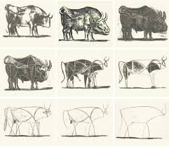
Abstraction
Model
  Simplification
  Extract key features
  See: Picasso ->

Slide 10
Abstraction and Layering
Present a simpler system
  Topology
  Protocol
  Behavior
Other simplifications
  Node subset
  Smaller distance

Slide 11
IEEE 802
Base layer
(802.2 LLC:
Logical Link Layer)
  Addressing
  Frame format
  Error detection
  Upper-layer interface (API)
Lower layer
  Bridging (802.1), i.e., switch control and configuration
Upper layers
  Ethernet (802.3)
  Token bus (802.4)
  Token ring (802.5)
  Wireless (802.11)
  Personal (802.15)
  Emergency (802.23)

Slide 12


Emulation
Abstraction to copy behavior
  Replicate capabilities of another system
  By limiting, composing, or modifying an existing system
Change existing system to another one by adding layers

Slide 13
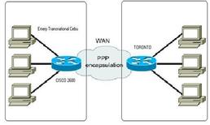
Emulation and Layering
PPP
  Point-to-point protocol
  Emulate a physical wire over a dialup modem
PPPoE
  Ethernet
PPPoA
  ATM

Slide 14
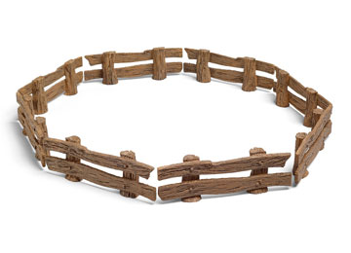
Containment
Enforce boundaries
  Protect interior
    Ensure a stable locale
    Enforce limited function
  Protect exterior
    Deploy new features
    Support local capability

Slide 15
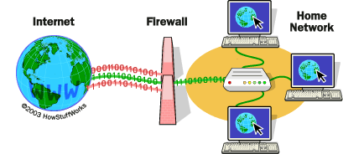
Containment and Layering
Hide / protect a network from the world
Hide / protect the world from an experiment

Slide 16
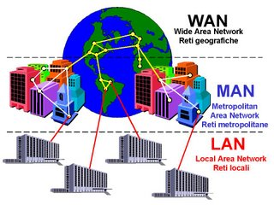
Scale
Limit complexity
  Hard to route everywhere, so maybe route via a tree?
Overcome physical limits
  Sharing can be very useful, but may require a very different protocol for relaying

Slide 17


Scale and Layering
Tree routing
  Know your descendants
  Route down for known, up for unknown
  Relies on varying detail at different layers
    Label groups
Cloud routing
  Traverse the clouds without knowing what happens inside
  Inside the cloud, it’s the cloud’s problem

Slide 18
Connections and layering
Dovetailed
  Edge connected
  Peer translators
  Both transit or terminus
Stacked
  Top-to-bottom connected
  Treat lower layers as encapsulation transit
  Never as terminus

Slide 19

Translation gateways
G
Gateway converts
  Bidirectional translation
  Complex internal state
Two views
  Presents two views
  Proxies in both directions

Slide 20
Benefits of adapters
Allow local optimization
Allow partial (subset) upgrades

Slide 21
Issues with adapters
The telephone game
Semantic gaps
Gateway state
Scale vs. number of “languages”

Slide 22
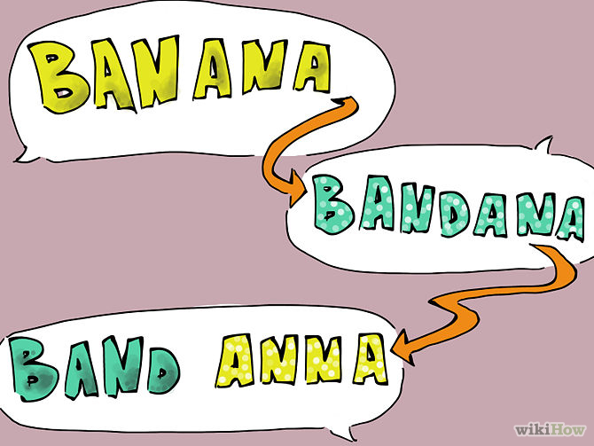
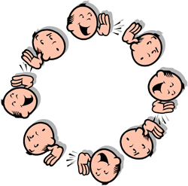
Lost in translation
Protocols have idioms
  Behaviors are “native” to a protocol
Sequences of translations lose info
  Telephone game

Slide 23

Semantic gaps
No protocol is “complete”
  Turing machine has “completeness”
  But protocols built on finite state machines
  FSM is a limited TM
Some things don’t translate
  “Ballpark”, “drop a dime”

Slide 24
State problems
Size
  Physical limits constrain state
  State can explode
    Combined FSMs = product of states
Reliability
  Gateway failure = lost state
  Lost state affects protocols on both sides
Path correlation
  End-to-end exchanges need to go through the same gateway for their entire interaction
  OR state needs to be shared among multiple gateways

Slide 25

Mutual modeling
My world
  Has a proxy for you
  Ends at that proxy
Your world
  Has a proxy for me
  Ends at that proxy
Sort of independent but not really
  We both think our worlds are contained
  But my proxy and your proxy are coupled

Slide 26
Scale of translation
More languages = more translators
  Each new language has cost proportional to the number of languages currently in use
  Gets worse as languages are added
Who adds the translator?
  Team effort – both new and old parties
  Need someone “fluent” in both

Slide 27
Stacked layers
The alternative to edge layers
Put one layer on top of another
Each layer has its own responsibilities
  Need not worry about things higher layers handle
  And higher layers assume lower layer has taken care of certain things
Layers can be customized to circumstances
  Wireless vs. wired links, e.g.

Slide 28

Stacked layers
Each layer sits on a lower layer
Each layer “depends” on the lower layer
  But not directly on the layers below that
We might have “icing” connecting the layers
  To “hold them together”
A network isn’t a cake, but it’s a little less different than you might think

Slide 29

Internet model
Internet
Net B
Net C
Net A
But how do these different nets work together?
One layer to rule them all!

Slide 30
IP Layer
The common layer for the Internet
Packets
  Variable length
  Includes source and destination addresses
Global addresses
  Two-level hierarchy
    High bits = assigned by central authority
    Low bits = locally assigned
Best-effort communication
  Allows for loss, reordering
  Enables simple forwarding, use smart ends to repair

Slide 31
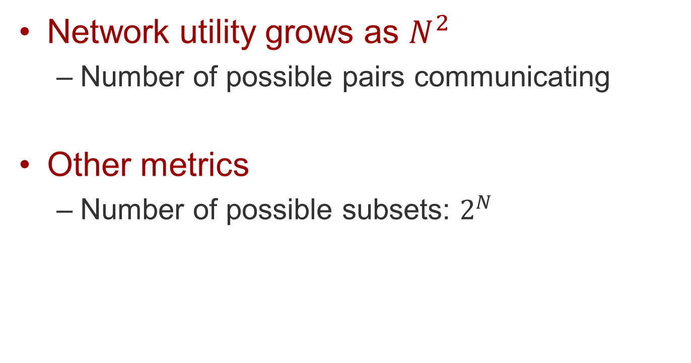
Metcalfe’s Law
Network utility grows as $N^{2}$
  Number of possible pairs communicating
Other metrics
  Number of possible subsets: $2^{N}$
If this is right, key to maximizing network utility is maximizing N

Slide 32
Internet principle
Talking to everyone poorly is more important than talking to anyone well
  Prefer capability over efficiency
  Prefer capability over performance
  Prefer capability over security
  Prefer capability over anything else!
Capability is everything

Slide 33
Benefits of a common layer
All the benefits of dovetailing
  Abstraction
  Emulation
  Containment
  Scale
Common expectations
  Encourages internetwork communication that avoids idioms, or uses them very carefully
Stacking supports recursion
  Can be applied in various places, repeatedly
  AND multiple versions don’t interact

Slide 34

The Hourglass Principle

Slide 35
The Narrow Waist
HTTP DNS FTP NFS IM
λPPM λCDMA eNRZ ePCM
IP

Slide 36
How may waists?
IP
  The one ring…
802.*
  The lowest layer above hardware, for many
HTTP/HTTPS
  A user layer that works everywhere
  Even where others are blocked

Slide 37
Issues with a common layer
Lowered expectations
  Avoiding idioms may be less efficient
  Least common denominator may be weak
Cost
  Everyone translates, sometimes even when not necessary
  Common language is native to no one
    Like Esperanto

Slide 38
Why has stacked layering won?
Benefits outweigh costs
  There were critics as recently as 1990s, e.g., that IP was not fast enough for network disks
Parallels lingua franca experience
  Removes “home field advantage”
Nobody “spoke” their “native languages” all that well, anyway
  The lingua franca of networking developed as networking itself developed

Slide 39
How layers are used
More about dovetailing (peer layers)
More about stacked layers

Slide 40


Dovetailed (peer) layers
G
Net A
Net B

Slide 41
Translation
G
Net A
Net B

Slide 42

Peer – what is translated?
Everything:
Message contents
Addresses

Slide 43
Stacked layers
Internet
Net B
Net C
Net A
Remember, we’re thinking layers, not physical connections here

Slide 44

Stacked layers
Where does communication go?
Between the subnets?
Or through the common layer?
Internet
Net B
Net C
Net A

Slide 45
Subnet to subnet
Common interchange
  Translate to common
  Relay common
  Translate back

Slide 46
Subnet to subnet
Pros:
  Reduces number of translators
    Compared to direct translation
  Sub-layers can be tuned to native contexts
Cons:
  Twice translated
  Like two-step dovetailing

Slide 47
Staying in the waist
Common as primary
  Use sub-layers as a transit

Slide 48
Staying in the waist
Pros:
  Sub-layers for local environments, local relaying
  Translate just the name
  Use sub-layer as a transit communications service
Cons:
  Enables communication only at the common layer

Slide 49
Conclusion: stacking as transit wins
Avoids translation
  Except for the names
  And content, as necessary, at the endpoints
Supports localization
  Using subnets as transits

Slide 50
A layer vs. layering
A layer (one layer)
  A homogeneous network
  Largest group that can communicate via transitive closure with one protocol and one name space
  Largest network with one protocol and one namespace
Layering (stacked transit using multiple layers)
  Creating a homogeneous network from a set of heterogeneous networks

Slide 51
Stacking via transit
Transiting other layers
  A layer as unifying different networks
    The basic definition
Translating capabilities
  A layer as an adapter between networks
    Takes one capability and turns it into another

Slide 52
Services provided by a layer
Communication
  Shared state coordination
Any computable function
  High-level capabilities built from shared state
  Typically that assist communication itself

Slide 53
Useful functions
Emulation
  Act like a single physical link
Splitting
  Large messages over smaller ones
Joining
  Pack many small messages in one larger one
Correction
  Repair the impact of loss, error, reordering

Slide 54
What defines a layer?
WHO can communicate
  Largest group using a single set of rules
HOW they use communication
  Services that users can apply to problems
  2-party? Multiparty?
  Reliable? Ordered? Like a wire or like packages?
HOW they interact with heterogeneous nets
  The kinds of other networks that a layer can “group”

Slide 55
Layers as building blocks
Capabilities it provides
Expectations it assumes

Slide 56
Layer expectations
A layer is a common language
  But only for nets it can translate to
Requirements:
  Name translation
    Identify party’s local name, given common one
  Capability translation
    Use the lower net as a communications link

Slide 57
Layer capabilities
A layer provides a common language
  A common interface
  A common set of services
  With which users can apply
Expectations:
  Name
    Users must identify party’s common name
  Capability
    Users must be able to use the services provided

Slide 58

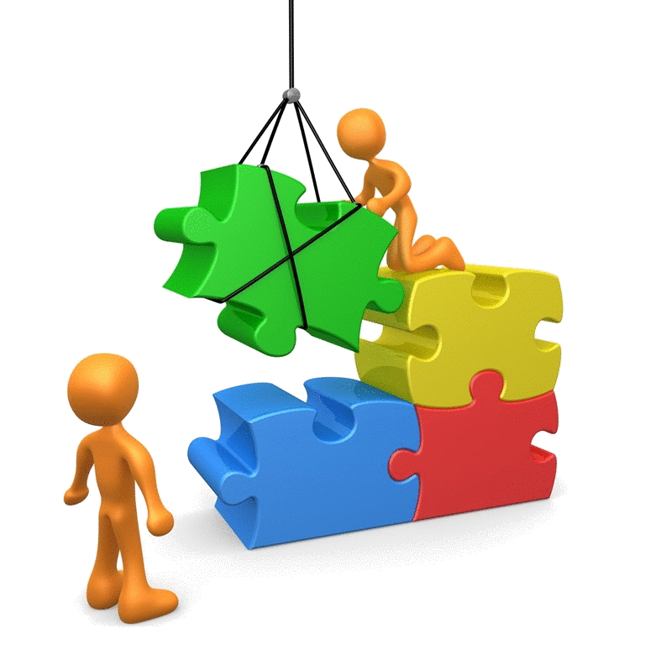
Things you can do with layers
Unify heterogeneous networks
  As we’ve seen
  Bridge communications between other layers
Create new services
  Does not have to join heterogeneous nets
  Can bridge capabilities between other layers

Slide 59
Glue layers
Adapt capabilities
  Lossy -> reliable
  Reordered -> ordered
  Jittery -> periodic
  Stream -> message
  Message -> stream
  Multiple stream -> 1
  1 stream -> multiple

Slide 60
How layers interact
Common (upper) layer
  Translates its (common) names to that of the lower layer
  Creates its own (common) services from those provided by the lower
Various (lower) layers
  Expect upper layer to use its names
  Expect upper layer to use its services
  Provides some set of communications capabilities within its network

Slide 61
Things that make you go hmm…
Upper layer also
  Expects its names
  Provides its services
Lower layer also
  Translates its names
  Creates its services

Slide 62
What’s the difference?
Common layer
Each heterogeneous layer

Slide 63

So what really defines a layer?
Largest set that can communicate with:
  Single name space
  Single protocol
A network with:
  Common expectations
  Common capabilities
Every layer is
its own “one ring”

Slide 64
Examples of layers
“Lowest” (touch the physical layer)
  Ethernet, ATM
Above Ethernet
  IP, ARP, PPPoE
Above IP
  TCP, UDP, ICMP
Above TCP
  HTTP, SMTP, IMAP, DNS, NFS, NTP

Slide 65
Different expectations and capabilities
HTTP
  Provides request/response messaging
  Expects reliable, ordered stream of bytes
TCP
  Provides reliable, ordered stream of bytes
  Expects messaging
    Delivered within 2 minutes if delivered
    If lost, because of congestion (competition)
    Mostly without errors
Ethernet
  Provides messaging without errors (can be lost)
  Expects a shared wire (originally)

Slide 66
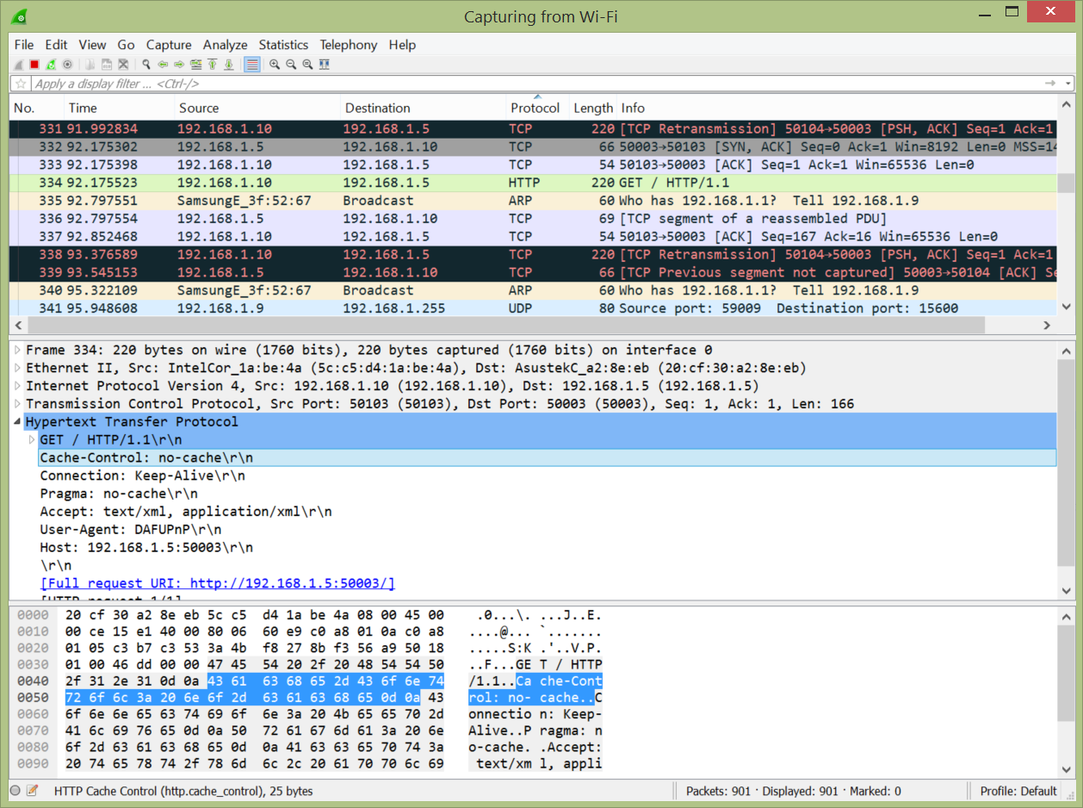
Messages inside messages
Frame
  Ethernet
    IP
      TCP
        HTTP

Slide 67
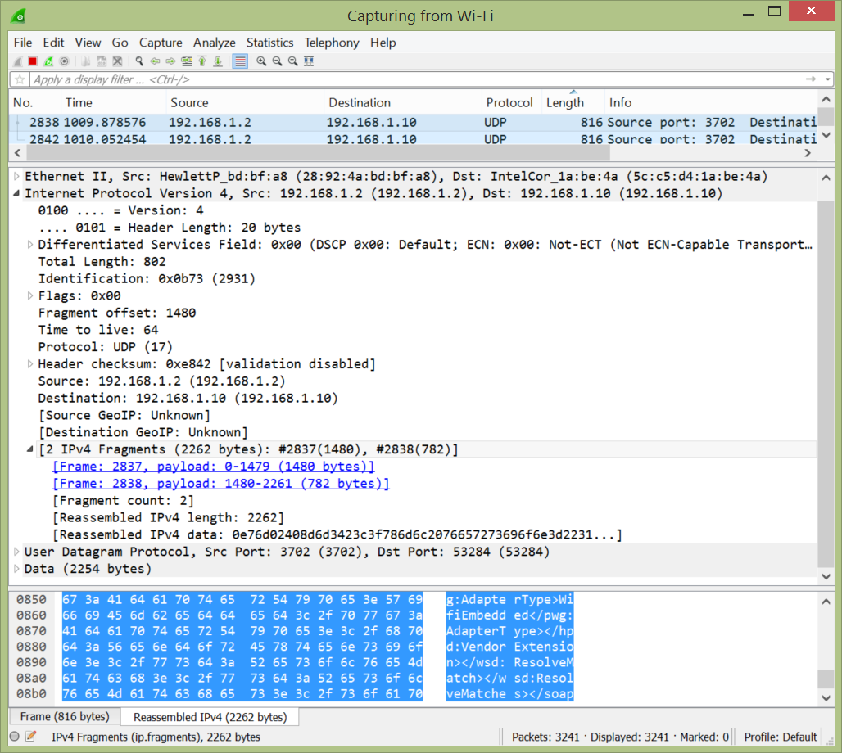
Messages spread across messages
IP datagram =
  IP fragment 1
  IP fragment 2

Slide 68
Summary
Layering allows us to create powerful networks from components
Stacking layers for transit
  Transit is the win for heterogeneity
Layers have requirements
  What they expect
Layers create capabilities
  What they provide

