Slide 1
Network Topologies
CS 118
Computer Network Fundamentals
Peter Reiher

Slide 2
Outline
What is network topology?
Types of network topologies
Issues in relaying messages

Slide 3
Network Topologies
So you’ve got a bunch of nodes
And you can connect the nodes with channels
So you can communicate to everyone with fewer total channels
  And avoid limitations of broadcast media
Which nodes do you connect?
That’s the question of network topology

Slide 4
Parties and nodes
Shannon talked about parties
  Entities that wished to communicate
  Generally a sender and receiver
  Very general
    Machines, people, whatever
In networking, we usually talk about nodes
  Physical machines used to move information
We’ll be changing to talk primarily about nodes

Slide 5
Channels and Links
Shannon talked about channels
  Logical connections between two parties
Physical networks tend to talk about links, instead
  A physical connection between two nodes
We’ll be changing to talk primarily about links
In network topologies, links connect nodes

Slide 6
Some simple topologies
Ring
Hub and spoke
Regular mesh
Manhattan network
Torus
Hypercube

Slide 7
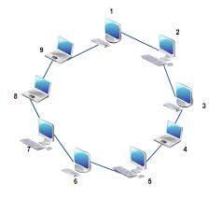
Ring
Connected in a circle
  N links
  Can tolerate 1 link or node failure
  Links can be simplex
  (one direction)
Managing failures
  “Pass through” on node failure
  Dual-ring (duplex)
  allowing ends to “heal”

Slide 8
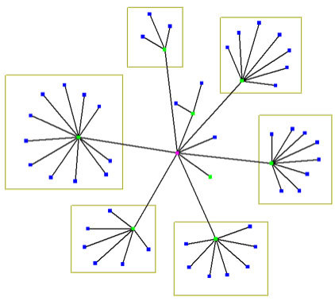
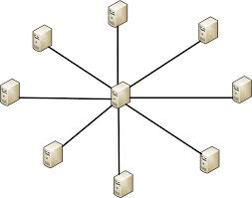
Hub and spoke
Node as a switch
  One or multiple levels
Failure of the hub disconnects entire network

Slide 9


Regular mesh
Any pattern
  Nodes where lines meet
Depending on pattern, tolerates multiple failures

Slide 10
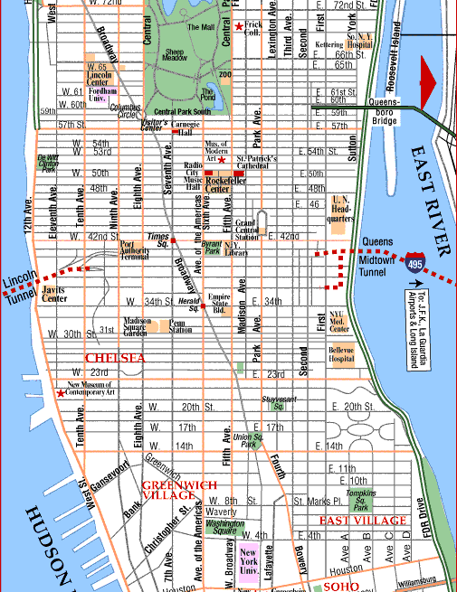
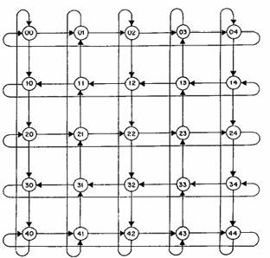
Manhattan network
Grid of squares
  Tend to wrap ends around (2D torus)

Slide 11
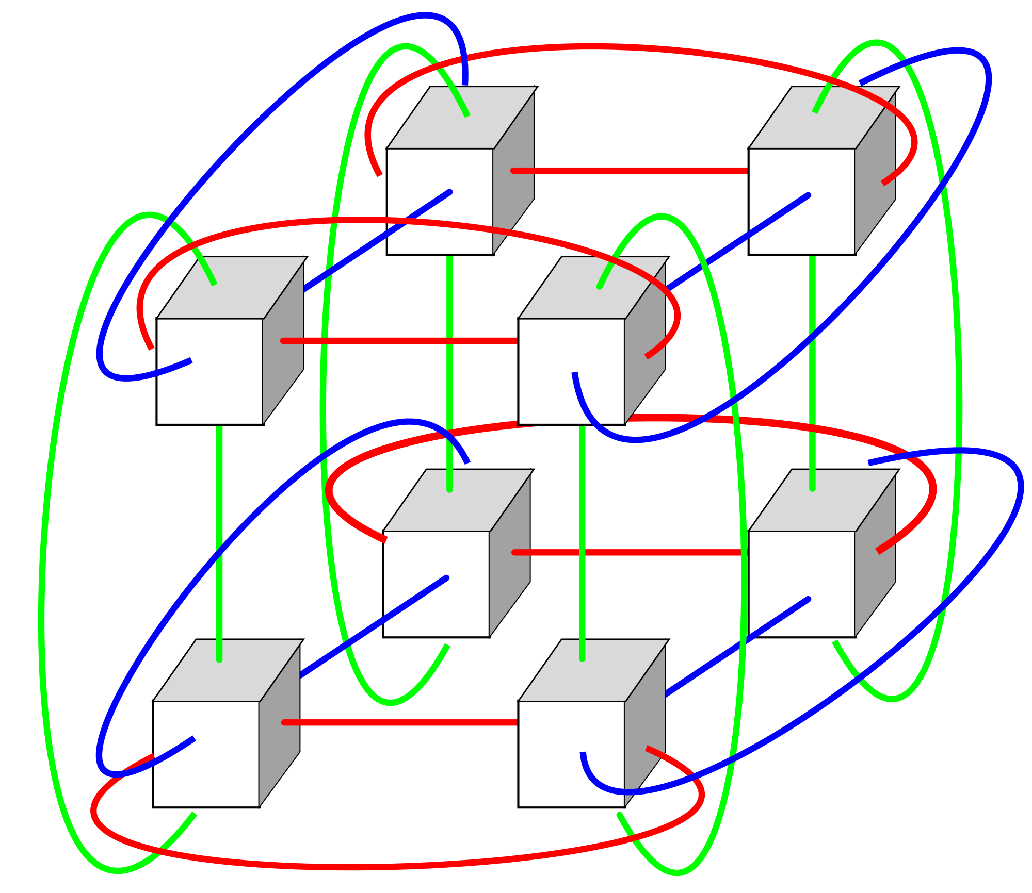
Torus
Each dimension
is a set of rings
  1D = ring
  2D = Manhattan
    network
  3D (see right)
  …

Slide 12
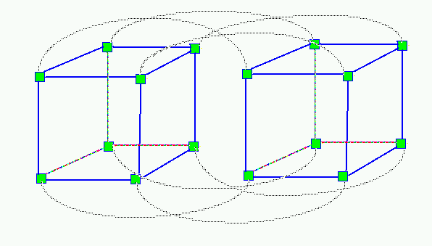
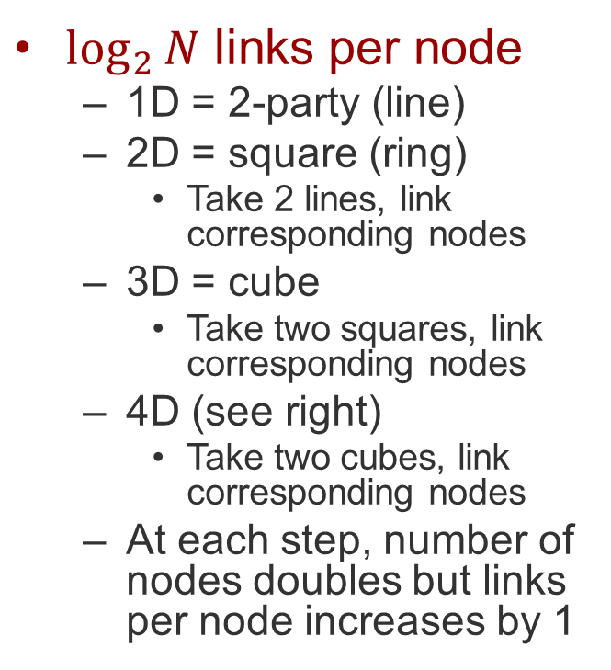
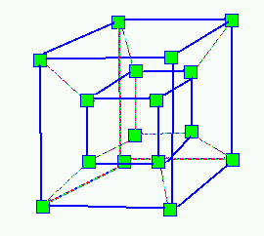
Hypercube

Slide 13
Multistage Interconnection Net (MIN)
Stages of nodes
  Either new nodes, or nodes “reused”
  Entire stage “switches” at the same time
Phased switching implications
  Fixed message size (“cells”)
  “Rearrangeable” vs. “not”
E.g., butterfly/banyan
Not usually used as general relays, but often used “inside the black box” to emulate a link

Slide 14
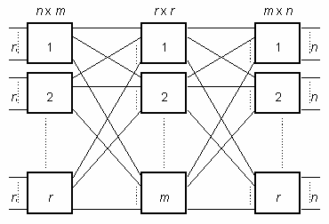
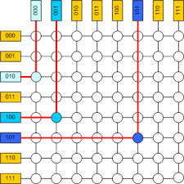
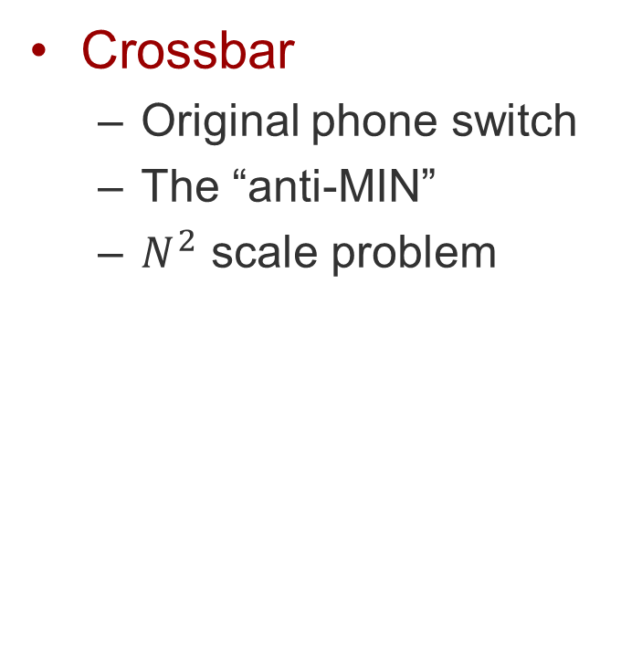
Examples
Crossbar
  Original phone switch
  The “anti-MIN”
  $N^{2}$ scale problem
Clos
  3-stage: in, middle, out

Slide 15
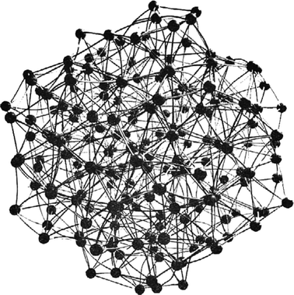
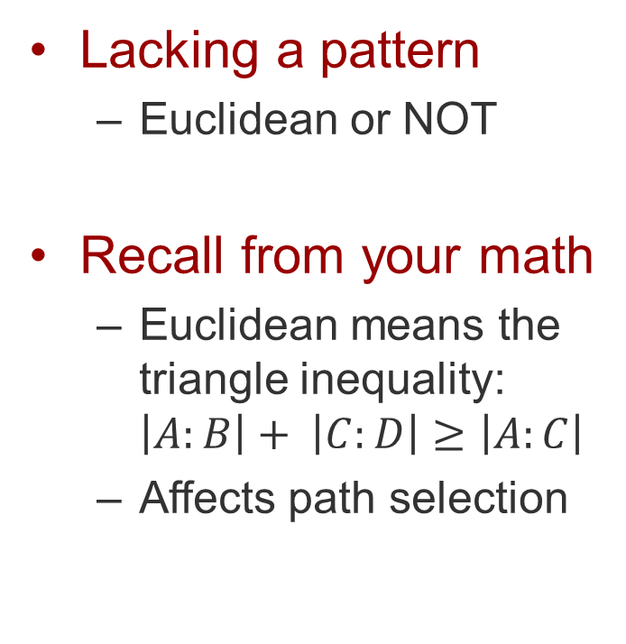
Irregular mesh
Lacking a pattern
  Euclidean or NOT
Recall from your math
  Euclidean means the triangle inequality:
  $\left|A:B\right|+ \left|C:D\right|≥\left|A:C\right|$
  Affects path selection

Slide 16
Impact of topology
Naming
  Node labels can describe location
  Location can indicate route
Use cases
  Distributed problems can be mapped to nodes
  Communication patterns can align to topology
    E.g., ATM cash machines and the bank map well to a hub-and-spoke

Slide 17
Scale and size
Limits of a single link
  Power limits distance
  Can fix with repeaters, but they’re not free
Limits of a shared link
  Protocol limits distance
  Fan-out power limits node count
Limits of relaying
  No distance limit (relay using nodes)
  No node count limit (fan-out using nodes)
  Complexity (nodes do more work)
  Overhead (communication takes more time)

Slide 18
WAN
Wide-area network
  Typically inter-city to global
  100-20,000 km

Slide 19
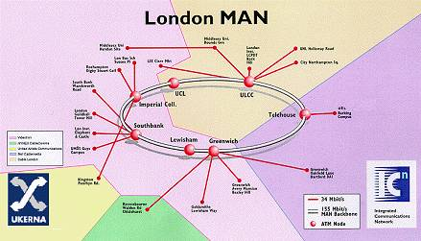
MAN
Metropolitan …
  Several buildings to a city and its suburbs
  0.1-100 km

Slide 20
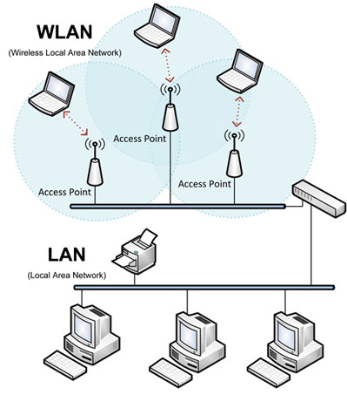
LAN
Local area network
  Inter-desktop to intra-building
  The first *AN
  1-100 m
  WLAN = wireless

Slide 21
Other *ANs
DAN
  Desktop
  Interconnecting devices inside a PC
PAN / BAN
  Personal / body
  Devices within one person’s space
  Phone, watch, tablet, sensors
SAN
  Storage
  LAN or DAN focused on storage devices
CAN
  Car or campus
  Car is maxi PAN
  Campus is mini MAN
HAN
  Home
  LAN with privacy limits

Slide 22
Networks without a “AN”
Intranet
  Network internal to a corporation
Internet
  Network of heterogeneous networks (“inter”)
Access / Aggregation
  Connects multiple LANs and WAN
Interplanetary
  Very large delays
  Intermittent links

Slide 23

Relaying and choices
Nodes in a topology must relay messages
Except for simple topologies, choices must be made
  Multiple outgoing links
  Which to send it on?
?
?
?

Slide 24
Relaying rules
What do you do when you get a message?
  Deliver it if it’s for you
  Otherwise, relay it!
How?
  (for now, assume everyone knows a-priori)
When?
What about collisions?

Slide 25
The when question
A message starts to come in
  And it isn’t for you
When do you start sending it out?
As soon as you know where to send it?
  Possibly before you’ve gotten all of it
Or only when the entire message has arrived?

Slide 26
Cut-through
Delay only long enough to decide
Node
Message
Time
Node
Message
Node
Message

Slide 27
Store and forward
Message “stops” inside the node
Node
Message
Time
Node
Node
Message

Slide 28

Collisions
Multiple messages arrive at a node
  More than one seeks the same output
  (output) contention, collision
Message
Message

Slide 29

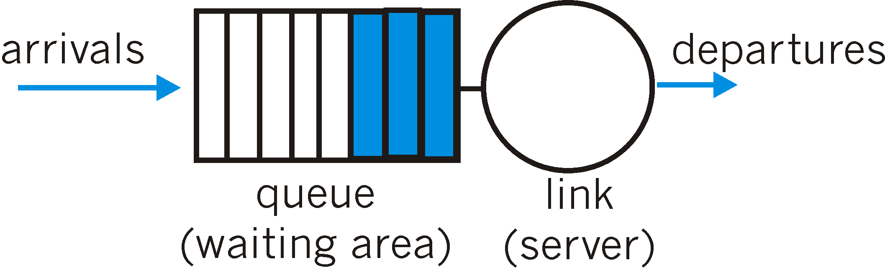
Avoiding collisions
Delete one
  Which one?
Save one
  Which one?
  How long?
Require storage
  A buffer

Slide 30
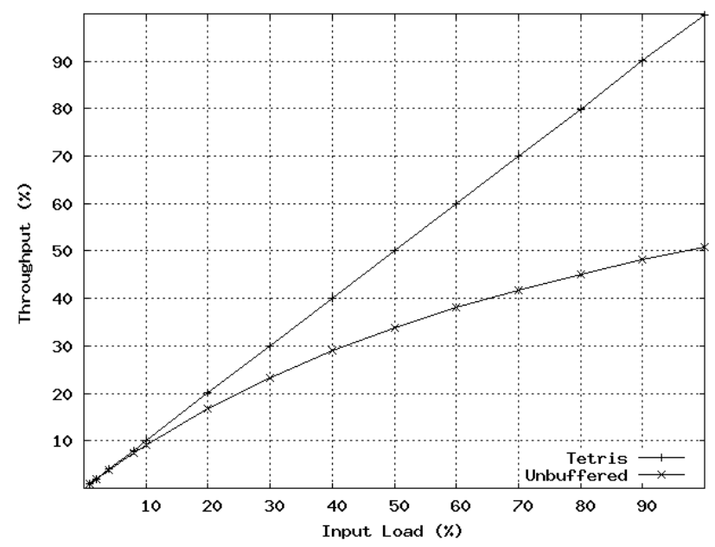
Buffered vs. bufferless
Opportunity
for buffering
to do better
Limit of unbuffered
Maximum
Unbuffered

Slide 31
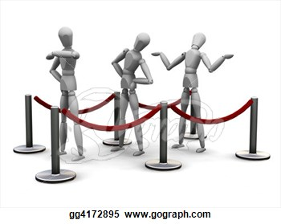
Queuing
Store and forward provides an opportunity
  Messages can be managed as a set
  Messages can be reordered
  Messages can be dropped
Critical issue – what do you do when buffer is full?

Slide 32
A short foray into queueing theory
Queueing theory is mathematical theory of handling lines
Highly applicable to networking
In particular, to the issue of handling messages as they arrive at a node
A fundamental question –
  Under what circumstances will we need to drop a message?

Slide 33
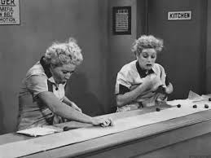
Answering that question
Informally, if you can’t keep up with the work
How can we formalize that idea?
Through queueing theory

Slide 34
The basics of queueing theory
We have a server
It has an input queue
The server takes work out of the input queue and sends it to an output
  Taking some amount of time to do so
  On average, W seconds to complete a piece of work
Work arrives at some rate λ items per second
When are we in trouble?

Slide 35
What’s trouble?
Trouble could be dropping any message
Or it could be getting into a state where we’ll never catch up
  And messages will always need to be dropped
Clearly, the latter is worse than the former
If we occasionally drop a message, maybe we can recover
If we always are dropping messages, that implies an unstable system

Slide 36
Little’s result
Under what conditions will our system be stable?
Say our arrival rate at the network element in question is λ messages per second
And we can forward a message in time W
Both on average
How many messages will be in the system, on average?
L = λW
So if we can handle L messages, we’ll be stable
  BUT we might still drop some messages

Slide 37
Drop behaviors
Tail drop
  Delete arrivals to a full queue
Head drop
  New arrivals push oldest members out
Random drop
  Delete randomly from both new arrivals and existing members
Random early drop
  Random drop before the queue reaches its limit
  Increase probability of drop as space decreases

Slide 38
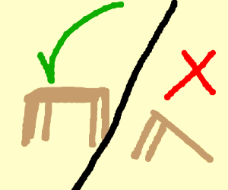
Priority
Some messages are “more equal” than others
  See George Orwell
  Messages are associated with priority
  Priority biases decisions

Slide 39
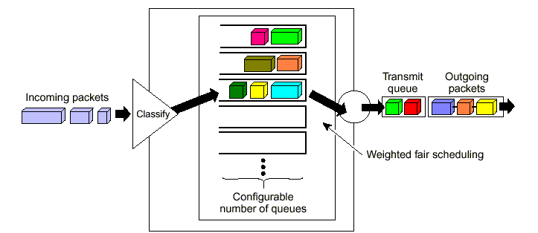
QoS
Quality of service
  Guarantees to a node about their messages
  Per-message or long-term average behavior
  Fixed guarantees or statistical
  Complex set of queues

Slide 40
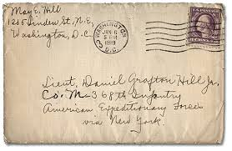
Returning to the question of choice
Where do we relay the message to?
Post office does it by looking at the address
Implies a need for naming
  Specifying who to deliver something to

Slide 41
Naming and relaying
So a message arrives at a relay node
It’s not for that node
How does the relay node know where to send it?
A problem (partially) in naming
The message can be associated with a name
Which can allow the relay node to know how to relay it

Slide 42
Terminology
Name space
  A set of possible names
  Usually indicated by syntax or semantic range
  E.g., N.N.N.N, where N=0..255
Name
  An instance within a name space
Identifier
  Another way to say “name”

Slide 43
Naming vs. identification
Naming:
  The act of assigning an identifier to an item
Identification:
  The act of selecting a subset of items based on a name

Slide 44
What can be “named”?
Place (source or sink of data)
  Endpoint, node, process (inside an OS)
  Location
Communications medium (path of data)
  Channel / link
  Path (sequence of adjacent links)
Information (the data itself)
  Group of data, e.g., a record or file
A behavior (the way data evolves)
  A sequence of events, an algorithm, etc.

Slide 45


Finding names
You have to know these things…
  A-priori knowledge
  A directory
Basically, some other way
Not associated directly with the message itself

Slide 46
Purpose of Names
Support shared channels
Support relaying
Support layering
Provide other information
Support naming itself

Slide 47
Support shared channels
Source identifier (N:1)
Destination identifier (1:N)
Group identifier (all, some, any)

Slide 48
Source vs. Destination ID
Distinct
  Source in the context of a destination
    “Reza’s professor named Peter”
  Destination in the context of a source
    “Peter’s student named Nora”
  Allows localized naming
  Easier to ensure unique names
One name for both
  Avoids need for context
  Requires coordination of all names

Slide 49
Types of group identifiers
All
  Broadcast
Some
  Multicast
Any
  Anycast

Slide 50
Broadcast
All everywhere
  Very rarely actually true
  At best, true within part of a network
All within a range of names
  I.e., all names between Jenny and Morton
  The metric is internal to the name space
  Assumes an ordered name space
All within some metric
  Where the metric is external to the names
  E.g., within 3 hops, within 2 ms, within 600m

Slide 51
Multicast
A group of selected members
  Indicated by the source
  Indicated by an external membership protocol
A subset of such a group (N of M)
  Exactly N of M
  At least N of M

Slide 52
Anycast
Any member
  Any available party responds
  More than one can “offer”; originator selects
Any ONE member
  At most one party responds
  The network (or the receivers) select
  Originator is given no choice

Slide 53
Support relaying
Structure in the name can help
  Name space is a hierarchy
  that matches the network topology
    E.g., IPv6
    E.g., telephone country codes, area codes, exchanges
  Name space can match geographic areas
    Where you are determines part of your name
    E.g., DNS country code suffixes (.us, .jp, .in)
    Zip codes on letters
    E.g., telephone country codes, area codes

Slide 54
Types of Names
Flat
  I.e., unstructured
Structured
  Syntax
  Semantics
Single-level
  One organization for the entire name space
Multi-level
  A sequence of organizations
  Organizations can repeat or vary
  Levels can represent a hierarchy (subdivision)

Slide 55

People
Size
  1-N Characters (var. charset)
Organization
  2-3 level hierarchy of flat
    Right, left, middle in US, most of EU
    Left, right in Japan
Content
  Surname (family)
    Usually flat
    Can change (marriage)
  Given name
    Flat
  Nickname
    Flat
Broad/multicast support?
  Geographically limited (hey you all!); geo-limited multicast (all the brown-eyed people)
Example
  Henry Jones, Jr.

Slide 56

Houses
Size
  1-N Characters (var. charset)
Organization
  4-6 level hierarchy of flat
    Country, region, city, street, unit, subunit
Content
  Flat in general
  Units
    Geographic in US
    Chronological in Japan
Broad/multicast support?
  No broadcast; no multicast
Example
  123 Main Street, Apt. 33, Boston, MA, USA

Slide 57

Geographic
Size
  3 groups: Latitude, longitude, altitude
Organization
  2-level independent
Content
  Latitude and longitude
    Degrees, minutes, seconds
    Or degrees and fractions
  Altitude
    Meters
Broad/multicast support?
  Geographic broadcast; no multicast
Example
  34° 1’ 16.86”, -118 °17’ 27.5352” (elevation unknown)

Slide 58
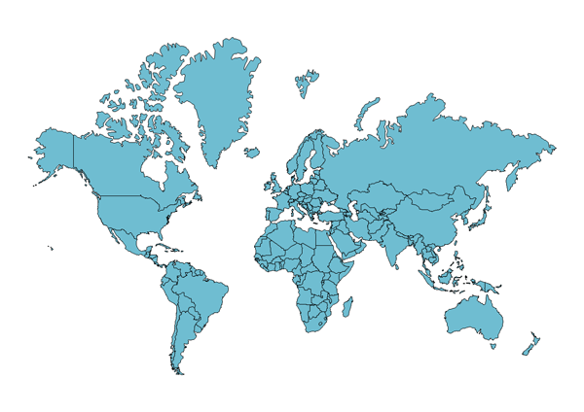
Geographic names
.ca
.ru
.us
.cn
.jp
.in
.br
.au

Slide 59
Topological names
*
A
E
W
A1
A8
E3
E9
W2
W5
A1x
A1z
A8r
A8y
W2c
W2p
W2r

Slide 60
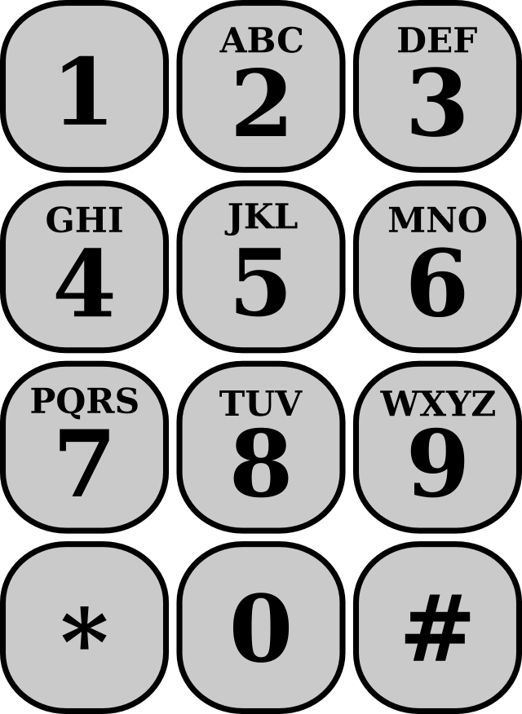
Telephone
Size
  6-N digits
Organization
  3-4 level hierarchy of flat, variable
Content
  Flat variable country code
  Flat variable region code
  Flat variable exchange code
  Flat variable line number
Broad/multicast support?
  No broadcast; no multicast
Example
  +49-89-636-48018

Slide 61
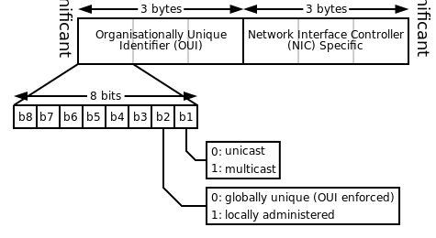
Ethernet
Size
  6 bytes
Organization
  2-level hierarchy of flat, fixed
Content
  Flat 3-byte OUI
    Organizationally Unique Identifier
    E.g., F0-F6-1C = Apple (one of many!)
  Flat 3-byte NIC
    Network Interface Controller
Broad/multicast support?
  Global broadcast; global multicast as configured
Example
  F0-F6-1C-24-E3-15

Slide 62
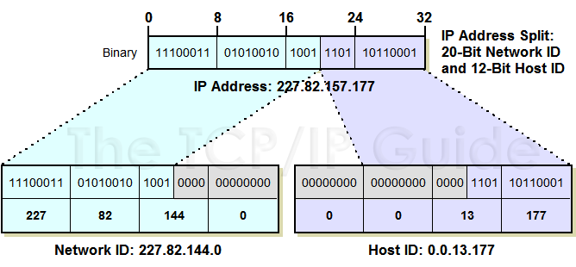
IPv4
Size
  4 bytes
Organization
  2-level hierarchy of flat, variable
Content
  Flat high-order network part
    Assigned by IANA
    Of variable length
  Flat low-order host part
    Assigned locally, either statically or via automation
    Of variable length
Broad/multicast support?
  One-hop broadcast; global multicast as configured
Example
  128.9.160.161

Slide 63
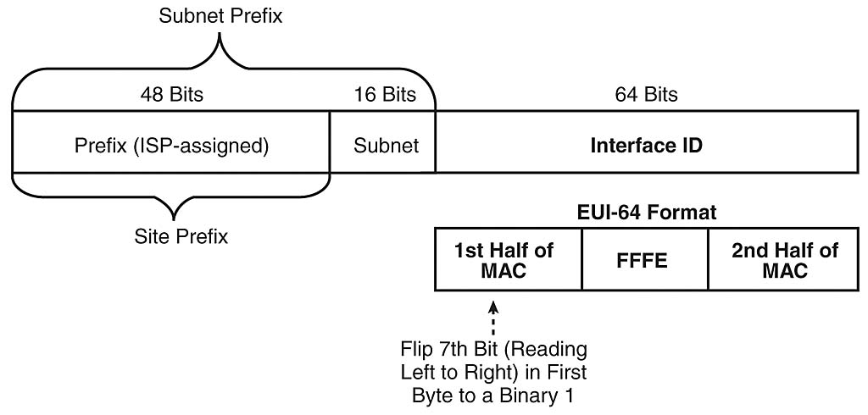
IPv6
Size
  8 bytes
Organization
  3-level hierarchy of flat, fixed
Content
  Flat, multi-level 6-byte site prefix
    Assigned by IANA, variable
    Assigned to ISPs hierarchically
  Flat 2-byte subnet
    Assigned locally, either statically or via automation
  Flat 8-byte interface ID
    Derived from Ethernet MAC address
Broad/multicast support?
  One-hop broadcast; multicast to preassigned groups or as configured
Example
  2001:0:9d38:6ab8:3c1f:108d:b898:6b35

Slide 64
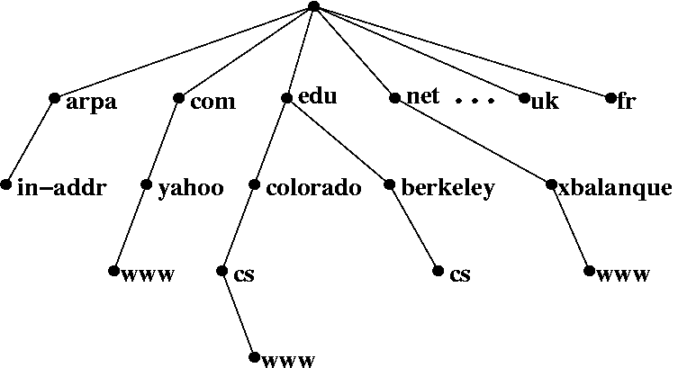
Host names (hosts.txt)
Size
  1-N characters
Organization
  Variable-level sequence of flat, variable
Content
  Labels separated by “.”
  Organized right to left
    Assigned and managed globally
Broad/multicast support?
  No broadcast; no multicast
Example
  lever.cs.ucla.edu
  Each level can have different number of characters

Slide 65
DNS
Size
  1-63 byte labels, 1-253 bytes total
Organization
  Variable-level hierarchy of flat, variable
Content
  Labels separated by “.”
  Delegated right to left
    Assigned and managed locally
Broad/multicast support?
  No broadcast; no multicast
Example
  lever.cs.ucla.edu
  Again, possibly different number of characters at each level

Slide 66
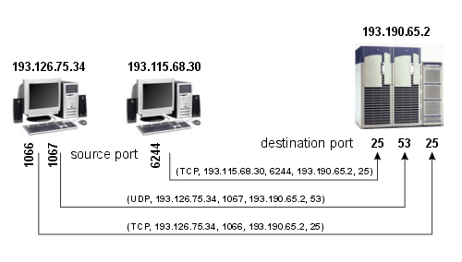
TCP, UDP, SCTP, etc.
Size
  2 4 byte labels, plus IPv4 or IPv6
Organization
  Three groups of flat
Content
  System (registered)
    0-1023, “privileged”
  User (registered)
    1024-49151
  Dynamic (self-assigned)
    49152-65535
Broad/multicast support?
  No broadcast; no multicast
Example
  80 for HTTP, 53 for DNS

Slide 67
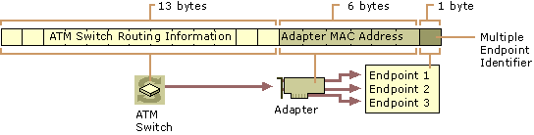
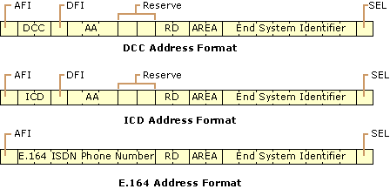
ATM
Size
  20 bytes
Organization
  3-level hierarchy of flat, fixed
Content
  13-byte switch part
    Three hierarchies
  6-byte interface part
    Borrows Ethernet MAC
  1-byte selector part
    Multiple endpoints within an interface
Broad/multicast support?
  No broadcast (emulation); no multicast
Example
  47.00918100000001604799FD01.0050A219F03B.0

Slide 68
Names also provide other information
Names do more than identify
  Cell area code – where/when you first got it
  Social security – where/when you were born
  People – lineage (typ. paternal)
  Ethernet – who made your device and when
  IPv6 – who your ISP is

Slide 69
Summary
We can build more scalable networks by connecting nodes and relaying messages
Nodes are connected in some topology
  Different topologies have different characteristics
Relaying needs more shared rules
  And often also a place to wait
Naming is one way to enable relaying

