Slide 1
Sharing Channels CS 118 Computer Network Fundamentals Peter Reiher

Slide 2
Outline
Carrier sense channel sharing
Naming
?
?

Slide 3
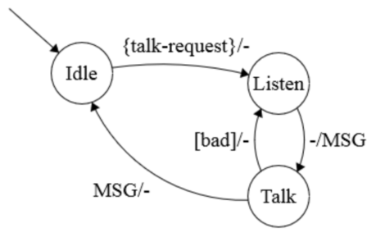
Sending without a master
Message to send
Listen for quiet
Send message
Did you hear it?
Yes – DONE
No – resend (goto #3)

Slide 4
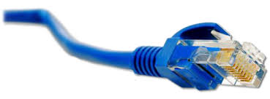
CSMA (IEEE 802.3)
An implementation of this idea
Carrier-sense multiple access (1974)
Carrier = channel idle
Listen before talking

Slide 5
CSMA behavior
I don’t hear anything!
1
1
2
3
4
5
6
7
2

Slide 6
CSMA and persistence
OK, so I listen to the channel
What if it’s busy?
Well, I certainly don’t send now
My message would interfere with what I hear
But do I keep listening?
Persistent CSMA listens till channel is free
Non-persistent CSMA stops listening and checks again later
After some random interval

Slide 7
CSMA behavior
I don’t hear anything!
I hear a message!
1
1
2
2
3
4
5
6
7
3
3
Node 1 wants to send a message to node 3
Node 1 listens to the medium
It happens again
But in the middle, node 2 wants to send a message to node 6
Node 2 listens to the medium
Node 2 doesn’t send

Slide 8
What about node 2’s message?
1
1
2
2
3
4
5
6
7
3
6
Node 2 wants to send a message to node 6
Node 2 listens to the medium
Node 2 doesn’t send
Now node 2 can send his message

Slide 9
CSMA and collisions
CSMA involves sharing a channel
Multiple senders can all put messages on the same channel
No master, no advanced reservations
So more than one sender can try to use the channel at once
When that happens, their messages collide
Which corrupts both messages, making them useless (for most purposes)

Slide 10

Collisions can happen
1
1
2
3
4
5
6
7
7
6
2
Let’s say 1 wants to send to 6
He listens and hears nothing
And 7 wants to send to 2, at about the same time
He listens and hears nothing
So they both send
Both messages are destroyed

Slide 11
CSMA variants
CSMA/CD
Carrier Sense Multiple Access/Collision Detection
Essentially, listen to determine if the channel is in use and send if it isn’t
Continue listening to detect if collisions occur
CSMA/CA
Carrier Sense Multiple Access/Collision Avoidance
Essentially, listen longer to determine if the channel is in use and send if it isn’t

Slide 12
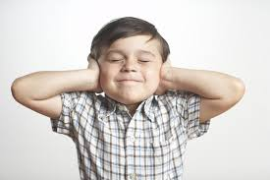
CSMA/CA- I’m Not Listening!
CSMA/CA listens before sending
But some versions don’t listen during sending
So they don’t detect collisions by listening
So what do they do?

Slide 13
Why not listen?
Not practical for some wireless channels
Need to send and listen at the same time
Sometimes expensive to build equipment that does both well simultaneously
The hidden terminal problem
We’ll get to that a little later

Slide 14
Acknowledgements
One way to detect collisions without listening during send
Receiver instantly acknowledges received message on channel
Using the channel, of course
Acknowledgements are short
But do take up channel space
Possibly leading to collisions themselves

Slide 15
A note about CSMA
Benefits:
CA avoids always colliding after idle if multiple parties want to send
Non-persistent, like CA, helps avoid collisions but also avoids work during busy period (spin-lock)
CD reduces the impact of a collision
These are NOT mutually exclusive
Though we usually talk about CSMA/CD or /CA
There are other optimizations

Slide 16
Ensuring channel capture
Start sending data
Data can collide in unpredictable ways
Someone else might have just started to send, but it hasn’t gotten to us yet
Message might be very short – how long do we wait to check to see if it worked?
Solution: preamble
Floods the channel before sending message
Also enables frame sync

Slide 17
Flooding the Channel
Put an unimportant signal onto the (apparently idle) channel
The preamble
Keep it there until you’re sure that no one else is sending
Implying long enough for you to hear everyone else who might be flooding
And for them to hear you
If preamble is trashed, someone else is sending too

Slide 18
More on flooding
Don’t start sending until you know you have the whole channel
If you can send a round-trip bit with no collision, then the channel is yours
At higher speeds, a given preamble is “shorter”
So the round-trip distance protected is less
Distance
Distance
Min preamble
Must flood round-trip
Min preamble
Must flood round-trip

Slide 19
Limitations of no-master sharing
Channel length
Protocol overhead
Capture effect
Need for a single, shared channel

Slide 20
Preamble vs. channel length
Preamble
7 bytes = 56 bits
Maximum shared link size
@3 Mbps = 1866 m
@10 Mbps = 560 m (set to 500 m)
@100 Mbps = 56 m
@1 Gbps = 5.6 m

Slide 21
Protocol overhead
Converse of channel length limit
Faster symbol rate = longer preamble
Longer preamble = higher overhead

Slide 22
Backoff
What do you do if your packet is trashed when someone else also sends?
Try again
But not right away
Wait some period of time before re-sending
That’s backoff
Commonly used in many non-master channel sharing schemes

Slide 23
Capture effect
Collision backoff is not fair (known in 1994)
Ethernet backoff picks a random value in a range that increases with each failure
A & B collide
Both pick from the small initial interval
A wins and transmits
A & B collide
A now picks from the small initial interval
B picks from a larger, second-try interval
A usually wins (repeatedly)
A is rewarded by having its interval reset whenever it wins

Slide 24
Single, shared channel limit
Signal power
Protocol
Topology
Hidden terminal

Slide 25

Signal power
Distance
Power absorption (except for a vacuum)
Most beams spread out
Number of receivers
Power needs to increase for everyone to get “some” of the signal
Result: effective distance limit

Slide 26
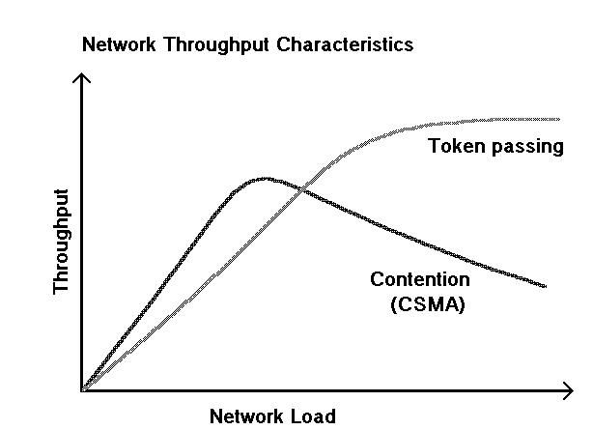
Protocol effects
Sharing can be inefficient
Collisions = no transfer

Slide 27
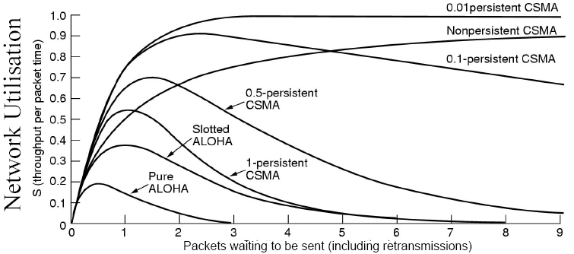
Protocol variations
Slight variations can have large effect

Slide 28
Protocol effect implications
Channel negotiation takes time
During which you might lose what you send
And you can’t know until you try
Result: strict distance limit, efficiency limit

Slide 29
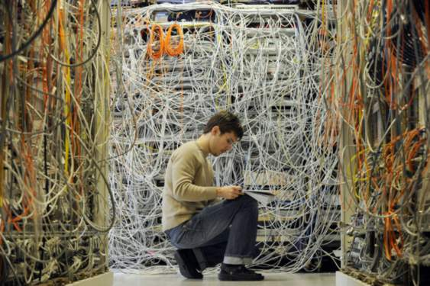
Topology
A single channel can be hard to deploy
RF doesn’t go around corners
Wire doesn’t go where you want

Slide 30
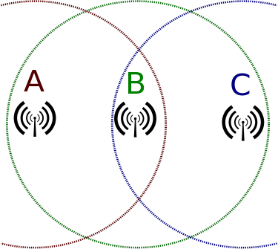
The hidden terminal problem
Incomplete sharing
Not all nodes reach all others
CSMA no longer works
A and C won’t know their transmissions collide
Acknowledgements can help

Slide 31
Naming implications for shared medium
Sharing is sharing
Same rules about uniqueness of names
In 1:N, only destination name must be unique
In N:1, only source name must be unique
In N:N (with no other info), source/destination pair must be unique
And there could be N² pairs
How do we achieve uniqueness?
A priori coordination

Slide 32
The cost of naming
Worst case: N² names
Costly to add one more party
Does not scale!
Simpler cases: N names
Adding one party adds at most one name
One more receiver in 1:N
One more sender in N:1
Need to be sure chosen names are unique
Scales well

Slide 33
Shared media naming techniques
Central authority
Two-level delegation
First three assigned per-organization (OUI)
Rest assigned locally
IEEE 802.* addresses are 48 bits (6 bytes)
IEEE also assigns 64 bit addresses
ATM NSAP
Multi-level hierarchy, starting at ITU, including IANA
IPv4 addresses
Multi-level delegation, starting at IANA
Self-assignment
IPv6 local part is self-assigned, then check for duplicates (“roll again!” = “Duplicate Address Detection”/DAD)

Slide 34
Other names
Name for “everyone”
Enables native (one-step) broadcast
Often “all 1’s”
Name for “a group”
Enables native (one-step) multicast
Name for “I don’t have an address yet”
Often “all 0’s” (for another day)

Slide 35
More switching
Recall:
Switching emulates sharing
What makes it useful?
Simper wiring (direct to closet)
Independence
Enhanced coordination

Slide 36
Simpler wiring
First step: everyone on a bus
Limited by the bus path
A
B
C
D
E

Slide 37
Simpler wiring 2
Second step: delegate to a shorter bus
Move per-node smarts together
E.g.: Ethernet MAU
A
B
C
D
E

Slide 38
Simpler wiring 3
Third step: box it up!
Simpler to manage and operate
A
B
C
D
E

Slide 39
A note about MAC protocols
Media access control
Just a name
Protocol to control shared access
NOT NEEDED without shared access!

Slide 40

Simpler wiring 4
Final step: who cares what’s in the box?
There are many ways to build N:N exchanges
What else changed?
A
B
C
D
E

Slide 41
Non-sharing protocol!
We can turn channel sharing
A sharing protocol
Into central switching
A 2-party protocol to the switch
A non-sharing protocol
NOTE THIS!
A
B
C
D
E
A
B
C
D
E

Slide 42

Benefits of independence
Add/remove nodes without affecting others
No need to shift wires
Dead (or mostly-dead) node can’t contaminate the network

Slide 43
Enhanced coordination
What can a switch see?
Everything at once, quickly (shorter channel)
What can a switch do?
Coordinate! (takeover role of master)
Enforce long-term fairness, avoid starvation

Slide 44
So what’s a switch really?
A way to emulate a shared link
Without the physical constraints

Slide 45
Switch examples
Ethernet
Emulates an RF channel
SONET
Emulates a wire
ATM
Emulates a phone wire (in particular)
Not all of these emulate sharing!

Slide 46
How do switches work?
Shared media
An internal star coupler, bus, or memory
A control algorithm to share the in/out links
Usually TDMA on the in/out links
A bunch of relays

Slide 47
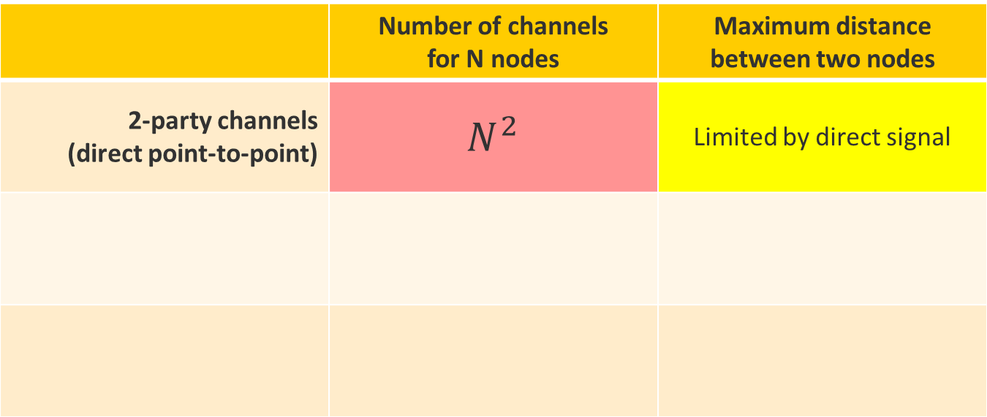
Goal: scalable communication
 | Number of channels for N nodes | Maximum distance between two nodes
2-party channels (direct point-to-point) | $$N^{2}$$ | Limited by direct signal
Can we do better?

Slide 48
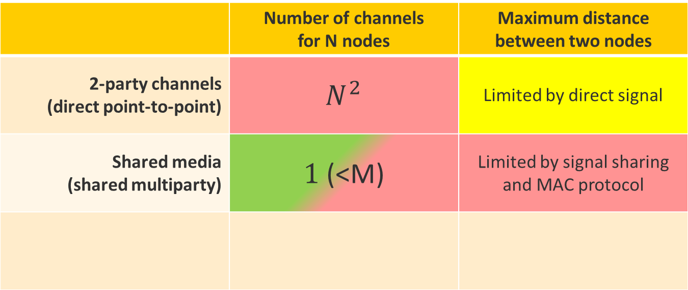
Goal: scalable communication
 | Number of channels for N nodes | Maximum distance between two nodes
2-party channels (direct point-to-point) | $$N^{2}$$ | Limited by direct signal
Shared media (shared multiparty) | $1$ (<M) | Limited by signal sharing and MAC protocol
Good for small groups – what about large?

Slide 49
Sharing and relaying
Emulate full connectivity
Networking to enable communication
Reduce connection cost
Sharing can be expensive or limiting

Slide 50
Sharing vs. relaying
Sharing
Increases endpoint work
Simple topology
Efficient small scale
Poor number scaling
Poor size scaling
Relaying
Spreads the work
Allows complex topologies
Efficient at large scales
Good number scaling
Good size scaling
If designed well

Slide 51

Relaying to the rescue!
Communicate through a third party
A to B, B to C = A to C
“Transitive closure”

Slide 52
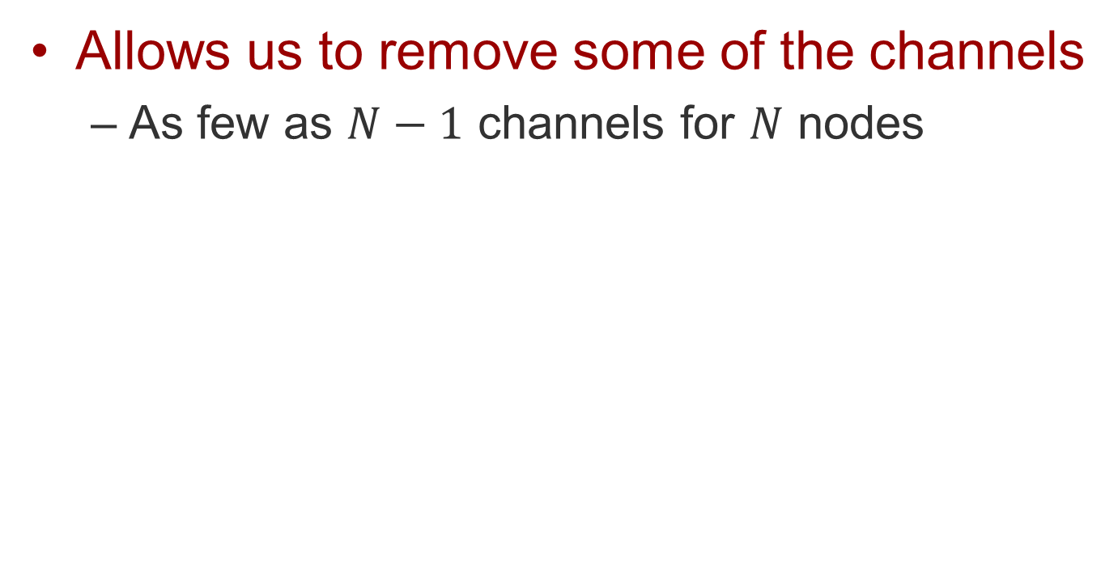
How does relaying help?
Allows us to remove some of the channels
As few as $N−1$ channels for $N$ nodes

Slide 53
How can we relay? #1
2-party channels
Media for action at a distance
Telephone lines originally direct copper pairs
Relay using actual switches
Switch selects alternate direct copper paths
Continuous path is called a circuit

Slide 54
The good, the bad, and…
Good news
Relaying can reduce the number of links
Bad news
This kind of relaying limits how many pairs can communicate at once

Slide 55
Circuits – a sure thing
Trains on a track
Scheduled in advance
Allocated whether in use or not
Resources locked along entire path
Path is fixed
Guarantees no competing traffic
Fixed delay, fixed jitter, fixed capacity
Can’t share resources concurrently

Slide 56

Circuit movie transfer
One long, continuous path
No need to reformat the movie
Lossless, in-order delivery
Along a single, static path
That blocks everything else until you’re done
X
X

Slide 57
Circuits – pros
Guaranteed service
Fixed capacity
Fixed delay
Advance knowledge
Properties known in advance
Advance reservation (if use-bounded)
Efficiency within a single stream
No overhead for processing, labels, etc.
The circuit is the label (no names after setup)

Slide 58
Circuits – cons
Fairness on a per-circuit basis
Per reservation
At the time of reservation
At the time of use
Path blocking
Resources blocked (even if not actively used)
Capacity limited
Min. of per-hop capacity of a single path

Slide 59
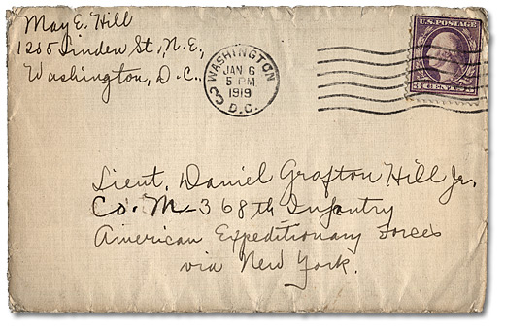
How can we relay? #2
Packets to the rescue
TDMA relaying
Allows circuits to be shared
Avoids blocking of cross-traffic
“Packet” coined in 1968 (Donald Davies)

Slide 60
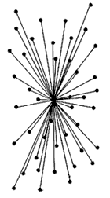
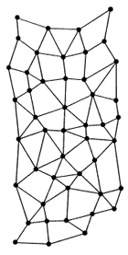
Baran’s study
Compared central and distributed nets
Divide messages into “blocks” (packets)

Slide 61
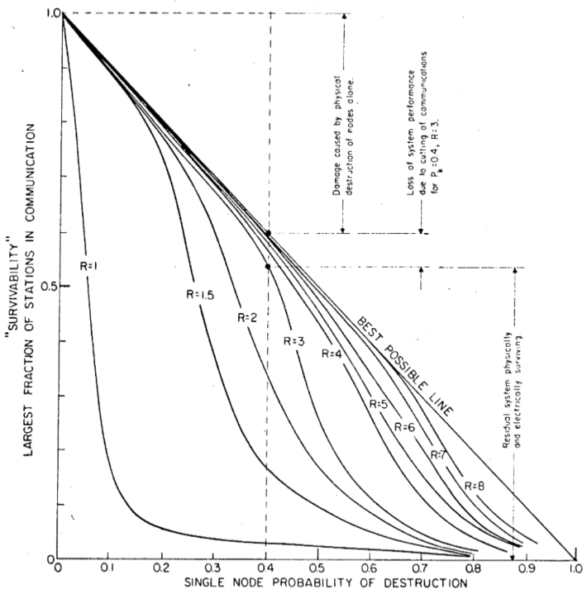
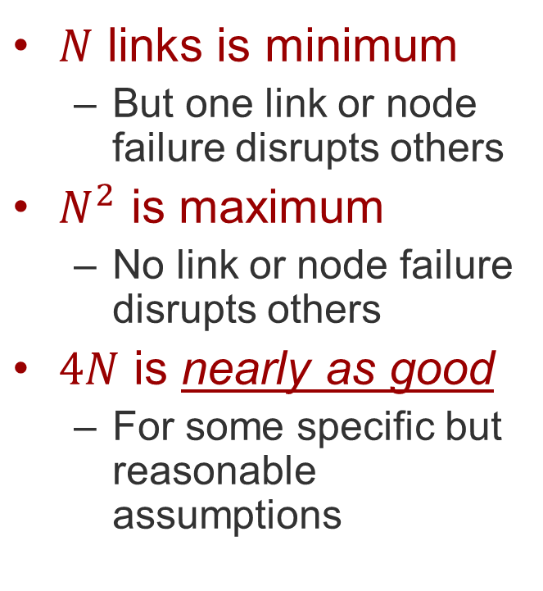
Baran’s insight
$N$ links is minimum
But one link or node failure disrupts others
$N^{2}$ is maximum
No link or node failure disrupts others
$4N$ is nearly as good
For some specific but reasonable assumptions

Slide 62
Packet example
Cars on a highway
No need to schedule
Resource used only during transit
Path can vary, even given identical headers
Focuses on sharing
Aggregate, concurrent resource use
Results in variable delay, variable jitter, variable capacity, and potential for loss
Each car is independent, so these variations not too important

Slide 63
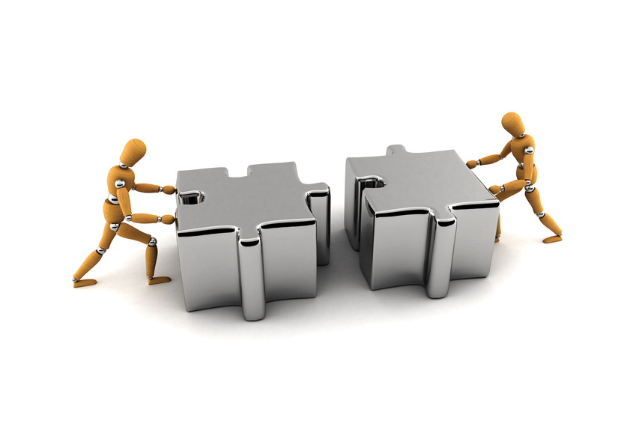
Packet movie transfer
Fragmentation
Split into chunks, label for reordering
Reassembly
Gather and restore the stream
Sharing
Concurrent transfers supported
But there are relationships between the packets . . .

Slide 64
Packets – pros
Sharing
“Stat-Mux” (statistical multiplexing) gain (2x-10x)
Fair over shorter time-scales
More dynamic and agile
Avoids path blocking
Brief uses share better and complete faster
Allows multipath
Concurrent use of multiple paths
Can increase capacity for a given transfer
Allows dynamic path variation
Can route around outages, delays

Slide 65
Packets – cons
More work
Pack/unpack
Compute checksums
Manage reordering, loss
Capacity overhead
Addressing – to guide the chunks
Demultiplexing fields – allowing sharing
Signaling fields – to help undo chunking effects
Storage required
Buffering to accommodate reordering, loss

Slide 66
Circuits vs. Packets
When circuits win:
Data patterns are mostly predictable
Sharing isn’t important
Service guarantees are important
Data length is long (path setup is worth the benefit)
When packets win:
Data patterns are unpredictable
Sharing is important
Guarantees are more flexible
Data length is short (relative to path setup cost)

Slide 67
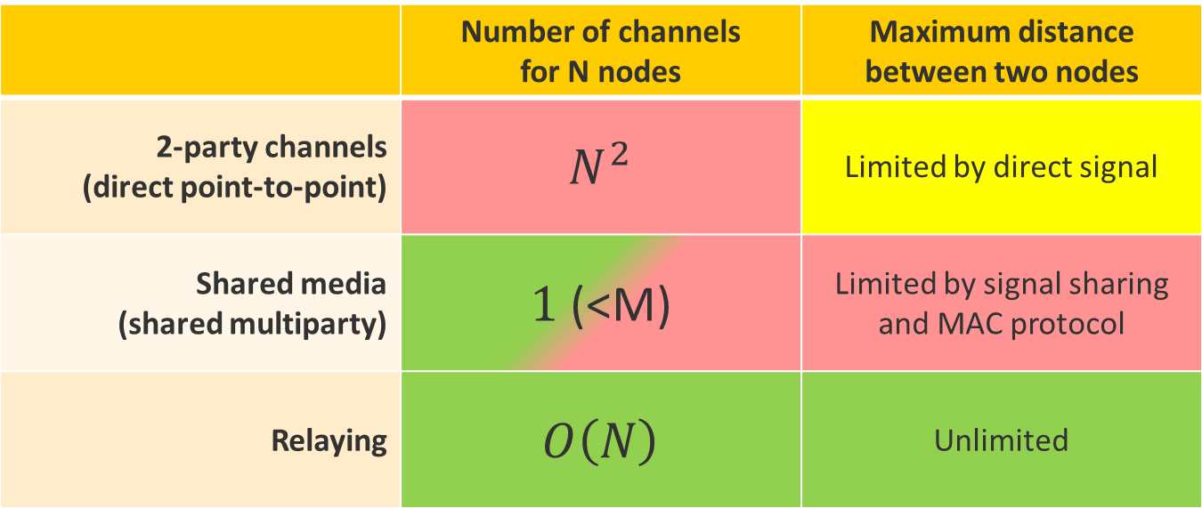
Goal: scalable communication
 | Number of channels for N nodes | Maximum distance between two nodes
2-party channels (direct point-to-point) | $$N^{2}$$ | Limited by direct signal
Shared media (shared multiparty) | $1$ (<M) | Limited by signal sharing and MAC protocol
Relaying | $$O\left(N\right)$$ | Unlimited
Sounds too good to be true…

Slide 68
Summary
We can share a channel without a master
If parties can all listen to what’s going on
We can overcome some drawbacks of channel sharing by relaying
Sending data over multiple separate channels connected together
Relaying can be done via circuit switching or packet switching

