Slide 1
Sharing Channels
CS 118
Computer Network Fundamentals
Peter Reiher

Slide 2
Outline
Ways to share the channel
Label (name) implications
Emulated sharing
Explicit coordination

Slide 3
Ways to share a channel
Different channels
Different times
Different symbol sets (“languages”)
Label the transmissions

Slide 4
Different channels
Spatial Division Multiplexing (SDM)
  Channels are spatially distinct
  The most costly
  (basically where we started – doesn’t scale)

Slide 5
Different times (TDMA)
Take turns using the channel
  Whole channel
  Split in time
Frequency
Time
TDMA

Slide 6
TDMA concerns
Time interval size
  Long enough for at least one symbol
Time interval allocation
  Fairness
  Starvation
  Efficiency (unused slots)
Gap between intervals
  “Guard time”

Slide 7
Impact of guard time
Guard time avoids sender overlap
  All receivers should see non-overlapping slots
  But:
    Sender clocks drift (gain or lose offset)
    Symbol delay varies
Consequence
  TDMA needs clock coordination
  TDMA has distance limit
    Long distance = large guard gaps = inefficient channel

Slide 8
Different symbol sets
Each symbol set is an independent “language”
  Independence means that the bit encoding is separate from the way the sets are distinct
Many different variants:
  Different representations using independent physical properties
  Different alphabets (logical representations)

Slide 9
Different physical representations
Frequency
Polarization
Orbital angular momentum
Combinations of the above

Slide 10
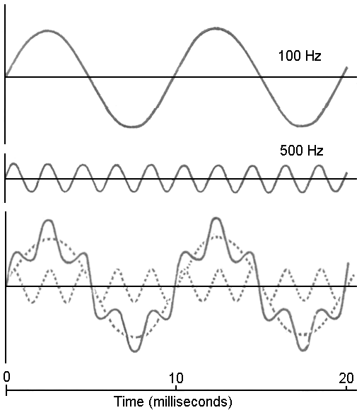
Frequency (FDMA)
Split channel capacity into non-overlapping ranges
  Works for wavelengths
  E.g., for EM (light, RF)
FDMA

Slide 11
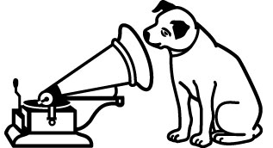
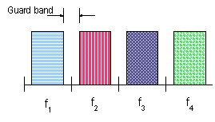
FDMA concerns
Width of the band (bandwidth)
  Large enough for desired bitrate
Band allocation
  Fairness
    Starvation
    Efficiency (unused frequencies)
  Gap between bands
  “Guard bands”
Sound familiar?

Slide 12
Impact of guard bands
Guard bands avoids sender overlap
  All receivers should see non-overlapping bands
  But:
    Sender frequencies drift
    Motion affects frequency (Doppler shift)
Consequence
  FDMA needs frequency coordination
  FDMA has band size limit

Slide 13
Different alphabets
A different way to group by physical property
  Instead of using independent properties, separate groups by the values of one or more properties
  Need the groups to be independently usable

Slide 14
Code (CDMA)
Combines frequency and time
  A combination of time and frequency that allows partial overlap that can enable communication in the presence of increased noise
CDMA

Slide 15
xDM vs xDMA
{Space, Time, Code} Division Multiplexing
  Sharing (dividing a resource) by multiplexing (merging) or demultiplexing (splitting) based on spatial, temporal, or coding context
{S/T/C) Division Multiple-Access
  Using xDM to coordinate shared access of a channel by multiple sources or receivers
Often used somewhat interchangeably

Slide 16
Sharing compared
Frequency
Time
TDMA
FDMA
CDMA

Slide 17
Label (name) implications
If you only worry about multiparty:
  Unique per-node peer names
  Unique per-node internal state/TM subset names
If you also worry about channel sharing
  Name sets used in overlapping contexts
  Need to ensure no namespace collisions
  Need to ensure both ends agree on names

Slide 18
Destination names
Context (1:N)
  Know the channel
  MAY mean the receiver knows the source
Uniqueness
  MUST be unique per-receiver on this channel
Shared
  MUST be known by sender and receiver
  Sender knows what to attach to a message
  Receiver knows where message goes to

Slide 19
Source names
Context (N:1)
  Know the channel
  MAY mean the source knows the receiver
Uniqueness
  MUST be unique per-sender on this channel
Shared
  MUST be known by sender and receiver
  Sender attaches its name to message
  Receiver knows where the message came from

Slide 20
Combined names
Context (N:N)
  Maybe know the subset of senders/receivers
  Not very useful
Uniqueness
  Send names MUST be unique
  Receive names MUST be unique
  MAY (usually) correlate send:receive names
Shared
  MUST be known by all senders and receivers
  Senders attach BOTH names (its send, dest’s recv)
  Receiver uses BOTH names (determine source, decide to accept)

Slide 21
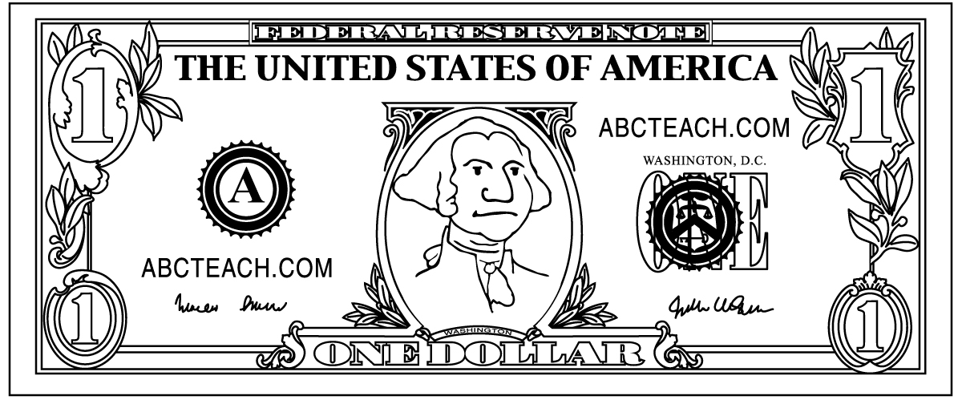
Name assignment
A-priori here (for now)
  Part of the protocol configuration
How?
  An organization (IANA, IEEE, etc.)
  To ensure uniqueness
  How expensive?

Slide 22
Emulated sharing
Devices can emulate sharing

Slide 23
Demultiplexer
1:N
  One source, multiple receivers
Isolates receiver from sharing
  Source still thinks the channel is shared
    Needs to indicate the destination
  Receiver thinks it has direct channels
    Doesn’t need to know whether to listen
What’s in the box?
  Copies / splits symbols
  Use destination names to demultiplex
  (pick output port)
  Can remove the differences (translation)
  i.e., using a FSM

Slide 24
Multiplexer
N:1
  Multiple sources, one receivers
Isolates sender from sharing
  Source still thinks it has direct channels
    Doesn’t need to indicate the source name
  Receiver thinks the channel is shared
    Needs to know the source
What’s in the box?
  Merges / interleaves symbols
  Add source names to output
  Adds the differences (translation)
  i.e., using a FSM

Slide 25
Switch
N:N
  Multiple sources, multiple recvs
  Combines demux with mux
Isolates sender and a receiver in different ways
  Sender still needs to indicate receiver (like demux)
  Receiver still needs to know sender (like mux)
Centralizes coordination
  Internal to the switch

Slide 26
Switch pros and cons
Pros
  Coordination is internal
  Easier to install/manage channel wiring/fibers
  All the pros of explicit coordination
    Efficient, global balance, simple to implement
Cons
  All the cons of explicit coordination
    Load, fault tolerance, trust
  Still needs source/dest to participate in naming
  Still needs unique names

Slide 27
What about circuits vs. packets?
Really just a continuum of TDMA
Smaller allocation avoids impact to others
In this case, doesn’t matter much!
  It will matter more in later lectures

Slide 28
Explicit resource coordination
Why coordinate?
  N:1 sharing needs to avoid collisions
Where is 1:N sharing coordinated?
  Can be just inside the OS in the endpoint
Why explicit?
  Simple case, focus of this class

Slide 29
A-priori coordination
Part of the pre-shared rules
  I.e., part of the protocol
Fixed allocation
  Fixed schedule, frequency bands, etc.

Slide 30
Limits of a-priori coordination
Requires coordination
  Need to build it into the protocol
  Still needs a starting point (time, frequency)
Inefficient
  Slow/costly to change (repeated coordination)
  Fixed allocations can’t adapt to dynamic uses
  Can’t easily add/remove nodes or resources

Slide 31
Centralized coordination
Manager node controls each shared channel
  They decide when each source can transmit
  Can ask the sources about needs

Slide 32
Requirements for central coordination
Symmetric channel
  All possible sources need to be able to hear the manager
  All possible sources need to respond to the manager
  Also receive-only nodes

Slide 33
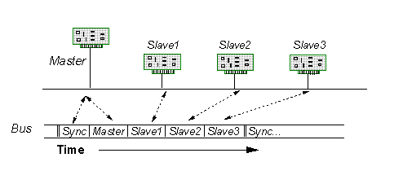
Central coordination protocol
Polling
  Non-PC terms:
    “Master”
    “Slave”
  Channel
    Bus
Master does the following
  Ask each source in turn – anything to send?
  Then schedules and gives each source a slot to send

Slide 34
Limits of central coordination
Load
  Pushes all the work to one manager
Fault tolerance
  Manager could fail
  Channel to manager can fail
Trust
  Manager has all the power!

Slide 35
Hierarchical/delegated coordination
Extend central coordination
  Single manager can split a shared resource and assign each to another to manage
Pros
  Relieves load on a single manager
Cons
  Less flexible; hard to coordinate sharing across delegated fractions

Slide 36
Benefits of explicit coordination
Potentially very efficient
  Esp. if requirements are stable (don’t vary)
Potential for global balance
  Manager knows all, so can make the most informed decisions
  Trivial to avoid starvation, ensure fairness
Simple to implement
  Simple coordination protocol

Slide 37
Limits of explicit coordination
Potentially very inefficient
  Inflexible, slow to react
  Can require lots of messages to parties not involved in the communication
Vulnerable
  Faults, non-malicious, and malicious errors
  All can completely halt shared channel use
Can be costly to implement
  Focused management can require centralized resources (CPU, memory, etc.)

Slide 38
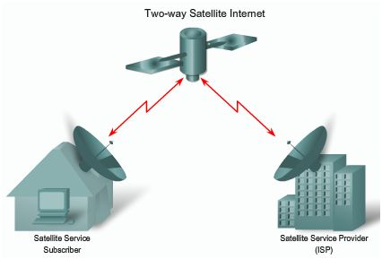
Use cases for explicit coordination
When all communication already flows through one party
When does that happen?
  Satellite
  Airplane/blimp
  Ceiling (infrared)
  Ethernet switch
  WIFI switch

Slide 39
Decentralized Sharing
Extending 2-party and N-party masters
Sharing without a master
Limitations of no-master sharing
Naming implications
More switching

Slide 40
Overall sharing goals
Fairness
  Allocation is proportional to needs
Starvation-Free
  All members receive non-zero allocations
Efficient
  Minimize resources not usefully allocated
As with any resource allocation

Slide 41
2-party master
Recall:
  One side controls the system
  Master: sends as desired, polls other side
Issues
  Controller (master) selection
  Fault tolerance
  Bias

Slide 42
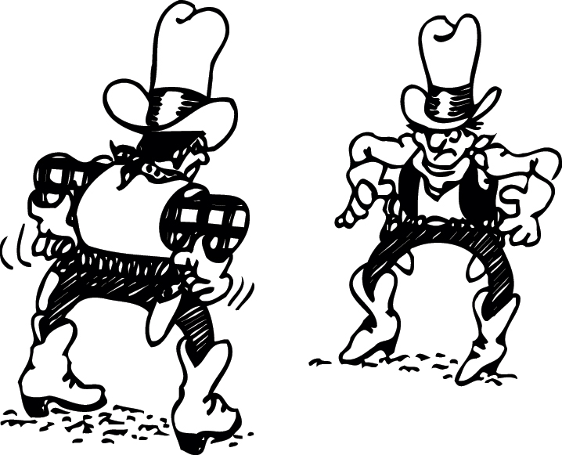
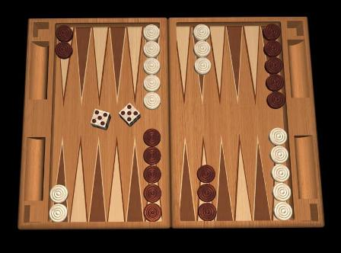
2-party controller selection
Seek inspiration
  O.K. Corral: whoever shoots first wins
  Backgammon: roll dice; highest roll goes first
Tie-breaking
  O.K. Corral: not needed (both dead!)
  Backgammon: try again!

Slide 43
Tie-breaking 101
Problem
  Computers are deterministic
  Rolls are pseudorandom sequences
  Algorithm and seed generates one sequence
Solution
  Highest serial number
  Requires a serial number that can never tie

Slide 44
2-party fault tolerance
What happens if controller halts?
  No problem!
  No communication anyway!
“Fate sharing”
  The controller and 2-party system share fate
  No case where communication could happen but a dead controller prevents it
More complex issue when we get beyond 2 parties . . .

Slide 45
2-party bias
Controller
  Can send whenever desired
Other side
  Needs to wait for controller to poll
Impact:
  Biased controller can undermine fairness
  Even a “good” controller has problems

Slide 46
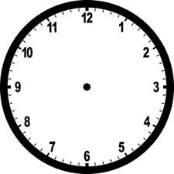
Why are there problems?
Client request might occur just after every poll
Got anything?
Master
Client
Client
Nope
When a poll returns NO, client must wait for next poll
Whereas the server can send immediately

Slide 47
Solving 2-party control
Transfer control of a master
  Helps balance bias over the long term
  Additional cost to initiate/confirm the transfer
Shift from master to ping-pong
  One side starts
  Send message or shift the token
  Token “ping-pongs” until useful data is sent
  Both sides get an equal chance to send
  Fair if message lengths are equal (on average)
  (can establish length upper bound)

Slide 48
N-party master
Like 2-party in general
  Controller (master) polls each member
Same issues
  Controller (master) selection
  Fault tolerance
  Bias

Slide 49
N-party controller selection
Same solutions
  Go-first (time)
  Highest-roll (value)
Same tie-breaking
  Try again
Doesn’t scale very well
  Many selection algorithms prone to ties at high scale
  The Birthday Problem

Slide 50
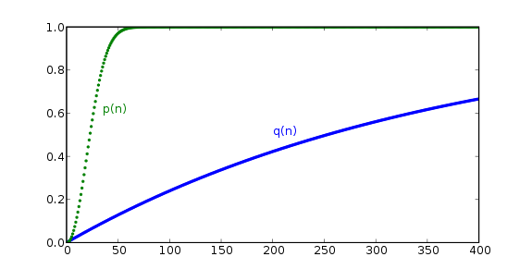
Happy Birthday!
How does this apply to controller selection?
What’s the probability that one of you shares Ben Franklin’s birthday (Jan. 17)?
  For 40 people,
  1-(364/365)^40 = 10%
What’s the probability that two of you share one birthday?
  Roughly 90% for 40 people
Unless random space is much larger than the number of candidates, ties are likely

Slide 51
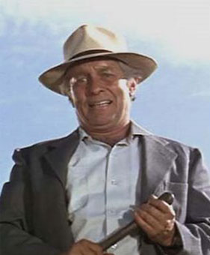
N-party fault tolerance
What happens if controller halts?
  “A failure to communicate”
No more “fate sharing”
  A controller can halt while other pairs could still want to communicate

Slide 52
N-party bias
Controller has much more “control”
  Can treat clients preferentially
  Can keep all clients waiting
New issues
  Not just controller/client message sizes, but also the sizes of each client’s messages

Slide 53
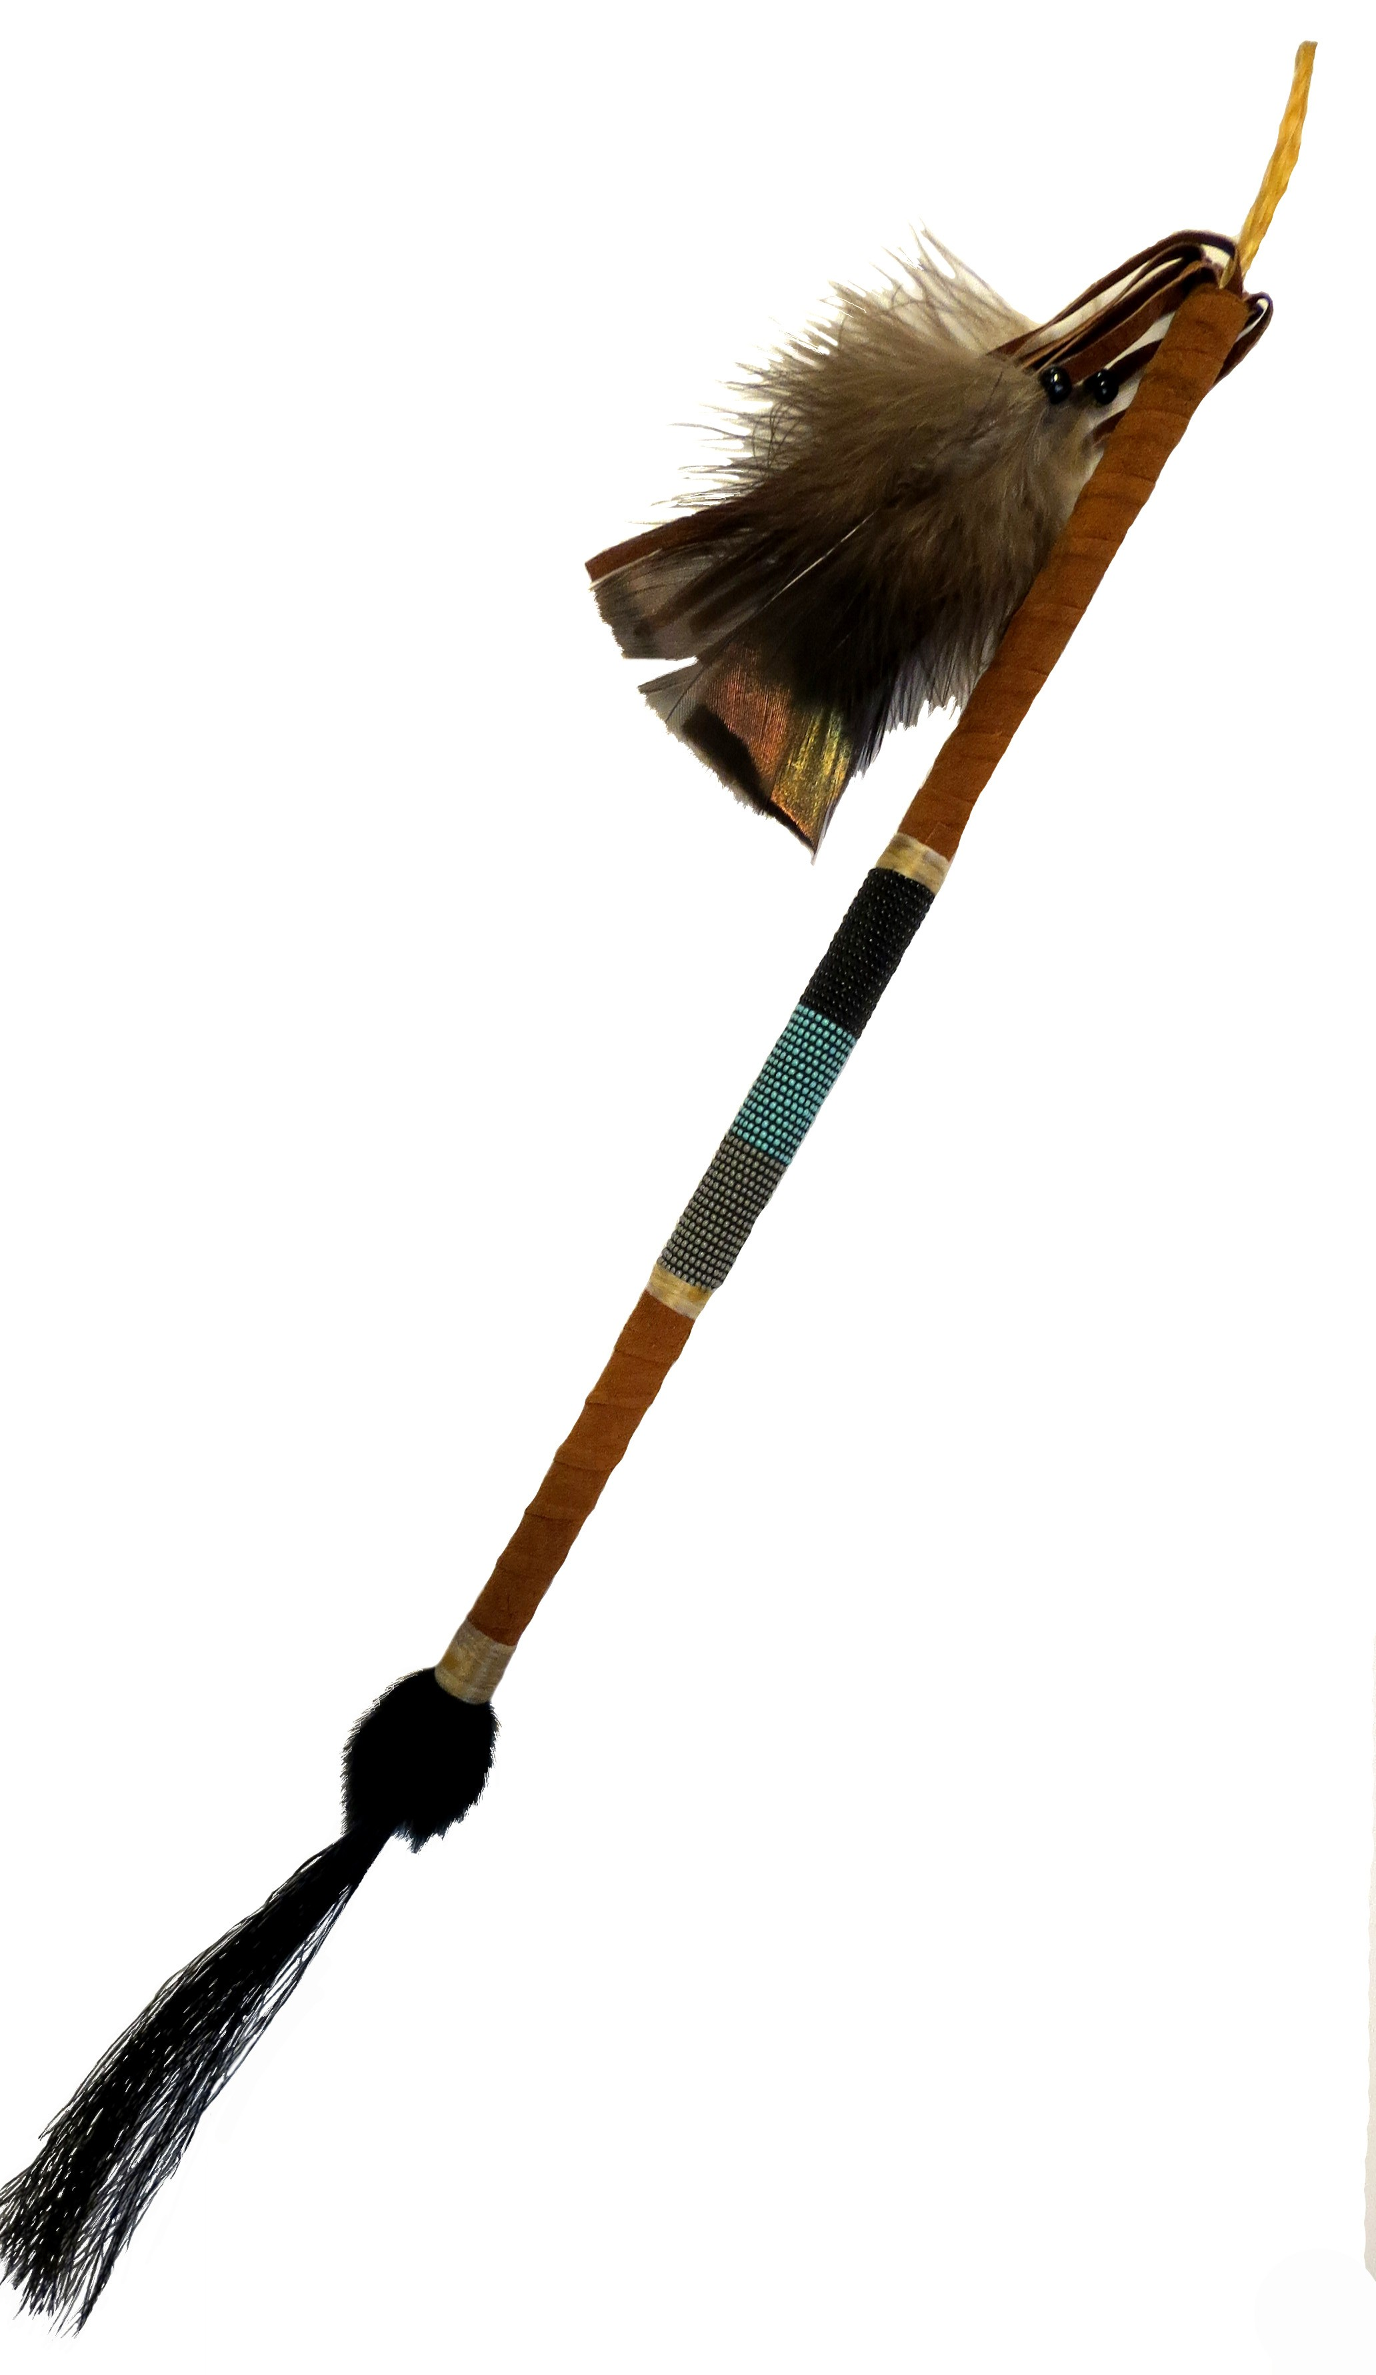
Solving N-party control
Shift from master to rotation
  Rotation is N-party version of ping-pong cycle
  Aboriginal “Talking stick”
Rules:
  Starts with the chief
    Need a “chief election” protocol (dice?)
  Pass in a circle to the right
  Only the stick holder can talk
This is “Token bus” (IEEE 802.4)
  Used by GM for automation
  Derived from a ring network
  (but we haven’t even gotten there yet)

Slide 54
Problems with token bus
Token generation
  Protocol to select the token holder
Token regeneration
  What if the token holder fails?
Enforcing single-token rule
  Members can cheat
Membership changes
  Add member – repair sequence
  Remove member – repair sequence, regenerate token
Result – largely abandoned

Slide 55
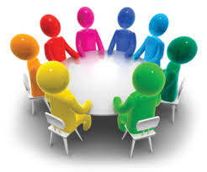
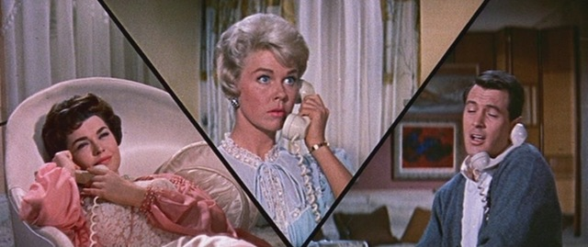
Sharing without a master
Inspiration:
  Discussion group without a talking stick
  “Party line” telephone

Slide 56
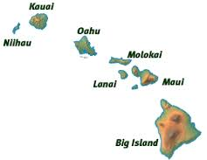
Aloha!
Radio network (1971)
  One shared channel
Message to send
Send message
Did you hear it?
  Yes – DONE
  No – resend (goto #2)

Slide 57
Why didn’t you hear your message?
Because someone else stepped on it
  By transmitting at the same time
What do you do about it?
  Send again
  Hoping it won’t get stepped on again
A little problem
  The other guy’s message also got stepped on
    By you
  He’s going to send again, too

Slide 58
Using random delays
If your message is stepped on, don’t send right away
Wait for a random time and try again
You hope the other guy waits longer
  Or sufficiently shorter
In which case you don’t step on each other again
Obvious issue of utilization vs. chances of repeated collisions

Slide 59

One solution
Slotted Aloha
Don’t send just any time
Divide time into slots
Only send at the start of a slot
On collision, retransmit in next slot
  With probability p (<1)

Slide 60
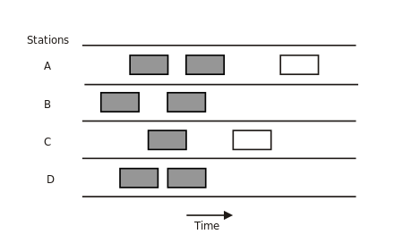
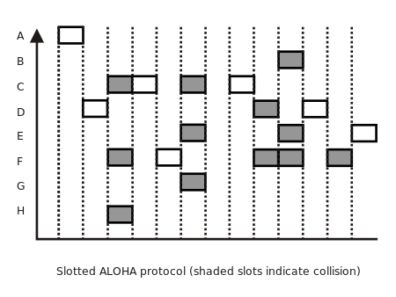
Pure vs. Slotted
Pure
  Send whenever
Slotted
  Common slot time
  Send at slot start only
  Mixes in TDMA

Slide 61
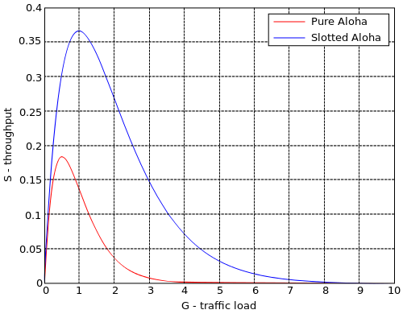
Pure vs. slotted
Assuming fixed-size messages
Assuming Poisson arrivals

Slide 62
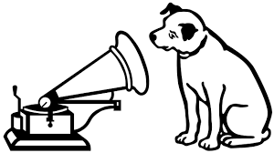
Do you hear what I hear?
Maybe we can do better, if we just listen first

Slide 63
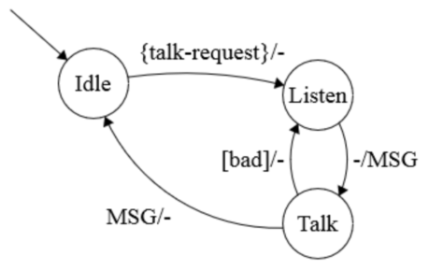
Discussion group rules
Message to send
Listen for quiet
Send message
Did you hear it?
  Yes – DONE
  No – resend (goto #3)
But there are some issues . . .

Slide 64
Summary
Multiple parties can share channels in various ways
  TDMA, FDMA, CDMA
Sharing suggests coordination
  Built into protocol
  Via a master (static or changing)
Like most things, more complex at high scale
If everyone can hear results, can sometimes share without any master

