Slide 1
Multiparty Communications
CS 118
Computer Network Fundamentals
Peter Reiher

Slide 2
Outline
Extending 2-party model to N-party
A party has multiple receivers (other end)
A party has multiple senders (local end)
Multiples of information

Slide 3
Shannon Channel
Two preselected parties
  Homogenous endpoints
Unidirectional channel
  Preselected sender, preselected receiver
One predetermined sender, one predetermined receiver

Slide 4
Shannon 2-party communication
We began by knowing:
  Participating endpoints
  Communication channel
We didn’t know, but fixed:
  When the endpoints share state
    So we need a handshake
    Including “when they want to be active” vs. idle
  Whether something is lost
    So we need timers

Slide 5
Decoupling party from channel
What if we want to talk to different parties?
  Sometimes we communicate with Twitter
  Sometimes we communicate with eBay
  Sometimes we communicate with Wikipedia
Don’t want a permanent, always-on channel to each of them
How can we do better?
  “Detach” channel end from party

Slide 6
Channel vs. party
Shannon channel
  Integrated with the endpoint (party)
  No choices – all information sent/received uses the only channel there is

Slide 7
Separating the two
Need to treat what happens in the endpoint (state to share) from the channel (because there might be more than one)

Slide 8
Abstract network components
Endpoint
  (“party”)
  Source or sink of state (“information”)
Link
  (“channel”)
  Action at a distance (“symbol transfer”)

Slide 9
Components
Shannon
Multiparty, modern terms
Party
Channel
Information
2-party interaction
Endpoint, node, host
Link, hop
State, data
N-party interaction

Slide 10
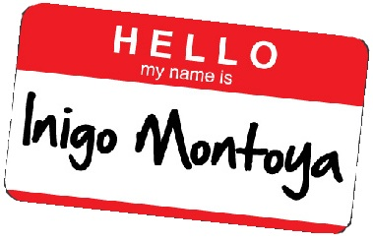
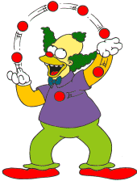

Multiparty extensions
Which party you’re talking to
  Need to differentiate the receivers
  Names
How talk to multiple parties at once
  Juggling multiple “senders”
  Sockets
How to say the same thing multiple times
  Broadcast and multicast

Slide 11
Multiparty
Multiple endpoints
  All connected
  By separate 2-party channels
  Using a single protocol

Slide 12
Multiparty assumptions
Multiple parties
Using ONE common protocol
Connected by direct 2-party channels
  I.e., fully-connected topology
  Each channel disjoint from the others
    In state
    In inputs and outputs

Slide 13
Why is this networking?
Networking
  Methods to enable communication between varying sets of indirectly connected parties that don’t share a single protocol
A small increment
  ONE protocol for now
  Direct 2-party channels for now
  (we’ll get to the other parts later…)

Slide 14
Importance of multiparty
Varying participants
  Pairs communicating change
Varying view of state
  Subsets of state, potential overlap, etc.
More power
  Can share with more than one other party

Slide 15
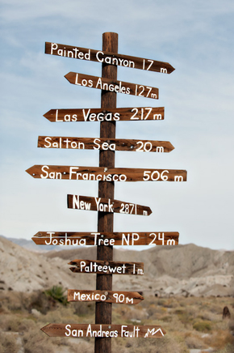
The need for names
Each source can interact with N-1 receivers
  How are receivers differentiated?
    Each uses a different channel
    But how do we specify which channel is which?
Need some sort of identifier to indicate which channel (indicating which receiver)

Slide 16
A simple case
One sender
How do we identify one of the two possible receivers?

Slide 17
What can the name apply to?
Identifier can mean several things at once:
  Channels
  Endpoints
WHY?
  Consider a fully-connected network
  For each source, channel:endpoint is 1:1
Foo

Slide 18
Names for receivers
Index
  A number that corresponds to the channel/endpoint
Port
  An OS-centric type of name specifying what the OS should connect the channel to
Channel
  Used more generically
Socket
  Originally (1974 TCP) meant one end of 2-party
  Unix/BSD copied the term (1983)
  Now means a LOT more
    Large data structure with many parts
    A “socket descriptor”, i.e., a pointer to that structure

Slide 19
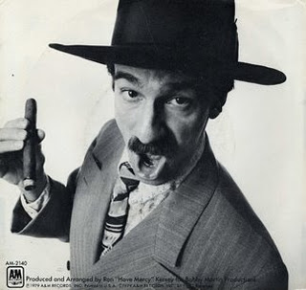
Receiver naming requirements
How unique?
  Each party needs to differentiate N-1 receivers
  Names need to be unique within that set
  NO need (yet) for names to be unique within the set of all parties
    You can call me Ray,
    or you can call me J,
    or you can call be Ray J,
    or you can call me RJ, …

Slide 20
Receiver name examples
One sender can name the other ends it can talk to
Bob
Ted
Ishmael
Alice
Carol

Slide 21
Receiver name examples
Another sender can do the same thing
  But possibly with different names
  Its names need not match anyone else’s
Names are local
  To the sender and receiver
2
Bob
Paul
George
Ringo
Ted
3
11
Ishmael
John
5
7
Alice
Pete
Carol

Slide 22
Multiple senders
A party can have multiple senders (local end)
Like my computer talking to multiple web sites

Slide 23
Concurrency
How does a party deal with multiple communications?
  The channels – need to “keep ‘em separated”
  Need to decouple the channel from the party itself
Socket
  A “disembodied” communication endpoint within a party

Slide 24
What’s inside the party?
Originate/terminate communication
  State to be shared
Where’s that state?
  Part of finite state machine (a process) within the party
  Outside the party
    We can treat this as output/input of a FSM that relays that info to the channel

Slide 25
How many machines are there?
Strictly, one
  Multiple FSMs can be modeled as one FSM
Simpler to think of them as independent
  A set of FSMs, running concurrently
    Multiprocessing
  And/or running as if concurrent with each other
    Multiprogramming
  And/or having internal concurrent components
    Multitasking / multithreading

Slide 26
So what else do we have to name?
On the machine (or state)
  Process/thread identifier
  State identifiers
Why?
  Need to know which portion of the party’s state interacts with a given channel

Slide 27
Internal naming requirements
How unique?
  Each party needs to differentiate some number of “FSMs” (sets of states)
  Names need to be unique within that set
  NO need for names to be unique within the set of all parties
    Will there ever be such a need?
    State is always local to the endpoint

Slide 28
Summary of multiparty naming
Need a way to pick an outgoing channel/receiver
  An internal channel index
A way to pick a subset of internal state/machine
  An internal machine index
BOTH ARE INTERNAL ONLY

Slide 29
Multiples of communications
Each party usually wants to communicate to multiple other parties
Sometimes 1-to-1
Sometimes same info to many others

Slide 30
Shannon channel
Unicast
  1:1
Two parties share state
  Pick which two
  Just communicate
State now shared!

Slide 31
Multiple receivers
Broadcast (1:N)
  Send same info. on all channels
  Every party in the network has the same info.
Multicast (1:M)
  Broadcast on a subset of channels

Slide 32
Broadcast
Share state everywhere
  No need to pick
  Need to replicate
    Multiple communication
    Multiple information

Slide 33
Broadcast
State now shared
  When?
  Need to coordinate
  How to coordinate?
    Three-way handshake
    Chang’s “Echo alg.”

Slide 34
Complexities of communications copying
Atomicity
  Losses don’t correlate across channels
  Might link “all-or-none” behavior
Synchrony
  Knowing all the receivers have the info at the same time
  Having them know that
  Having you know that
Efficiency
  Send one to each receiver? Can we do better?

Slide 35
Multicast
Share with a subset
  How to pick?
  Who picks?
Similar to broadcast
  Need to replicate
  Need to coordinate

Slide 36
Multicast
Things get worse…
  Subset can change
    Add parties
    Remove parties

Slide 37
Multicast complexities
Group selection
  How do you indicate the subset desired?
  Who picks? Sender or receivers?
Changes in group
  Members join
  Members leave

Slide 38
Full pairwise connectivity
One topology
  Full, 1-hop connectivity
  Simple to understand
Expensive to maintain and use
Hard to add new members

Slide 39
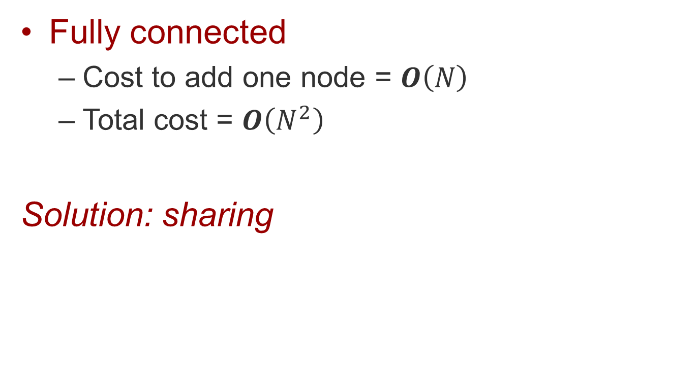
Problems with this picture
Fully connected
  Cost to add one node = $O\left(N\right)$
  Total cost = $O\left(N^{2}\right)$
Solution: sharing

Slide 40
What can we share?
Endpoints
  We’re already doing that
  Multiprocessing, multiprogramming, etc.
  The rest is for CS 111 (Operating Systems)
    Virtualization (abstraction!)
    Resource sharing within a FSM
Channels
  Let’s explore…

Slide 41
Sharing a channel
Sharing in different directions
  Full-duplex
Shared outgoing destination
  A way to support broadcast/multicast
Shared incoming source
  To gather information from multiple sources

Slide 42
The big reason
Scale

Slide 43
Scale
A relationship between two variables and their ratio
  An independent variable that changes arbitrarily
  A dependent variable that is expressed in terms of the independent one
    y = f(x)
The ratio grows in some way:
where c is a positive constant
We say f(x) is bounded by O(g(x))

Slide 44
Scale magnitude
Growth is bounded
  No increase
    Unlimited messaging at no extra cost
  Logarithmic increase
    Phone numbers –one digit gets 10x more numbers
  Linear increase
    6 phones cost roughly 6x one phone
  Polynomial increase
    Every new person in the room adds N possible pairings
  Exponential increase
    Not as bounded!
  Beyond exponential increase
    Even worse, like factorial
y = c log_{k}x
y = cx
y = cx^{k}
y = ckc^{x}
y = cx^{cx}

Slide 45
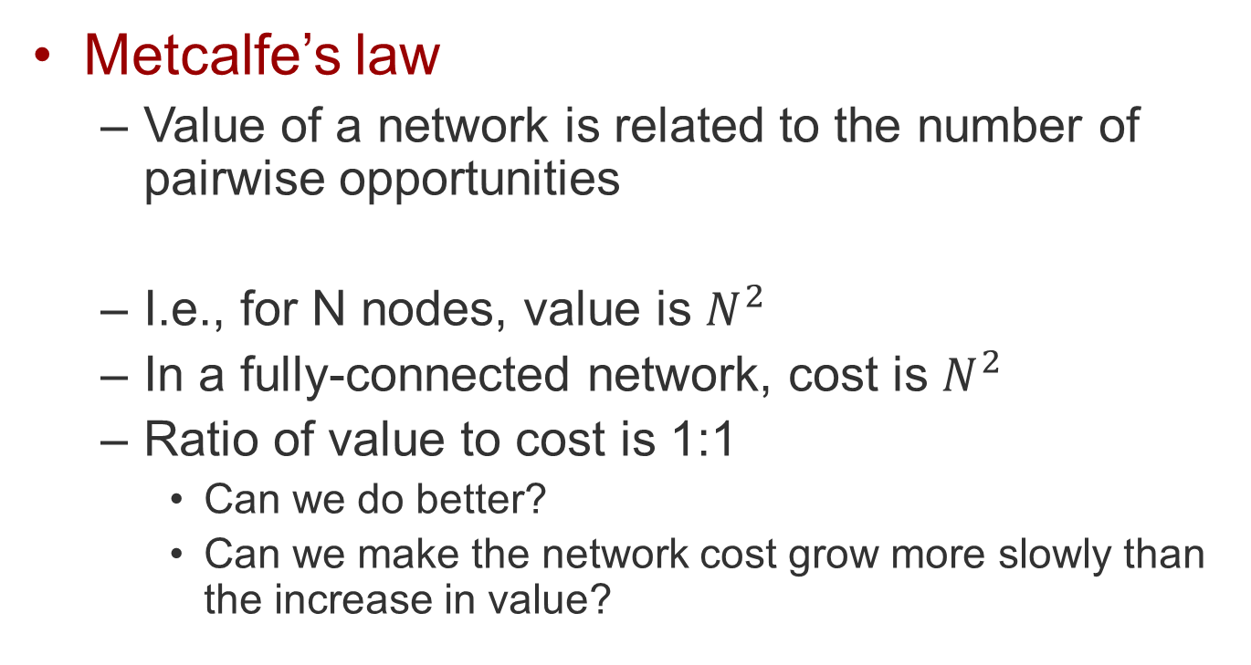
Why do we care?
Metcalfe’s law
  Value of a network is related to the number of pairwise opportunities
  I.e., for N nodes, value is $N^{2}$
  In a fully-connected network, cost is $N^{2}$
  Ratio of value to cost is 1:1
    Can we do better?
    Can we make the network cost grow more slowly than the increase in value?

Slide 46
2-party sharing
2-party channel
Let’s make it two way:
How?

Slide 47

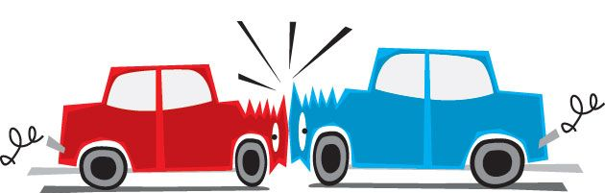
Signals in different directions
Some types of particles don’t interfere
  Bosons: pass right through each other
Others do interfere
  Fermions: collide (Pauli exclusion principle)

Slide 48
For those that interfere,
Keep them separated
By space
  Two simplex channels
  Back where we started!
By time
  “Timesharing”
  Time-division

Slide 49
Time sharing control
Prior agreement
  I.e., embedded in the protocol description
  Requires a common time event (synchronization)
Central controller
  One side controls the communication
We’ll see more general cases later

Slide 50
N-party sharing: 1 to N
Share an outgoing channel
One channel to several destinations

Slide 51
1:N – How?
Receivers all see what transmitter sent
  “Non-destructive” reads
Which receivers accept the symbols?
  All of them (“native” multicast/broadcast)

Slide 52
Non-destructive reads
Read by one receiver doesn’t affect others
  Typical case
Two ways:
  Groups of identical symbols (e.g., particles)
  Perfect copies (measurement doesn’t alter value)
Allows sharing to assume broadcast messages
  Can simplify the sharing protocol

Slide 53
Destructive reads
Read by one (or a subset) of receivers
  Rare
How?
  Observer effect (read affects value)
  E.g., quantum state, collect majority of particles, etc.
Usually considered undesirable
  Non-determinism – can’t control which receiver reads
  Prevents using broadcast for sharing protocol
Can be useful for security
  Tamper evidence if expect only one receiver
  Quantum cryptography, e.g.

Slide 54
Limiting 1:N transmissions
How can a sender control which receiver gets the message?
  Transmit on different channels
  Transmit at different times
  Transmit different symbol sets (“languages”)
  Label the transmission destination (names)
All can be internal to the source
I.e., this is the easy part

Slide 55
N-party sharing: N to 1
Share an incoming channel
One channel from several sources

Slide 56
N:1 – How?
Receiver sees what all transmitters sent
  Technically difficult, at the particle level
  Collisions between particles
  Or confusion of who sent which particle
  One of them
    But which one?

Slide 57
Limiting N:1 transmissions
How can transmitters avoid collisions?
  Transmit on different channels
  Transmit at different times
  Transmit different symbol sets (“languages”)
How can a receiver determine transmitter?
  (all of the above)
  Label the transmission source (names)
Why is this harder than 1:N?

Slide 58
N:1 is harder than 1:N
1:N
  Coordinate use internal to the source
    Time, symbol set
  Naming needs to be coordinated with receiver
    Need to use IDs the receiver recognizes
    But each set is unique in the context of that sender
N:1
  Coordinate use between sources
    Time, symbol set
  Coordinate naming
    Converse of 1:N naming, but name attached by sender
    How does sender know it has a unique name?

Slide 59
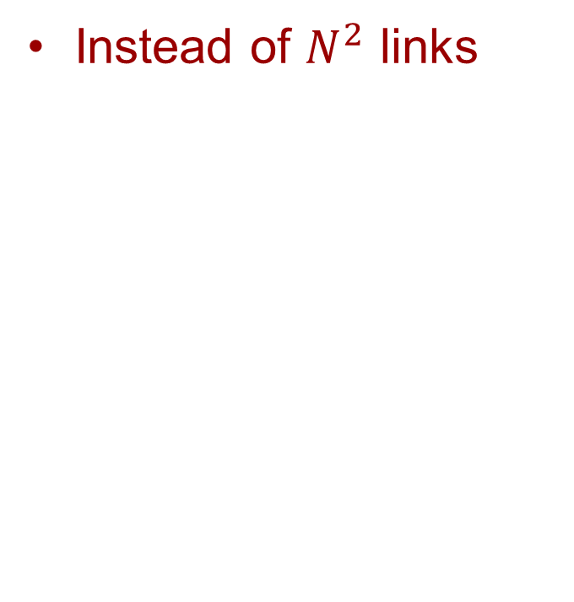
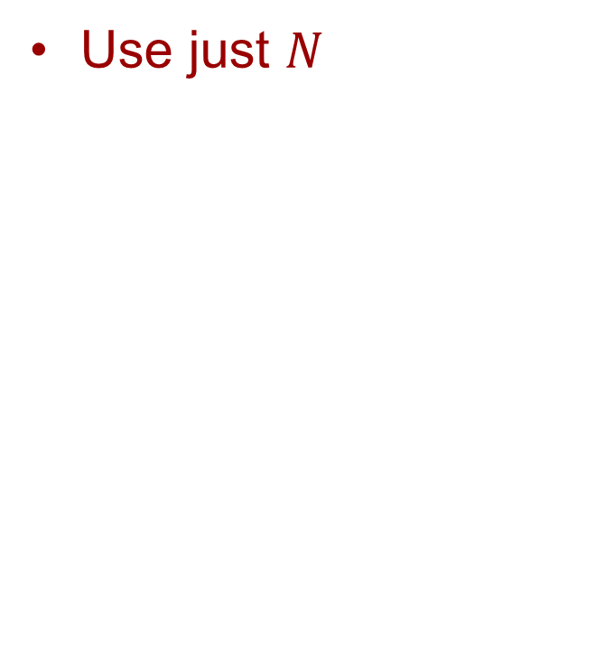
N-party sharing: N to N
Instead of $N^{2}$ links
Use just $N$

Slide 60
The ultimate shared channel
One channel
  All parties transmit on
  All parties receive from
Minimizes link cost
  One link to add
  one node

Slide 61
Single shared channel examples
Freespace
  Diffuse infrared
  Omidirectional RF
Wired
  Bus
  Ethernet
Fiber
  Individual fibers to a passive coupler

Slide 62
N:N – combine rules
1:N – control receiver
  Transmit on different channels
  Transmit at different times
  Transmit different symbol sets (“languages”)
  Label the destination
N:1 – avoid collision
(control transmitter)
  Transmit on different channels
  Transmit at different times
  Transmit different symbol sets (“languages”)
N:1 – identify source
  (all of the above)
  Label the source

Slide 63
Summary
Channel sharing affects network size
  Distance, number of parties
Shared channels requires shared namespaces
  Networking required internal names
  Sharing requires coordinated names
Sharing requires mechanism
  Protocols to manage the network, not just to share endpoint state

