Slide 1
Communications Channels
CS 118
Computer Network Fundamentals
Peter Reiher

Slide 2
Review: Comm. as shared state
Communication is less than most think
  Just syntax – not semantics or intent
Information is based on states
  Which is based on entropy (disorder)
We can model how state evolves
  Each side models the other
  Successive steps in models are how we go from sharing state to transferring files
Noise decreases the information we can pass
  Encodings can correct errors
  But cannot break the Shannon limit

Slide 3

Communication: Roadmap
The imperfect channel
Making the channel real
Automating the channel

Slide 4
What is “encoding a block”?
Forward error correction
  A way to detect and correct errors without asking for more information
Examples:
  Parity
  Majority
  Hamming
  Reed-Solomon

Slide 5
Parity
Sender
  Add one bit to ensure a block has an EVEN (or ODD) number of 1’s
  01011 -> 010111
Receiver
  Check to see if the pattern has the correct number of 1’s
  010111 is OK
  011111 is BAD

Slide 6
What can parity help with?
Error detection
  Detects any ODD number of bit errors in the block
Cost:
  One extra bit per block
Limits:
  Won’t detect any EVEN number of errors (regardless of parity type)
  Cannot correct the errors

Slide 7
Majority
Sender uses a repetition code
  E.g., send each bit three times
  01011 -> 000111000111111
Receiver uses majority voting
  For each triplet, pick the majority value
  001111011110111 becomes 01111

Slide 8
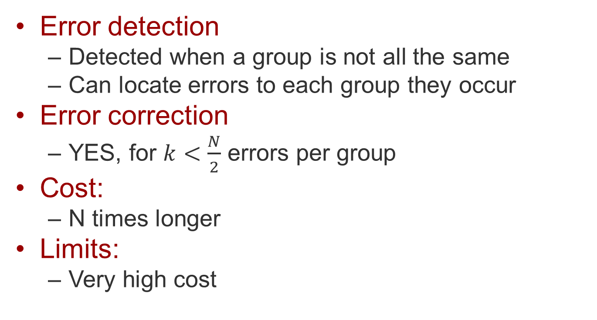
What can majority help with
Error detection
  Detected when a group is not all the same
  Can locate errors to each group they occur
Error correction
  YES, for $k<\frac{N}{2}$ errors per group
Cost:
  N times longer
Limits:
  Very high cost

Slide 9
Hamming
Combines parity with sets
Sender
  Use the algorithm to generate parity codes within various subsets of the bits
Receiver
  Use the algorithm to check parity codes within various subsets. When a parity check fails, it indicates the bit position of the error

Slide 10
A Hamming Code Example
Let’s say we have a 15 bit data item
We want to send it on a noisy channel and be able to correct a 1-bit error
Add 5 parity bits
  Why 5? We’ll see in a minute
But don’t use them as a single 5-bit number
Have each parity bit cover a subset of the overall bits
d1
d2
d3
d4
d5
d6
d7
d8
d9
d10
d11
d12
d13
d14
d15

Slide 11
Building the Hamming Code
We’re going to send 15 bits encoded as 20 bits
  Adding 5 parity bits to the 15 data bits
Where do we put the 5 parity bits?
Not at the end
Scattered through the 20 bit encoded value
OK, so which bits are parity bits?
Any bit whose binary value for position contains only one 1
  Bit 1 (1), bit 2 (10), bit 4 (100), bit 8 (1000), bit 16 (10000)

Slide 12
Adding the parity bits
d1
d2
d3
d4
d5
d6
d7
d8
d9
d10
d11
d12
d13
d14
d15
p1
p2
p4
p8
p16
1
10
11
100
101
110
111
1000
1001
1010
1011
1100
1101
1110
1111
10000
10001
10010
10011
10100
1
2
3
4
5
6
7
8
9
10
11
12
13
14
15
16
17
18
19
20
p1
x
x
x
x
x
x
x
x
x
x
p2
x
x
x
x
x
x
x
x
x
x
p4
x
x
x
x
x
x
x
x
x
p8
x
x
x
x
x
x
x
x
p16
x
x
x
x
x
What does each parity bit cover?

Slide 13
What do we mean by “cover”?
The parity bit is calculated in the usual way
But considering only the bits it covers
So each of the five parity bits is computed differently
  Considering a different (but overlapping) set of data bits

Slide 14
What does this buy us?
If one bit is flipped, some parity bits will come out wrong, when checked
Which indicates that we had an error
But we get more than that from a Hamming code
Let’s consider an example

Slide 15
Hamming code example
Data value:
Add the parity bits
That’s what you send
Receiver checks using the same rules
If all parity bits match, no single bit errors
0 0 1 1 1 0 1 0 0 0 1 0 1 1 0
1 0 0 1 0 1 1 1 1 0 1 0 0 0 1 0 0 1 1 0

Slide 16
What if there’s an error?
What if a single bit is flipped?
  Say, bit #3 changes from 0 to 1
Now compute the parities on what you got
  They come out to:
  But in the message we have:
  Error occurred!
1 0 0 1 0 1 1 1 1 0 1 0 0 0 1 0 0 1 1 0
1 0 1 1 0 1 1 1 1 0 1 0 0 0 1 0 0 1 1 0
0 1 1 1 0
1 0 1 1 0

Slide 17
But we get even more info
Consider the parity bits alone
Which bits didn’t match?
The first and second parity bits (p1 and p2)
Add their positions up:
  1 + 2 = 3
The error was in the third bit of the 20 bits
So we can correct it!
0 1 1 1 0
1 0 1 1 0

Slide 18
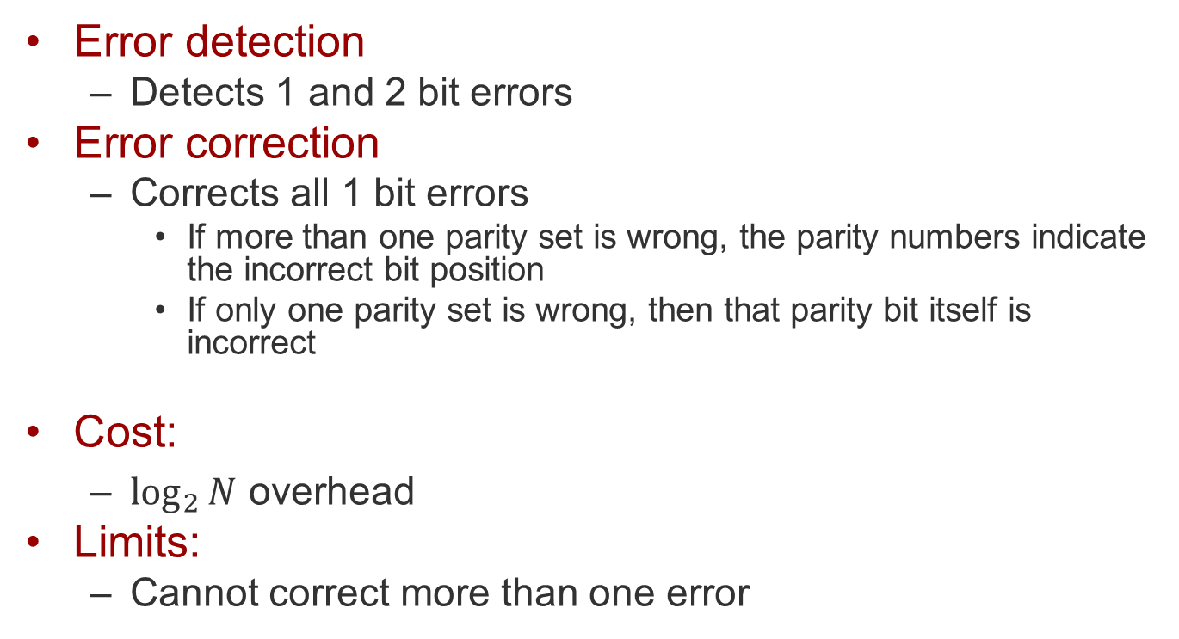
Hamming

Slide 19
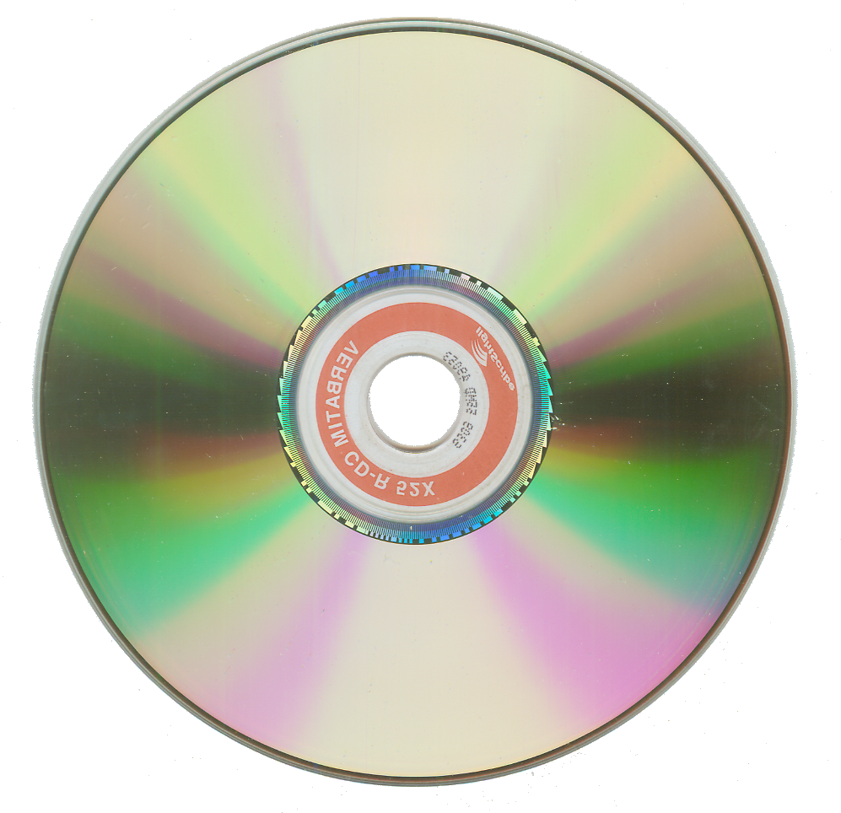

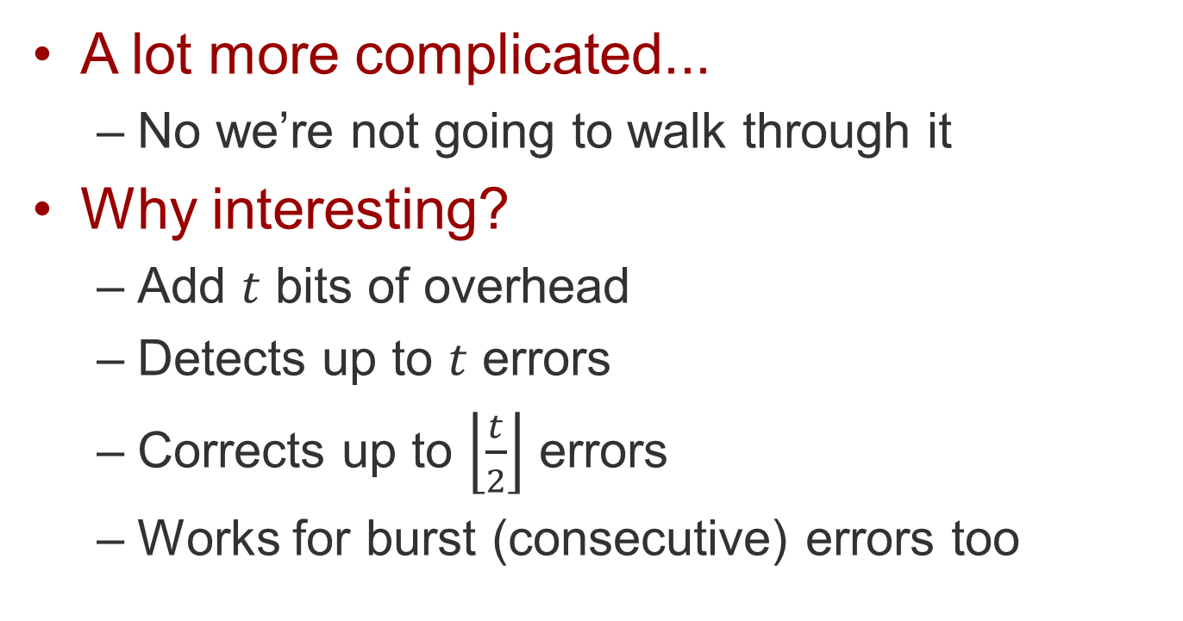
Reed-Solomon
A lot more complicated...
  No we’re not going to walk through it
Why interesting?
  Add $t$ bits of overhead
  Detects up to $t$ errors
  Corrects up to $\left\lfloor \frac{t}{2}\right\rfloor$ errors
  Works for burst (consecutive) errors too

Slide 20
Error vs. loss
Error
  Symbols are received, but not what was sent
Loss
  Nothing is received
How do you detect a loss?

Slide 21
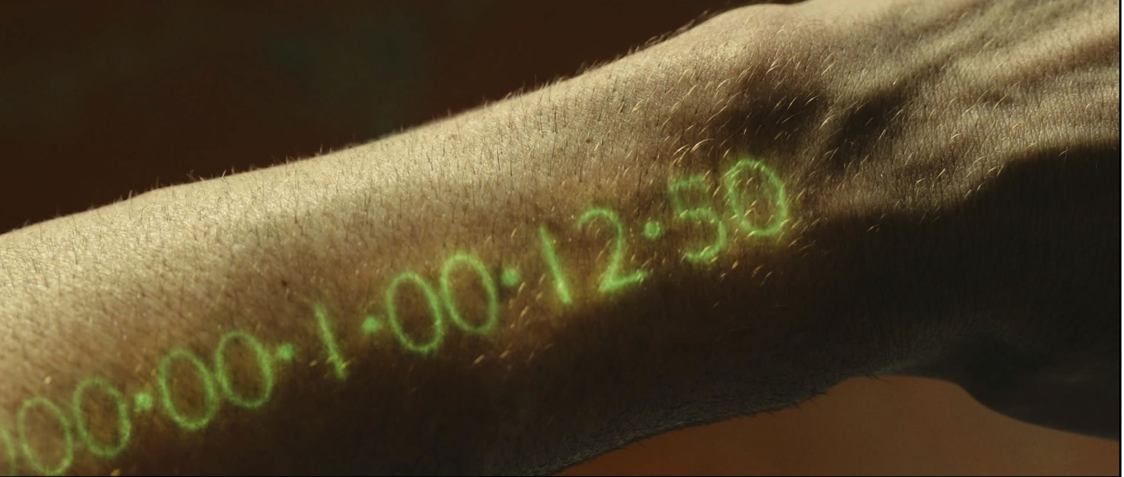
The role of time
The only way to detect loss
  Timer expires
Do you KNOW it was lost?
  Nope. Maybe just late.

Slide 22
Dealing with loss
So what do you do?
At some point, assume loss occurred
  Though perhaps it didn’t
Then fix it!
  In a way that won’t cause problems if you’re wrong
ARQ: Automatic Repeat-reQuest

Slide 23
ARQ
Sender
  Transmits info in blocks with IDs
  Keeps copies and retransmits on request
Receiver
  Collects blocks and looks for missing IDs
    Typically gaps within received sequence
  Ask sender to help (requires reverse channel)
    What do you say?
    When do you say it?

Slide 24
ARQ variants
Negative feedback (NACK)
Positive feedback (ACK)
Receiver reports the IDs lost
  Explicit request to resend
  The IDs presumed lost
  Messages could just be late
Sender resends those explicit requests
  No sender timers
Receiver reports the IDs received
  Confirms receipt
  Implicit request to resend
  No receiver timers
Sender resends IDs not reported
  Looks for gaps
  IDs presumed lost
  IDs could be lost, but so could NACK be

Slide 25
Variants of ARQ
Stop-and-go
  Positive feedback (ACK)
  ID is 1 bit
  Send ACK when block is received
  Also called “alternating bit”
Go-back-N
  Positive feedback (ACK)
  ID is larger
  Send ACK when block is received
  Sender backs up to block after (ID+1) and resends
Selective repeat
  Positive and/or negative (ACK/NACK)
  ID is large
  Sender retransmits only individual lost blocks

Slide 26
Reordering as error
When is a message lost?
  Or just late?
What happens when messages are out of order?
  Buffer them and reorder
  Should this be limited? HOW?

Slide 27
Basic components of a channel
A signal to use to indicate symbols
A media the signal propagates in
A set of symbols
A way to generate and receive symbols
Direction

Slide 28
How to create signals?
Move photons
Move electrons
Move atoms
  Motion waves (sound)
    Pressure waves in gas, liquid
    Transverse waves in solids
  Streams of atoms (water flow)
Move collections of atoms
  Letters, flags, etc.

Slide 29
Types of media
Unguided
  Transparent
  Mechanically conductive
Guided
  Transparent
  Electrically conductive

Slide 30

Freespace
Unguided
  Transparent (includes vacuum)
  Mechanically conductive (except a vacuum)
Propagation velocity
  Faster for EM
  Slower for sound
Signals degrade over distance
Need a clear path
  Not necessarily line-of-sight, though

Slide 31
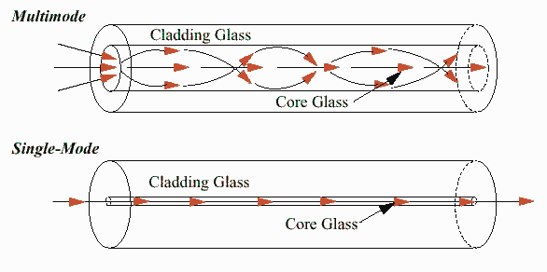
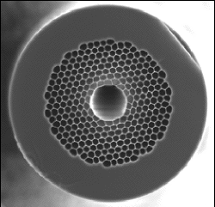
Fibers
Multi-mode
  Thick core
  Many paths
  Many wavelengths
Single-mode
  Thin core
  Fewer paths
  Long-distance
Hollow core
  Uses air as the medium
  Like freespace, but “guided”

Slide 32
Wires
Guided
Conductive
  Material
    Superconductors (various)
    Silver, copper, gold, aluminum,…
Number
  Single-wire (ground-return)
  Two-wire (direct return)

Slide 33
Communication symbols
How we encode information on the signal
Encodings do a lot for us
  Represent information
  Simplify generation
  Simplify reception
  Minimize errors

Slide 34
Some Example Encodings
Amplitude shift keying
  Use different signal power/strength values as symbols
Return to zero
  High/low signal value shows encoding
  Signal value goes to zero between symbols
Non-return to zero
  Using common clock to encode/decode
There are many others

Slide 35
Generating and interpreting signals
Strictly:
  Generation is a way to modulate non-varying sources to generate symbol pattern sequences that correspond to information patterns
Practically:
  Generation is a way to translate one symbol sequence into another
  Since the source has its own representation of a sequence of symbols
Interpretation is pretty much the same thing as generation
  Just a different direction

Slide 36
Direction
We’re still talking about 2-party communication…
Using a single channel, which of them can send to the other?

Slide 37
Simplex
A channel transfers symbols in one direction only
How?
  Signal propagates in a medium

Slide 38
Duplex
A channel simultaneously transfers symbols in both directions
How?
  Using one natively bidirectional channel and transferring non-interfering particles
    EM, e.g., photons or RF
  Using two simplex channels
    One in each direction

Slide 39
Half-duplex
Introduces sharing, but still 2-party
How?
  Using one natively bidirectional channel
  Ensuring that the channel always contains only symbols travelling in the same direction
How do we ensure that?
  Need an automated mechanism to determine which end “speaks” next
  One element of a protocol

Slide 40
What Is a Protocol?
A set of rules, agreed in advance, that enable communication
  Endpoints: the things that want to communicate
  Link: enables action at a distance between the two endpoints
  Protocol: specifies how to automate how these interact

Slide 41
How Do We Automate a Protocol?
Use a finite state machine
  One at each protocol participant, actually
The “machine” is always in exactly one state
There are a finite (and predefined) set of states
Predefined actions cause transition from one of the states to another

Slide 42
Limits of FSMs
Cannot count
  Finite state, so limits on the count
Cannot reverse or duplicate input
  Duplicate would be:
    AB -> ABAB
  Reverse would be:
    AB -> BA

Slide 43
Why do we want a FSM?
Keep our state manageable!
For networking, it’s enough
  We’re basically playing “do what I do”

Slide 44
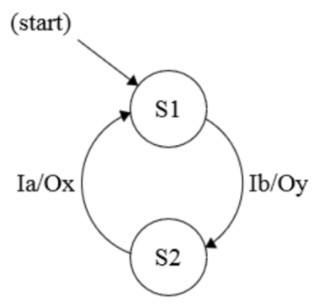
Mealy machine
One type of FSM
Has states (S)
And transitions
  Triggered by inputs (I)
  Causing outputs (O)
Generally a convenient type of FSM for networking

Slide 45
Sharing simple state for networking
A wants to communicate with B
  The goal is for A and B to share state
Assume a perfect channel
  No errors, loss, reordering

Slide 46
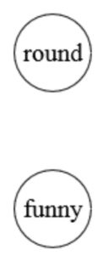
Simplest state
Simplest case:
  Two states: “round” and “funny”
  Do the names matter?
A decides to be in one of two states.
  The goal of communication is for A to make B in the same state.

Slide 47
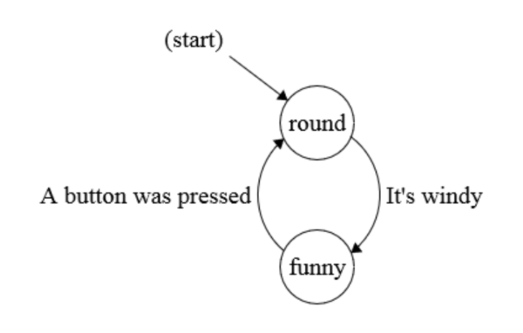
A gets to change state
By itself, for some external reason

Slide 48
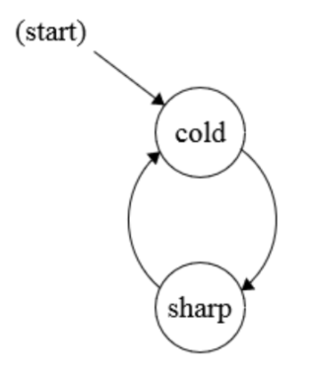
B has a similar state
Names don’t have to match

Slide 49
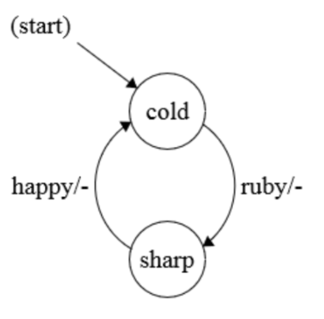
B gets to change state too
Based on what it receives

Slide 50
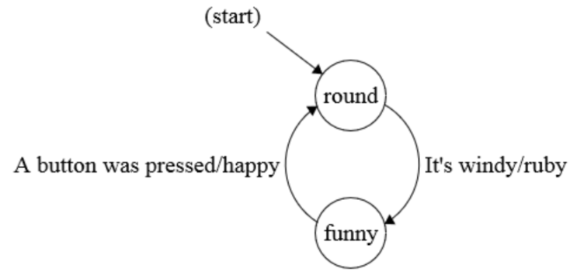
How do we communicate?
Rules:
  Every time A changes state, it let’s B know
  Every time B finds out, it changes state to match
A
B
RUBY
HAPPY

Slide 51
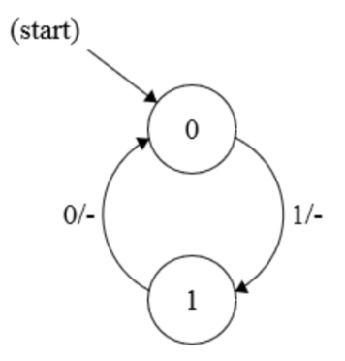
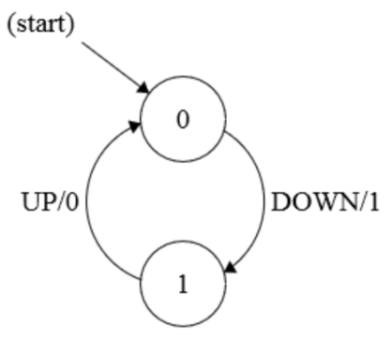
Let’s do that again, more simply
A decides to toggle a switch UP or DOWN
  Causes A to change state
  Protocol makes B match A’s state
A
B
0
1

Slide 52
When are we done?
When will the two states match?
  Some time after A changes state, B will follow
How long?
  Who knows?
  But it’s a reliable channel, so it WILL change state eventually
  Can we do better than that?

Slide 53
Mutual state
States of A and B:
A
B

Slide 54
Mutual state
States of A, B, A’s view of B, B’s view of A:
A
B
B
A

Slide 55
Mutual state
Keep going!
  No limit to the mutual modeling
A
B
B
A
A
B

Slide 56

Yikes!

Slide 57
Limiting mutual state
Stop at one step
  Your state
  Your view of the other end’s state
A
B
A’s view of B
B’s view of A

Slide 58
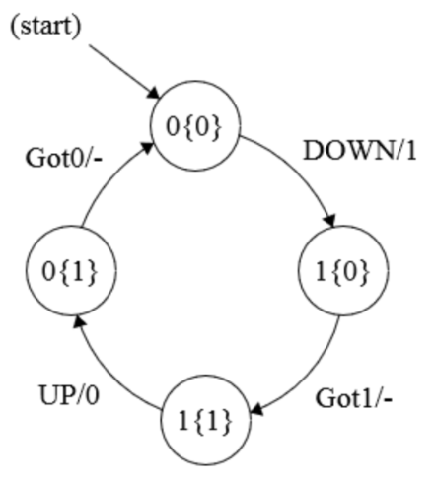
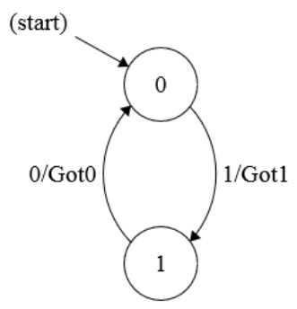
Simple communication with confirmation
Still sending info just from A to B
  A models both sides
  B confirms when it has changed state
A
B
0
Got0
1
Got1

Slide 59
Confirmation
How does A know B learned of the state change?
Positive acknowledgement
  ACK
  Confirms receipt of information

Slide 60
Complication #1: imperfection
Real channels aren’t perfect
Loss
  Need to handle that
Error
  That can happen, too
  But detect and address it as loss
  Error you don’t detect isn’t an error (!)
    It’s the definition of your system . . .

Slide 61
How do we detect loss?
Is it lost or just late?
We can never know for sure
We can only give up
  When timer expires, we declare “loss”

Slide 62
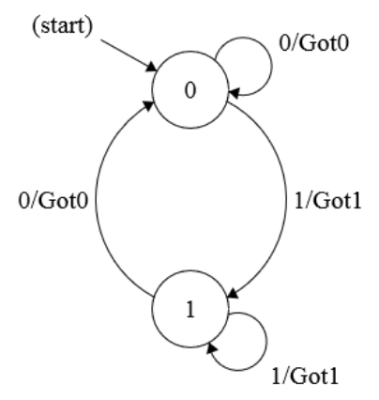
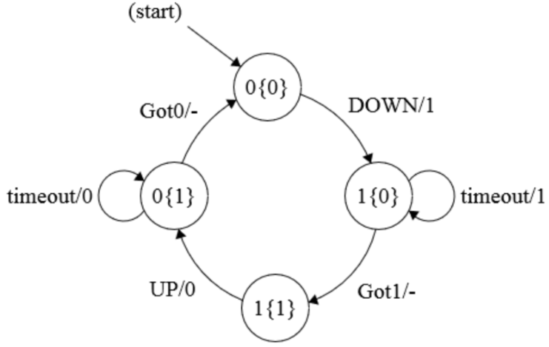
Simple communication with loss
Still sending info just from A to B
  Add repeats based on timeouts
A
B
0
Got0
But what if an ack is lost?

Slide 63
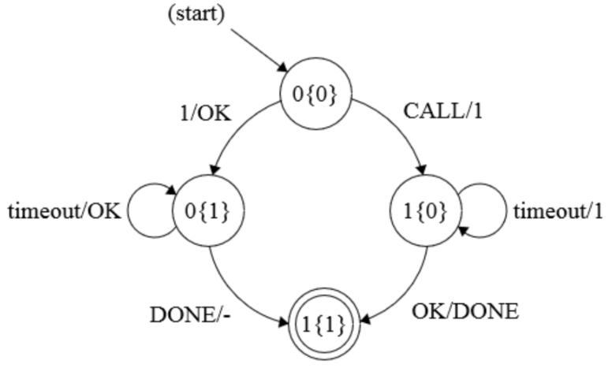
Time out on ACKs, too
The three-way handshake (TWHS)
1
OK
DONE

Slide 64
What’s magic about TWHS?
A
B
0
0
0
0
1
0
1
0
1
OK
1
1
DONE
1
1

Slide 65
What’s magic about TWHS?
Both sides have confirmed with each other
0
0
0
0
1
0
1
0
1
OK
1
1
DONE
1
1
We’ve achieved our limited mutual state

Slide 66
Specifying a protocol
States
  Endpoint values
Symbols
  Messages “on the wire”
Events
  Incoming
  Outgoing
Transition table
  Relates the above
All expressible as a state machine

Slide 67
Let’s break that down a bit more
States at the endpoints
Symbols “on the wire”
Events
  IN:
    Symbols received from the channel (receive) Unix receive()
    Symbols incoming at the sender Unix write()*
    Timer expires
  OUT:
    Symbols sent on the channel (transmit) Unix send()
    Symbols out from the receiver Unix read()*
    Timer is set
Transition table
  Maps events and states to other events and new states
  * these are used from outside the protocol,
  so write() is when an external process sends data into the protocol

Slide 68
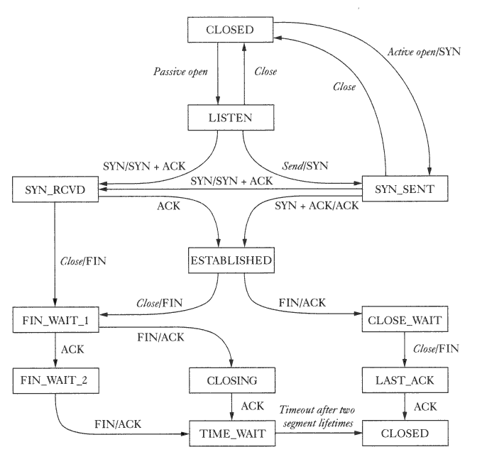
TCP state diagram
Remember
  They’re just NAMES
  It’s the relation,
  not the name,
  that has meaning

Slide 69
This should look familiar
What have we seen before?
  Two sets of handshakes
What’s the rest?
  “corner cases”

Slide 70
Complication #2: sharing complex state
What if we want to share more than one bit?
Share bulk by “leap-of-faith”
  Share a sequence of states

Slide 71
What’s the leap of faith?
We already know how to share a bit
To share more:
  First we agree on a first bit
    We’re both on the call
  Then we agree on each block of bits sent
    We’re really agreeing on one bit:
      Did you get that block?
      “That” defined by an ID (sequence number) and checksum
  Finally we agree we’re done
  We assume that if the above sequence is true, then the file was communicated correctly

Slide 72
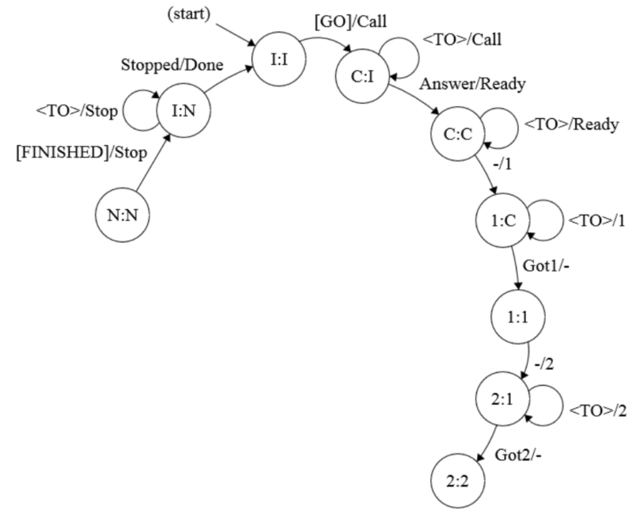
Sequence of states
Step through N items
  Move forward once confirmed
  Stepwise agreement
  End with a final agreement

Slide 73
This 2-party stuff seems universal
It is!
  All protocols should be described the same way
    States
    Symbols (message formats)
    Events
    Transition tables
  State diagrams have familiar parts
    Three-way handshake
    Confirmed shared state

Slide 74
Look at TCP
States
  Connection status
    CLOSED, LISTEN, SYNSENT, SYNRECD, ESTABLISHED, …
    Round-trip time, congestion window, …
  Blocks transferred
    Sequence number
Symbols
  SYN, FIN, RST, ACK
  Block sequence ID
  Data with checksum
Events
  Input
    Message arrivals
    Timer expires
    Write events
  Output
    Message departure
    Timer to set
    Read events
Transition table
  State + inputevent ->
  newstate, outputevent

Slide 75
Why is it hard?
Protocols can be large
  Made of familiar parts
  But many such parts
There’s more than 2 parties to consider
  And we’re getting to that soon too…

Slide 76
Summary
Even noisy channels are useful
  And we can calculate exactly how useful
Errors happen
  We can detect them
  We can correct them
We use protocols to automate communication
  Which are implemented with finite state machines

