Slide 1
Communications and Information Sharing CS 118 Computer Network Fundamentals Peter Reiher

Slide 2
Shared Information
Technical What did you hear?
Semantics What did that mean?
Effectiveness What did I want you to understand?

Slide 3
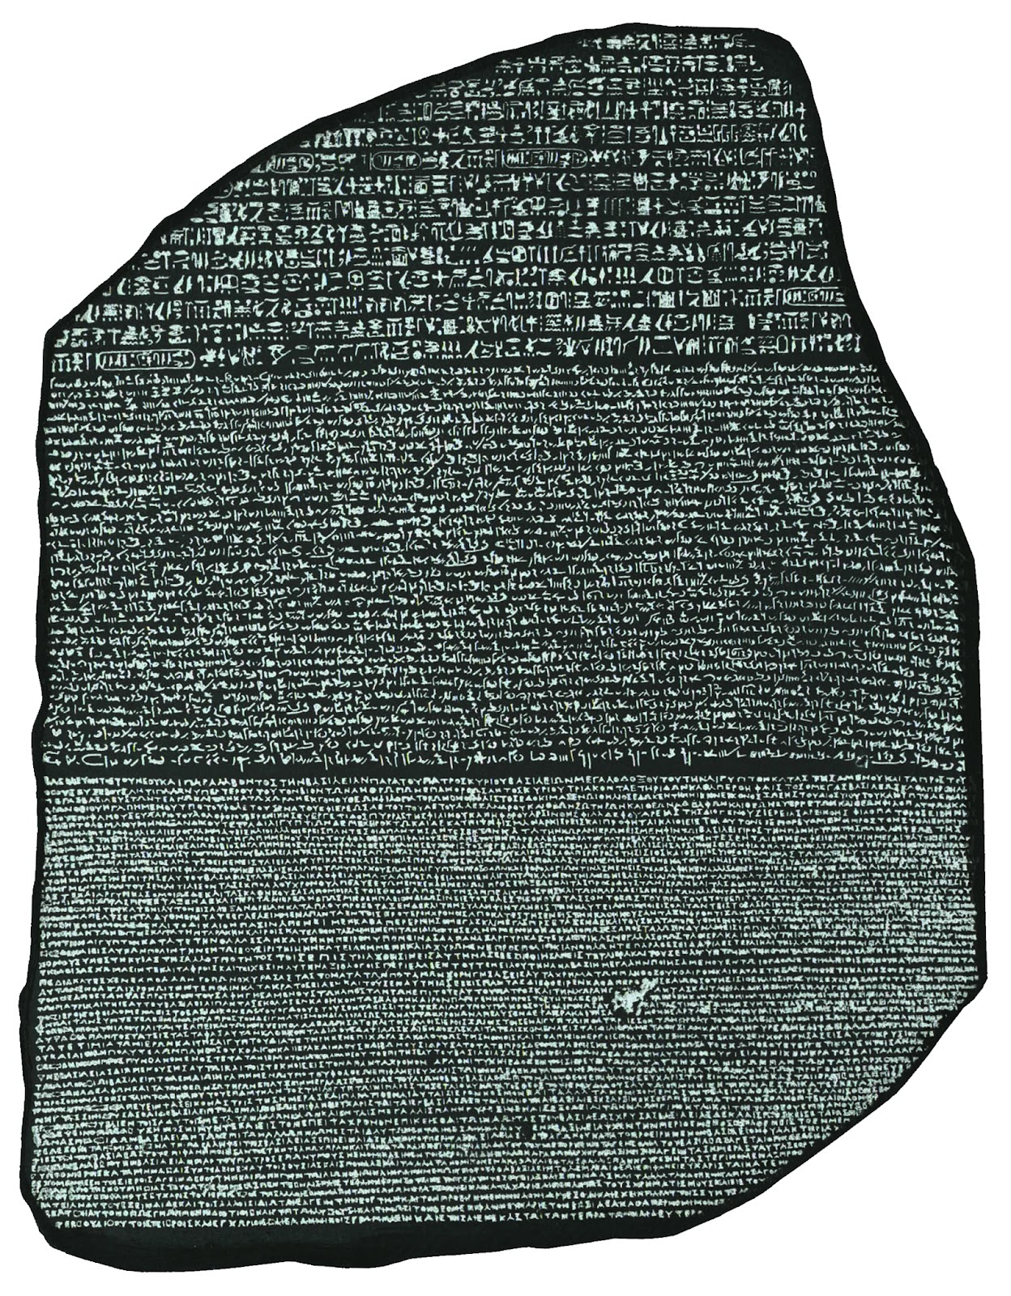
Syntax
Symbols
Particular symbols
Sequences
Order and arrangement

Slide 4

Semantics
What does it mean?
Assigning values to symbols

Slide 5
Analog vs. Digital
Symbol type matters
Analog symbols can be ambiguous
Is the curl at the end of the letter significant or not?
Digital can be mapped to ONE meaning
Computers don’t do ambiguity
And they don’t really do analog, anyway
So we often map analog to digital

Slide 6
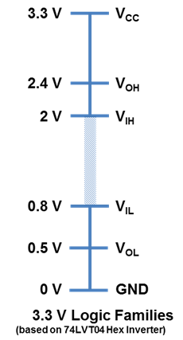
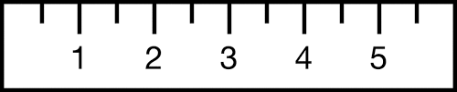
Discretization
Pick specific analog values
Treat only those values as valid
Round unambiguous values (“restoration”, “redigitization”)

Slide 7
Effectiveness
We want our messages to be understood by those who receive them
Precision and accuracy are two important aspects of message effectiveness
Would two receivers interpret a given message as the same state? (precision)
Is it the state the transmitter intended? (accuracy)

Slide 8
Which Shared Information Aspects Can We Handle?
Syntax
Maybe, with enough rules, if we fix errors
Semantics
Kitchen sink problem
Fruit flies like a banana, time flies like an arrow.
Effectiveness
Often related to intent
Which is beyond technical means

Slide 9
Constraining the problem
Syntax
Always check it
Semantics
For control only
Not for message content
Meaning of loss, retransmission, flow control
Effectiveness
Not really a communications problem
Assume effective or check results and redo

Slide 10
What Is Communications?
Information
Source
Transmitter
Receiver
Destination
Raw info
Encoded info
Raw info
But we need to encode the information for transmission
Both to match the physical characteristics of the transmission medium
And for other purposes that will become clearer
Then it needs to be decoded after transmission
Converting it back to something the destination can understand

Slide 11
Raw vs. encoded information
Remember, we’re at a general level here
Not just computer messages
Also speech, audio, and everything else
Raw information is what the sender wants to communicate
And what the receiver wants to get
Encoded information is what the transmission medium can deal with
Probably not the same as raw information

Slide 12
Raw information
Not necessarily the same for sender and receiver
A German speaker sends a message to a Korean speaker
Probably starts out as German
And ends up as Korean
Same may be true for computer communications
E.g., 32 bit word sender vs. 64 bit word receiver

Slide 13
Encoded information
A characteristic of the communication medium
Not the nature of the raw information, usually
If you’re using Morse code, it’s dots and dashes
Regardless of whether you send English or French
Though conversion to and from encoding could change
If you’re using electrical wires, it might be voltage levels

Slide 14
Messages and State
The sending and receiving of a message specifies states
What states?
The states at the sender and receiver

Slide 15
Sender and Receiver States
The sender sent a particular message
With particular syntax, semantics, and effectiveness
Those specify a state at the sender
The receiver received a particular message
Again, with particular syntax, semantics, and effectiveness
That’s the receiver’s state
But we can only send syntax
Not semantics or effectiveness

Slide 16
Entropy and Information
A measure of disorder
Lack of predictability
Entropy specifies the maximum amount of information in a message
How many different messages could be sent?
How many could be received?
The more you could send or receive, the more possible states
And thus more entropy

Slide 17
For Example,
The sender only sends YES or NO
And only sends one such message
How much information is sent?
One bit – a zero or a one
What if the sender sends two such messages?
Two bits – 00, 01, 10, or 11
More choices, more states, more uncertainty ➔ more entropy

Slide 18
Communications and Entropy
Shannon developed the basic equation describing communications in terms of entropy
Consider the source as a finite state machine
For each source state i there is an entropy H_{i} equal to –p_{i}log p_{i}
Also, there is a probability p_{i}(j) of producing symbol j from state i
So the source’s entropy is –Σp_{i}(p_{i}(j)log p_{i}(j))
Stationary assumption gives us H = –Σp_{i}log p_{i}

Slide 19
Max and min entropy
Consider a two-state sender
Max entropy is when the choice is 50/50
Min entropy is when there is no choice
Entropy
Probability

Slide 20
Returning to Our Example
The sender only sends YES or NO
And only sends one such message
When is the sender entropy at max?
When either message is equally likely
When is the sender entropy at min?
When he always sends YES
Or always sends NO

Slide 21
Generalizing the Example
What if we can send N different symbols?
Rather than just YES or NO
When is entropy of the sender minimized?
When only one of the N symbols is ever sent
When is entropy of the sender maximized?
When any one of the N symbols is equally likely

Slide 22
So What?
We can now say something about how much information you can push through a channel
Let the source have entropy H (bits per symbol)
Let the channel have capacity C (bits per second)
Then we can transmit C/H – ε symbols per second
For arbitrarily small ε
But never more than C/H

Slide 23
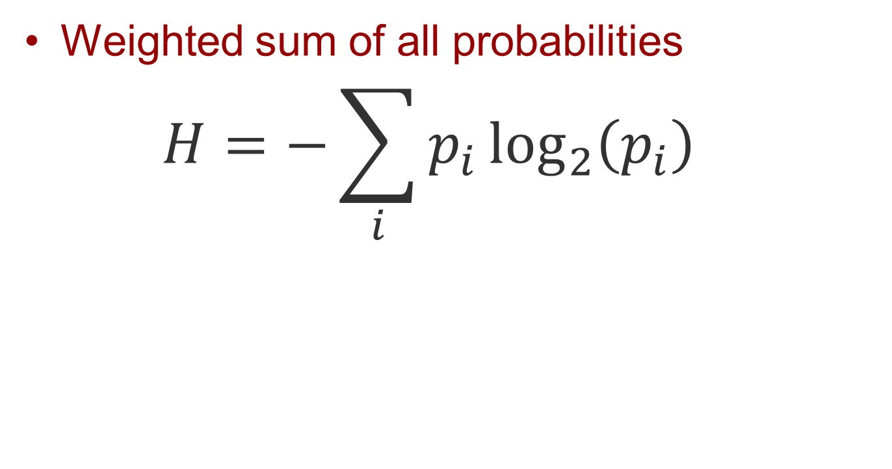
Information
Weighted sum of all probabilities
$$H=−\sum_{i}{p_{i}\log_{2}\left(p_{i}\right)}$$
Notes:
H = Shannon entropy for information (vs. randomness)

Slide 24
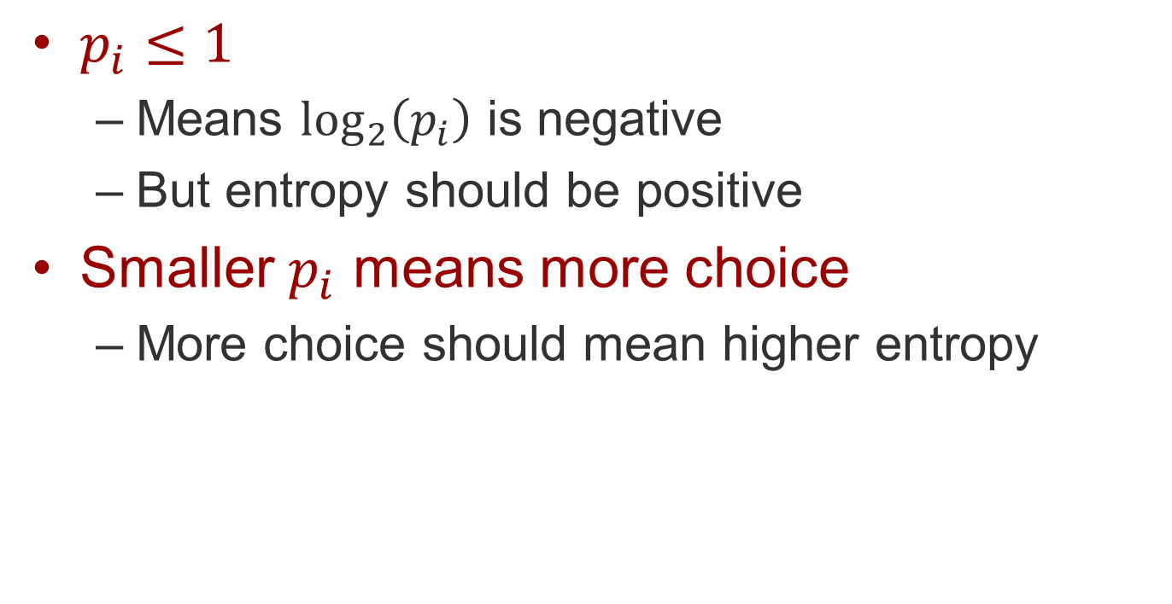
Why negative?
$p_{i}≤1$
Means $\log_{2}\left(p_{i}\right)$ is negative
But entropy should be positive
Smaller $p_{i}$ means more choice
More choice should mean higher entropy

Slide 25
What about zero probabilities?
What if p_{i} = 0?
log (0) is not defined
But we’re summing p_{i}log(p_{i})
So treat p_{i}log(p_{i}) as 0 when p_{i} = 0

Slide 26
Predictability
What if we’re not sending random bits?
Maybe it’s English text in ASCII
Maybe it’s Morse code
Then the p_{i}(j)’s are not uniform
Some symbols are more likely, given the symbols already sent
Entropy is lower than the max
Meaning we can squeeze more information through

Slide 27
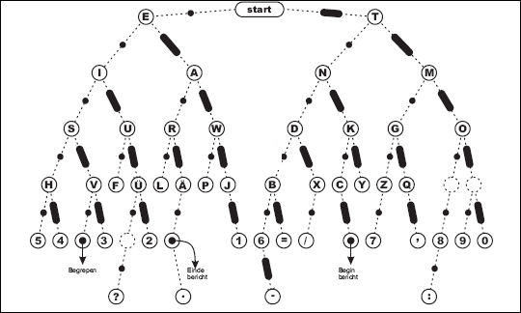
Morse code
Code representation:
E ● 1
T ▬ 3
A ● ▬ 5
O ▬ ▬ ▬ 11
I ● ● 3
N ▬ ● 5
S ● ● ● 5

Slide 28
What if choices aren’t equal?
YELLO_
What comes next?
PIT_
What comes next?
“Next letter” in English isn’t 1 of 26
Roughly 50% redundant

Slide 29
A look at Morse code again…
Time units:
Dot = t
Dash = 3t
Inter-symbol gap within a letter = t

Slide 30
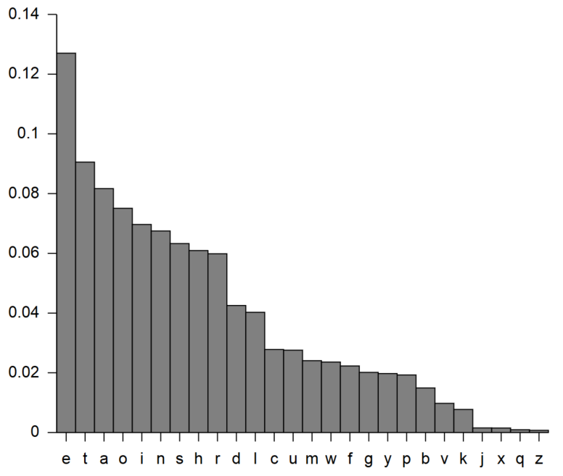
American English letter frequencies
Basic order:
E
T
A
O
I
N
S

Slide 31
How Do We Get More Through?
Encoding it properly
In essence, “short” signals for common things
Long signals for uncommon things
E.g., Morse code
Common letters are few dots and dashes
Uncommon letters require more dots and dashes
Each dot or dash takes up time on the line
They didn’t do it perfectly . . .

Slide 32
Who Does This Coding?
Information
Source
Transmitter
Receiver
Destination
e
●
e
And the receiver decodes

Slide 33
The perils of sharing
Shared state may be inaccurate
Channel errors
Time (i.e., ‘staleness’)
Capacity is finite
Nobody can know everything

Slide 34
Simple state

Slide 35
How does communication affect state?
Knowledge doesn’t stay still…

Slide 36
Effect of receiving
Entropy decreases
Receiver knows more about the transmitter

Slide 37
Effect of time
Entropy never decreases over time
Usually increases

Slide 38
Effect of sending (1)
Sending information about your state
Makes your view of receiver state fuzzier

Slide 39

Effect of sending (2)
Entire system entropy never decreases
Receiver’s model of transmitter entropy decreases in entropy, so sender’s model of receiver MUST increase in entropy
$$S\left( \right)+S\left( \right)≥0$$

Slide 40
Putting it all together – CTP
Character transfer protocol
(we’re creating this as an example)
Sending a message one letter at a time
Assume a perfect channel
No errors in transmission, ever

Slide 41
CTP events
Starting condition
Both sides share rules (protocol)
And share endpoint info (link)

Slide 42
CTP rules
Both endpoints start in the state:
NOT-CONNECTED
Use phone-call protocol to get to:
CONNECTED
Connected transmitter
sends characters one a time
Connected receiver
receives characters one at a time until CLOSED
At EOF
transmitter closes connection

Slide 43
From not-connected to connected
Simple phone-call protocol
Transmitter initiates, waits for response
Receiver responds when asked
Once confirmed, both sides enter CONNECTED state
Remember – perfect channel, so no need for timeouts or exceptions

Slide 44
Simple transfer
Character at a time
Transmitter sends characters in order
Receiver collects characters and places them in order
What state is shared?
CONNECTED state
The character

Slide 45
From connected to closed
Final change in shared state
Lets receiver know
Transfer can be stopped
Message is complete

Slide 46
CTP evolution
Successive increased shared state:
Agree to change from not-connected to connected
Using the phone-call protocol
Agree on each character sent
In a perfect channel, nothing is lost or reordered, so transmitter knows what receiver gets (i.e., agreement always happens)
Agree to end transfer

Slide 47
Limits of CTP
Assumes a perfect channel
Ignores loss, reordering, flow control, etc.
Inefficient
The agreed state is augmented one character at a time

Slide 48
Once closed, what do we know?
The message!
WHY? – the succession of shared state

Slide 49
Back to predictability
We know more than we think
Can send groups of characters
Can confirm using “checksums”

Slide 50
Putting it all together – FTP
A more efficient version of CTP

Slide 51
Starting point
Share protocol rules
Already know each other’s endpoint
Know we’re using those rules
TCP port 22

Slide 52
From not-connected to connected
Uses TCP’s version of the phone-call protocol:
Transmitter sends SYN
Receiver sends SYN-ACK
Once confirmed, both sides enter ESTABLISHED TCP state
What’s the difference?
Over a perfect channel, NOTHING

Slide 53
What about an imperfect channel?
Some characters might be dropped
“H e l l o” becomes “H e l l”
Some characters might be changed
“F a r” becomes “F u r”
Some characters might be added
“H e a t” becomes “H e a r t”
Or maybe it came through unchanged
How can the receiver know what happened?

Slide 54
Better transfer
Block at a time
Transmitter sends characters in order inside blocks, labeled with a checksum
Receiver collects blocks, verifies checksums, and places them in order
What state is shared?
Connection state
The CHECKSUMS!

Slide 55
FTP evolution
Successive increased shared state:
Agree to change from IDLE to ESTABLISHED
Using the TCP protocol
Agree on each checksum sent
Agree to end transfer

Slide 56
From connected to closed
Final change in shared state
Lets receiver know
Transfer can be stopped
Message is complete – WHY?

Slide 57
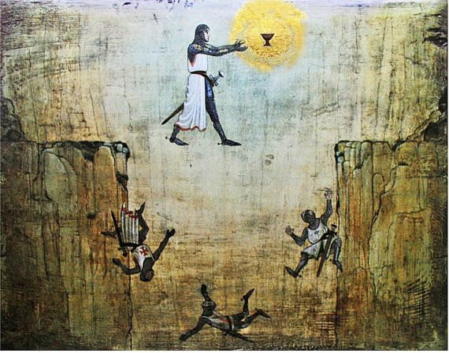
FTP’s leap of faith
Correct file transfer IFF:
Sequence of correct blocks
Each block is correct IFF checksum is correct

Slide 58
Examples of FTP-like exchanges
File transfer
Web request/response
Netflix

Slide 59
What other states can we add?
Pacing
How fast does the transfer go?
At constant or changing tempo?
Number of outstanding messages
Messages sent but not yet received
Or perhaps received, but not yet acknowledged
Amount of reordering

Slide 60
What should you assume?
As little as possible!

Slide 61
Postel Principle
Be conservative in what you do…
Transmit only what you think will help
Transmit only what you expect will be understood
Be liberal in what you tolerate.
If a message could mean multiple things, allow as many as possible
Do not assume malice where incompetence will suffice (errors happen)

Slide 62
Information
Weighted sum of all probabilities
$$H=−\sum_{i}{p_{i}\log_{2}\left(p_{i}\right)}$$
Notes:
H = Shannon entropy for information (vs. randomness)

Slide 63
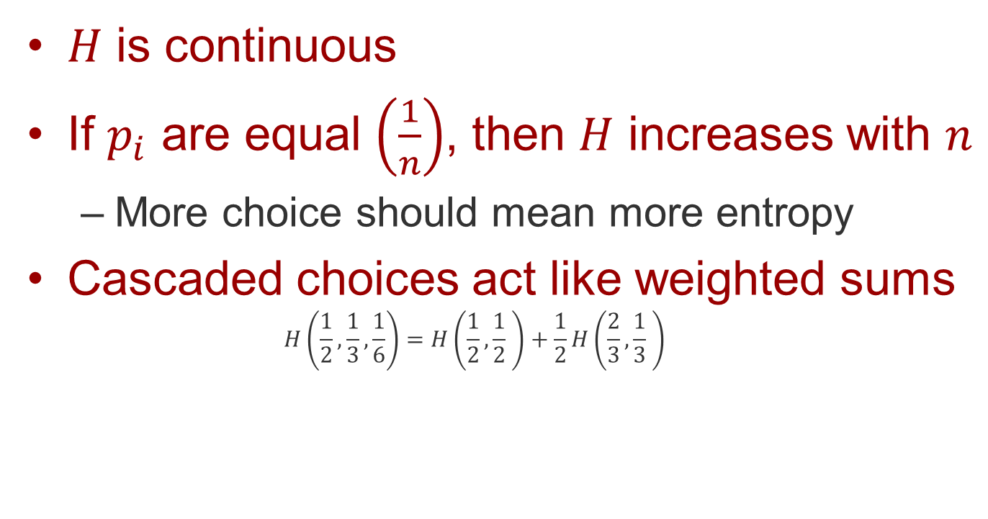
Why exactly this function?
$H$ is continuous
If $p_{i}$ are equal $\left(\frac{1}{n}\right)$, then $H$ increases with $n$
More choice should mean more entropy
Cascaded choices act like weighted sums
$$H\left(\frac{1}{2},\frac{1}{3},\frac{1}{6}\right)=H\left(\frac{1}{2},\frac{1}{2} \right)+\frac{1}{2}H\left(\frac{2}{3},\frac{1}{3} \right)$$
=

Slide 64
Unbalanced tree of 32 choices
1 bit (avg)
0.5 bit (avg)
0.25 bit (avg)
0.125 bit (avg)
Consider putting a new item in one of the yellow bins; for every 32 items, the count indicates how many end up in that bin. The bin use is heavily biased in this example. How many bits are needed to classify the item?
Σ 1.875 bits (avg)

Slide 65
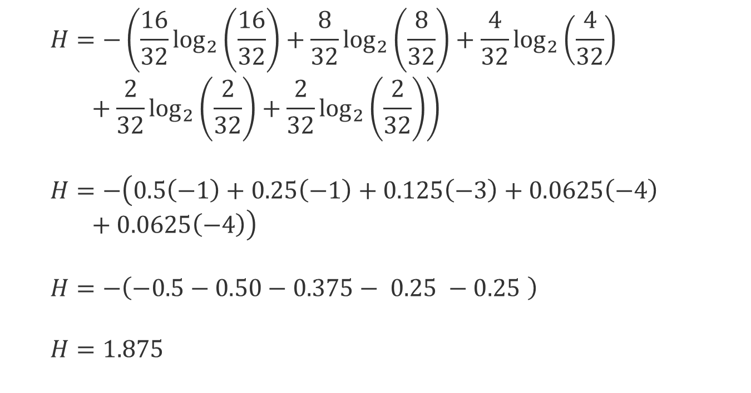
Unbalanced tree – weighted sum
$$H=−\left(\frac{16}{32}\log_{2}\left(\frac{16}{32}\right)+\frac{8}{32}\log_{2}\left(\frac{8}{32}\right)+\frac{4}{32}\log_{2}\left(\frac{4}{32}\right)+\frac{2}{32}\log_{2}\left(\frac{2}{32}\right)+\frac{2}{32}\log_{2}\left(\frac{2}{32}\right)\right)$$
$$H=−\left(0.5\left(−1\right)+0.25\left(−1\right)+0.125\left(−3\right)+0.0625\left(−4\right)+0.0625\left(−4\right)\right)$$
$$H=−\left(−0.5−0.50−0.375− 0.25 −0.25 \right)$$
$$H=1.875$$

Slide 66
Balanced tree of 32 choices
1 bit (avg)
1 bit (avg)
1 bit (avg)
1 bit (avg)
1 bit (avg)
Consider putting a new item in one of the blue bins; for every 32 items, the count indicates how many end up in that bin. This time the counts per bin are the same, and the number of bins used is maximized. How many bits are needed to classify the item now?
Σ 5 bits (avg)

Slide 67
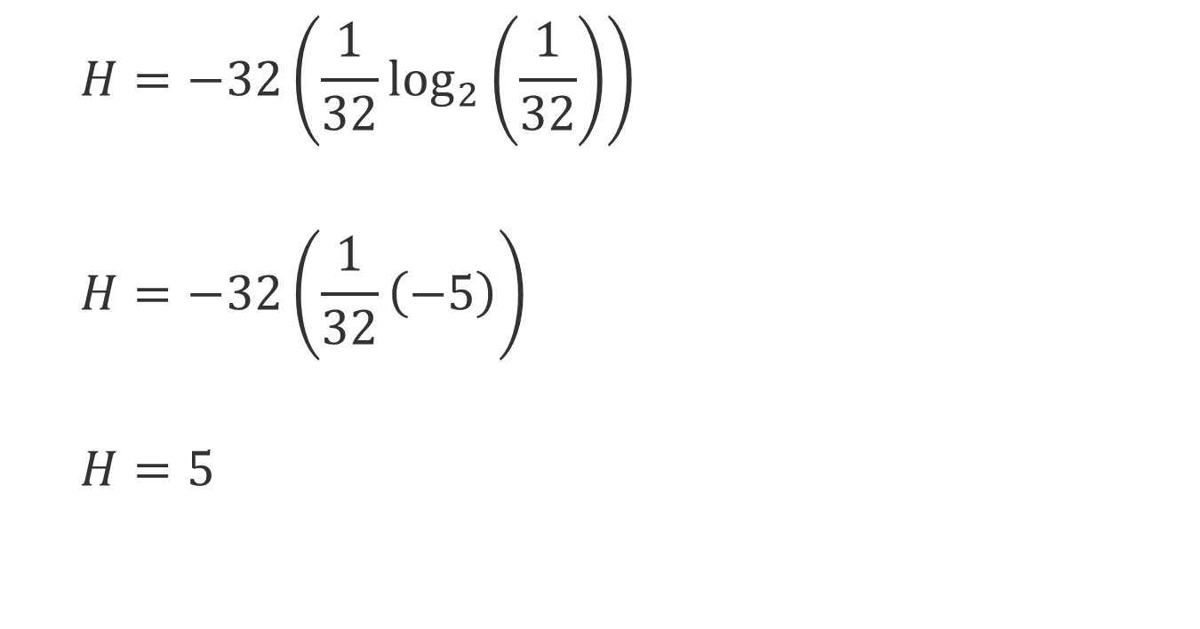
Balanced tree – weighted sum
$$H=−32\left(\frac{1}{32}\log_{2}\left(\frac{1}{32}\right)\right)$$
$$H=−32\left(\frac{1}{32}\left(−5\right)\right)$$
$$H=5$$
For 32 choices, that’s the maximum entropy

Slide 68
What if only 1 of 32 was possible?
Let’s say 31 values have zero probability and one value has probability 1
So H = 0
As expected, when there’s no choice

Slide 69
The Perfect Channel
Information
Source
Transmitter
Receiver
Destination
Raw info
Encoded info
Raw info
The channel never alters the encoded information
The transmitter and receiver always convert perfectly back and forth

Slide 70
The Noisy Channel
Information
Source
Transmitter
Receiver
Destination
Raw info
Encoded info
Raw info
Encoded info
Noise
=
Raw info
Raw info

Slide 71
What is a noisy channel?
A channel that introduces errors into transmission
What is sent is not always what is received
Noise can be of arbitrary nature
Always or sometimes
Affects some or all of message
The capacity of a noisy channel is the maximum rate at which useful information can be transmitted
Information not altered by the noise

Slide 72
Equivocation
A situation where a received symbol might have been caused by more than one sent symbol
E.g., you got a 1, but I might have sent either 0 or 1
How did that happen?
Noise in the channel
Possibly altering my intended signal

Slide 73
Consider three cases
0% change
0->0, 1->1
No noise
100% change
0->1, 1->0
All the symbols change, but there’s no ambiguity!
No noise!
50% change
0->(0,1), 1->(0,1)
The symbols change with max randomness!
All noise – NO way to recover

Slide 74
Consider a matrix of choices
 | Receive a 0 | Receive a 1
Send a 0 | a | c
Send a 1 | b | d

Slide 75
What does it mean?
Sender transmits 0
(a+c)/(a+b+c+d) sent as 0
a/(a+c) received as 0
c/(a+c) received as 1
Sender transmits 1
(b+d)/(a+b+c+d) sent as 1
b/(b+d) received as 0
d/(b+d) received as 1
 | Receive a 0 | Receive a 1
Send a 0 | a | c
Send a 1 | b | d

Slide 76
What does it mean 2.0?
Receiver gets 0
(a+b)/(a+b+c+d) rec’d as 0
a/(a+b) sent as 0
b/(a+b) sent as 1
Receiver gets 1
(c+d)/(a+b+c+d) rec’d as 1
c/(c+d) sent as 0
d/(c+d) sent as 1
 | Receive a 0 | Receive a 1
Send a 0 | a | c
Send a 1 | b | d

Slide 77
Perfect Channel
Receive a 0
Receive a 1
Send a 0
1
0
Send a 1
0
1
No noise

Slide 78
Swap the choices
Receive a 0
Receive a 1
Send a 0
0
1
Send a 1
1
0
No noise

Slide 79
Merge things
Receive a 0
Receive a 1
Send a 0
0
1
Send a 1
0
1
Total noise – no communication

Slide 80
Split things . . .
Receive a 0
Receive a 1
Send a 0
.5
.5
Send a 1
1
0
More complex noise . . .

Slide 81
What is the capacity of this last channel?
How many bits per second are we effectively communicating?
Rate of channel = H(x) + H(y) - H(x,y)
Intuitively, the bits per second that the sender and receiver “share”
Let’s calculate that for our example
Using information from the matrix
Working on the assumption that the sender is equally likely to send 0 or 1

Slide 82
So what is the conditional entropy for this channel?
First we need the entropy of the source
H(x) = 1
Since two equally likely signals
We also need the entropy of the receiver
More complex calculation, but H(y) comes out to .81
And the joint entropy H(x,y)
That’s 1.5 (also a bit more complex to calculate)

Slide 83
Where did I get those numbers?
I hope you understand where H(x) = 1 came from
But where did that .81 and 1.5 come from?
From simple (if tedious) probability calculations
Laid out in Shannon’s paper
You should try these for yourself

Slide 84
Working it out
R = H(x) + H(y) – H(x,y)
R = 1 + .81 – 1.5
R = .31
We’re effectively communicating around 1/3 of a bit per second

Slide 85
But . . .
What do I do with this result?
It means, sort of, the bit I got is about 1/3 likely to be correct
How can I know when it is and when it isn’t?
I can’t, really
But I can use encoding to improve my odds
I can create a code that will help correct the errors

Slide 86
However, . . .
No matter how clever my code is, I don’t get to cheat on Shannon’s limit
On average, I will need to send ~3 1/3 encoded bits to transmit 1 actual bit more reliably
When you work out my rate, it’s still .31 bits per second
And if I’m not maximally clever, it will be less
NEVER more

Slide 87
Summary
Communication is less than most think
Just syntax – not semantics or intent
Information is based on states
Which is based on entropy (disorder)
We can model how state evolves
Each side models the other
Successive steps in models are how we go from sharing state to transferring files
Noise decreases the information we can pass
Encodings can correct errors
But cannot break the Shannon limit

