Slide 1
Layer Optimization: Security and Privacy CS 118 Computer Network Fundamentals Peter Reiher

Slide 2
Another type of layer deficiency
Some layers of protocol do not provide any security or privacy
What if we want to have better security and privacy?
What do we do to get them?

Slide 3
What do we mean by “security?”
Informally, providing some of three properties:
Confidentiality
Integrity
Availability
In the face of adversaries attempting to compromise those properties

Slide 4


Security on a single link
A relatively simple problem
If this picture is accurate
Nobody else can hear your messages
So confidentiality is good
Nobody else can alter your messages
So integrity is good
Nobody else can interfere with your messages
So availability is good

Slide 5
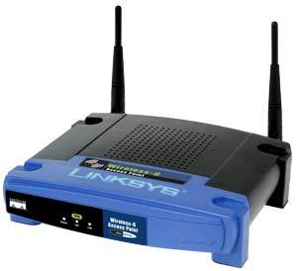
Security in a complex network
AS 91
AS 158
AS 47
AS 7
No longer so simple
AS 55
Others might hear your messages
So confidentiality is bad
Others might alter your messages
So integrity is bad
Others might interfere with your messages
So availability is bad

Slide 6
Authentication
Proving that something was created by a particular party
E.g., a message was created by the user who appears to have sent it
Vital property to achieve many security goals
Since sometimes you will do things for some parties, but not others
Only works out if you can tell who is who

Slide 7
Security
Background
Information protection
Resource protection

Slide 8
Background
Basic mechanisms
Key management

Slide 9
Basic mechanisms
For networks, primarily based on data manipulations
Hashes
Ciphers and codes
Signatures
Also need to protect network resources
Need different mechanisms for that

Slide 10
Security by data manipulation
Put (or alter) data in packets to improve security
Hashing
Integrity (detect tampering)
Encryption
Confidentiality (obscure semantics/meaning)
Signature
Authentication (identify source)

Slide 11
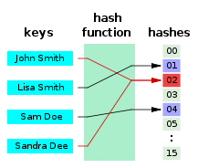
Hash functions
Maps a variable-length message onto a fixed-length “digest”

Slide 12
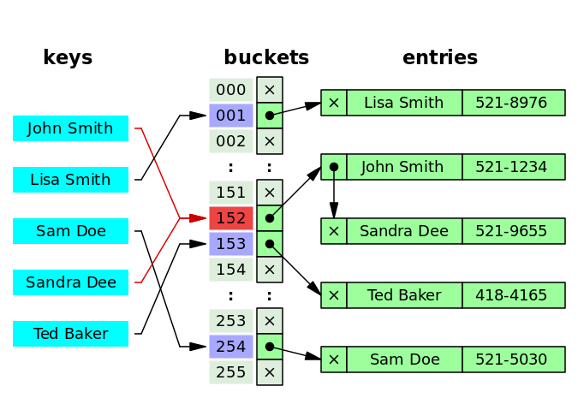
Why hash?
Scramble
Nearby messages yield very different digests
Distributes / scatters load, usage
E.g., hash tables
Rapid lookup
Avoids bunch-up
Collisions OK

Slide 13
Cryptographic hash
A hash function useful for cryptography
Scrambles and spreads (like any hash)
Difficult to “game”
Anti-“game” properties
Unidirectional (non-invertible)
Difficult to generate another input for a given output
Rare collisions
Difficult to generate two inputs with the same output

Slide 14
Why not just use a checksum?
Checksums don’t protect against tampering
Easy to generate a new message with the same checksum
Easy to generate two messages with the same checksum
Cryptographic hashes do protect
Unidirectional and rare collisions make the above difficult

Slide 15
Example hash functions
Message Digest 5 (MD5)
The 5th attempt at a message digest
MD, MD2, MD3, MD4, MD5, now MD6
Weak – found a birthday attack
Secure Hash Algorithm (SHA)
SHA-1 is weak
SHA-2 and SHA-3 well regarded
US Government designed

Slide 16
What do you do with a hash?
Publish it as-is
A “fingerprint” to validate as “untampered”
Assumes the published hash wasn’t tampered
Use it in other algorithms
HMAC
Digital signatures

Slide 17
Fingerprint checks
E.g., for GPG software
d065be185f5bac8ea07b210ab7756e79b83b63d4 gnupg-2.0.27.tar.bz2
091e69ec1ce3f0032e6b135e4da561e8d46d20a7 gnupg-2.1.3.tar.bz2
fb541b8685b78541c9b2fadb026787f535863b4a gnupg-w32-2.1.1_20141216.exe
5503f7faa0a0e84450838706a67621546241ca50 gnupg-1.4.19.tar.bz2
d0cf40cc42ce057d7d747908ec21a973a423a508 gnupg-1.4.19.tar.gz
dc03ae4e4c3e8fe0583b37dd6c3124f94246d2f8 gnupg-w32cli-1.4.19.exe
4997951ab058788de48b989013668eb3df1e6939 libgpg-error-1.19.tar.bz2
9456e7b64db9df8360a1407a38c8c958da80bbf1 libgcrypt-1.6.3.tar.bz2
86fe0436f3c8c394d32e142ee410a9f9560173fb libksba-1.3.3.tar.bz2
7cf0545955ce414044bb99b871d324753dd7b2e5 libassuan-2.2.0.tar.bz2
01e62c45435496ff0e011255fb0ac1879a3bc177 pinentry-0.9.1.tar.bz2
8dd7711a4de117994fe2d45879ef8a9900d50f6a gpgme-1.5.3.tar.bz2
9eb07bcceeb986c7b6dbce8a18b82a2c344b50ce gpa-0.9.7.tar.bz2
a7a7d1432db9edad2783ea1bce761a8106464165 dirmngr-1.1.0.tar.bz2

Slide 18
Any alternatives to hashing?
Protect the path
Lock it down, seal it up, etc.
Detect tampering
Power loss, other physical changes
All are very hard to do

Slide 19
Encryption
Convert an easily readable bit pattern into a bit pattern that looks very different
Typically one that looks like random data
Usually in a reversible way
So those you want to use the data can
Requires that not everyone can reverse it
How to achieve that?

Slide 20
Keyed encryption
Use a secret to perform the conversion
If you know the secret, reversing it is easy
If you don’t know the secret, reversing it is hard
Preferably impossible
The secret is called the key
Leading to an obvious question:
How can I keep a secret by using another secret?

Slide 21
Symmetric and Asymmetric Encryption Systems
Symmetric systems use the same keys to encrypt and decrypt
Encrypt your data with key K
Decrypt and get the data back with K
Asymmetric systems use different keys to encrypt and decrypt
Encrypt your data with K_{E}
Decrypt and get the data back with K_{D}
K_{E} != K_{D}

Slide 22
Example codes
Symmetric
Data Encryption Standard (DES)
Advanced Encryption Standard (AES)
Asymmetric
Diffie-Hellman
They just won the Turing Award for inventing asymmetric crypto
RSA algorithm
Elliptic curve algorithms

Slide 23

Symmetric keys
Also known as “shared secret”
Both sides share the same key
Both sides can encrypt or decrypt
Generally faster than asymmetric crypto
This turns out to be really important!

Slide 24
Using symmetric keys
Assume the data you want to encrypt is P
The encryption algorithm is E
The decryption algorithm is D
And the symmetric key is K
C = E(K, P)
P = D(K, C)
Expanding, P = D(K, E(K,P))
You end up with what you started with
And you used the same key twice

Slide 25
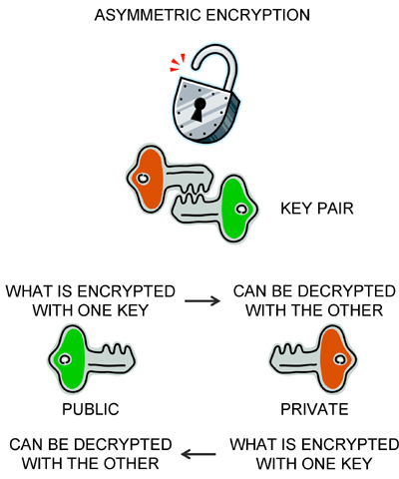
Asymmetric keys
Public key cryptography
Two keys: public and private
To encrypt to a single recipient:
Anyone encrypts a message with your public key
Only you can decrypt with your private key
Only you can read it
To identify a source:
You encrypt a message with your private key
Anyone can decrypt with your public key
Only you could have written it

Slide 26
Symmetric vs. asymmetric
Symmetric: same key is used on both ends
Anyone who has the key can create the message
Anyone who has the key can read the message
Info is private to those who share the key
Info was created by someone who knew the key
Asymmetric: keys are used as pairs
Public key creates message only private key can decrypt
Confidentiality – only private key owner can read it
Private key creates message only public key can decrypt
Authenticity – only private key owner could create it
But anyone can check ownership
Again, symmetric is much cheaper than asymmetric

Slide 27
Using asymmetric keys
Applying both keys yields the original message
C = E(K_{E},P)
P = D(K_{D},C)
Or
C = E(K_{D},P)
P = D(K_{E},C)
Unlike symmetric keys, the intermediates are different
E(K_{D},P) != E(K_{E},P)

Slide 28
Digital signatures
Rely on asymmetric keys
Signer encrypts using their private key
Entire message?
That’s too costly
Remember asymmetric being expensive?
Less costly to sign a hash
Signature
A cryptographic hash signed with a private key
A.k.a. Message Authentication Code (MAC)

Slide 29
Signatures and integrity
Signature assures receiver of message integrity
Via the hash
Contents haven’t changed since the hash was computed
If they had, the hash wouldn’t match
Attacker can’t just generate a new hash
Since it must be signed by the private key
Which he doesn’t have
We hope . . .

Slide 30
Signatures and authenticity
Signature assures receiver of authenticity
Message was created by the apparent sender
Sender’s private key was used to sign the hash
Hash came from the party with that private key
Which can only be the apparent sender
We hope . . .

Slide 31
Signatures and non-repudiation
Signature prevents sender repudiation
Sender can’t deny it sent that message
Why not?
The decrypted signature matches the message hash
But it’s a cryptographic hash
So it’s not likely the message could be changed to match the signature
OR that a signature can be reused for a different message

Slide 32
What do we have so far?
Hash
Integrity, if you trust the hash
Encryption
Privacy, given a key
Signature
Authentication and integrity, given a key

Slide 33
“given a key”
Security’s three most feared words
Keys need to be shared in advance
Both sides have the symmetric key
Both sides have part of an asymmetric key
The two challenges:
Endpoints need to know which key to use
Using the wrong key ruins everything
Endpoints need to get (and trust) the key
And if anyone else gets a symmetric key, you’re screwed

Slide 34
Key management
Pre-shared
PKI
Key exchange
Keyless

Slide 35

Pre-shared
Both sides share the key in advance
Technically, this is usually assumed
Typically referred to as “out-of-band” distribution
Out-of-band = someone else’s job
I.e., “I’m not solving the hard part of the problem”
Useful for any keys
Shared secret (symmetric)
Public key (asymmetric)

Slide 36
PKI
Public Key Infrastructure
Using a database to get a key
Same as most other network databases
Distributed vs. central
Flat vs. hierarchical
Structured vs. “hash tree” (destroys locality)
Infrastructure for public keys
Useful only for public part of asymmetric keys
Not a “public infrastructure for keys”

Slide 37
PKI example
PGP keys (e-mail)
Set of servers hold public keys
Users find keys explicitly
X.509 keys
Key signed by a hierarchy
Many roots (built-in to browsers)
Can add others (self-signed, other-signed)

Slide 38
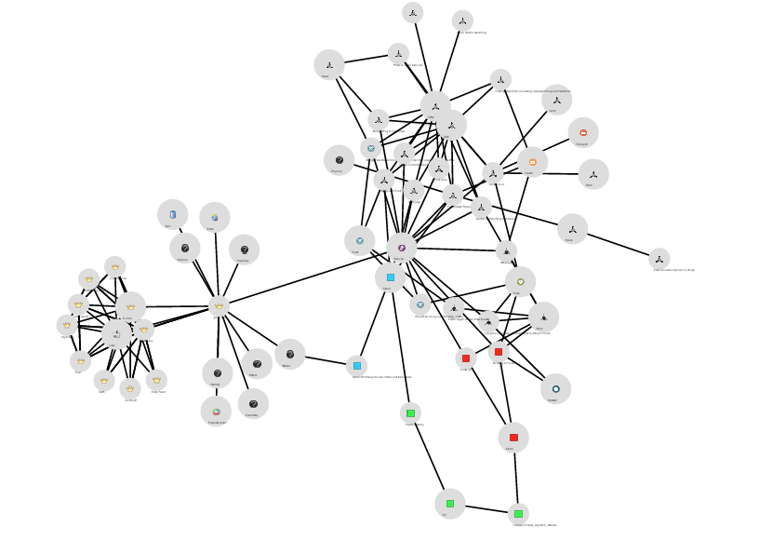

PGP vs. X.509
PGP
Web of trust
Users sign each other’s keys
Key signing “parties”
Trust based on who YOU trust
X.509
Hierarchy of trust
Roots sign keys
Companies charge to sign keys
Trust based on “anchors” (roots)

Slide 39
Key Exchange
Let’s say you want to communicate
But you don’t share a key
Or you want to use a new key
Generally good not to use a single key too much
Then you need to exchange a key between the communicating partners
How?

Slide 40
Key exchange using both symmetric and symmetric crypto
Common to use both in a single session
Asymmetric cryptography essentially used to “bootstrap” symmetric crypto
Use RSA (or another PK algorithm) to authenticate and establish a session key
Use AES with that session key for the rest of the transmission

Slide 41


Combining Symmetric and Asymmetric Crypto
Alice wants to share the key only with Bob
Bob wants to be sure it’s Alice’s key
Unfortunately, it’s more complex than this
Only Bob can decrypt it
Alice
Bob
K_{EA}
K_{DA}
Only Alice could have created it
K_{EB}
K_{DB}
K_{EB}
Take CS 136 if you’d like to know why
K_{EA}
C=E(K_{S},K_{EB})
K_{S}=D(C,K_{DB})
C=D(M,K_{EA})
M
K_{S}
M=E(C,K_{DA})

Slide 42
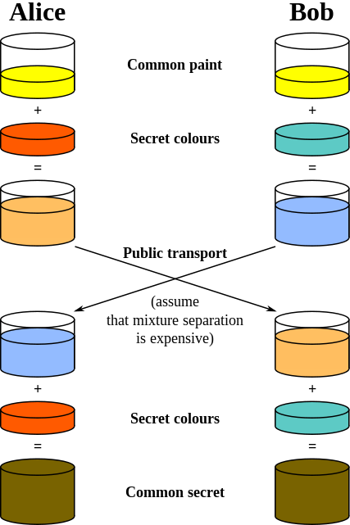
Diffie-Hellman key exchange
Share a key starting from nothing
Diffie-Hellman
Establish a shared secret over a public net
Each side has a secret (pick a random number)
Both sides share a common value
Relies on non-inverting mixing

Slide 43
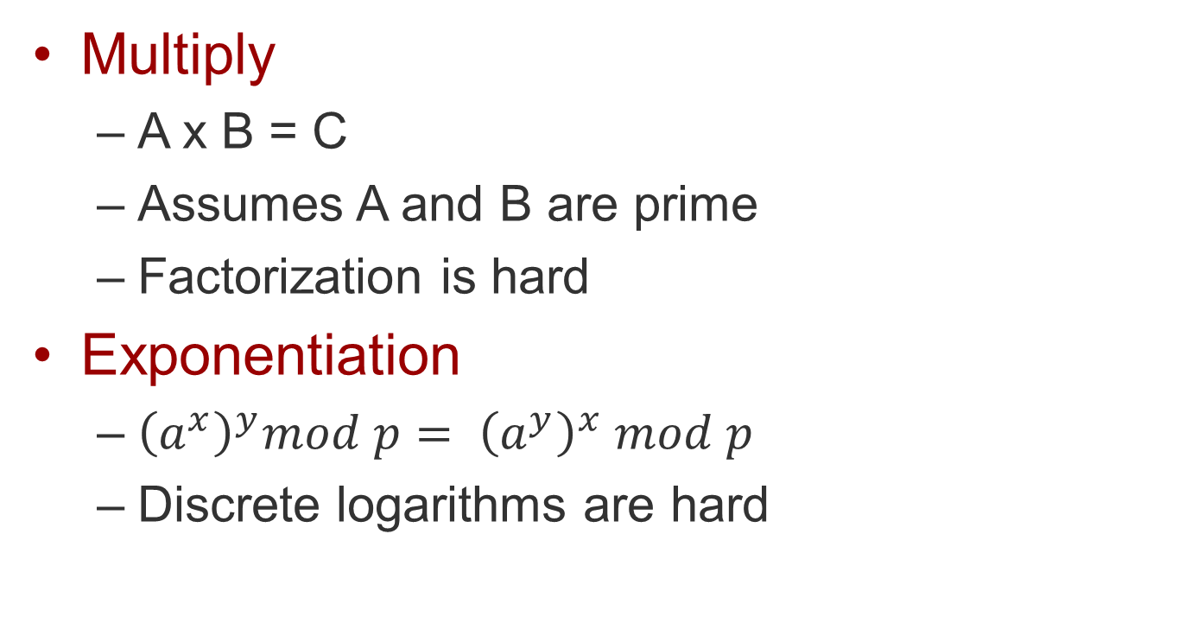
How to mix irreversibly?
Multiply
A x B = C
Assumes A and B are prime
Factorization is hard
Exponentiation
${\left(a^{x}\right)}^{y}mod p= {\left(a^{y}\right)}^{x} mod p$
Discrete logarithms are hard

Slide 44
What does DH do?
DH establishes a shared secret
A symmetric key
But symmetric keys don’t establish identity
“Man in the middle” attack
Who do you share the secret with?
Solution: signed DH

Slide 45
Signed DH
Use public key cryptography
Sign the messages (encrypt with private key)
Prevents MITM attack
But if we have public key, why use not use that?
Remember how important it was that asymmetric crypto was expensive?
Why not what we did a few slides ago?
Requires fewer of those expensive PK operations

Slide 46
Keyless
The I in PKI is a pain
The hardest part of PKI is the key database
Everyone has to have a key
Everyone has to find the other party’s key
Solutions
Make the “I” easier (automate, etc.)
Avoid the “PK”

Slide 47
Keyless keying
What if we use DH without signatures?
I.e., original DH
Share a secret – but with whom?
What if we don’t care?
WHO isn’t know
But the rest of the exchange is protected
“Better than nothing security” (BTNS)
Protects against others interfering

Slide 48
BTNS protection
The connection is secure!
But to whom?
Who cares!
Once you start a conversation, you can’t be interrupted
Maybe you can somehow verify identity later?

Slide 49
Are we done?
What have we protected?
Integrity
Privacy
Origin
What have we not protected?
Resources!

Slide 50
Resource protection
Endpoint
Forwarding

Slide 51
Endpoint resource protection
Resources to protect
Buffers
Processing / CPU
Content – the FSMs
Ways to protect the endpoint
Shed load
Verify before acting

Slide 52
Typical endpoint protections
Rate limiting
Limit investment in new connections
Toss out when beyond a limit
Protect against SYN flooding attacks
Firewalls, port blocking
Fixed: drop all packets to a particular port and/or in a particular direction
Conditional: drop a port until you know better

Slide 53
Conditional port blocking
NATs
Network and port address translator
Private and public side
Fixed: public side -> private side
Conditional: private side -> public side
Conditional example
Allow incoming only if outgoing
Wait for DNS UDP out, allow response back in
Wait for TCP SYN (open), allow replies until FIN (close)

Slide 54
Variable load shedding
Port blocking: drop based on partial work
Examine addresses, ports, some content
Drop before investing more work
Cipher/code/sign: drop on separate work
Validate (decrypt, authenticate) based on an algorithm that is separate from the FSM of the protocol
Drop before performing separate work
Both attempt to separate security from FSM
Checking is distinct from acting on the message

Slide 55
Forwarding resource protection
Routers have two distinct roles
Relaying messages
As endpoints of routing and control protocols
Two kinds of protection
Endpoint-like
Forwarding focused

Slide 56
Router endpoint protection
Similar to other endpoints
Block ports
Limit rate
Validate content
But a little harder sometimes
Bellman-Ford relays content indirectly
How can you protect the FSM?
Do you attach signatures for all the path components?
How does this affect scalability?

Slide 57
Forwarding protection
Why would I refuse to forward a packet?
Others similar packets are causing a problem here
Overloading of security processing
Overloading my buffers
Other similar packets are causing a problem elsewhere (most commonly downstream)
The other end of the link has no room for it
The other end of the link says these are a problem
It never should have come to me
“Reverse path” checks

Slide 58
Where do we put security?
Everywhere you want to protect resources
Everywhere in the DAG
Sometimes at every hop, sometimes on ends
In layers
Always better to shed load earlier in traversal
Don’t always have enough info until later

Slide 59
Summary
Security happens everywhere
At every layer
As early as possible, but no earlier
Security uses several tools
Most based on math
Not all based on pure math – lots of alchemy
Security assumes shared secrets
Like naming, it can’t start from nothing

