Slide 1
Layer Optimization: Congestion Control CS 118 Computer Network Fundamentals Peter Reiher

Slide 2
We can lose packets for many reasons
Corruption
Not delivered to receiver
Poor flow control
But also because of overall network conditions
If there’s too much traffic in the net, not all packets can be delivered
Can happen locally at one link or one part of network

Slide 3
Congestion control
Receiver might be ready, but is the net?
Don’t want to overwhelm the network
We have some windows
Send = how much info can be outstanding
Recv = how much info can be reordered
Can isn’t the same as should
How much SHOULD be outstanding?

Slide 4
A network problem
Congestion control is not directly about the sender and receiver
It’s about the network path they use
And share with others
The shared paths can only handle so much traffic
A given sender might send less
But all the senders using the path in combination might overwhelm it
Perhaps just part of it

Slide 5
How to address the congestion control problem?
A global problem, so perhaps a global solution?
But who is in charge of the problem?
And how does that party enforce its dictates?
Instead, if everyone cooperates, maybe we can solve it without global control
Everyone does his part to solve the problem, leading to a better global solution

Slide 6
But what can I do?
You can only change your own behavior
But if everyone does, that will reduce the congestion
And life becomes better for everyone
OK, so how do I change my behavior to help?
And how much should I change it?

Slide 7
Recall the two windows
Receiver window
Reorder out-of-order arrivals
Buffer messages until receiver catches up
Send window
Hold for possible retry until ACKed
Emulate how the channel delays/stores messages in a pipeline until ACKed

Slide 8
Send window maximum
Round-trip to the receiver
“BW * delay” product
Really “fill the pipe until you get an ACK”, presuming there isn’t any loss
Once you fill the pipe, send at the rate you get ACKs
ACK clocking
Forces sender to pace to the receiver

Slide 9
TCP and congestion control
TCP is one protocol that addresses congestion control
Probably the most important congestion control factor in the Internet
Essentially a cooperative approach
When congestion occurs, all TCP senders slow down

Slide 10
TCP’s CWND
Another window used by TCP
Not the same as the send window
Not intended to handle flow control
Rather, to handle congestion control

Slide 11
TCP MSS and RTT
Two important parameters for TCP use
MSS – Maximum Segment Size
Biggest TCP payload you can fit into one IP packet
By default, 536 “octets” (essentially bytes)
Find it by trial and error
RTT – Round Trip Time
Time to send a TCP packet and receive an ACK

Slide 12
Adjusting the congestion window
TCP CWND management
CWND is the send window max
Starts at 1, 4, 10K, or 10 packets
Additive Increase
Until you see loss, increase CWND by a constant amount for every ACK
Multiplicative decrease
When you see loss, halve CWND

Slide 13
AIMD feedback
A conservative approach
Grow slowly by probing
Backoff faster than you grow if there’s signs of trouble

Slide 14
The slow start phase
New TCP connection starts in a slow start phase
Until CWND reaches SSTRESH
A parameter of TCP
CWND grows by 1 for each ACK
I.e., CWND doubles* each RTT

Slide 15
Why’s that exponential?
Sender sends out some number of packets N
Without waiting for an ACK
If all goes well, N ACKs come back quickly
You add one to CWND for each ACK
So the next time, you send out 2*N packets
And expect back 2*N ACKS
In which case, you add 2*N to CWND
Getting 4*N
That’s exponential

Slide 16
Why does it stop?
Either you hit the limit to change TCP congestion control behavior
Your CWND reaches SSTHRESH
Or you time out waiting for an ACK
Assuming that the packet is lost
Due to congestion
Will that assumption always be true . . . ?
In latter case, also halve SSTHRESH
Depending on TCP variant

Slide 17
Congestion avoidance phase
Happens once SSTHRESH is reached
Assumption is that there is no congestion so far
Inch up a bit further to see if more can be sent
Until you reach MAX
CWND grows by 1 for each RTT
NOT each ACK received

Slide 18
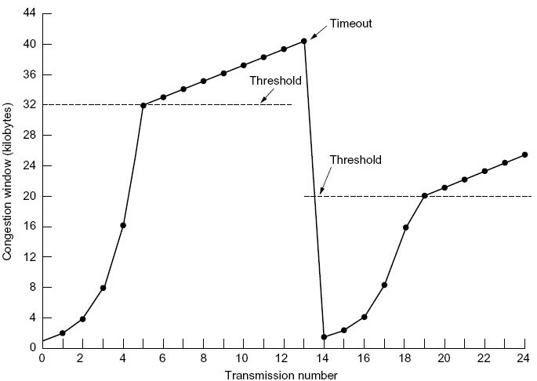
Visualization

Slide 19
Details
CWND doesn’t double per RTT in slow start
Because receiver doesn’t ACK every segment
It ACKs every other (“ACK compression”)
CWND increases by 50% each RTT in slow start
This is one TCP variant
There are dozens, and they keep changing!

Slide 20
TCP’s biggest assumption
TCP only knows:
What arrived
A timeout happened
TCP measures:
RTT directly (timestamps)
Based on sent packets and ACKs
Max receive window (window)
Network congestion (via timeout!)

Slide 21
What does a loss mean?
Corruption
Should send more, i.e., send another copy
Congestion
Should send less
TCP assumes loss implies congestion
I.e., the more conservative interpretation

Slide 22
Impact of loss=congestion
TCP works poorly when corruption is high
I.e., wireless networks
When corruption is not due to load
TCP is aggressive
It keeps sending more until something is lost
Two TCP flows always fight each other
But TCP loses to cheaters
TCP backs off
Others might not

Slide 23

Congestion control algorithms
Many of them
Lots of variations
Lots of incremental tweaks
Many based on fluid flow, feedback theory
Many based on whomever types it in…

Slide 24
Latency management
Networks have buffers
Buffers adjust for bursts
Most networks “tail drop”
I.e., keep as many messages as the buffer can hold, and drop ones that arrive once full
Tail drop favors keeping buffers full
Full buffers mean high delays

Slide 25
Solutions to latency management
Explicit network congestion signals
Routers tell endpoints when buffers are filling
Progressive loss
Drop probability increases as buffer grows
Don’t just wait for “full” and drop all
“Random Early Drop” and variants

Slide 26
Explicit congestion notification (ECN)
ECN routers (relays) indicate congestion
Mark instead of drop
Implies space to hold marked packets
So really more like “mark before drop”
E.g., mark packets arriving when queue is more than half full
Endpoints react to ECN flags as if congestion was noticed
For TCP, ECN makes the CWND smaller
TCP can react to congestion without losing packets

Slide 27
What if ECN isn’t available?
Tail-drop queue
Do not drop if there’s room
Drop if queue is full
Random Early Detection
Drop probability increases as queue grows
Various curves

Slide 28
Better buffering
Relays can cause problems
Connections compete one packet at a time
Maybe separate buffering by connections is better
“Fair queuing”
Need better use of buffers
Memory is cheap, but has a cost

Slide 29
Space
Compression
Caching

Slide 30
Compression
Translate a set of long messages into a set of short ones
Take a set of messages
Represent frequent ones with fewer bits, longer ones with more bits
Translate a long message into a short one
Take a set of groups of symbols in a message
Represent frequent groups with fewer bits, longer ones with more bits

Slide 31
Compression examples
Web traffic
E-mail
TCP/IP headers

Slide 32

Web traffic
HTTP 1.1
Compress content of responses
E.g., zip images, large text areas
Inside Google Chrome browser
HTTP 2.0
Compress headers

Slide 33

E-mail
By the program
Postscript, Word
By the user in advance
Zip folders
By the email system
Compress attachments

Slide 34
TCP/IP headers
Compress the TCP and IP headers
40 bytes down to 16
Most of the header is predictable within a single connection
Typical for PPP and SLIP (dial-up lines)
I.e., over path that doesn’t examine the header

Slide 35
TCP/IP compression
When is it useful?
What benefit?
For 40B ACK packets, saves 60%
For 512B payload data, saves 4%
For 1500B segments (Ethernet), saves 1.6%
Where useful?
ACK-only, BW-limited returns
For 2400bps modems (1990), saves 87ms

Slide 36
Required compression information
Patterns and frequencies of those patterns
Usually from a set of previous messages
E.g., Morse code
Or from previous use on this channel
E.g., LZW, used in GIFs
Or just obvious patterns
Run-length encoding, used for faxes and JPEG

Slide 37
Compression trade-offs
Trade (consume)
Effort
CPU works harder
Energy
CPU burns power
Time
Encode/decode needs to delay the stream
Encode/decode operation takes time
Gain (produce)
Space
Smaller message takes up less memory
Capacity
Smaller message uses less bandwidth
Time
Smaller message takes less time to transfer

Slide 38
Compression caveats
Works once
Compression removes patterns
Works at only ONE layer or over ONE hop
Obscures information
Can’t modify or easily read until undone
Uncompress/recompress is expensive
Small returns if used on only part of large messages
HTTP/2 header compression is controversial

Slide 39
Caching
Save via reuse
Over time within one stream
If you have the answer from before, use it again
Across a set of streams
Don’t ask if your friends know the answer

Slide 40
Caching examples
Inside a protocol
TCP control block sharing, TCP/IP compression
Content
ARP, DNS, Web

Slide 41
TCP control block sharing
New connections start from “zero”
Why?
New connections can reuse
From past (reuse CWND, RTT, MSS)
From peers (reuse RTT, MSS, split CWND)

Slide 42
Why reuse?
Change is unlikely
Path (routing) tends to be stable
Endpoints tend to be stable
Aggregate traffic patterns tend to be stable
So RTT, MSS tend to be stable
Why infer when you can share?
Endpoints within the same machine can share
No need to have CWNDs fight and balance; can just “split at start”

Slide 43
Net effect of TCP sharing
Less blind probing
No need to send large segments to find MSS
No need to use RTT over-estimates
No need to compete via loss
Shared info can “rebalance” CWND
Safe
Tries to anticipate transients – only at connection start/end
Tries to jump closer to convergence, then lets existing feedback take over

Slide 44
More complex sharing
Endpoints within a LAN
Can share their experience
Can explicitly coordinate rather than compete
Inherently harder
No longer just sharing information on a single computer
Which means it must be communicated

Slide 45
Information delineation
Boundaries
Flows

Slide 46
Boundaries
Message vs. packet alternatives
Span: messages longer than a packet
Preserve: message matches packet
Pack: packet carries multiple messages
None: no boundary support (e.g., TCP)

Slide 47
Adding markers is easy…
Length indicator
E-mail attachments, IP packets, HTTP chunks
Efficient (rapid jump), but fixed max
Special symbols (“escape” sequences)
Not used for data
Arbitrary chunk size, but need to scan

Slide 48
Deciding marker use is hard
Costs
Gathering small chunks can cause delays
Picking the wrong size increases overheads
Cost to split/merge or merge/split
Risks
Lack of fate-sharing
Different chunks via different paths

Slide 49
Marker examples
Length
Pack: HTTP, e-mail, SCTP
Preserve: UDP, DCCP
Span: ATM AAL5, IP frag., multipart MIME
Special symbols (“escape” sequences)
ATM, Ethernet preamble

Slide 50
Flows
Like a channel…
Information shared between parties
…with multiple viewpoints simultaneously
One channel
Several separate channels

Slide 51
Examples of multiple flows
Multiplexing
Striping (inverse multiplexing)
Partitioning

Slide 52
Multiplexing
Using one flow to emulate many
HTTP chunking and muxing
Allows one TCP connection to support concurrent web transfers
Hazards
“Fair sharing”
Head-of-line blocking

Slide 53
Fair-sharing
Merging multiple flows onto one
Who goes next?
Various strategies
Shortest-first, largest-first, round-robin, proportional
How is “fair” defined?
Each according to their needs?
Each gets the same?
How is “each” defined?
Per human? Per endpoint? Per application?

Slide 54
Head-of-line blocking
Consider lines at a market
Large basket arrives before 2-item
BLOCKS system
Avoiding HOL blocking?
Limit chunksize
E.g., everyone pays 10 items at a time
Leaves when done paying for entire basket
Use separate connections
E.g., multiple TCP connections for web clients

Slide 55
Striping
Making multiple channels appear as one
Increased bandwidth
Increased reliability
Examples
Multipath TCP
SCTP
Various datacenter optimizations

Slide 56
Partitioning
Split one info stream into separate ones
To avoid HOL blocking
To manage differently (loss vs. recovery)
Examples
Teleconference audio vs. video
FTP control vs. content

Slide 57
Translation
Formats
Conversion
Marshalling

Slide 58
Recall encodings
Represent information with symbols
Various strategies
Earlier lectures focused on physical, error
More encoding issues
More encoding variants
Coordinating the endpoints

Slide 59
Bit order and formats
Many channels exchange bit sequences
Upper layers exchange bytes, words, etc.
What order?
LSB vs. MSB
LSB-first: enables serial arithmetic
Ethernet, Token bus
MSB-first:
Token ring

Slide 60
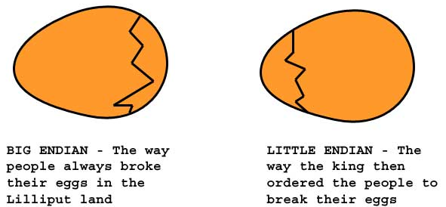
On holy wars and plea for peace
Gulliver’s Travels

Slide 61
Endianess
Big-endian: ABCD stored as A, B, C, D
The Internet
Motorola 68000, RISC (PowerPC, SPARC)
Telephone numbers
Little-endian: ABCD stored as D, C, B, A
Intel and AMD processors
Both (configurable)
ARM

Slide 62
Conversion
Host to net, net to host
Long, short, etc.
Converts from Internet (big-endian) to local

Slide 63
Marshalling
Packing and unpacking
Format conversion
Sequencing
Labeling
All for what?
Same as for a function call
A way to know the meaning of shared bits

Slide 64
Why is marshalling hard?
Expensive
Conversion takes time
Tedious
Many steps to mess up
Exacting
All the steps have to match to work

Slide 65
Summary
Lots more optimizations and features
The details depend on the implementation
Details matter and they don’t
Parties must agree on details to communicate
Detail differences affect performance
But particulars of details not always otherwise critical
Things can be done many ways

