Slide 1
Layer Optimization: Handling Loss CS 118 Computer Network Fundamentals Peter Reiher

Slide 2
Intralayer examples
Integrity
Time

Slide 3
Integrity
Error
Detect accidental alteration
Loss
Detect missing packet(s)
Reordering (related mechanism)

Slide 4
Detect or correct?
If we can correct, there’s no problem
Here we focus on integrity failure
Based on detecting uncorrectable errors

Slide 5
What do errors look like?
Errors in destination address
The message ends up elsewhere
Errors in source address
The message affects the wrong FSM
Errors in contents
Impacts other layers (up to the user)
It’s important to know when you see an error

Slide 6
Making errors visible
Consistency checks
Portion of a message has a valid range
Value is outside that range (invalid values)
Redundancy checks
Add redundancy in a message
If error only alters one of the redundant values, the other indicates an error

Slide 7
Consistency checks
Some values of some fields for some layers aren’t allowed
Examples:
Padding field in TCP header must be all zeros
Can’t have unroutable IP address in Internet
IPv4 IHL field can’t be less than 5

Slide 8
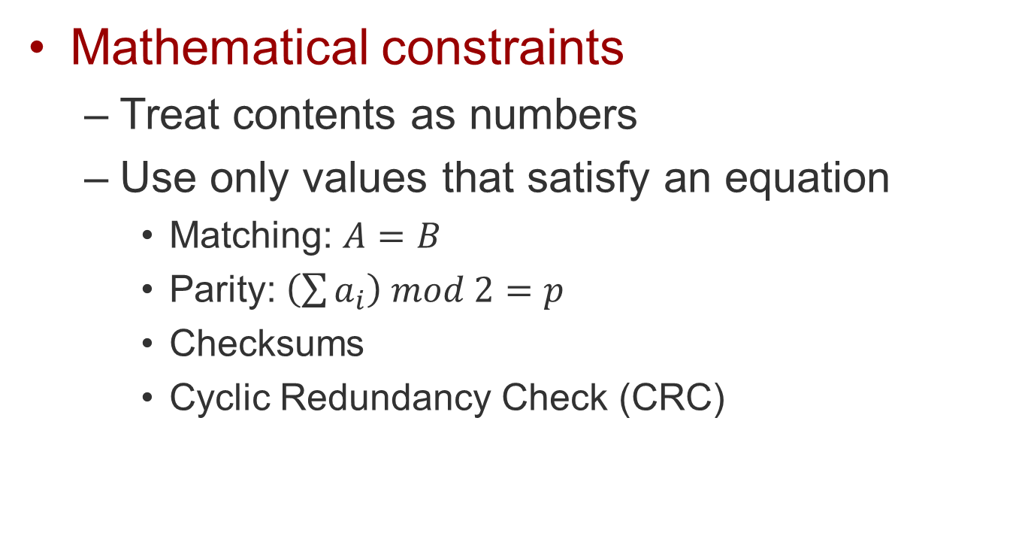
Redundancy checks
Mathematical constraints
Treat contents as numbers
Use only values that satisfy an equation
Matching: $A=B$
Parity: $\left(\sum{a_{i}}\right) mod 2=p$
Checksums
Cyclic Redundancy Check (CRC)

Slide 9
Example – IPv4 checksum
16-bit ones complement sum
Consider IPv4 header as set of 16 bit numbers
Add the numbers and hold the carry
Add the carry back in (carry-wraparound)
Easy to implement in SW or HW
IPv6 doesn’t have header checksum

Slide 10
TCP checksum
Independent of IPv4 checksum
Taken over entire packet (except a few IP header fields)
Basic method like IPv4 checksum
Somewhat different computation method if running over IPv6
Interlayer dependency in this optimization . . .

Slide 11
Loss
Detecting when a message should have arrived but did not
Message completely lost
Never sent
Never arrives
Message source/destination error
Message arrives but cannot reach the intended receiver (or relay) FSM

Slide 12


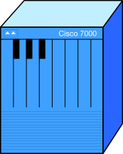
One way to lose a message
Timeout

Slide 13

Another way to lose a message
Error Detection/Correction
If we can’t figure out what the message is, it’s as good as lost

Slide 14

A third way to lose a message
Flow control
If the receiver is too busy and has nowhere to put it, he’ll have to drop it

Slide 15

A fourth way to lose a message
Congestion control
If the network is too congested, it may be dropped
Even if the receiver isn’t overloaded

Slide 16
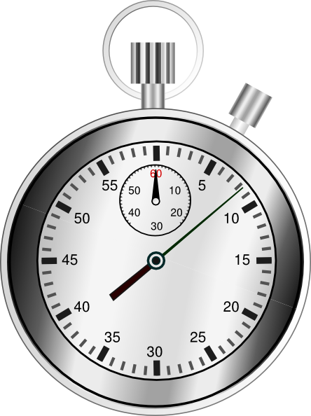
Detecting loss
We’ve talked about this before
Need to keep track of time
So let’s say we do…

Slide 17
The key issue: what time?
Different possible times:
Time expected
Latest time we want to wait
Time since last message sent
Time since last message received
Let’s say we know (or pick) one
Still need to know the value to use

Slide 18
Estimating time
Based on a network property
Number of hops (diameter)
Longest transmission time
Longest time held per relay * # relays
Based on past measurements
How do we measure time?
How do we aggregate measurements?

Slide 19
Measuring time
Need a timer
Can’t wrap-around too quickly
Good resolution (time of smallest increment)
Need to timestamp messages
Measure differences

Slide 20
Reordering
Messages arrive without loss
But out of order

Slide 21
Fixing reordering
Hold onto messages
Keep the ones that come too early
Process once sequence gaps are filled
RED arrives before BLUE
Wait for BLUE
Deliver BLUE first
Sender
Receiver
Then deliver RED second

Slide 22
What’s hard about reordering?
Need more state – a reordering buffer
How much space?
Enough to store maximum displacement
Where?
At the receiver, where things arrive too early
Do you just wait for late messages?
Or request a resend?
If so, how aggressively?

Slide 23
TCP receive window
TCP segments have a sequence number
Number indicates byte offset of each segment
TCP receive window enables reordering
Make it large to handle large displacements
Left side = smallest offset not yet here
Right side = largest offset that can be held

Slide 24
Receive window management
Message arrives
Put it in the buffer if it fits
Buffer size = RCV.WND
RCV.NXT (left side)
Move right to deliver info to the user (upper)
Stop and wait at the first gap
RCV.NXT + RCV.WND (right side)
Moves right (allow higher offsets) whenever left side moves right

Slide 25
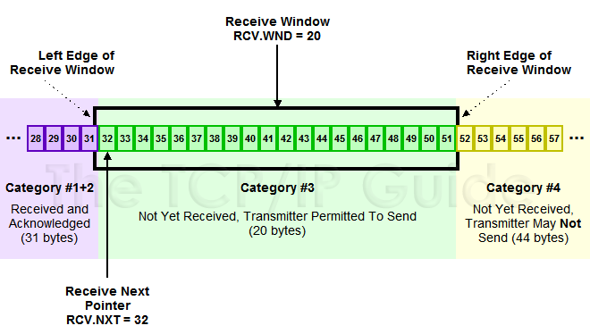
Receive window
32-40
Now we can move the window 8 to the right

Slide 26
Receive window with misordering
40-48
Can’t move the window yet

Slide 27
Hmm – what’s that about the sender?
That figure shows how the receive buffer is tied to the send buffer
The receive buffer is for reordering
So what’s the send buffer for?
Why (and how) are the two related?

Slide 28
Time
Flow control
Congestion Control
Latency management

Slide 29
Flow control I
Not overrunning the receiver
The receiver always can handle one message
Send that, wait for confirmation, send the next, …
Why does the sender need to wait?
Message was lost
Message is waiting at the receiver
If receiver can handle messages as fast as the sender, not an issue
Solution: send one at a time
One message outstanding at any given time

Slide 30
Stop and Go
Assume a sequence number
One number per message
Sender and receiver work in lockstep
Both “walk” the number space
Both have “inchworm” behavior

Slide 31
Let’s take a walk
Messages are numbered
Sender “walks” the line via receiver ACKs
1
2
3
4
5
6
7
8
9
To be ACK’d
To send
1
2
3
4
5
6
7
8
9

Slide 32
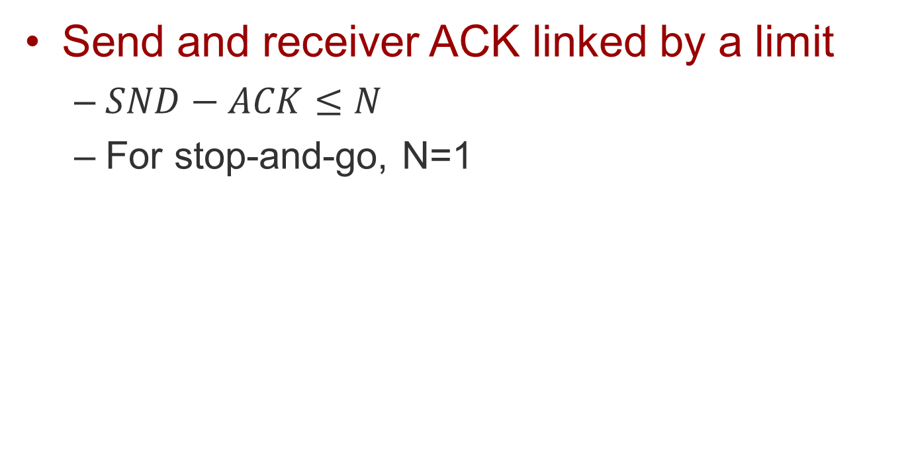
Limiting the walk
Send and receiver ACK linked by a limit
$SND−ACK≤N$
For stop-and-go, N=1
ACK
SND
1
2
3
4
5
6
7
8
9

Slide 33
A look at the exchanges
One message per round trip
ACK indicates received and ready for next

Slide 34
A look at the numbering
If SND and ACK differ by at most 1, we don’t need to number 1..999
OK to just number 0,1,0,1,0,1
Also known as “alternating bit” protocol
RCV
SND
1
0
1
0
1
0
1
0
1

Slide 35
Why do anything else?
Receiver might be faster than sender
In which case it could handle more messages
Learning that receiver has handled a message takes time
At least time to get acknowledgement to sender
During that time, channel is not in use, receiver is not busy, sender is not busy
Lots of wasted resources

Slide 36
What if we have more than 1 outstanding message?
Messages could arrive out of order
As we’ve already discussed
A message could arrive while receiver is busy handling an earlier message
Not possible with 1 message window Stop and Go
If we allow multiple outstanding messages, we must handle both problems

Slide 37
Flow control II
How to handle these problems?
As discussed, use a buffer to handle misordered messages
The receive window indicates max misorder
Also max “outstanding” held messages
Hmm – let’s use that buffer two ways!
If receiver is busy when message arrives, put it in the buffer
Even if it is the next message to be received
So we can send more than one at a time…

Slide 38
Go Back N
Assume a sequence number
One number per message
Sender and receiver work in lockstep
Both “walk” the number space
Both have “inchworm” behavior
Just like stop-and go, but with N messages

Slide 39
Let’s take another walk
Messages are numbered
Sender “walks” the line via receiver ACKs
1
2
3
4
5
6
7
8
9
To be ACK’d
To send
1
2
3
4
5
6
7
8
9

Slide 40
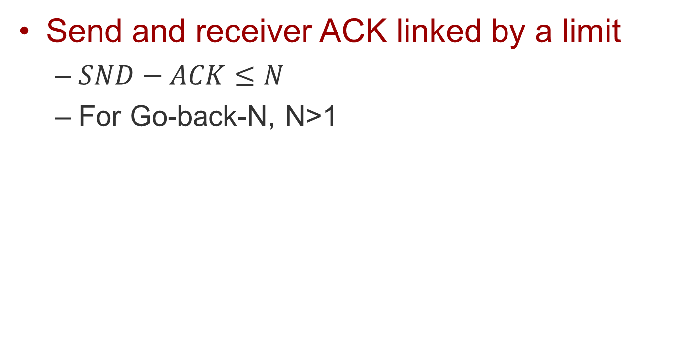
Limiting the walk
Send and receiver ACK linked by a limit
$SND−ACK≤N$
For Go-back-N, N>1
ACK
SND
1
2
3
4
5
6
7
8
9

Slide 41
A look at the exchanges
N messages per round trip
ACKs indicates received and ready for next

Slide 42
A look at the numbering
If SND and ACK differ by at most N, we don’t need to number 1..999
OK to just number 0,1,2,3,…,2N-1
RCV
SND
3
0
1
2
3
0
1
2
1

Slide 43
Why 2N values?
N outstanding values
Each RTT, the window can slide forward by N
Need to prevent overlap from one RTT to next

Slide 44
How big is N?
How many messages before getting ACK?
Once you get the ACK for the first, you can send N+1
ACK provides a “clock” to the pipeline
Every ACK/N+1 pair acts like stop-and-go
Go-back-N is like N overlapping stop-and-go

Slide 45
About the receive window
What if the receiver isn’t fast enough?
Info (message) has to go into the buffer as fast as it arrives (or we have other problems!)
If the FSM doesn’t release the info to the upper layer as fast as it comes in, there’s a delay

Slide 46
Recall receive rules
Info (message) arrives
Place message in sequence
Move left side to the right until a gap
Pass that info to the next layer up
Right side moves to the right at the same time
If the FSM is fast enough
The left side doesn’t move immediately
Takes time – time to process the message

Slide 47
Left and right
If left side doesn’t move, right doesn’t
I.e., receiver isn’t ready for new offset info
How do we coordinate with the sender?
Sender has a similar buffer
SND.WIN = RCV.WIN
If smaller, we could have sent messages that could have been held by receiver – wasted resources
If bigger, we won’t be able to send it anyway (we can only fill the receive buffer!)

Slide 48
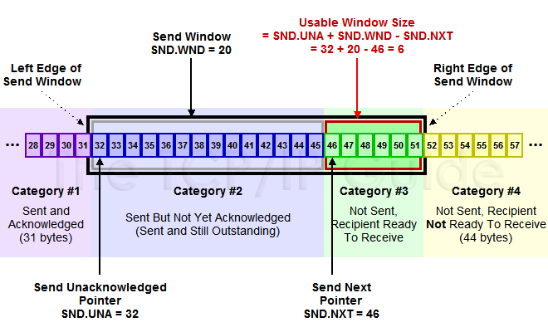
Coordinating SND and RCV

Slide 49
Combining loss + windowing
Positive feedback (ACK)
Indicate what was received
Negative feedback (NACK)
Indicate what is missing but expected
Always a gap after the last msg received
Use this info to coordinate retransmission

Slide 50
Loss / windowing variants
Stop and Go
On timeout, send retransmit request
Only one message to ever request
Go back N
On timeout, ACK lowest missing sequence number
Sender “backs up” to where ACK indicates
Every round trip, backs up to the lowest gap
Selective ACK
ACK everything you get, ask to fill in the holes
Sender fills in only the holes

Slide 51
Congestion control
Receiver might be ready, but is the net?
Don’t want to overwhelm the network
We have some windows
Send = how much info can be outstanding
Recv = how much info can be reordered
Can isn’t the same as should
How much SHOULD be outstanding?

Slide 52
Solution: congestion window
Receive window
Stays fixed (no benefit to adjusting)
As large as reordering max
As large as send pipelining too
Send window
No larger than the reordering max
As large as is needed to keep up with the receiver
Not so large that messages are lost in the net
OK, how big is that?

