Slide 1
Layer Optimization CS 118 Computer Network Fundamentals Peter Reiher

Slide 2
Where are we at?
We understand communications over direct channels
We understand building networking from layering and relaying
We understand how a DAG explains layering
We understand how to build routing for relaying purposes

Slide 3
For example,
B
D
E
A
C
Recursive Core
stream
DNS A
DNS->IPv4
stream
DNS AAAA
DNS->IPv6
Stream
DNS txt
DNS->O-ID
Hard state
TCP conn.
Soft state
Delta-T
Soft state
tunnel
HTTP->TCP
packet
64tun cfg
IPv6->IPv4
packet
OSPF
IPv4->IPv4
packet
sBGP
IPv4->IPv4
packet
BGP
IPv4->IPv4
Hard state
WDM link
Hard state
WDM link
Hard state
WDM link
Now we need to relay through C
TCP->IP
Legend
Service type
Update protocol
From->To
packet
ARP
IPv4->E-mac
E-net
Id=45
WDM
ID=3
IP->802.11
A sends an HTTP request to E
802.11->physical
We recurse down the DAG

Slide 4
Relaying through C
B
D
E
A
C
And back down
C now uses its DAG
Recursive Core
IP<-802.11
IP->ATM
stream
DNS A
DNS->IPv4
stream
DNS AAAA
DNS->IPv6
Stream
DNS txt
DNS->O-ID
Hard state
TCP conn.
Soft state
Delta-T
Soft state
tunnel
802.11<-physical
ATM->physical
packet
64tun cfg
IPv6->IPv4
packet
OSPF
IPv4->IPv4
packet
sBGP
IPv4->IPv4
packet
BGP
IPv4->IPv4
Hard state
WDM link
Hard state
WDM link
Hard state
WDM link
Legend
Service type
Update protocol
From->To
packet
ARP
IPv4->E-mac
Now relay through D
E-net
Id=45
WDM
ID=3

Slide 5
Relaying through D
B
D
E
A
C
Recursive Core
D now uses its DAG
stream
DNS A
DNS->IPv4
stream
DNS AAAA
DNS->IPv6
Stream
DNS txt
DNS->O-ID
Hard state
TCP conn.
Soft state
Delta-T
Soft state
tunnel
IP<-ATM
IP->ethernet
packet
64tun cfg
IPv6->IPv4
packet
OSPF
IPv4->IPv4
packet
sBGP
IPv4->IPv4
packet
BGP
IPv4->IPv4
Hard state
WDM link
Hard state
WDM link
Hard state
WDM link
ATM<-physical
ethernet->physical
Legend
Service type
Update protocol
From->To
packet
ARP
IPv4->E-mac
E-net
Id=45
WDM
ID=3
And back down
Now relay to E

Slide 6
Delivering at E
B
D
E
A
C
HTTP<-TCP
Recursive Core
E now uses its DAG
stream
DNS A
DNS->IPv4
stream
DNS AAAA
DNS->IPv6
Stream
DNS txt
DNS->O-ID
Hard state
TCP conn.
Soft state
Delta-T
Soft state
tunnel
TCP<-IP
packet
64tun cfg
IPv6->IPv4
packet
OSPF
IPv4->IPv4
packet
sBGP
IPv4->IPv4
packet
BGP
IPv4->IPv4
Hard state
WDM link
Hard state
WDM link
Hard state
WDM link
IP<-ethernet
Legend
Service type
Update protocol
From->To
packet
ARP
IPv4->E-mac
E-net
Id=45
WDM
ID=3
ethernet<-physical
And the message is delivered to E’s web server

Slide 7
Where are we and where next?
So now we know how to use networking between multiple network points
Being able to communicate at all is more important than anything else
But other things are important, too
Like performance, reliability, security, and other properties
How can we optimize the basic networking to achieve these goals?

Slide 8
Outline
Background
Deficiencies
Performance
Emulation
Examples…

Slide 9
Networks and optimizations
Using fully general mechanisms can be expensive
Common special cases can be optimized to reduce costs
Optimizations are possible at many semantic levels of networking

Slide 10
But where to optimize?
Is optimization a layer or a communication issue?
Where do we optimize?
At some layer?
Or for some connection?

Slide 11
Intra-layer vs. intra-communication?
Optimizations involve shared context
Layers sharing common mechanisms
Connections managing shared state
Either one can support optimization
Connections coordinate explicitly
Layer members coordinate implicitly

Slide 12
If layers, which ones?
Do optimizations occur only at certain layers?
No
Are optimizations typical at certain layers?
Yes, for several reasons
Do optimizations interact across layers?
Absolutely

Slide 13
Living at a layer
Optimizations can occur at any layer
They’re increasingly used at many layers

Slide 14
Living at a layer
Some occur more often at certain layers
Most information errors are at the physical layer
Once corrected at the next layer up, they tend not to occur again
So optimizations based on these errors often at low levels

Slide 15
Living at a layer
Some optimizations occur because of a layer
I.e., TCP provides an ordered data stream but IP does not
So TCP corrects ordering, but IP does not
Therefore, any ordering optimization occurs above IP

Slide 16
What connection?
Optimizations often share state over a connection
State can be
hard (maintained)
or
soft (recoverable)
State can be for one connection or a group
State can be explicit or inferred

Slide 17
What connection?
Not everything is associated with an explicit, stateful connection
I.e., there’s more than TCP, web, and e-mail

Slide 18
The End-to-End principle
Put application-specific network functionality at the endpoints
Not in the middle
Functionality in the middle should be generally usable by all applications
Not a hard and fast rule
As its name states, a principle
But well known and highly influential

Slide 19
The End-to-End Principle and optimizations
Many optimizations are particular to a network layer
This principle suggests those optimizations should occur at the endpoints
But remember –
The endpoints for a layer aren’t always the endpoints for a message’s transit

Slide 20
For example,
B
D
E
A
C
From the sender’s perspective, A and E are the endpoints
IP->ATM
IP<-ATM
ATM->physical
ATM<-physical
For the purpose of an ATM optimization, C and D are the endpoints

Slide 21
Now let’s explore how to optimize:
Deficiencies
Performance
Emulation

Slide 22
Deficiencies
Optimizations sometimes overcome deficiencies in the communication
For example, deficiencies in:
Integrity
Authentication
Privacy

Slide 23
Why do you care about deficiencies?
Deficiency impedes communication
You can’t share state, which means you can’t share information
Deficiency impedes relaying
If you can’t relay for others, they can’t communicate
Deficiency impedes networking
The two above also mean you can’t automatically manage your network configuration, routing, DAGs, etc.

Slide 24
Integrity
Definition
Types:
Corruption
Loss
Tampering

Slide 25

Integrity
Definition: the quality of being whole
WYGIWWS: what you got is what was sent
For a message:
Not split up
Not missing pieces
Not altered (accidentally or deliberately)

Slide 26

Integrity: Corruption
Accidental alteration
For a message:
Symbol changed (noise)
Symbol is ambiguous (equivocation)
A portion is deleted

Slide 27

Integrity: Loss
Missing everything!
Degenerate case of corruption
Receiver doesn’t know a message arrived
Why?
Not sent (by origin or relay)
Not received (by destination or relay)
Corrupt beyond recognition

Slide 28

It’s 2:20pm, do you know where you are?
Time is fleeting…
But it keeps coming up
How do you detect loss?
Useful to know about time
Longest time until delivery

Slide 29
Integrity: Corruption vs. loss
Corruption
A message arrives
Unrecoverable error
Loss
No message arrives
Timer implies loss
Indistinguishable when:
Destination name is corrupted or missing
Source name is corrupted or missing
Key portions of message are corrupt or missing
Difference
How much of the message is “gone”

Slide 30

Integrity: Tampering
Deliberate alteration
To corrupt
To alter to different content (thought to be non-corrupt)
How?
Intercept and retransmit (e.g., during relay)
Overlap physical signals

Slide 31
Integrity: Corruption vs. tampering
Corruption
During origination, receipt, or relay
Detect via error checks
Tampering
During relay or receipt
Detect via integrity checks
That a relay can’t ‘fake’
Difference
Intent
Probability of generating different but valid message
Tampering is similar to the worst case for corruption

Slide 32
What about order?
Order is not a property of a message
It is a typical property of a channel
Only a deficiency if you need to assume it
We’ll come to that when we talk about channel emulation

Slide 33
How much integrity protection?
Easy to encapsulate
You don’t want to modify contents anyway
Relay might become more difficult
May need to change portions of the message
E.g., hopcount, route path record, etc.
Does the integrity cover those?
So you might not protect the entire message

Slide 34
Authentication
Definition
Types
Origin and/or destination
Control
Content

Slide 35
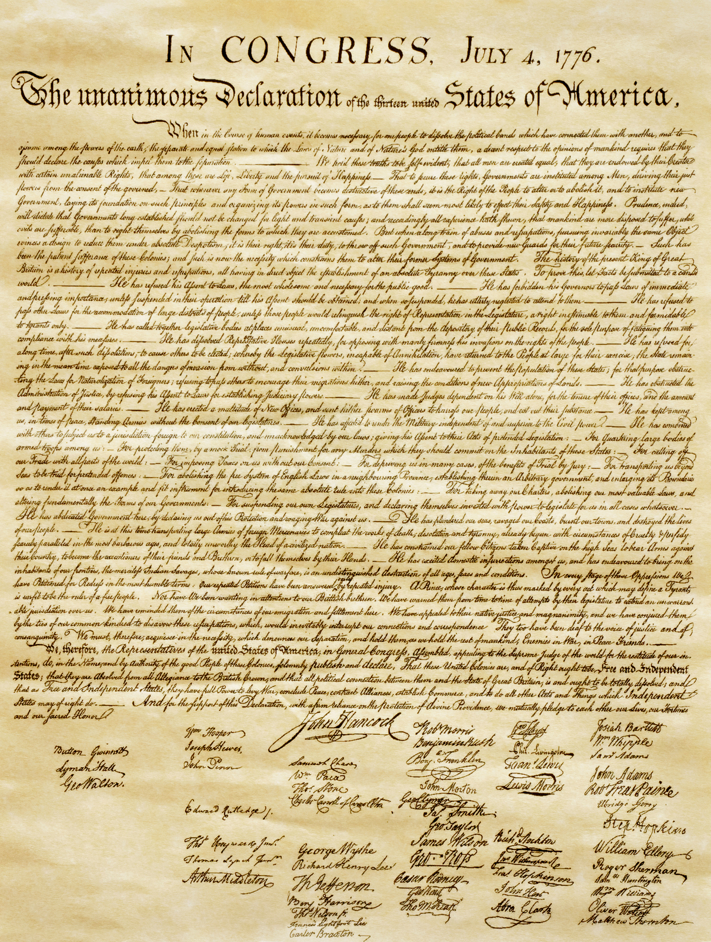
Authentication
Definition: ensuring that particular information was created by a particular party
For a message, ensuring:
All important elements of the
message
Were created by the sender

Slide 36

Authentication: Name
The source and/or destination noted in the message comes from the source that generated it
The message says it came from John, and it actually came from John
The message says it goes to Ben and that name came from John too
Why?
Protects the entire message’s path
Protects the endpoint machines

Slide 37

Authentication: Control
The message includes control signals that come from the source that generated it
Such as what layers it uses
And parameters to those layers
Ensuring that sender used those
layers and those parameters
Why?
Layers use state machines
Protects operation of the state machines

Slide 38

Authentication: Content
The content of the message comes from the source that generated it
I.e., the data that is shared with John actually came from John
Why?
Protects information that the machines share

Slide 39


Why bother with all three?
Why do we separate:
Identity
Control
Content
They could be signed by different parties
Different endpoints, different layers, etc.

Slide 40
Why?
For example, content comes from the “top” of the stack
So the top layer should authenticate content
The identity might be associated with a proxy at a lower layer
So that layer should authenticate identity
The control might be for a very low layer
So control must be authenticated there

Slide 41
How much to authenticate?
Same problem as integrity
Easy to attest to the source of the entire message when encapsulated
Hard to make that guarantee if portions change
Again, might want to authenticate only part

Slide 42
Privacy
Definition
Types
The origin and/or destination
Control
Content

Slide 43

Privacy
Definition: hiding the information in a message from all parties except the receiver
For a message:
Hide the origin
Hide the message
From everyone but the receiver

Slide 44
Privacy: Identifier
Hide the endpoints
Who sent it
Who receives it
From whom?
Source: everyone except receiver
Destination: everyone except relay and receiver
Perhaps even from relay
Why?
“who talks to whom” exposes information!

Slide 45
Privacy: Control
Hide the state machine control signals
From whom?
Everyone except receiver
Why?
Exposes what the state machine is doing
That information can be used to attack the machine
Or deduce things about the communications

Slide 46
Privacy: Content
Hide the information shared between the parties
From whom?
Everyone except receiver
Why?
(should be obvious)

Slide 47

Impact of deficiencies
Need to balance
Relay, source, receiver perspective
Various preferences, requirements, and limits
Various costs (time, space, CPU effort)

Slide 48
Performance deficiencies
Time
Space
Energy

Slide 49
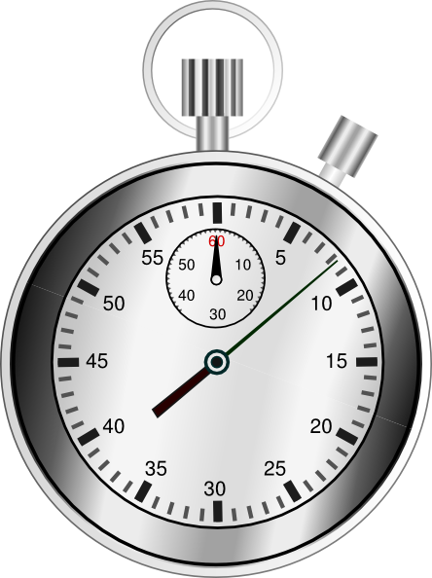
Time
Rate
Messages per time
Latency/jitter
Time per message (between send and receive)

Slide 50
Rate
How many messages can you send?
Messages per unit time
1/(time to send a msg) * (# msgs sent concurrently)
How to improve?
Less time for each message (higher BW)
More messages sent concurrently (parallelism)
Messages at the rate the receiver supports
Messages at the rate the network allows

Slide 51
Flow control
Messages arrive at the receiver’s rate
Avoid overwhelming the receiver
Avoid using excess storage resources
How?
Control pacing (inter-message timing)
Control number of unanswered messages
Use feedback from the receiver

Slide 52
Congestion control
Messages arrive at the relay’s rate
Avoid overwhelming the network
An aggregate, network variant of flow control
How?
Similar mechanism as flow control
Different source of feedback (net, not receiver)

Slide 53
Latency
How long for a message to arrive?
Time per message between send and receive
How to improve?
Decrease distance between sender/receiver
Increase BW
...

Slide 54
Space
How much space to represent a message?
Bits per message
How to improve?
Compress (remove predictable patterns)
Within a message, across messages, etc.
Encode efficiently

Slide 55
Energy
CPU capacity
Actual energy

Slide 56
CPU
How much work to process a message?
How many opcodes?
How to improve?
Save reusable results / avoid duplicate effort
Alternate algorithm
Same result a different, “cheaper” way
Different, “cheaper” result with similar properties

Slide 57
Actual energy
How much energy to process a message?
Electrical power, heat to dissipate, etc.
Not just “green”; saves $, heat, and space
How to improve?
Reuse rather than recompute
Lower clock rates
Avoid conversions

Slide 58
Emulation
Wires
Boxes and bundles
Transactions and beyond

Slide 59
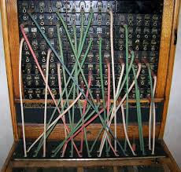
Wires
Making a circuit from packets
Pseudowire

Slide 60
Circuits from packets
Reliable info stream from messages
Ordered and reliable
Typically relies on endpoint state
Not necessarily guaranteeing performance
More like a wire than a message; not equivalent
Examples
TCP from IP (Internet)
AAL 1-4 from ATM (ATM)
TP4 from CLNP (OSI)

Slide 61
Pseudowires
A channel from messages
Ordered, reliable, static capacity and delay
I.e., performance emulation, too
As close to a channel as possible
Examples
SONET
TDMoIP (TDM emulation over IP)
PWE (pseudowire emulation)

Slide 62
Order
Circuits and pseudowires emulate channels
Most channels assume ordered signal transfer
Need to detect and correct misordering
Examples
TCP over IP (Internet)
TP4 from CLNP
Not ATM! (ATM is never misordered!)

Slide 63
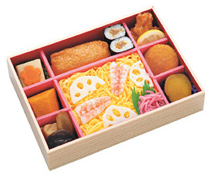
Boxes and bundles
Boundaries
Flows

Slide 64
Boundaries
Marking edges between items
Multiple items in one message
An item that spans multiple messages
Examples
IP message vs. its fragments
DCCP, SCTP
HTTP over TCP (stream)

Slide 65
Flows
Grouping separate connections to act together
Striping (increased capacity)
Coordinated management (shared control)
Alternate/backup (fault tolerance)
Examples
ISDN channel bonding
TCP control block sharing
Multipath TCP, SCTP

Slide 66
Transactions and beyond
Transactions
Translation
Other services

Slide 67
Transactions and beyond
Extend service beyond information sharing
Support specific structured interactions
Why?
Mostly software reuse (any of these can be built on any communication service)

Slide 68
Transactions
Conditional information flow
Serial: send B only if A is complete
Conjunction (AND): send C only after A and B
Disjunction (OR): send C only after A or B
Many variations:
N of M: send Z only if at least 3 of 6 alternates
Send Z only if exactly 3 of 6 alternates

Slide 69
Translation
Convert one message to another
Occurs within the recursive block
Also occurs for “gateway” relays
Examples
Language translation (content)
Format conversion (HTML to ASCII)
Display conversion (desktop to mobile web)

Slide 70


Other services
If you can dream it, you can do it!
Any capability another user/system wants
Some dreams are nightmares, though…

Slide 71
Overview of issues - sources
Deficiencies
Integrity
Error
Loss
Reordering?
Tampering
Authentication
Privacy
Performance
Time
Rate (flow, congestion)
Latency
Space
Compression
Caching
Energy
CPU, actual energy
Emulation
Circuit/wire
Reordering?
Boundaries
Flows
Transactions
Translation

Slide 72
Summary
Deficiencies need to be fixed first
Can’t communicate if we can’t communicate
Then performance should be addressed
Go fast, go cheap
Then emulation
Make it look like the user wants it to look

