Slide 1
Using the Network Layering DAG CS 118 Computer Network Fundamentals Peter Reiher

Slide 2
Outline
The DAG
A closer look at tables
A closer look at directed links
A closer look at FSMs and their state
Optimizations and equivalences
DAG walks

Slide 3

Reminder
This is an conceptual approach
There’s no common implementation approach
Most code is designed as a fixed structure
And what are shown as a separate tables and FSM state is often mangled together
There are programmable communication systems
That COULD be programmed like this
E.g., Netgraph, Click

Slide 4
Another reminder
The DAG describes motion through network layers
Not motion between network nodes
Each node on a path has its own DAG of this type
Simple or complex

Slide 5
The DAG
Components
Nodes
Arcs
Rules (constraints)

Slide 6
10,000 ft view
Rec. block
Alternating nodes
FSM + state
Tables
Directed arcs
With rules governing what they connect
stream
DNS A
DNS->IPv4
stream
DNS AAAA
DNS->IPv6
Stream
DNS txt
DNS->O-ID
Soft state
tunnel
Hard state
TCP conn.
Soft state
Delta-T
packet
64tun cfg
IPv6->IPv4
Hard state
WDM link
Hard state
WDM link
packet
OSPF
IPv4->IPv4
packet
sBGP
IPv4->IPv4
packet
BGP
IPv4->IPv4
Legend
Service type
Update protocol
From->To
packet
ARP
IPv4->E-mac
WDM
ID=3
E-net
Id=45

Slide 7
Components
Tables
FSMs and their state
Directed links

Slide 8
Tables
Name translation
Bridge identities between layers
…which indicates choices of layers (or not)
…which indicates network paths
stream
DNS A
DNS->IPv4

Slide 9
For example,
Rec. block
stream
DNS A
DNS->IPv4
stream
DNS AAAA
DNS->IPv6
stream
DNS A
DNS->IPv4
Stream
DNS txt
DNS->O-ID
Soft state
tunnel
Hard state
TCP conn.
Soft state
Delta-T
This table translates the DNS name to an IPv4 name
packet
64tun cfg
IPv6->IPv4
Hard state
WDM link
Hard state
WDM link
We could have chosen tables that translate the DNS name to an IPv6 or OID name
packet
OSPF
IPv4->IPv4
packet
sBGP
IPv4->IPv4
packet
BGP
IPv4->IPv4
Legend
Service type
Update protocol
From->To
packet
ARP
IPv4->E-mac
Implying different layer choices
WDM
ID=3
E-net
Id=45
And different paths through the network

Slide 10
FSMs and their state
Hard state
TCP conn.
Represents the protocol
State
Representing a running FSM
Waiting for
Tape-in (from FSM above, i.e., “upper layer”)
Messages (from FSM below, i.e., “lower layer”)
Timer events
Emitting
Tape-out (to FSM above, i.e., “upper layer”)
Messages (to FSM below, i.e., “lower layer”)
Rules
Governing the relation of the above

Slide 11
For example,
A TCP finite state machine
Rec. block
The layer above provided an IPv4 address (name) and a DNS name (msg)
stream
DNS A
DNS->IPv4
stream
DNS AAAA
DNS->IPv6
Stream
DNS txt
DNS->O-ID
Hard state
TCP conn.
Soft state
tunnel
Hard state
TCP conn.
Soft state
Delta-T
packet
64tun cfg
IPv6->IPv4
It will emit messages to the lower layer
Hard state
WDM link
Hard state
WDM link
packet
OSPF
IPv4->IPv4
packet
sBGP
IPv4->IPv4
packet
BGP
IPv4->IPv4
The lower layer will eventually provide a response from the DNS server
Legend
Service type
Update protocol
From->To
packet
ARP
IPv4->E-mac
WDM
ID=3
Which the TCP layer will emit to the upper DNS layer
E-net
Id=45

Slide 12
Directed links
Describe relationships between
Running FSMs (protocols in progress)
Including “users” (information source/sink)
Including links (physical information conduits)
Translation tables

Slide 13
For example,
Rec. block
stream
DNS A
DNS->IPv4
stream
DNS AAAA
DNS->IPv6
Stream
DNS txt
DNS->O-ID
Soft state
tunnel
Hard state
TCP conn.
Soft state
Delta-T
Describes relationship between DNS ➔IPv4 table and TCP FSM
packet
64tun cfg
IPv6->IPv4
Hard state
WDM link
Hard state
WDM link
That table outputs serve as inputs to TCP FSM
packet
OSPF
IPv4->IPv4
packet
sBGP
IPv4->IPv4
packet
BGP
IPv4->IPv4
Legend
Service type
Update protocol
From->To
packet
ARP
IPv4->E-mac
WDM
ID=3
E-net
Id=45

Slide 14
Rules (graph constraints)
Structure
Nodes
Links
Paths

Slide 15
Node rules
Table rules
Root tables
Leaf tables
Other tables
FSM + state rules

Slide 16
Root table rules
Table just below the “user FSM”
User FSM represents input/output to the communication system
User FSM isn’t really part of the system
“User” is not necessarily a human user
Translates user-provided names to the first protocol name
User-provided names are local to the OS

Slide 17
For example,
Rec. block
stream
DNS A
DNS->IPv4
stream
DNS A
DNS->IPv4
stream
DNS AAAA
DNS->IPv6
Stream
DNS txt
DNS->O-ID
Soft state
tunnel
Hard state
TCP conn.
Soft state
Delta-T
packet
64tun cfg
IPv6->IPv4
The user or application provides a DNS name
Hard state
WDM link
Hard state
WDM link
packet
OSPF
IPv4->IPv4
packet
sBGP
IPv4->IPv4
packet
BGP
IPv4->IPv4
This table translates the DNS name to an IPv4 name
Legend
Service type
Update protocol
From->To
packet
ARP
IPv4->E-mac
For the use of the next protocol down (TCP, here)
WDM
ID=3
E-net
Id=45

Slide 18
Leaf table rules
Table just above the “link FSM”
Link FSM represents input/output to the physical link
Link FSM is the only part that’s “real” (all else is emulated)
Translates
Protocol names to physical encodings
Computation to communication

Slide 19
For example,
This table translates the IPv4 address to an Ethernet MAC address
Rec. block
stream
DNS A
DNS->IPv4
stream
DNS AAAA
DNS->IPv6
Stream
DNS txt
DNS->O-ID
Soft state
tunnel
Hard state
TCP conn.
Soft state
Delta-T
packet
64tun cfg
IPv6->IPv4
Which the leaf protocol can use to physically send a message across an Ethernet channel
Hard state
WDM link
Hard state
WDM link
packet
OSPF
IPv4->IPv4
packet
sBGP
IPv4->IPv4
packet
BGP
IPv4->IPv4
Legend
packet
ARP
IPv4->E-mac
Service type
Update protocol
From->To
packet
ARP
IPv4->E-mac
WDM
ID=3
E-net
Id=45

Slide 20
Intermediate table rules
All other tables except root and leaf
Represents message in/out to FSM above
Represents tape-in/-out to FSM below
Translates
Names in FSM above to names in FSM below

Slide 21
FSM + state rules
FSM represents the protocol
Operates in a single namespace
Real FSMs (part of the system)
Matches names in table above AND table below
Virtual user FSM (top/root)
Represents system in/out
Virtual link FSM (bottom/leaf)
Represents a physical link

Slide 22
For example,
A virtual user FSM
Rec. block
stream
DNS A
DNS->IPv4
stream
DNS AAAA
DNS->IPv6
Stream
DNS txt
DNS->O-ID
Hard state
TCP conn.
Soft state
tunnel
A real FSM
Hard state
TCP conn.
Soft state
Delta-T
packet
64tun cfg
IPv6->IPv4
Hard state
WDM link
Hard state
WDM link
packet
OSPF
IPv4->IPv4
packet
sBGP
IPv4->IPv4
packet
BGP
IPv4->IPv4
Legend
Service type
Update protocol
From->To
packet
ARP
IPv4->E-mac
A virtual link FSM
WDM
ID=3
E-net
Id=45

Slide 23
General node rules
Roots
FSMs that represent user programs
Link to root tables
Leaves
FSMs that represent physical links
Linked from leaf tables
FSMs
Operate in a single name space
Refer to tables “below”

Slide 24
Paths
Meaning
Rules (constraints)

Slide 25
Linking nodes
Orientation
Directed
Acyclic
Head/tail
Connects different types of graph nodes:
If head is a table, tail is a FSM
If head is an FSM, tail is a table

Slide 26
Head/tail rule
Tables and FSMs “alternate”
In our pictures, looks like this:

Slide 27
Path meaning
Creates communication from networking
Composed of layered capabilities
Describes the “stack” of layers
All communication is pairwise
Nested composition = linear path (the “stack”)
Each message traverses a single path

Slide 28
Path rules
View of a user host
View of an intermediate (relay) host
User to user view

Slide 29
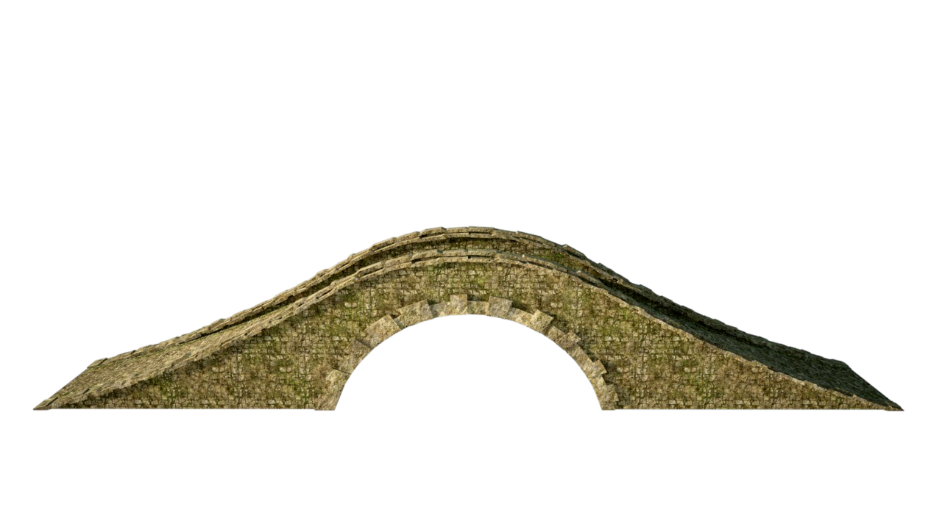


The different host types
User hosts
Σ
1
9
r
s
Δ
Relay hosts

Slide 30
Path in a user host
Source (push)
Enter at top
Exit at bottom
Destination (pop)
Enter at bottom
Exit at top

Slide 31
Implications of host path rules
Tables must tie user to a physical link
Must start with a name a user knows
Must follow a continuous chain of tables
Must end with a physical link
The maps tell you the DAG structure
(real or implied)

Slide 32
DAGs and links
Links are the physical network connections
DAGs exist at the nodes at each end of a link
We can hook together DAGs of different nodes together
Describing the overall network path through layers on multiple nodes

Slide 33
Path in a relay host
Messages
Enter at a leaf (pop)
Exit at a leaf (push)
Share a common FSM
No user input/output

Slide 34
Path matching
Links match tails
Source
Relay
Destination

Slide 35
Path matching
Links match tails
Links must match
Tails must match
Source
Relay
Destination

Slide 36
Path matching
Links match tails
Links must match
Tails must match
Ends *and* hops match heads
Source
Relay
Destination

Slide 37
Path matching
Links match tails
Links must match
Tails must match
Ends *and* hops match heads
Emulate end-to-end
By relaying through shared node
Source
Relay
Destination

Slide 38
Pushing and popping
Each FSM
On the way down, adds info needed …
For matching FSM on the way up
Push/pop
Stacked layers make messages and FSMs work like one large, distributed FSM

Slide 39
A deeper look…
Tables
FSM + state

Slide 40
Tables
Name translation
Relay support

Slide 41
Name translation
Map FROM domain into TO domain
“Domain” is another term for “namespace”
Map can have:
Aliases (N:1)
Proxies (1:N)
Additional information
“From” domain
Translation Table
From: To:
IP-1 Eth-22
IP-5 Eth-85
“To” domain

Slide 42
Relaying support
Governs when can you relay
Provides additional information
Table origins

Slide 43
When can you relay?
When a table entry exists
When it’s already there (cached, “push”)
When you can fill it in (i.e., “pull”)

Slide 44
Does an entry ensure connectivity?
Nope!
DAG inside one host should match, though
E.g., remove “thread” of entries “above” when the “bottom” has no entry

Slide 45
Other table information
Resolution context
Cost, weight, etc. to differentiate proxies
Table maintenance
Expiration time
Origin (for refresh, duplicate detection, etc.)

Slide 46
Table origins
Manual
External

Slide 47
Manual table configuration
Preconfigured
Config files, boot files, etc.
Manual manipulation
User commands

Slide 48
External table configuration
Host configuration
DHCP
Dynamic update
Routing protocols (covered next week)

Slide 49
Directed links
As part of the table
Defining alternates
Defining protocol reuse and sharing

Slide 50
Links in the table
What needs to be there?
Name you have
Name you want
A way to get to the next FSM
Via identifier of the namespaces
Via separate identifier (OS pointer, e.g.)
Or implied
In the picture so far, a table is defined as having one TO namespace, so the “next FSM” is implied

Slide 51
Alternates
Multiple entries for a name to resolve
I.e., proxy
Weights or costs
Allows us to prioritize selection
Indicators of usage
Use only one
Use one until one works
Use multiple at the same time
Forces “parallelism” for fault tolerance, e.g.
I.e., the bottom half of the hourglass

Slide 52
Reuse
Many FSMs point to a single table
All share the same FROM namespace
Allows the rest of the path down the DAG to be shared/reused by other protocols
I.e., the top half of the hourglass

Slide 53
FSMs and their state
Soft vs. hard
The base case as an FSM

Slide 54
Soft state
Not critical to FSM operation
Recoverable
Cached optimization
MUST be equivalent to “null start”
I.e., reaches the same result as an FSM that starts in the idle state

Slide 55
Hard state
Critical to FSM operation
Cannot be recovered; results in error/failure
Persists between messages
E.g., represents shared state with the other end of the channel
Provides context for FSM operation
Acts like a “paused” FSM

Slide 56
Soft vs. Hard
Soft
Fault tolerant if lost
More efficient if it can recover/refresh
Hard
Requires guarantees, backups, etc.
No communication until restored (if possible)

Slide 57
The base case as an FSM
The base case FSM isn’t really there
The channel is treated like an FSM

Slide 58
DAG walks
Early binding
Late binding

Slide 59
Early binding
Setup path through DAG on first use
Record that path (e.g., socket data structure)
Reuse that path (forever)
Independent of FSM hard/soft state

Slide 60
Late binding
Every message finds its own way
Ignore path of previous messages
Each message finds its own
Independent of FSM hard/soft state

Slide 61
Early vs. late
Early (static)
Pros
Ensures stability
Cons
Cannot adapt (suboptimal, fragile)
Late (dynamic)
Pros
Adapts while info exchange is in progress
Cons
Can be expensive (slow, costs resources)
Can be unpredictable

Slide 62
Processing
The recursive block walks the tree
Using message as part of context for FSM
Soft state
Service=#42
ID=JN3E
Recursive Block
Service=#42
ID=JN3E

Slide 63
Graph traversal
Each recursive step
Walks a layer down
Wraps needed state for retrieval at receiver FSM
Recursive Core
Service=#42
ID=JN3E
Translation Table
From: To:
JN3E 223.45-7
Recursive Core
Service=#42
ID=223.45-7

Slide 64
Summary
The DAG encodes:
The protocol stack
The network architecture
The DAG has constraints
Esp. DAG portions must match
The DAG is a concept
Implementations vary, grouping/partitions vary

