Slide 1
Recursion and Networking
CS 118
Computer Network Fundamentals
Peter Reiher

Slide 2
Outline
Preview and motivation
What is recursion?
The basic block concept
Stacks, hourglasses, and DAGs

Slide 3
Preview and motivation
What do we have so far?
Putting the pieces together
What’s missing?

Slide 4
What do we have so far?
Communication
  2-party info. coordination over a direct link
  Requires a protocol
A layer
  Homogenous indirect communication
  Requires naming, relaying
Stacked layers
  Heterogeneous indirect communication
  Requires resolution

Slide 5
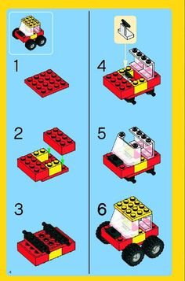
Putting them together
We have the pieces
  Communication
  Layers
  Stacking
Some assembly required
  Is there just one way?

Slide 6
How do we know:
Which layers can stack
  Have resolution mechanisms
Which layer you should use next
  Does it help you move closer
  towards communicating?

Slide 7
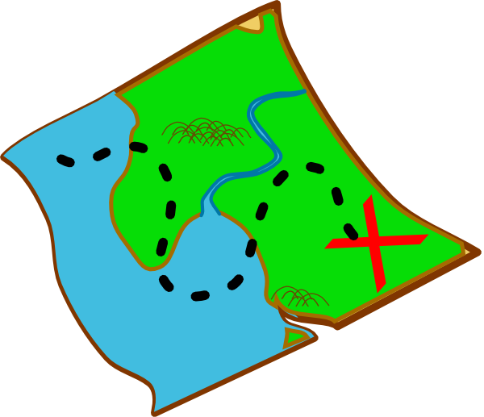

What’s missing?
A map
  To show layer relationships
A way to use that map
  Picking a trail
  Following a trail
  Some breadcrumbs to find our way home

Slide 8
Maps and map use
We’ll start with map use
  That’s where recursion comes in
Then we’ll look at the map
  Hint: remember stacks and hourglasses?

Slide 9
Using recursion to describe network layering
We will use the general idea of recursion to unify our understanding of network layering
That’s NOT how the code, hardware, and most architectures really work
  You’d look in vain for obvious recursive steps
But at a high level it’s really what’s going on
REMEMBER – we’re talking concepts, not implementations, here

Slide 10
What is recursion?
Definition
Properties
Variants

Slide 11
Induction
Base case:
  Prove (or assert) a starting point
  E.g., 0 is a natural number
Inductive step:
  Prove (or assert) a composite case
  assuming already proven cases
  E.g., X+1 is a natural number if X is too

Slide 12
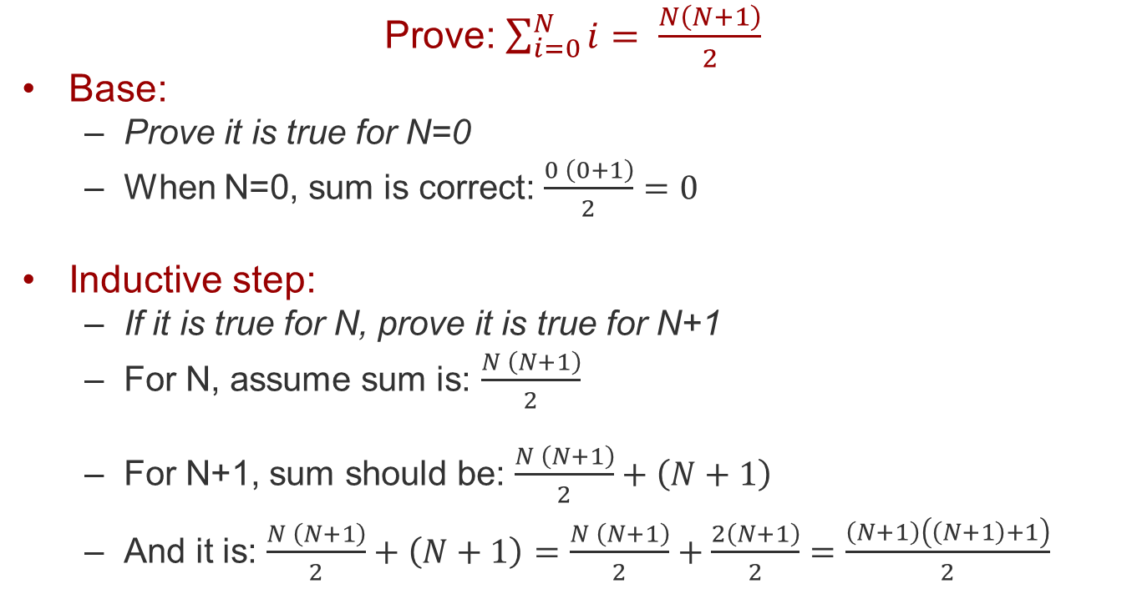
Induction proof
Prove: $\sum_{i=0}^{N}{i= \frac{N\left(N+1\right)}{2}}$
Base:
  Prove it is true for N=0
  When N=0, sum is correct: $\frac{0 \left(0+1\right)}{2}=0$
Inductive step:
  If it is true for N, prove it is true for N+1
  For N, assume sum is: $\frac{N \left(N+1\right)}{2}$
  For N+1, sum should be: $\frac{N \left(N+1\right)}{2}+\left(N+1\right)$
  And it is: $\frac{N \left(N+1\right)}{2}+\left(N+1\right)$ $=\frac{N \left(N+1\right)}{2}+\frac{2\left(N+1\right)}{2}=\frac{\left(N+1\right)\left(\left(N+1\right)+1\right)}{2}$

Slide 13
Recursion: backwards induction
Reductive step:
  Rules that reduce a complex case into components, assuming the component cases work
Base case:
  Rules for at least one (irreducible) case

Slide 14
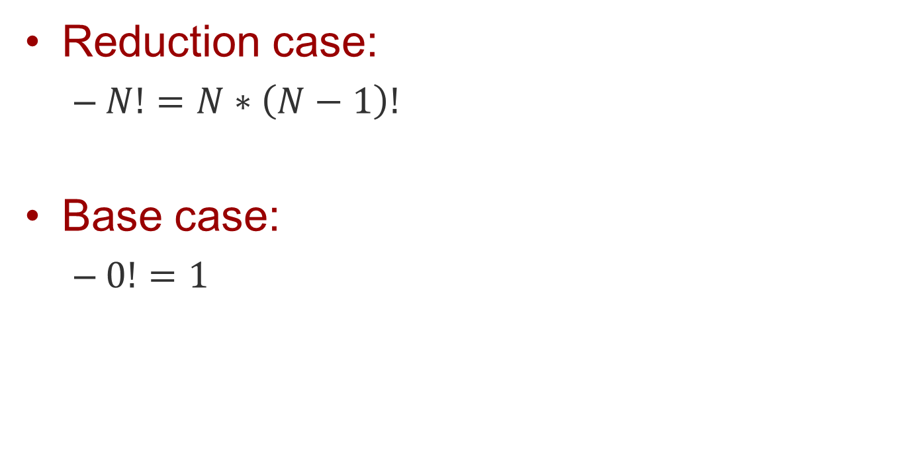
Recursion: example
Reduction case:
  $N!=N∗\left(N−1\right)!$
Base case:
  $0!=1$

Slide 15
Recursion as code
int factorial(int n)
{
if (n < 0) {
exit(-1); // ERROR
}
if (n == 0) {
return 1;
} else {
return n * factorial(n-1);
}
}

Slide 16
Fibonacci series
Base:
  Fib(0) = 0
  Fib(1) = 1
Reduction:
  F(n) = F(n-1) + F(n-2)

Slide 17
Properties of recursion
Base case
  Just like induction
Self-referential reduction case
  Just like induction, but in reverse

Slide 18
Differences
Induction
  Starts with the base case
  Uses finite steps
  Extends to the infinite
Recursion
  Starts with a finite case (base or otherwise)
  Uses finite steps
  Reduces to the base case

Slide 19
Properties of recursion
All cases are the same
  Except the base case(s)
Recursive step is self-referential
  Import interface = export interface
  “Provides what it expects”
  E.g., C func: vtype recfunc(vtype x)

Slide 20
Variants of recursion
Regular
Tail

Slide 21
Regular recursion
Reductive step is an arbitrary function
  MUST include self-reference
  Self-reference MUST be ‘simpler’
  int fib(n) { return fib(n-1) + fib(n-2); }

Slide 22

Why simpler?
Reductive step must simplify
  If it ever doesn’t, recursion is infinite
  If you don’t change just once, you never will

Slide 23
Tail recursion
Same rules as regular recursion
PLUS
Self-reference ONLY as the sole last step
  int fib(int i) {
  return dofib(i, 0, 1);
  }
  int dofib(int i, int x, int y) {
  if (i==0) { return x; } // base case
  if (i==1) { return y; } // base case
  return dofib(i-1, y, x+y); // reduction step
  }

Slide 24
Why tail recursion?
Replace self-reference with “goto”
  Turns recursion into a while loop
  int fib(int i) {
  return dofib(i, 0, 1);
  }
  int dofib(int i, int x, int y) {
  while (i > 0) {
  tx = x; ty = y; // need for temp storage
  i = i-1; x = ty; y = tx+ty; // “recursive call”
  }
  return x;
  }

Slide 25
How is recursion related to networking?
Base case: communication
  Two parties already directly connected
Reduction steps: networking
  Stacked layering
  Relaying
= regular recursion
= tail recursion

Slide 26
Stacked layering as recursion
P can reach Q
  Assuming P translates to X,
  Q translates to Y,
  and X can reach Y
Turns P-Q layer into X-Y layer
  Using resolution
Base case – some layer in the stack allows the source to reach the destination

Slide 27
Relaying as tail recursion
A can reach C
  Assuming A can reach B
  and B can reach C
How is this tail recursion?
  We’ll get back to that …

Slide 28
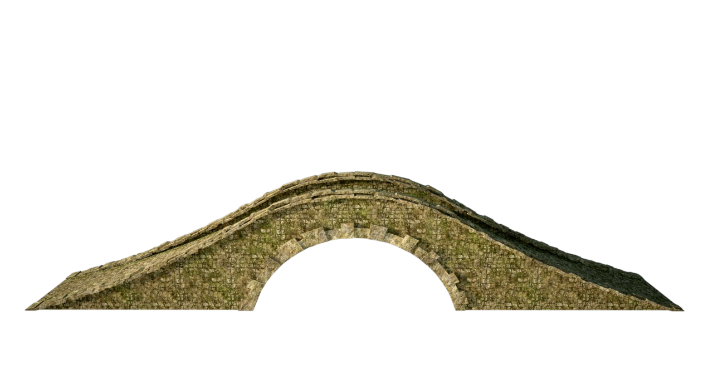
Recall how stacked layering works
Get to the layer you share with dest.
  Go down and up to get where you need to go
A
T
K
P
Σ
1
9
r
s
Δ

Slide 29
Where’s the elevator?
Next layer down?
  When do we do this?
    When we don’t share a layer with current destination
    How do we know?
What do we do if we can’t go down?
    We pop “up” instead
    Then we need to pick another layer to go down
    How do we know?
Let’s start with the elevator itself

Slide 30
The basic block
The block
Interfaces
Internal functions
The role of naming and routing

Slide 31
The block
LAYER(DATA, SRC, DST)
Process DATA, SRC, DST into MSG
WHILE (Here <> DST)
IF (exists(lower layer))
Select a lower layer
Resolve SRC/DST to next layer S’,D’
LAYER(MSG, S’, D’)
ELSE
FAIL /* can’t find destination */
ENDIF
ENDWHILE
/* message arrives here */
RETURN {up the current stack}
The elevator:
Next Layer

Slide 32
What’s happening inside…
LAYER(DATA, SRC, DST)
Process DATA, SRC, DST into MSG
WHILE (Here <> DST)
IF (exists(lower layer))
Select a lower layer
Resolve SRC/DST to next layer S’,D’
LAYER(MSG, S’, D’)
ELSE
FAIL /* can’t find destination */
ENDIF
ENDWHILE
/* message arrives here */
RETURN {up the current stack}
A layer is…
Next Layer

Slide 33
What’s happening inside…
A layer is:
  Prepare msg
  for communication
LAYER(DATA, SRC, DST)
Process DATA, SRC, DST into MSG
WHILE (Here <> DST)
IF (exists(lower layer))
Select a lower layer
Resolve SRC/DST to next layer S’,D’
LAYER(MSG, S’, D’)
ELSE
FAIL /* can’t find destination */
ENDIF
ENDWHILE
/* message arrives here */
RETURN {up the current stack}
Next Layer

Slide 34
What’s happening inside…
LAYER(DATA, SRC, DST)
Process DATA, SRC, DST into MSG
WHILE (Here <> DST)
IF (exists(lower layer))
Select a lower layer
Resolve SRC/DST to next layer S’,D’
LAYER(MSG, S’, D’)
ELSE
FAIL /* can’t find destination */
ENDIF
ENDWHILE
/* message arrives here */
RETURN {up the current stack}
A layer is:
  Is it for you?
Next Layer

Slide 35
What’s happening inside…
A layer is:
  Is it for you?
    Yes – done
Well, except you need to go back up the stack
LAYER(DATA, SRC, DST)
Process DATA, SRC, DST into MSG
WHILE (Here <> DST)
IF (exists(lower layer))
Select a lower layer
Resolve SRC/DST to next layer S’,D’
LAYER(MSG, S’, D’)
ELSE
FAIL /* can’t find destination */
ENDIF
ENDWHILE
/* message arrives here */
RETURN {up the current stack}
Next Layer

Slide 36
What’s happening inside…
LAYER(DATA, SRC, DST)
Process DATA, SRC, DST into MSG
WHILE (Here <> DST)
IF (exists(lower layer))
Select a lower layer
Resolve SRC/DST to next layer S’,D’
LAYER(MSG, S’, D’)
ELSE
FAIL /* can’t find destination */
ENDIF
ENDWHILE
/* message arrives here */
RETURN {up the current stack}
A layer is:
  Is it for you?
    No:
      Find help
Next Layer

Slide 37
What’s happening inside…
LAYER(DATA, SRC, DST)
Process DATA, SRC, DST into MSG
WHILE (Here <> DST)
IF (exists(lower layer))
Select a lower layer
Resolve SRC/DST to next layer S’,D’
LAYER(MSG, S’, D’)
ELSE
FAIL /* can’t find destination */
ENDIF
ENDWHILE
/* message arrives here */
RETURN {up the current stack}
A layer is:
  Is it for you?
    No:
      Find help
      Translate ID
Next Layer

Slide 38
What’s happening inside…
LAYER(DATA, SRC, DST)
Process DATA, SRC, DST into MSG
WHILE (Here <> DST)
IF (exists(lower layer))
Select a lower layer
Resolve SRC/DST to next layer S’,D’
LAYER(MSG, S’, D’)
ELSE
FAIL /* can’t find destination */
ENDIF
ENDWHILE
/* message arrives here */
RETURN {up the current stack}
A layer is:
  Is it for you?
    Yes – done
    No:
      Find help
      Translate ID
      Send it there
Next Layer

Slide 39
Deeper look at the steps
Prepare message for communication
  Take what you get (from the user/FSM)
  Add whatever you need for your state sharing
  Run the protocol at this layer
Then check to see where it goes

Slide 40


Why prepare then send?
You can’t reverse order
  You need your message in order to talk
  One request might turn into multiple messages
It might be for you
  A nice degenerate case
  “Dancing with yourself”

Slide 41
Why does this work?
Recursion
  Base case: direct connection
  Recursive steps:
    Layering
    Relaying

Slide 42
An example: DNS request
User requests gethostbyname() to the OS
  Prepares the DNS query message
  to the default server (random root or local)
  Is it for me?
    No:
      Find a way to get to the server
      Translate this layer’s names (“YOU”, “servername”)
      into the next layer’s names
      RECURSE

Slide 43
Recursion steps
DNS Layer
User calls gethostbyname() to OS
  Make DNS query “me”->dns
  For “dns” use UDP
  Translate me to bob.com:61240, dns to ns.com:53
  Call UDP
UDP Layer

Slide 44
Recursion steps
DNS Layer
User calls gethostbyname() to OS
  …
  Call UDP
    Make UDP message 61240->53
    For “UDP” use IP
    Translate bob.com to 52.3.5.3,
    ns.com to 2.43.14.123
    Call IP
UDP Layer
IP Layer

Slide 45
Recursion steps
DNS Layer
User calls gethostbyname() to OS
  …
  Call UDP
    …
    Call IP
      Make IP message 52.3.5.3 ->2.43.14.123
      For IP use ethernet
      Translate 52.3.5.3, 2.43.14.123 to ethA, ethB
      Call Ethernet
UDP Layer
IP Layer
Ethernet Layer

Slide 46
Recursion steps
DNS Layer
User calls gethostbyname() to OS
  …
  Call UDP
    …
    Call IP
      …
      Call Ethernet
        Make ethernet message ethA->ethB
        For ethB, use em0 directly
        BASE CASE – send it!
UDP Layer
IP Layer
Ethernet Layer

Slide 47
What about at the receiver?
Message comes in at some base protocol
  E.g., the Ethernet on the receiving node
It’s to be handled by a higher level protocol
  E.g., DNS
How do we get up to that layer?
Recursion in the opposite direction
Call up the stack, instead of down

Slide 48
Recursion block at receiver
Now you pop back up the stack
You’re at the destination, but not at the right layer
It’s recursive calls again
But in the opposite direction
LAYER(DATA, SRC, DST)
Process DATA, SRC, DST into MSG
WHILE (Here <> DST)
IF (exists(lower layer))
Select a lower layer
Resolve SRC/DST to next layer S’,D’
LAYER(MSG, S’, D’)
ELSE
FAIL /* can’t find destination */
ENDIF
ENDWHILE
/* message arrives here */
RETURN {up the current stack}

Slide 49
Interfaces
LAYER(DATA, SRC, DST)
Process DATA, SRC, DST into MSG
WHILE (Here <> DST)
IF (exists(lower layer))
Select a lower layer
Resolve SRC/DST to next layer S’,D’
LAYER(MSG, S’, D’)
ELSE
FAIL /* can’t find destination */
ENDIF
ENDWHILE
/* message arrives here */
RETURN {up the current stack}
What does the block input?
  Source name
  Destination name
  Message
  In the layer of the block
What does the block output?
  Recursive step: same thing! (it has to)
  Base case: physical signal with same effect
Next Layer

Slide 50
Process the message
This is the protocol FSM
  Starts in default state (non-persistent) or last state (persistent)
  Tape-in is the “input” message to be shared
  Tape-out is the “output” message(s) to share with the corresponding FSM at the destination

Slide 51
The role of naming and routing
Resolution tables
  Indicate whether you can get somewhere
  Translate names from one layer to next
I.e., resolution tables are BOTH
  Name translation
  Routing

Slide 52
Stacks, hourglasses, and DAGs
Recursion: the engine that gets you there
  But it needs a map to follow

Slide 53
Stacks
A linear chain of layers
  “Next layer” is fixed
  Describes a path taken
  by the recursive steps
  But not all possible paths
  that could be taken
HTTP
XDR
BEEP
TCP
IP
802.3
100bT

Slide 54

The Hourglass
A bigger picture
  Many possible paths
Top half describes reuse
  Many different layers share
  ways to “get there”
Bottom half describes choices
  One layer has many ways
  to “get there”

Slide 55
Top half
HTTP, DNS, FTP
  All use TCP
TCP, UDP, SCTP
  All use IP
Sharing to reuse
mechanism
IP

Slide 56
Bottom half
IP
  Can use ethernet, sonet
Ethernet
  Can use optical, electrical
Choice to allow
diversity and
optimization
IP

Slide 57
Who talks to whom?
Every communicating pair
  Is at the same layer
  MAY have different lower layers
  (recursive next steps)
  CANNOT have different upper layers
  (share a common previous recursive steps)

Slide 58
Who talks to whom
HTTP
HTTP
TCP
TCP
IP
IP
IP
SONET
SONET
Ether
Ether

Slide 59
The DAG
Recursive Core
Structure of tables
  Directed
  Acyclic
  Graph
stream
DNS A
DNS->IPv4
stream
DNS AAAA
DNS->IPv6
Stream
DNS txt
DNS->O-ID
Soft state
tunnel
Hard state
TCP conn.
Soft state
Delta-T
packet
64tun cfg
IPv6->IPv4
Hard state
WDM link
Hard state
WDM link
Hard state
WDM link
packet
OSPF
IPv4->IPv4
packet
sBGP
IPv4->IPv4
packet
BGP
IPv4->IPv4
Legend
Service type
Update protocol
From->To
packet
ARP
IPv4->E-mac
WDM
ID=3
E-net
Id=45

Slide 60
DAG Components
Capabilities
Environment
Interface
RECBLOCK(DATA, SRC, DST)
Process DATA, SRC, DST into MSG
WHILE (Here <> DST)
IF (exists(lower layer))
Select a lower layer
Resolve SRC/DST to lower layer S’,D’
RECBLOCK(MSG, S’, D’)
ELSE
FAIL /* can’t find destination */
ENDIF
ENDWHILE
/* message arrives here */
RETURN {up the current stack}
Components
  Recursive block (RB)
  Translation table (TT)
  State instance (SI)
Structure
  Directed acyclic graph
    TT as primary nodes, connected on matching entries
    SI as intermediate nodes on all arcs connecting TTs
  Recursive block – traverses the graph
Recursive Block
Needs
Recursion
Interface
“From” domain
Translation Table
From: To:
IP-1 Eth-22
IP-5 Eth-85
“To” domain
Soft state
ID=name
Soft state
ID=name

Slide 61
What does the DAG indicate?
Recursive steps
FSM rules and state

Slide 62
Recursive steps
Fan-out
  Alternate (equivalent) next step
Fan-in
  Protocol reuse/sharing (NOT interoperation)

Slide 63
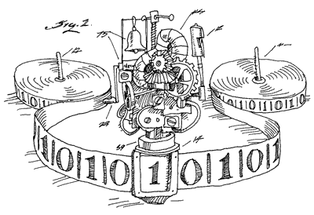
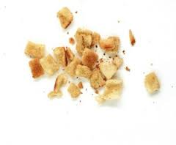
FSM rules and state
A place to “wait” until there’s more tape-in
  State needs a place to wait
  FSM rules need a place too
  I.e.,a paused FSM
i.e., the “breadcrumbs”

Slide 64

Follow the yellow brick road
(overlapping euphemism alert)
Picking a trail
  Use the map; search all “next step” options
  Find a choice with a translation entry
Follow the trail
  Use the “breadcrumbs” (state) left by previous msg
Find your way home
  Use the “breadcrumbs” inside the message

Slide 65

Breadcrumbs inside the message?
Remember the message in the envelope?
Envelope inside an envelope
  Inner envelope is the “breadcrumbs”
  Encodes path UP at receiver

Slide 66
The DAG looks complicated
It is because it supports:
More than one hourglass
Dynamic path selection

Slide 67
More accurate than ONE hourglass
Describes many overlapping hourglasses

Slide 68
Dynamic graph path selection
Internet “stacks” graph
  Static
  Only ever picks one choice:
  it never tries another on failure
Other variants allow dynamic choice
  Research projects
  Datacenter optimizations

Slide 69
Summary
Networking traverses layers via recursion
That recursion needs a map
The map governs recursive step choice and manages FSM (protocol) state

