Slide 1
Automatic Naming
CS 118
Computer Network Fundamentals
Peter Reiher

Slide 2
Outline
What is automatic naming?
Why automatic?
Designed-in
Asking someone else
Figuring it out for yourself
Issues

Slide 3
What is automatic naming?
Assigning a name to a network entity without human intervention
Usually very dynamically
Usually at the moment when it is first needed
Often using different names for the same thing at different times

Slide 4
Why automatic?
“Because it must be!”
Ease of configuration
Adapting to changes

Slide 5
Because it must be!
Without a name, what can you do?
  Anonymous reporting (N:1)
  Broadcast announcements (1:N)
Not all that useful, but…
we can use these to get a name!

Slide 6
Ease of configuration
Convenience matters
  Plug-and-play, Zero-touch, etc.
Complexity is painful
  How many devices do you own?
  Are they all configured the same way?
  What if you had to configure them explicitly?

Slide 7
Adapting to changes
Mobility
Renaming

Slide 8
Mobility
Change of physical location:
  Changes network location
    Topological or geographic names change
    E.g., USC IP on campus, TimeWarner at home
  Changes network
    Name space changes
    E.g., phone number on 4G,. IP address on WiFi

Slide 9
Renaming
Change by the network operator
  E.g., area code “split”
Change by the user
  E.g., off-campus WiFi then VPN to campus

Slide 10

How can you get a name?
What are the options?

Slide 11
Alternatives
Design-in (preconfigure)
Pick at random
Ask someone else

Slide 12
Designed-in sub-options
The $1 solution
Dude, where’s my card?
Getting the boot

Slide 13

The $1 solution
Maximum cost of globally unique names
  Use a USD $1 serial number as your name
  Put the $1 in the device (or whatever)

Slide 14
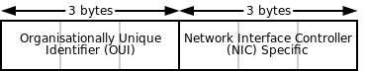
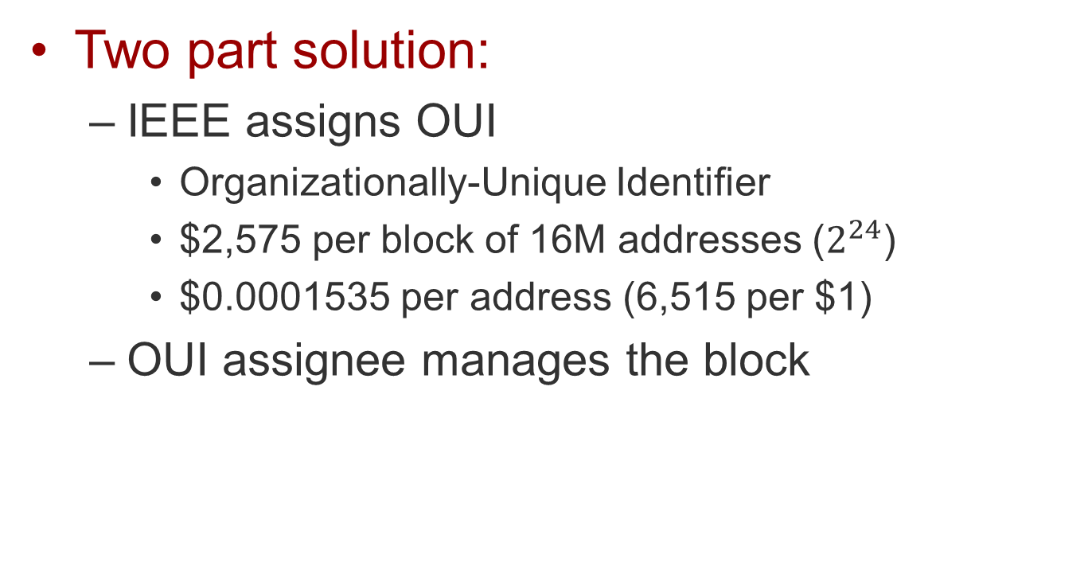
Ethernet
Two part solution:
  IEEE assigns OUI
    Organizationally-Unique Identifier
    $2,575 per block of 16M addresses ($2^{24}$)
    $0.0001535 per address (6,515 per $1)
  OUI assignee manages the block

Slide 15
Ethernet addresses
All Ethernet devices have:
  Fixed
    Wired-in or write-only by manufacturer
    Unique Burned-in (BIA) / hardware (EHA) address
    Broadcast (all 1’s)
  Writeable
    To change your BIA (to replace systems)
    To add multicast addresses

Slide 16
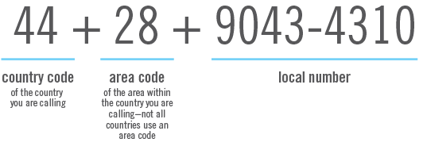
POTS, non-SIM cellphones
Assigned by a hierarchy of authorities
  ITU country codes, country area codes, …
  POTS – paired to the “tail circuit” (house wire)
  Non-SIM cell – paired to 7-byte MEID
  (Mobile Equipment ID; 32-bit ESNs ran out in 2008)

Slide 17
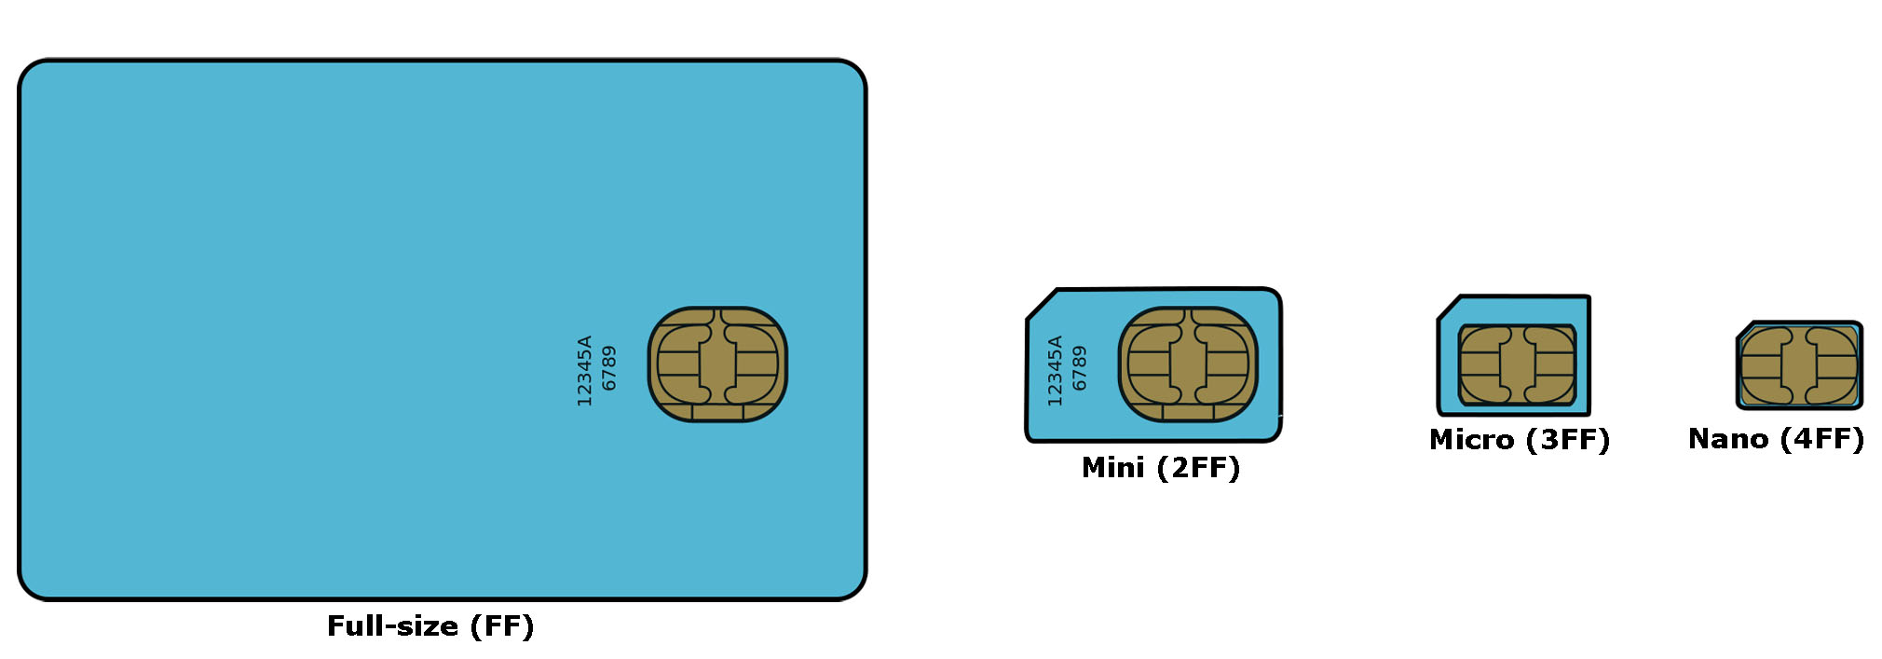
Dude, where’s my card?

Slide 18
SIM-based cellphones
GSM phones have two names
  The phone (IMEI)
  (International Mobile Equipment ID 14 digits, 6.228 bytes)
  The SIM card (Subscriber Identity Module)
    Includes a 20 digit ICCID (IC circuit ID)
Telco links ICCID to your phone number
  Also checks your IMEI isn’t blacklisted (stolen)

Slide 19
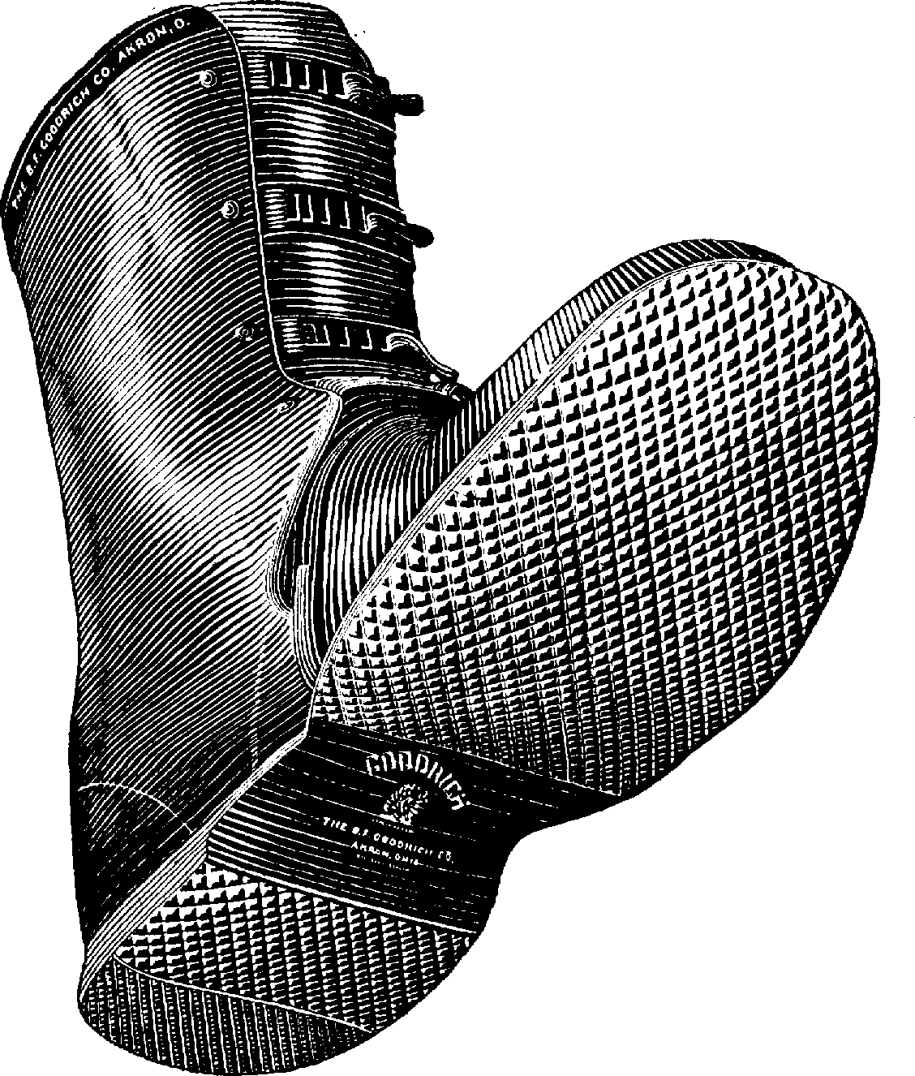
Getting the boot
Power-on configuration
  Files on disk, USB, floppy
  Flash memory
  *PROM (EEPROM)
  Ask the user (let’s hope not . . .)

Slide 20
Figuring it out for yourself
Pick me a winner!
Parental support

Slide 21

Rolling the dice…
If the number space is large enough
  Why not just pick one?
  What could go wrong?

Slide 22
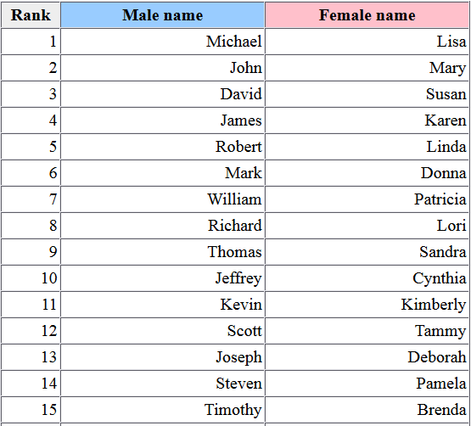
People names
Hierarchical in spirit
  Given name(s) are “random”
  But are they?
  What if your last name
  is common?

Slide 23
IPv4 link local
169.254.x.x
  EXCEPT first 256, last 256 (RFC 3927)
  Based on MS Automatic Private IP Addressing (APIPA)
  Pick randomly, do a test to confirm
  Works only on the local link
    Where the test works (ARP)
    NEVER relayed
    E.g., on your Ethernet

Slide 24
Pseudo-what?
Random
  Having no predictability
  A sequence with maximum disorder
Is a single number ever random?
  No such thing!
  Random applies to a sequence

Slide 25
Random number generation
Cannot be generated by a TM in finite time
  A TM would read only a finite tape
  TM + finite tape = predictable output
So what do we do?

Slide 26
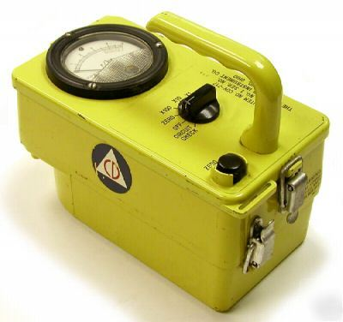
True random
Need an external source of infinite entropy
  A random physical event
  E.g., radioactive decay, thermal noise, Brownian motion

Slide 27
Pseudorandom
Deterministic, but appearing random
  Unix rand()
  Sometimes includes arbitrary “seed” (input)
    Ethernet BIA
    Disk access times
    Keystroke delays
    Mouse movements
  Repeatable
    Useful to replay simulations

Slide 28
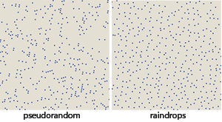
“Spot” the difference

Slide 29
Eyeballs aren’t always useful
2089986280348253421
1706798214808651328
2306647093844609550
5822317253594081284
8111745028410270193
8521105559644622948

Slide 30


Compute the difference

Slide 31
IPv6 link local
FE80::/10
  Assign based on MAC address
  or
  Pick randomly (RFC 4193)
  Do a test to confirm
  Works only on the local link
    Where the test works (ND)
    NEVER relayed

Slide 32
iOS Ethernet anonymity
When configured
  Every time device wakes from “sleep”
  (almost never, FWIW)
  Pick a new random MAC
  Hope it doesn’t collide (!)
    There is no test!
  Avoids “fingerprinting” SSID requests
    Some stores monitor these

Slide 33
Asking DAD for help
Duplicate Address Detection
  Any general mechanism
  “DAD” is specific to IPv6
Works where?
  IPv4: yes
  IPv6: yes
  Ethernet: NO

Slide 34
IPv4 duplicate detection
Use ARP
  Send an ARP probe for yourself
    Source IP = none
    Destination IP = broadcast
    Owner MAC = yours (presumed unique)
    Query for = the tested address
  Do NOT send a query from the tested address
    It will overwrite the cache of others!
    Possibly even the existing owner!

Slide 35

Crossing the streams?
ARP vs. IP
  Different layers
  IP nodes sit on both
    Nodes on shared links
Are these gateways?
  Not quite
  We never translate, only encapsulate (stack)

Slide 36
Implications for IPv4
IPv4 addressing
  Ask one network layer for help with another
  Exchange ARP so IP can autonumber
  Exchange ARP so IP can discover
  IP on shared links doesn’t exist alone!
What about non-shared links?
  Addresses are assigned statically

Slide 37
IPv6 DAD
Use IPv6 Neighbor Solicitation
  Same basic principle as IPv4
  Ask to see if anyone has the desired address
  If nobody asks, we get it

Slide 38
IPv6 Neighbor Solicitation
IP-level replacement for ARP
  But IPv6 has no broadcast
  Use multicast instead
How?
  Could multicast to “all nodes” (like ARP does)
  Instead multicast to MAC based on IPv6 addr
  Only the node we want joins that group
  NOBODY ELSE IS BOTHERED!
Notes:
IPv6 solicited node address
fc4291#section-2.7.1

Slide 39
More parental support – IPv6
Global IPv6 address
  Listen for a Router Advertisement
  (or ask routers via Router Solicitation)
Create an address you know is unique
  Combine RA information with Ethernet MAC
Do a test to confirm
  The test is only on the local link
    Avoids MAC collisions
  But the address is good globally
    RA part is assumed unique

Slide 40
IPv6 example
Listen for router advertisements
  Collect them as they come in
For each RA received on an interface
  Combine the router prefix with the MAC BIA
  Also join an IPv6 multicast based on the BIA

Slide 41
Asking someone else
A horse with no name
Name servers for self-namers

Slide 42
A horse with no name
Asking a question without an ID
Getting an answer without an ID?

Slide 43
Asking a question…
How do you start?
  If you don’t know who to ask, broadcast the question
  If you do know who to ask, send directly
What’s your address?
  At the layer you need to know, NONE
  (typically “0”)

Slide 44
What layer do you ask?
IPv4
  Another layer (generally)
IPv6
  Your layer (always)

Slide 45
IPv4
Mixing the layers
  On a different layer that already has an address
    E.g., broadcast Ethernet ARP with your MAC address
    E.g., ATMARP request to LANE server on known circuit
Same layer
  IP (with UDP inside) to DHCP server
    On the same layer to a server
    Using source address 0

Slide 46
IPv6
IP directly
  Neighbor Discovery
  Source address = 0

Slide 47
Getting an answer…
Broadcast
  When you didn’t know who was asking
Unicast
  When you do
  (e.g., when the request is over a different layer)

Slide 48
What can someone else tell you?
What are the options now?

Slide 49
What can someone else tell you?
Just the facts
  An address based on a table
The facts and stuff
  An address based on a table
  A file that could have anything
A loan
  More specific information
  Organized by type
  Loaned out, then recovered for reuse

Slide 50
Reverse ARP
ARP
  Broadcasts request providing IP address
  Owner replies with corresponding Ethernet MAC
RARP
  Broadcasts request providing Ethernet MAC
  Server replies with corresponding IP address

Slide 51
RARP limitations
Only provides an IP address
  Systems often need more, e.g., default router, DNS server (to avoid bugging the roots), etc.
Requires preconfigured server
  Each expected request must match an entry
Runs on its own protocol
  Like ARP, this isn’t over IP; it’s over Ethernet

Slide 52
BOOTP
Bootstrap Protocol
  Still needs a static, preconfigured table
Replacement for RARP
  Runs over UDP over IP
  (rather than Ethernet directly)
  Also provides a file to retrieve
    That file can be a script, a program, or a table

Slide 53
DHCP
Dynamic Host Configuration Protocol
Replacement for BOOTP
  Runs over UDP over IP
  Explicit way to manage specific configuration parameters
  Managed via leases
    Assignment has an expiration; can be renewed, released
    Allows easy reassignment

Slide 54
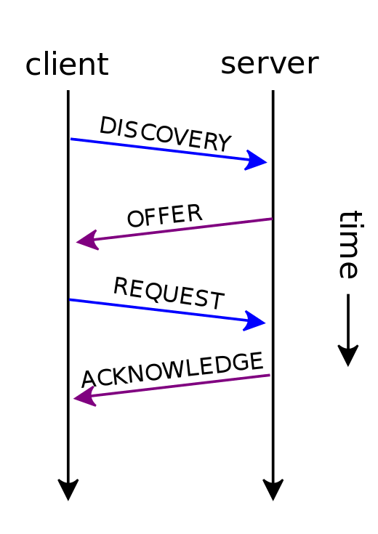
Steps in DHCP
ARP-like two-phase address assignment
  Client broadcasts (IPv4) or multicasts (IPv6) a UDP DISCOVER request
  DHCP servers all broadcast/multicast a UDP lease OFFER
  Client picks one offer and unicasts a REQUEST
  DHCP server unicasts a UDP ACK

Slide 55
Why two phases?
Multiple servers can make an offer
  Client picks only one
  Second phase confirms selection
  Offers are released after a time if not selected

Slide 56
B/Mcast vs unicast
Unicast where possible
  If you know which DHCP server you want
  If you’ve already leased some info
    E.g., and you go back to get more…

Slide 57
DHCP relay
A little like proxy ARP
  But in both directions

Slide 58
DHCP relay
A little like proxy ARP
  But in both directions

Slide 59
What can DHCP configure?
DHCP offer
  Information critical to configuring the channel
  IP address
    dynamic from a range or static based on a table
  Default router
    And “netmask” (indicates shared link addresses)
  Lease time
  DNS server
    To avoid root overload
DHCP inform
  Other additional context
  Time server
    Network Time Protocol
  Web proxy
    Address, parameters, etc. for shared caching
  Just about anything else

Slide 60
DHCP events
Request
  Client searching for initial offers
Offer
  Servers making initial offers
Request
  Client picking one offer
ACK
  Server confirming offer
Renew
  Client asking for lease extension
Release
  Client asking for lease cancellation

Slide 61
USB
Master (host), assigns to slaves
  Assigned each time a device is plugged-in
  127 addresses (7 bits, 0=not set yet)
The single master controls “the world”

Slide 62
Name service for self-namers
Recall: bind
  Maps a process to a TCP/UDP port
  How does another party find that port?
    It knows the number (IANA list, pre-agreement)
    It knows the name, but not the number
Register your name
  Contact the DNS that has your name:IP map
    Add the portname:portnum entry too

Slide 63
Issues
Telling everyone else
Configuring DHCP
Impact to communication in progress

Slide 64
Telling everyone else…
How do others know your new name?
  Esp. if you make one up
Remember the DNS?
  Can also map persistent names to changing ones
  lever.cs.ucla.edu -> IPv4 address that isn’t 131.179.192.136
  IMAP@lever.cs.ucla.edu -> port that isn’t 110

Slide 65
Using the net to find names
Remember the need for glue?
  DHCP’s “glue” to the client:
    Router address
      Even better when it’s a “default” router
    Channel subnet mask
      What’s reachable without contacting the router
    DNS server
      A way to get names without needing a default router
      It needs to be reachable either on the shared channel or via the router indicated

Slide 66
Configuring DHCP server
DHCP makes leases
  Where does it get its land (resources)?
Currently:
  Manual configuration
Experimentally:
  Another server (“Dynamic DHCP Configuration”)

Slide 67
Pros and cons
Design-in (preconfigure)
  Pro: easiest, known to work
  Con: won’t deal with mobility, changes
Pick at random
  Pro: second easiest, might work
  Con: might not (verify?), finding others is hard
Ask someone else
  Pro: easy for the client, allows coordination
  Con: right back where you started for the server!

Slide 68
Impact on in-progress comm.
What happens to connections or relays using addresses that change?
  Continue using the old name
    How do you know if this is even possible?
  Shift to the new name
    What if there isn’t one?
    What if there’s more than one?

Slide 69
Summary
Giving a name to yourself can be easy
  Verification is needed
  Using that name beyond the shared link is harder
Most naming involves
  Assumed uniqueness
  Asking someone else
Getting started is still manual
  True “zero configuration” is very rare

