Slide 1
Layers, Naming, and Sockets CS 118 Computer Network Fundamentals Peter Reiher

Slide 2
Outline
What’s a party?
Inside names
Outside names
Linking the two
Sockets as an example

Slide 3
Recall: definitions
Communication
Methods for exchanging information between a fixed set of directly-connected parties using a single protocol
Networking
Methods to enable communication between varying sets of indirectly connected parties that don’t share a single protocol
Protocol
A set of rules, agreed in advance [between the parties], that enable communication

Slide 4



Names, layers, and translations
B3
J3
B2
J2
Bill wants to send a message to Jim
J1
B1

Slide 5
Today’s theme: #WTPA?
What is a “party”?
Where is that party?
Physically (in some physical place)
Logically (in some layer)

Slide 6
A network layer
Nodes
Sources and sinks of information
Links
Channels that connect two or more nodes

Slide 7
A closer look:
What’s inside a node?
What actually communicates to the outside?
?

Slide 8



One View
One node has channels to multiple parties

Slide 9
Another view
Proc A
Three processes have channels to one party each
Proc B
Proc C

Slide 10
A closer look v2:
What’s inside a node when:
It has multiple channels on a single network (several names used external to the node)?
?

Slide 11
What Does That Mean?
All on the same network – the Internet, for example
With a different name for each connection

Slide 12
A closer look v3:
What’s inside a node when:
It has channels on multiple networks (different kinds of external names)?
?

Slide 13
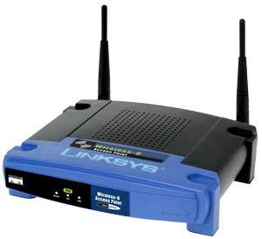
What does that mean?
One is on the Internet, the other is on an 802.11 wireless network
One with an Internet name, the other with a wireless MAC address
Remember, one of these channels can be layered below the other

Slide 14
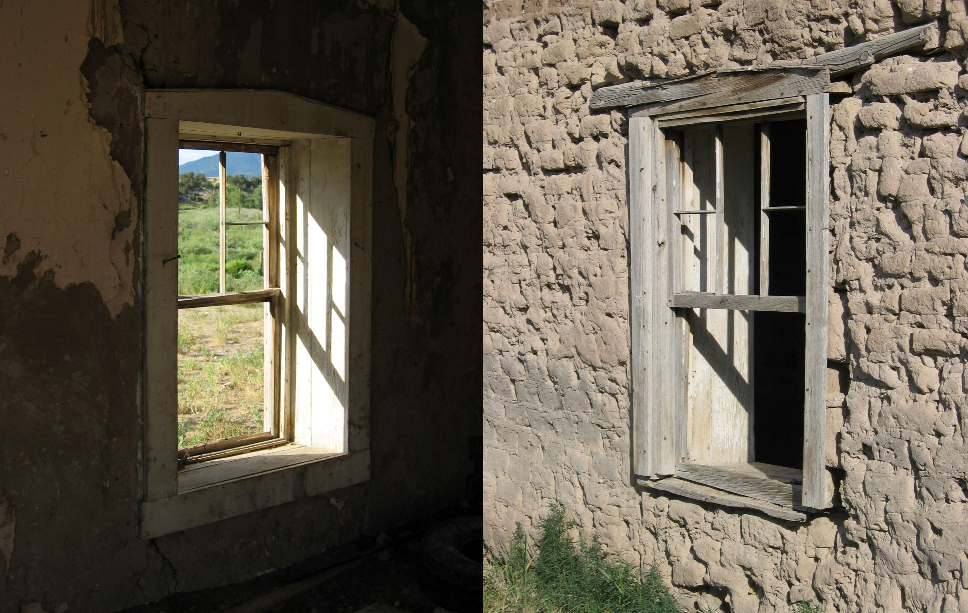
Inside vs. outside names
Another way of distinguishing names
That all “belong” to the same node
Names depend on your viewpoint…

Slide 15
“Outside” names
Giving a name to the source or destination on a network layer
Source address to enable N:1
Destination address to enable 1:N
Same address to enable bidirectional communications

Slide 16
“Outside” names
Names of a party
Node names
Interface names

Slide 17
Node vs. interface
Node
Where processes run
Interface
Network attachment point

Slide 18
Node vs. interface
Node
Source/sink of all network channels at a single place
Interface
End of one network channel

Slide 19
Node names
Unique across
All nodes within a layer
A node many have multiple
Node names
On the same or different layers
Node names are equivalent
Within a node

Slide 20
Interface names
Unique across
All endpoints within a layer
A node may have multiple
Interfaces
An interface may have multiple
Interface names
Endpoint names are equivalent
Within an interface

Slide 21
Node name uniqueness
Node vs. interface uniqueness
A, C
A == C
C == D == E
A, B
C, D, E
2,8
4
4
A == B
2 == 8
4 != 4
2 != 4

Slide 22
Strong vs. weak endpoint models
We name interfaces AND nodes
What happens when we use those names?

Slide 23
Strong
Names refer to the interface (channel end)
If a message arrives at a node from network A, it must be addressed to the endpoint address where that node attaches
All names belong (in effect) to the interface
Like the name of the doors of a house
C
D
E
x
C
C

Slide 24

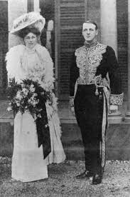
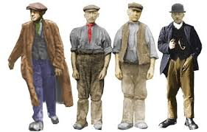
Like at Downton Abbey
Tradesmen around the back
Guests to the front door
But they both end up in the house

Slide 25
Weak
Names refer to the node
Even if assigned to the interface
If a message arrives at a node, it can be addressed to any endpoint address where that node attaches
All names belong (in effect) to the node
Like the names of a house
C, D, E
C
C

Slide 26


As in, All Roads Lead To Rome
Goths!
Huns!
Lombards!
Visigoths!
Not always a good thing . . .
Vandals!

Slide 27
Kinds of outside names
Ethernet
A name for a channel endpoint for Ethernet messages (Ethernet layer)
IP
A name for a channel endpoint for IP messages (IP layer)
TCP, UDP
A name within an IP endpoint called a port (we’ll get back to that shortly…)

Slide 28



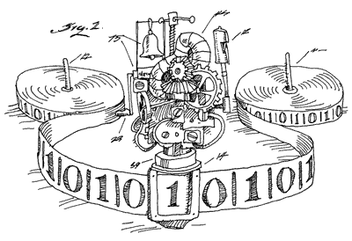
A look inside the endpoint…

Slide 29
“Inside” names
Names within a party
A communication source or sink from the view within the endpoint

Slide 30
Inside names…
What do we need to refer to?
The data itself (objects)
The process that uses or creates it

Slide 31
Object related names
File names (static data)
C:\Users\guest\Desktop\file.doc
/usr/include/stdio.h
I/O names (infinite source/sink of data)
LPT1:, COM0:
/dev/pty0, /dev/ttya, /dev/eth3
Socket descriptor (complex data structure)

Slide 32
Process related names
Process
8842
Thread
223
Other related names
User – 521, “reiher”
Group – 9111, “lasr”

Slide 33
OS Review
Process
Smallest independent running program with its own memory space
Resources include program code, memory, and thread(s)
Thread
Smallest independently-schedulable running program

Slide 34
Why we prefer process names to…
Thread names
Single address space of a process ensures each process name is unique
Thread names might be unique only within their parent process space
File, I/O, etc. names
In this class, comm. endpoints are TMs
A TM more closely maps to a process

Slide 35
Properties of inside names
Syntax
Defined only for that node
Value
Unique within the node
Meaningless as network identifiers

Slide 36
Job of an OS
Coordinate resource sharing
Share memory, CPU capacity, devices, channels, etc.
Provide abstractions
Of machines
To allow multiprocessing
Of other resources
Like the network layers

Slide 37
How do OSes abstract layer endpoints?
Socket
Created by ARPAnet research (RFC33, 1970)
A communication endpoint from the view of the “user” (program)
Usually two-way
Basically: a socket is an inside name for outside communication…

Slide 38
What’s that mean?
Channel X
Proc A
We need to tell the computer’s operating system to connect
Process A
To channel X
A socket is A’s inside name for the outside name (channel X)

Slide 39
Room for confusion . . .
Unix-style systems also use sockets for machine-internal IPC
Where one process communicates to another
With no actual (or even virtual) networking involved
Our concern is with network sockets

Slide 40
Inside and outside
How do we link: inside names and outside names?

Slide 41
Linking the two
Bind
Currently common OS convention
OS operation linking an internal I/O name to an external communication layer name

Slide 42
Two sides to a socket
Server side
Client side
Channel X
Proc A
Proc J

Slide 43
A socket (either side)
Ask the OS to create a placeholder
Attached to the process that creates it
A data structure that will link to the outside
if ((sockfd = socket(AF_INET, SOCK_STREAM,0)) == -1) {
perror("Server: socket");
}
Now I’ve got a socket
But I need to attach it to an inside name

Slide 44
Common kinds of sockets
Datagram (e.g., Ethernet, IP, UDP, ATM AAL0)
Direct to the channel
Separate messages
Individually addressed
Stream (e.g., TCP, ATM AAL2-5)
Two-party association (“connection”)
Two steps:
Establish shared context with an address
Exchange data using that shared context
Others are possible, but not common

Slide 45
Bind
Link a socket to an address on the server end
For TCP
Describes server end of the connection
For UDP
To limit messages you receive
To avoid source-addressing each message sent
if (bind(sockfd, (struct sockaddr *)&server, sockaddr_len) == -1) {
close(sockfd);
perror("Server: bind");
}

Slide 46

Server first steps
Socket
Create a channel placeholder local to the process
Bind
Link the channel placeholder to an external name
Channel X
Proc A
Proc J

Slide 47
Stateless: receiving messages
Recvfrom
Accept a message
Indicate who it is from (other end)
recvlen = recvfrom(sockfd, inbuf, MAXDATASIZE, 0,
(struct sockaddr *)&client, &clientlen);

Slide 48
Stateless: sending messages
Sendto
Send a message
Indicate who it is to (other end)
if (sendto(sockfd, outbuf, outbuflen, 0,
(struct sockaddr *)&client, clientlen) < 0) {
perror("Server: sendto failed");
}

Slide 49
Server side - connections
Listen
Accept

Slide 50
Listen
Wait for incoming connection
Mark socket available for incoming requests
Prepare for someone to connect to the other end
Limit max waiting to be handled
if (listen(sockfd, MAX_CLIENTS) == -1) {
perror("Server: listen");
exit(1);
}

Slide 51
Accept
Turns a socket into a socket pair
Socket pair defines a connection (both ends)
Now someone is connected to the other end
NB: in Unix, a socket and a socket pair are both described by the same data structure (a Unix socket)
new_fd = accept(sockfd, (struct sockaddr *)&client, (socklen_t *) &sockaddr_len);

Slide 52
Client side – connections
Socket
Need something to connect to
Connect
Connect socket to the channel
Channel X
Proc A
Proc J

Slide 53
Connect
Initiate a connection to a remote end
Indicate the remote end
Wait for the connection to be accepted
if ((connect(sockfd,
(struct sockaddr *)&server,sizeof(server))) == -1) {
perror("Client: connection error");
exit(-1); }

Slide 54
sockaddr and names
What is the sockaddr?
A data structure containing an external name
A name the client can use to specify which server socket to connect to
In practice, an IP address and a port
Which is, remember, the type of name used by TCP and UDP

Slide 55
Client and server data exchange
Send
Recv

Slide 56
Send
Write data on the connected socket
Same as sendto with NULL remote endpoint
Can be wrapped with a write call for simpler use
if (send(sendsock,sendbuf,strlen(sendbuf), 0) == -1){
perror("Client: send");
exit(1);
}

Slide 57
Recv
Read data from a connected socket
Same as recvfrom with NULL remote endpoint
Can be wrapped with a read call for simpler use
if ((num = recv(recvsock, &buf, MAXLEN, 0)) == -1) {
perror("Server: recv failed");
exit(1);
}

Slide 58
Putting it all together
How do you arrange a client/server connection with sockets?
Server creates a local socket and binds to it
Client creates a local socket and connects it to the server’s external name
Server listens on the socket and accepts incoming messages
Client writes, server reads

Slide 59
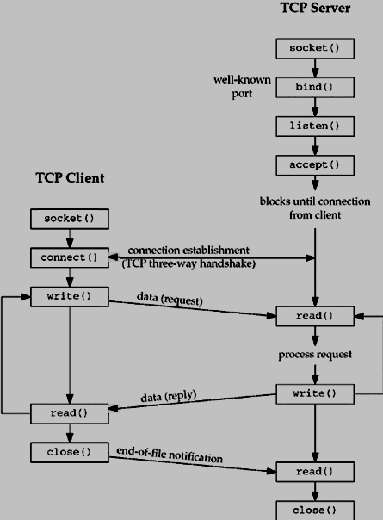
For example,
Server creates socket
Server binds to socket
Server listens
Client creates socket
Server accepts
Client connects
Client writes to socket
Server reads from socket

Slide 60
Issues
Messages without bind
A horse with no name
Socket type and boundaries

Slide 61
No bind, no problem
Stateless (connectionless) messages
Bind indicates local end
What if you omit bind?
The OS figures out where the message should go and adds the source address itself

Slide 62
Automatic source addressing
What do you already indicate?
Destination address (required in sendto)
Includes “address family”
Unix-speak for layer name
Only one layer of each name!
Includes destination address
Use that with an internal (route) table to pick an outgoing interface
Set the source address to the outgoing interface

Slide 63
What about ports?
Recall:
Port distinguishes different TCP or UDP layer endpoints within a IP layer
How do you know the one to send to?
Someone tells you!
From a published list
Because you’re replying to a message (or within a connection) already know

Slide 64
What’s your port number?
Messages
The one you know to send to
The one you got a message from (to reply)
Connections
The one a server LISTENs on
The one a client CONNECTs to

Slide 65
Port numbers
Ports are local to the pair communicating
Identifies the socket (thus the process) on each end
Sometimes ports have common meaning
At “first contact”, they help you pick who you’re talking with (i.e., client-side)
That’s why they’re registered by IANA

Slide 66
Two meanings of ports
During first contact – expected process
E.g., web server (80), secure server (443), email server (110), etc.
After that, just an endpoint identifier
At the TCP/UDP layer

Slide 67
Port meaning
By common convention (assumption)
Groups:
System ports (80, 110, 53)
User ports (8080, etc.)
Dynamic ports (unassigned!)
Assigned to “services” (TM expecting messages)
By other coordination
Because you and the other endpoint agree
Port can mean anything you (and they) want

Slide 68
Having no name
Bind with no name?
Technically, you cannot
Bind to “0” = ANY (i.e., “don’t care”)
Works for IP address, TCP/UDP port
What happens when you need a name?
If you picked ANY, the OS assigns you one
Address = based on path, from ones you “own”
Port = pick one not in use

Slide 69
Socket types and boundaries
Sometimes send/recv boundaries match
E.g., the channel preserves the boundaries
Sending messages
Sending data over a connection with markers
Sometimes, not so much
E.g., TCP!
If you send 100 bytes, that might go in one TCP message, two, three, etc.
When the other side recvs, you don’t know what data is ready

Slide 70
Summary
Naming is more than just for networking
Names inside the machine
Binding between inside and outside names
Names are linked in a set of steps
We used Unix as an example
Names also set expectations
E.g., port number implies TM type (“service”)

