Slide 1
Introduction CS 118 Computer Network Fundamentals Peter Reiher

Slide 2
Purpose of the class
To familiarize you with the basic concepts of computer networking
Computer networks are increasingly key to most systems
All educated computer scientists should have a good understanding of how they work

Slide 3
Pre-requisite
CS 111 – Operating System Principles
Which itself has CS 31, 32, and 35 as pre-requisites
So you’re expected to be able to program
And to have a reasonable understanding about how computer software systems work

Slide 4
Textbooks
Shannon/Weaver, The Mathematical Theory of Communication (any edition)
Peterson/Davie, Computer Networks: A systems approach (any edition)*
*readings are cited from the Sixth Edition; students are responsible for location of corresponding material if using other editions

Slide 5
Assignments
Programming projects
Two
On a schedule set by the TA
All work is to be completed INDIVIDUALLY.

Slide 6
Grading
30% projects
15% each for 2 assignments
30% midterm
Feb. 4, in class
40% final exam
March 14, 8-11 AM
Projects due as announced
Due at the start of class on date indicated
TA will set policy for late submissions

Slide 7
Office Hours
TTh 2-3 PM
In 3532F Boelter Hall
Other times possible by arrangment

Slide 8
The TA
Seungbae Kim
ksb2043@gmail.com
He will handle all issues related to the projects
Also will hold weekly recitation sections and office hours
Times to be announced

Slide 9
A bit about style
A bit more “abstract” than typical
This is an education, not merely training
It’s for your entire life, not just your first job
You’re expected to *apply* what you learn
Repeating what you learn will not be enough
Just attending class will not be enough
You will be challenged
I am here to help
Specific questions will always be answered

Slide 10
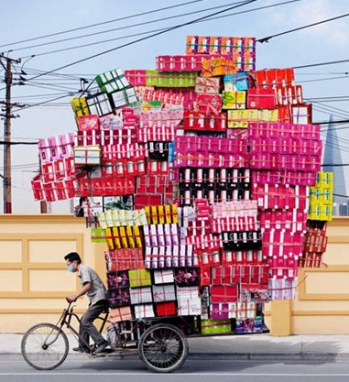
Mastering the material
There’s a lot of stuff
What should you focus on?
Things to keep in mind:
Understanding
Recognizing
NOT memorizing
Focus on the subject
Side-discussions are intended to illuminate, not dump extra stuff on you

Slide 11
Let’s begin…

Slide 12

A Roadmap
Introduction and history
Performance and efficiency

Slide 13
Overview
Definitions
What about the layers we’ve heard about?
The first-principles approach
A little history

Slide 14
Why are we here?
Computer networking
Really: networked computer communication
Information exchange between computers
The challenge:
What is information?
What is communication?
What is networking?
How are these related?

Slide 15
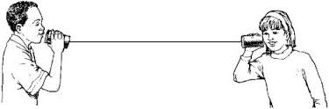
What is communication?
Methods for exchanging information between:
a fixed set of
directly-connected parties
using a single, shared set of pre-agreed rules

Slide 16
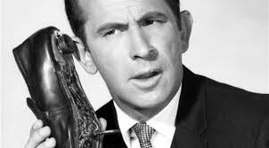
So then what’s a protocol?
A single, shared set of pre-agreed rules
E.g.:
I call you
The phone rings
You pickup and say “Hello”
We start talking

Slide 17
Protocol variations
What word (for the telephone)?
Bell originally proposed “Ahoy!”
Who talks first when I call you?
Typically:
You pickup and you say “Hello” [callee first]
Alternate:
You pickup and I say “Hello” [caller first]
Either one works
Only if both sides agree in advance
There is a lot of complexity in just two-party communication.

Slide 18
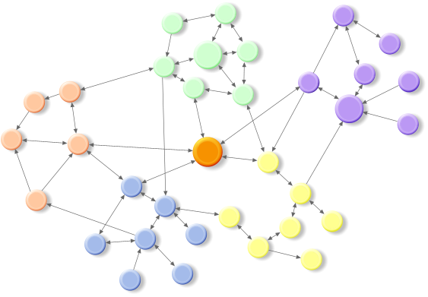
What is networking?
Methods to enable communication between:
varying sets of
indirectly connected parties
that don’t share a single set of rules
Networking:
how we get from “nothing” to being able to communicate

Slide 19
Let’s compare…
Communication
Networking
Methods for exchanging information between:
a fixed set of
directly-connected parties
using a single, shared set of pre-agreed rules (a protocol)
How you exchange info when you know who you’re talking to and how
Methods to enable communication between:
varying sets of
indirectly connected parties
that don’t share a single set of rules
How you figure out who you’re talking to and how

Slide 20
Summary definitions
Communication
Methods for exchanging information between a fixed set of directly-connected parties using a single protocol
Networking
Methods to enable communication between varying sets of indirectly connected parties that don’t share a single protocol
Protocol
A set of rules, agreed in advance, that enable communication

Slide 21
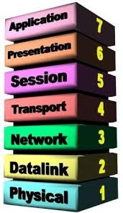
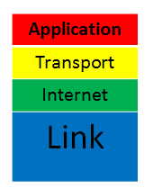
Where are the layers we’ve heard about?
International Standards Organization (ISO)
Open Systems Interconnect (OSI)
Seven layers based on function/capability
Developed as a reference model
Implemented but not really used
Internet
Four layers
More or less . . .

Slide 22
Slapping Names on Layers Isn’t Useful
The name doesn’t really tell you anything
Calling it “transport” doesn’t mean much
What’s important is what happens in the network
There can be many ways of mapping desired functionality into elements of the system

Slide 23
Names – What’s valuable about them
They allow us to specify things
To make sure the right actions happen to the right things
In networks, to get messages to the right recipients
In network layers, to ensure that we understand what layer we’re dealing with

Slide 24
Names – What’s unimportant about them
The actual name is meaningless
Meaning is achieved by binding it to something
The same thing can have several different names
The same name can be applied to several different things
Depending on context
Changing over time

Slide 25
The important lesson about names
Don’t obsess about the name itself
Concentrate on how the name relates to reality

Slide 26
These Layers Aren’t the Truth, Anyway
It’s not 1984 anymore
Both models describe early networking
Layers aren’t defined by function
Most layers do most functions now
There are too many exceptions
In-between layers
Virtual layers (tunnels)

Slide 27
Let’s go back to the beginning…
Two fundamental ideas of CS:
Abstraction
Recursion

Slide 28
Abstraction
Represent something complex…
with something simpler…
that is easier to understand
AND
that can be used to predict the behavior of the complex
A MODEL

Slide 29

Recursion
The converse of induction
decompose a large problem into the combination of its components
declare a value for the minimal atomic component

Slide 30
The goal of our approach
To describe networked computer communication from first principles of:
Abstraction
Recursion
We’ll still have layers
Just recursive ones

Slide 31
If layers aren’t fixed things?
Then what are they?
A layer is the largest set that can communicate
i.e., a layer is the largest group that is:
directly connected
shares a single, common protocol

Slide 32
A Roadmap Through the Course
Bits
A very fine place to start…
Communication
Two-party bit sharing
Networking
Multiparty bit sharing

Slide 33
Course roadmap
Communication
Two-party shared state
Channels
Protocols

Slide 34
Course roadmap
Communication
Two-party shared state
Channels
Protocols
Networking
Multiparty complications
Layers
Naming
Recursion/forwarding

Slide 35
Course roadmap
Communication
Two-party shared state
Channels
Protocols
Networking
Multiparty complications
Layers
Naming
Recursion/forwarding
Examples & mechanisms
– Communication
– Networking

Slide 36
A little history too
~5000 years of networking to consider!

Slide 37
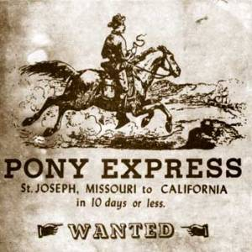
Couriers
Human-based
More reliable
Slow
Walking, horse galloping
Limited range
Tens of miles
Relay only where pre-deployed
Vulnerable
Loss, corruption, interference
Costly

Slide 38

Carrier pigeons
Unidirectional messaging
From release to “home”
Hard to “reset”
Bring the pigeon back
Fixed locations
Messages go only where pigeons are “homed”
Unpredictable
High loss rate!

Slide 39
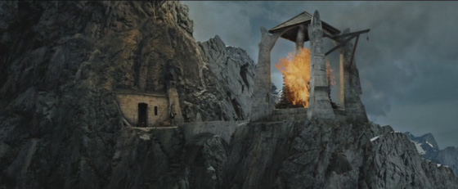

Beacons
Limited BW
One signal
Slow to reset
Long distance
Relays over hundreds of miles
Costly
Requires resident attendant
First optical comms!
Works at night
Better than daytime
Worked for Paul Revere

Slide 40
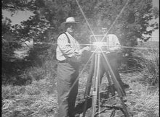
Heliograph
More optical comms
Sunlight
Unreliable
Hard to aim
Limited use
Sunny days only
Low bitrate

Slide 41
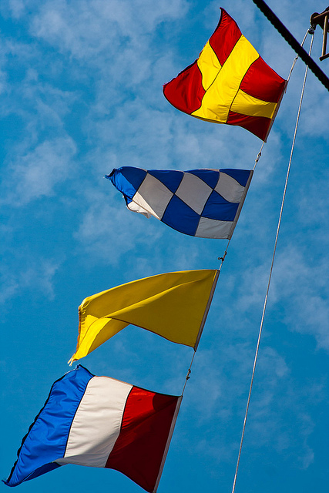
Flags
Still in current use
Maritime communications
Public communications
E.g., swim safety

Slide 42
Origins
Couriers Spoken/written (30,000 BC)
Pigeons 2900 BC, Egypt
Beacons 1200 BC, Troy
Heliographs 400 BC, Greece
Flags 400 BC, Greece

Slide 43
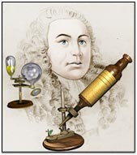
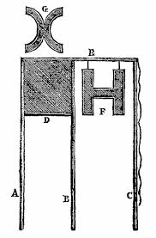
Hooke
Yes, the microscope guy
1680’s
“On Showing a Way How to Communicate One’s Mind at a Distance”
Telescope + semaphores

Slide 44
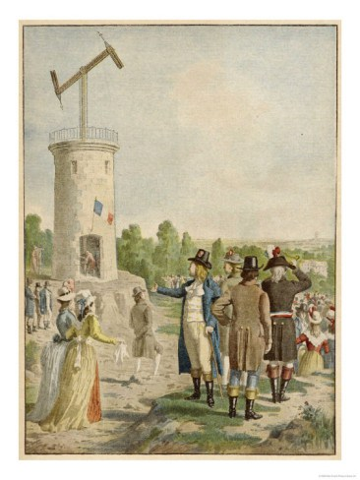
French Telegraph
Semaphore telegraph
1790s, Claude Chappe
Letters, numbers
Time sync
Contention (message collision)
Priority
Flow control
Error recovery

Slide 45
Emergence of electricity
Electromagnets invented 1820 (Sturgeon)
Electrical relays – 1835
Cooke/Wheatstone – 1837
Multiple needles
13 miles near London
Morse – 1837
Single relay
Killed the Pony Express (courier) by 1861

Slide 46
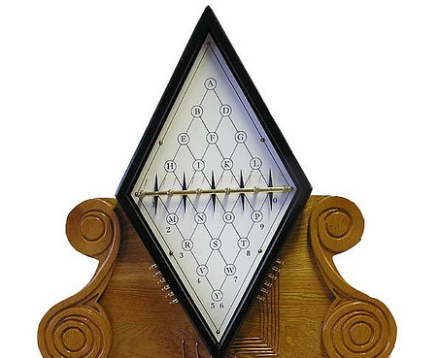
Cooke/Wheatstone

Slide 47
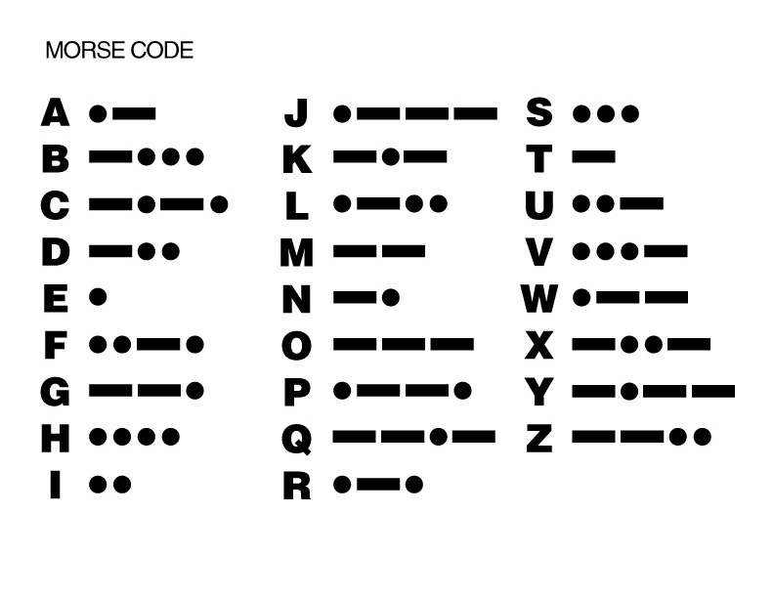
Morse
Symbols == letters
Time encoding
Dot
3 dots = dash
Intra-symbol
dot delay
Inter-symbol
dash delay
Inter-word
seven dot delay

Slide 48
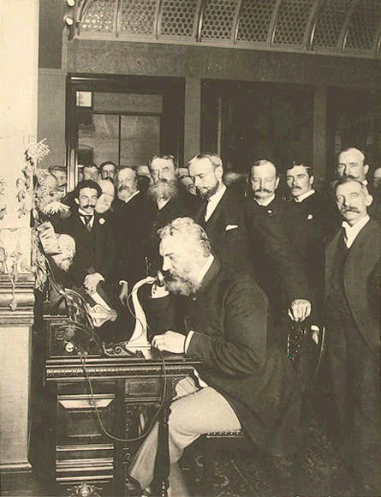
Telephone
First patented by Alexander Graham Bell
In 1876
Carried actual voice over electromagnetic media
In wide use by early 20th century
Still in wide use today

Slide 49
Radio
Transmission of signals without wires
Originally encoding sound
Eventually encoding many forms of data
Theoretical possibility shown by Maxwell (1864)
Patent of practical device by Marconi (1896)

Slide 50
Computer networking
Small, special purpose computer networks in 1950s, 1960s
Packet switching developed in 1960s
ARPANET went online in 1969
Internet replaced the ARPANET in 1981
And became commercial in 1989
World Wide Web introduced in 1991
Not a new hardware technique
But a revolution in what networks could do

Slide 51
Characterizing Networks
Some characterizations are based on purpose
“It’s a network for voice”
Others are numerical
“It can transmit 10 Mbytes per second”
Numerical characterizations tend to be more useful
What will we measure for networks?
Values to characterize work and power
Time
Number & size of messages

Slide 52
Communications is all about time…
Time for information transfer
Info at A -> info at B
Time for a transformation
Info -> f(info)
Time for a transaction
I at A -> request starts at A I at B -> request arrives at B f(I) at B -> response created at B f(I) at A response moves to A

Slide 53
Communications/Network Measures
Frequency
Bandwidth
Processing
Speed
Propagation speed
Delay
Propagation latency
Access delay
Loss rate

Slide 54
Rate vs. Frequency
Rate
Events per unit time
Frequency
Time between events
Sometimes: time to complete (TTC) a given event
Not always related!
Rate = 1/TTC * #servers
E.g., you can cook pies at a rate faster than 1 pie per hour, but each pie will still take 1 hour to cook (i.e., pie baking frequency doesn’t change)

Slide 55
The importance of being quick
Latency is the fundamental metric of computing and communication
Performance is measured as the latency required to perform a task
Everything else is a means to that end
Exceptions aren’t computing or communication (e.g., I/O capabilities such as screen size, pixel depth, digitizer resolution)

Slide 56
What is latency?
Latency is...
(focus) | The time between:
Generic | two events
Interaction | asking question and receiving an answer
Communication | creating information at a source and receiving it at a destination

Slide 57
Defining latency
Latency is:
The time between creating information at a source and receiving it at a destination
Latency is:
A cumulative effect
A property of two events and a message in a system (sender/receiver/path)

Slide 58
Latency isn’t a single value
The cumulative system impact on a message
Fixed, per-message costs
Header processing
Message house-keeping
Propagation delay
Proportional, per-bit costs
Message composition/interpretation
Transmission delay
Unpredictable aggregate effect
Not strictly additive
Some latencies overlap (pipeline), others don’t
Message size matters

Slide 59
Five Root Causes
Generation
Transmission
Processing
Multiplexing
Grouping
More than propagation + transmit + queue!

Slide 60


Cost #1: Generation
Delay between occurrence of a physical event and the availability of information

Slide 61

Cost #2: Transmission
The delay in transferring information from one location to another

Slide 62
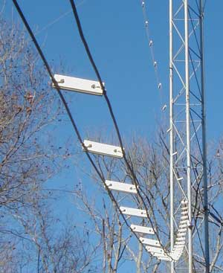

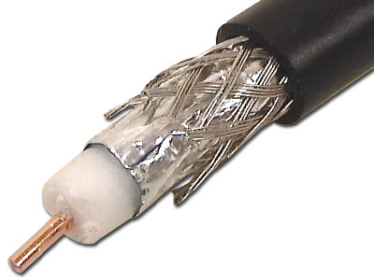
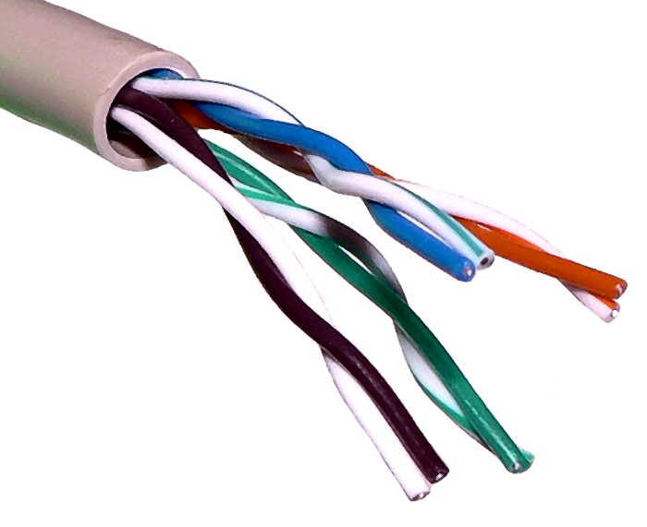
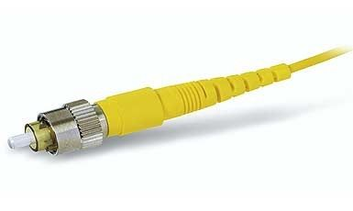
The speed of light – or less
Constant in each medium:
Vacuum | c (3E8 m/s)
Air (RF) | 0.9997 c
Open-ladder wire | 0.95 c
Twin-axial wire | 0.8 c
Coax wire Twisted –pair wire Optical fiber | 0.66 c

Slide 63
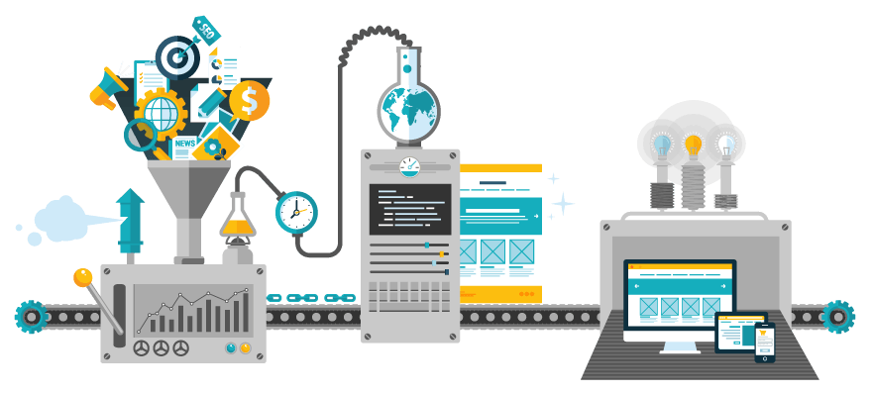
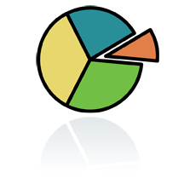
Cost #3: Processing
The delay due to the computational translation or frequency of information

Slide 64
Cost #4: Multiplexing
The delay incurred as the result of sharing a resource

Slide 65
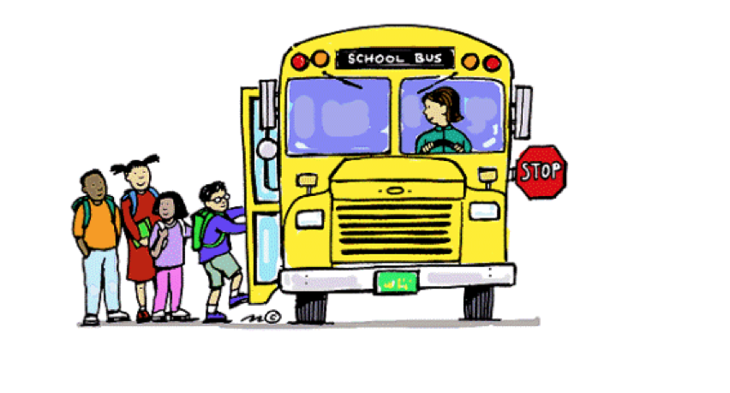
Cost #5: Grouping
The delay incurred to reduce the amount of control information and overhead

Slide 66
Summary
Definitions
Communication, networking, and protocol
Names are just names
You do need to know them
But their meaning is just as important
Networking didn’t start with the Internet
There’s a lot of history that’s still useful
Important characterization of network performance are time related
Especially latency

